Slide 1
Google File System
Eduardo Gutarra Velez

Slide 2
Outline
Distributed Filesystems
Motivation
Google Filesystem Architecture
Chunkservers
Master
Metadata
System-Wide Operations
Writing to a file
Consistency Model
File Mutation
Atomic Record Append
Master Operations

Slide 3
Distributed File system
The Google Filesystem is a Distributed filesystem.
Allow access to files from multiple hosts shared via a computer network.
Provides an API that allows it to be accessible over the network.
They are layered on top of other filesystems.
Distributed filesystems are not concerned with how the data is actually stored.
They are more concerned with things such as concurrent access to files and replication of data.

Slide 4

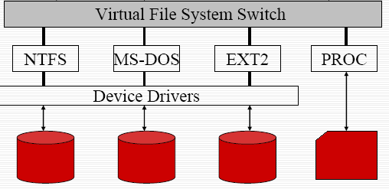
Distributed Filesystem
Distributed Filesystem
Machine 1
Machine N

Slide 5
Outline
Distributed Filesystems
Motivation
Google Filesystem Architecture
Chunkservers
Master
Metadata
System-Wide Operations
Consistency Model
File Mutation
Real World Benchmarks

Slide 6
Motivation
Component failures are the norm rather than the exception.
Files are huge by traditional standards.
Google Client Applications seldom overwrite the files. Most often they read from them, or write at the end of the file. (append)
Co-designing the applications and the filesystem API benefits the overall system. Primitives can be created specific to the Google applications.

Slide 7
Outline
Distributed Filesystems
Motivation
Google Filesystem Architecture
Chunkservers
Master
Metadata
System-Wide Operations
Consistency Model
File Mutation
Real World Benchmarks

Slide 8
Google Filesystem Architecture
Consists of a single master and multiple chunkservers.
Multiple Clients access this architecture at once.
A machine can act both as a client of the filesystem architecture, and as a chunkserver.

Slide 9
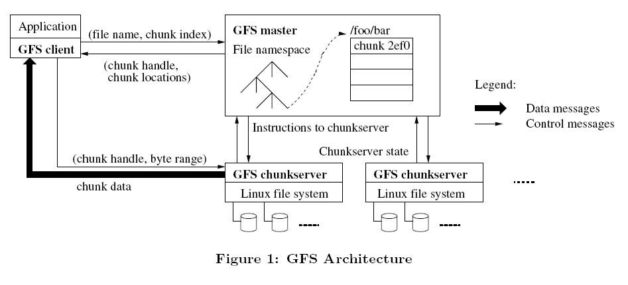
Google Filesystem Architecture

Slide 10
Outline
Distributed Filesystems
Motivation
Google Filesystem Architecture
Chunkservers
Master
Metadata
System-Wide Operations
Consistency Model
File Mutation
Real World Benchmarks

Slide 11
Chunkservers
A chunkserver is typically a commodity Linux machine
Files are divided into fixed size chunks. (64 MB).
Chunks are stored on local disks as Linux files.
For reliability the chunks are replicated in multiple chunkservers. Each chunk is stored at least 3 times by default, but users may specify a higher number of replicas.
Chunkservers don’t cache file data.
Chunkservers rely on the Linux’s buffer cache which keeps the frequently accessed data in memory.

Slide 12
Outline
Distributed Filesystems
Motivation
Google Filesystem Architecture
Chunkservers
Master
Consistency Model
File Mutation
Real World Benchmarks

Slide 13
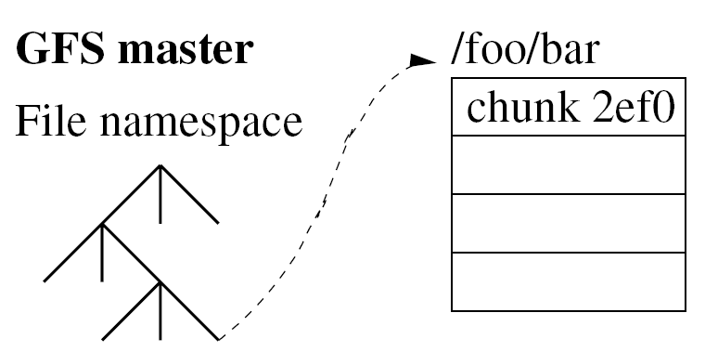
GFS Master
Maintains all the file system metadata:
Namespaces (Hierarchy)
Access Control Information (Read-write)
Mapping from files to chunks.
Chunkservers where a chunk is located.
5 | 7 | 3 | 1
Chunk 31ef
5 | 7 | 2 | 6
Chunk 451d
5 | 7 | 3 | 1

Slide 14
How would one read a file?

Slide 15
The Metadata
Metadata is kept in the master’s memory.
Metadata is also kept minimal so that the number of chunks, does not affect to much the amount of memory the master has to use.
File namespace data and filenames are kept compressed using prefix compression. (64 bytes per file).
Namespaces, and mapping from files to chunks are also kept persistent.
Modifications to these are written in an operations log which is stored in the master’s local disk.
These changes are also replicated through the log on remote machines called shadow masters.

Slide 16
The Operations Log
The operation log allows the updates to the master’s state to be performed simply, and reliably without risking inconsistencies due to events like when the master crashes.
The log is kept persistently.
If it gets too large, a checkpoint is made and a new log is created.
Metadata
Operations Log
Perform change X
Start
X
Y
END
Perform change Y

Slide 17
Chunk Locations.
Master does not keep a persistent record of what chunkservers have a replica of a given chunk.
Instead they always poll this information at startup
The information is kept updated by periodically polling for this information.
Why? Easier to maintain the information this way. Chunkservers will often join, leave, change names, fail restart , etc…

Slide 18
GFS Master
In-Memory Data Structures are kept to allow the master operations to be fast.
Periodic scans in the background are made in order to keep the information up to date
Controls System-Wide activities.
Chunk lease management -- Writing to files.
Chunk garbage collection -- Deleting files
Re-replication in the presence of chunk server failures.
Chunk migration to balance load and disk space.
Finding Stale Replica -- Collecting chunkservers’ state

Slide 19
Consistency Model .:. 3 Different States.
Intended
Replicas
defined
inconsistent
undefined

Slide 20
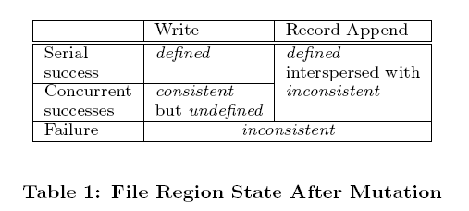
Consistency Model
File namespace mutations (e.g., file creation) are kept atomic. (locking guarantees atomicity and correctness, and the operation log defines the correct order).
Data operations in the chunkservers can have the 3 different region states after a file region is modified.

Slide 21
Implications for GFS Applications
GFS applications can accommodate the relaxed consistency model with a few simple techniques already needed for other purposes:
Relying on appends rather than overwrites
Self-validating (checksums)
Self-identifying records (for duplicates).

Slide 22
Leases and Mutation Order
Mutation is an operation that changes the contents or metadata of a chunk.
Write operations must be performed at all the chunk’s replicas.
The master grants lease to one of the replicas, which is promoted as primary copy.
The primary picks a serial order for all mutations

Slide 23
Steps to perform a mutation.
1
2
3
The client asks the master which chunkserver holds the current lease for the chunk and the locations of the other replicas.
The master replies with the identity of the primary and the locations of the other (secondary) replicas.
The client pushes the data to all the replicas. A client can do so in any order. Each chunkserver will store the data
The client caches this data for future mutations. It needs to contact the master again only when the primary becomes unreachable or replies that it no longer holds a lease.

Slide 24
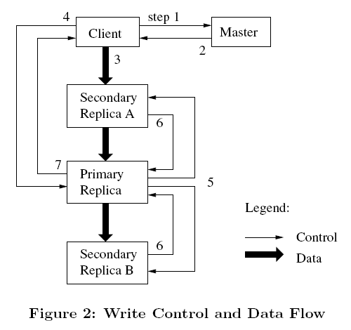
Leases and Mutation Order

Slide 25
Steps to perform a mutation.
4
Specifies the order of how the data needs to be written.
The primary assigns a consecutive serial number to all the mutations it receives.
Applies the mutation to its own local state in serial number order.
5
Once all the replicas have acknowledged receiving the data the client sends a write request to the primary.
The primary forwards the write request to all the secondary replicas, and each replica applies the mutations the same way.

Slide 26
Leases and Mutation Order

Slide 27
Steps to perform a mutation.
7
6
The secondaries all reply to the primary indicating that they have completed the operation.
The primary replies to the client. Any errors encountered at any of the replicas are reported to the client. In case of errors, the write may have succeeded at the primary and an arbitrary subset of the secondary replicas.
If it had failed at the primary, it would not have been assigned a serial number and forwarded.

Slide 28
Leases and Mutation Order

Slide 29
Atomic Record Appends
GFS provides an atomic append operation called record append.
In write operations the client specifies the offset
In this operation GFS chooses the offset.
GFS will append a record at least once atomically.
It does the same function as O_APPEND mode in unix except it handles the race conditions when there are multiple writers.
Serves as multiple-producer/single-consumer queues.

Slide 30
Master Operation
Namespace Management
Unlike many traditional file systems, GFS does not have a per-directory data structure that lists all the files in that directory.
It logically represents its namespace as a lookup table mapping full pathnames to metadata.
Uses prefix Compression.
Locking
Each node in the namespace tree (either an absolute file name or an absolute directory name) has an associated read-write lock
File creation does not require a write lock on the parent directory because there is no “directory”.

Slide 31
A short example.
/home/user/foo
/home/user/baz.
Acquire read lock on /home
Acquire read lock on /home/user
Acquire write lock on /home/user/foo
Acquire write lock on /home/user/baz

Slide 32
Master Operation
Creation: When the master machine creates a new chunk it chooses where to place the initially empty replicas. It takes 3 things into consideration:
Chunkservers with below-average disk space utilization
We want to limit the number of “recent” creations on each chunkserver.
Spread replicas of a chunk across racks.
Re-replication: This is done when the number of available replicas falls below a user-specified goal.
Highest priority given to chunks blocking client progress
Rebalancing: The master rebalances replicas periodically: it examines the current replica distribution and moves replicas for better disks pace and load balancing.

Slide 33
Garbage collection
When a file is deleted GFS does not remove it from the filesystem immediately, it renames it to a hidden name and gives it a timestamp.
During the master’s scan of the filesystem namespace, it removes files that have been renamed and are at least 3 days old (interval is configurable).
This erases the metadata associated to those chunks, and the chunks become orphaned.
To identify this chunks the master server sends a requests a list of chunks from a chunkserver, and responds with a list of chunks that are not associated to any file.
The chunkserver then is free to delete those chunks.

Slide 34
References
Sanjay Ghemawat, Howard Gobioff, and Shun-Tak Leung. The Google file system. In 19th Symposium on Operating Systems Principles, pages 29-43, Lake George, New York, 2003.

Slide 35
Thank You!
Questions?

Slide 36
Distributed FS, they don’t deal with how the actual data is being stored.
Concurrency – locks.. Etc.
Replication data

Slide 37
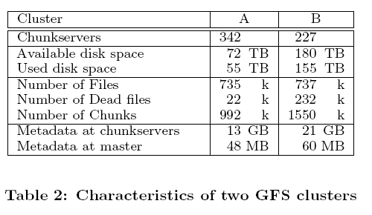
Real World Use

Slide 38
Steps to perform a mutation.
Once all the replicas have acknowledged receiving the data the client sends a write request to the primary.
Specifies the order of how the data needs to be written.
The primary assigns a consecutive serial number to all the mutations it receives.
Applies the mutation to its own local state in serial number order.
The primary forwards the write request to all the secondary replicas, and each replica applies the mutations the same way.

Slide 40
Snapshot
A mechanism to create quickly branch copies or checkpoints.
Client tells Master that it wants to create a snapshot.
Revokes any outstanding leases on the files it wants to do a snapshot on.
Master logs the operation to disk, and then duplicates the metadata for source file or directory tree.
Master asks each chunkserver that has the current replica of filehandle

