Slide 1
Google File System
Eduardo Gutarra Velez

Slide 2
Outline
Distributed Filesystems
Motivation
Google Filesystem Architecture
The Metadata
Consistency Model
File Mutation

Slide 3
Distributed File system
The Google Filesystem is a Distributed filesystem.
Allow access to files from multiple hosts shared via a computer network.
Provides an API that allows it to be accessible over the network.
They are layered on top of other filesystems.
Distributed filesystems are not concerned with how the data is actually stored.
They are more concerned with things as concurrent access to files, replication of data, and network related stuff.

Slide 4

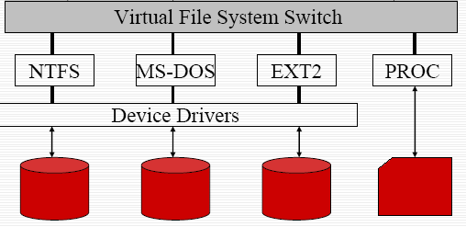
Distributed Filesystem
Distributed Filesystem
Machine 1
Machine N

Slide 5
Motivation
Component failures are the norm rather than the exception.
Files are huge by traditional standards.
Google Client Applications seldom overwrite the files. Most often they read from them, or write at the end of the file. (append)
Co-designing the applications and the filesystem API benefits the overall system. Primitives can be created specific to the Google applications.
High sustained bandwidth is more important than low latency

Slide 6
Google Filesystem Architecture
Consists of a single master and multiple chunkservers.
Multiple Clients access this architecture at once.
A machine can act both as a client of the filesystem architecture, and as a chunkserver.

Slide 7
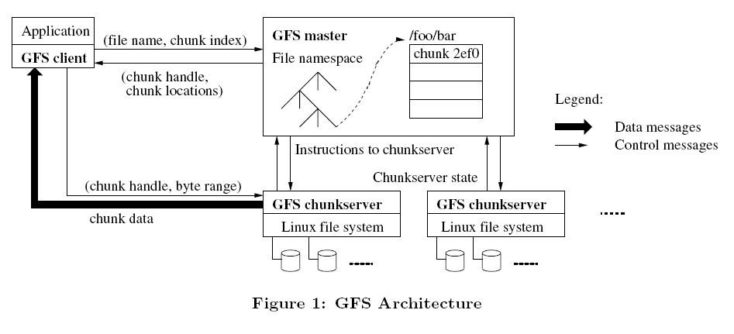
Google Filesystem Architecture

Slide 8
Chunkservers
A chunkserver is typically a commodity Linux machine
Files are divided into fixed size chunks. (64 MB).
Chunks are stored on local disks as Linux files.
For reliability the chunks are replicated in multiple chunkservers. Each chunk is stored at least 3 times by default, but users may specify a higher number of replicas.
Chunkservers don’t cache file data.
Chunkservers rely on the Linux’s buffer cache which keeps the frequently accessed data in memory.

Slide 9
Single Master
Maintains all the file system metadata:
Namespaces (Hierarchy)
Access Control Information ()
Mapping from files to chunks.
Chunkservers where a chunk is located.
Controls System-Wide activities.
Chunk lease management
Garbage collection
Orphaned chunks.
Chunk migration between chunk servers.
Communicates with each chunkserver to collect its state.

Slide 10
The Metadata
3 Types of Metadata:
The file and chunk namespaces.
The mapping from files to chunks.
Locations of the chunk’s replicas.
Metadata is kept in the master’s memory.
The first two types of metadata are also kept persistent, and the mutations are logged in an operation log which is stored in the master’s local disk, and replicated on remote machines.

Slide 11
The Operations Log
The operation log allows the updates to the master’s state to be performed simply, and reliably without risking inconsistencies due to events like when the master crashes.
The log is kept persistently.
If it gets too large, a checkpoint is made and a new log is created.
Metadata
Operations Log
Perform change X
Start
X
Y
END
Perform change Y

Slide 12
In-Memory Data Structures.
Allow the master operations to be fast.
Master periodically scans through its entire state in the background, this is used for:
Chunk garbage collection
Re-replication in the presence of chunk server failures.
Chunk migration to balance load and disk space.
Data kept in-memory is kept minimal so that the number of chunks, does not take up all the memory the master has.
File namespace data and filenames are kept compressed using prefix compression. (64 bytes per file).

Slide 13
Chunk Locations.
Master does not keep a persistent record of what chunkservers have a replica of a given chunk.
Instead they always poll this information at startup
The information is kept updated by periodically polling for this information.
Why? Easier to maintain the information this way. Chunkservers will often join, leave, change names, fail restart , etc…

Slide 14
Chunk Locations

Slide 15
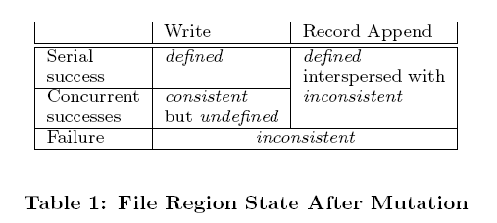
Consistency Model
File namespace mutations (e.g., file creation) are kept atomic. (locking guarantees atomicity and correctness, and the operation log defines the correct order).
3 possible states are returned after a file region is modified.
Defined
Undefined

Slide 16
Implications for GFS Applications
GFS applications can accommodate the relaxed consistency model with a few simple techniques already needed for other purposes:
Relying on appends rather than overwrites
checkpointing
self-validating (checksums)
self-identifying records (for duplicates).

Slide 17
Leases and Mutation Order
Mutation is an operation that changes the contents or metadata of a chunk.
Write operations must be performed at all the chunk’s replicas.
The master grants lease to one of the replicas, which is promoted as primary copy.
The primary picks a serial order for all mutations

Slide 18
Steps to perform a mutation.
1
2
3
The client asks the master which chunkserver holds the current lease for the chunk and the locations of the other replicas.
The master replies with the identity of the primary and the locations of the other (secondary) replicas.
The client pushes the data to all the replicas. A client can do so in any order. Each chunkserver will store the data
The client caches this data for future mutations. It needs to contact the master again only when the primary becomes unreachable or replies that it no longer holds a lease.

Slide 19
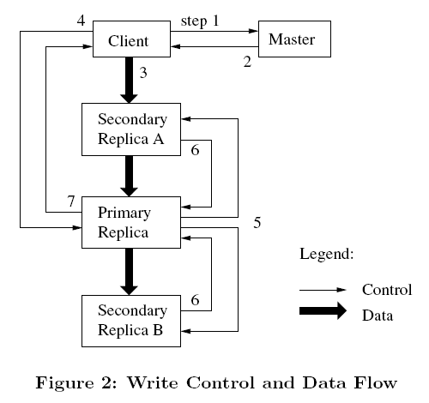
Leases and Mutation Order

Slide 20
Steps to perform a mutation.
4
Specifies the order of how the data needs to be written.
The primary assigns a consecutive serial number to all the mutations it receives.
Applies the mutation to its own local state in serial number order.
5
Once all the replicas have acknowledged receiving the data the client sends a write request to the primary.
The primary forwards the write request to all the secondary replicas, and each replica applies the mutations the same way.

Slide 21
Leases and Mutation Order

Slide 22
Steps to perform a mutation.
7
6
The secondaries all reply to the primary indicating that they have completed the operation.
The primary replies to the client. Any errors encountered at any of the replicas are reported to the client. In case of errors, the write may have succeeded at the primary and an arbitrary subset of the secondary replicas.
If it had failed at the primary, it would not have been assigned a serial number and forwarded.

Slide 23
Leases and Mutation Order

Slide 24
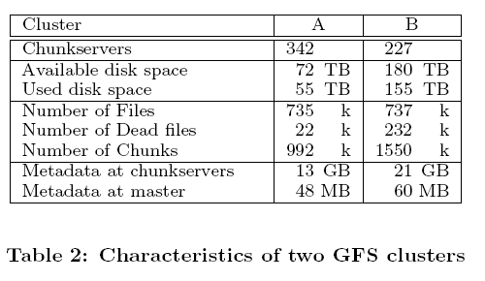
Real World Clusters

Slide 25
References
Sanjay Ghemawat, Howard Gobioff, and Shun-Tak Leung. The Google file system. In 19th Symposium on Operating Systems Principles, pages 29-43, Lake George, New York, 2003.

Slide 26
Thank You!
Questions?

Slide 27
Distributed FS, they don’t deal with how the actual data is being stored.
Concurrency – locks.. Etc.
Replication data

Slide 28
Steps to perform a mutation.
Once all the replicas have acknowledged receiving the data the client sends a write request to the primary.
Specifies the order of how the data needs to be written.
The primary assigns a consecutive serial number to all the mutations it receives.
Applies the mutation to its own local state in serial number order.
The primary forwards the write request to all the secondary replicas, and each replica applies the mutations the same way.

