Slide 1
Uncompressing a Projection Index in CUDA
Eduardo Gutarra Velez

Slide 2
Prefix Sum (Scan)
3 | 3
1 | 4
7 | 11
0 | 11
1 | 12
6 | 18
3 | 21

Slide 3
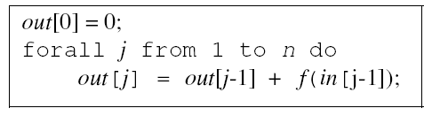
Many uses for prefix sum but our use will be to uncompress a previously compressed index, that will be sent to memory.
A3B1C7
AAABCCCCCCC
Source:

Slide 4
Introduction
Size of datasets outpace the growth of speed in CPUs
Many researchers are turning to the new many-core architectures.
New algorithms must be implemented, or existing ones must be modified in order to work with this new thread-level parallelism on a shared memory system.

Slide 5
Previous work.
The employment of GPUs for database operations has been demonstrated to be effective for improving their performance.
The indexing structure used in much of the research has been the projection index which is taking the concerned columns of the table that you are querying and loading them in memory.

Slide 6
Previous work
Even though there are other indexing structures that are more effective than our projection index. They are not easily parallelizable.
The main idea is to have a one-to-one mapping of threads-to-records, so that the number of records you are checking simultaneously is dependent on the number of threads.
NVIDIA 8800 GTX GPU
16 multiprocessors
Each supports 768 concurrent execution threads.
GPU can manage over 12,000 concurrent execution threads

Slide 7

Select * from table
where Area > 350
Area
300
200
400
545
445
444
451
City | Area
Houston | 300
Fredericton | 200
St. John | 400
Houston | 545
Fredericton | 445
St. John | 444
Houston | 451
> 350?
> 350?
> 350?
…

Slide 8
Outline
Introduction & Previous Work
The Problem with the Previous Work
The Solution: (Index proposed)
Data Structures of that Index.
Algorithm for the Index.
Benchmark against Projection Index

Slide 9
The Problem with Previous work
Even though GPUs offer a great level of thread-level parallelism, we are limited by the amount of memory that the GPU has.
A projection index can be significantly heavy for the GPUs memory, turning the problem more I/O intensive.
Arithmetic intensity ratio of our problem goes down, thus our GPU performance decreases.
There are also limitations imposed by the data buses that transfer data to the GPU.

Slide 10
Outline
Introduction & Previous Work
The Problem with the Previous Work
The Solution: (Index proposed)
Data Structures of that Index.
Algorithm for the Index.
Benchmark against Projection Index

Slide 11
Bin-Based Indexing
Concentrates on reducing both the amount of bandwidth and memory required to evaluate a query.
Their DP-BIS integrates two key strategies:
Data binning
Use of Data Parallel Order-preserving Bin-based Clusters (OrBiC)

Slide 12
Outline
Introduction & Previous Work
The Problem with the Previous Work
The Solution: (Index proposed)
Data Structures of that Index.
Algorithm for the Index.
Benchmark against Projection Index

Slide 13
Data Binning
1
4
7
6
4
5
8
10
3
2
0
0
1
1
0
0
1
2
0
0
Original data values which fall in a given small interval are replaced by a value representative of that interval
Each encoded value represents a bin

Slide 14
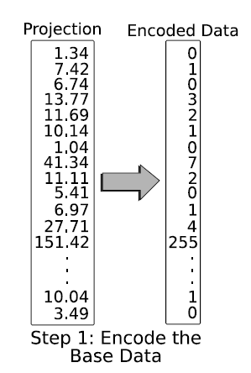
High Resolution Data
Low Resolution Data
32 bits
8 bits

Slide 15
Data Binning
Minimizing data skew is important.
Bin boundaries are selected so that each bin contains approximately the same number of records. (N/b records per bin).
N: Number of Records.
b: Number of Bins.
If the frequency of a single value exceeds N/b (the average of number of records per bin), a single-valued bin is used to contain all records corresponding to this one value.

Slide 16
Candidate Check
Select * from table
Where 4 < Area < 16
Checking whether the data in a boundary bin satisfies your query.
1-5
15-20
…
B₀
B₁₀
B₀ < All bins < B₁₀
For B₀
For B₁₀
Area > 4
Area < 16

Slide 17
Order-preserving Bin-based Clusters (OrBiC)
Candidate check can take very long.
It is a structure that improves the latency of candidate checks.
The full-resolution data is stored in a table that provides contiguous access.
Positions are kept in order relative to the bin numbers.
An offset table is kept for mapping the full-resolution data associated to each bin.

Slide 18
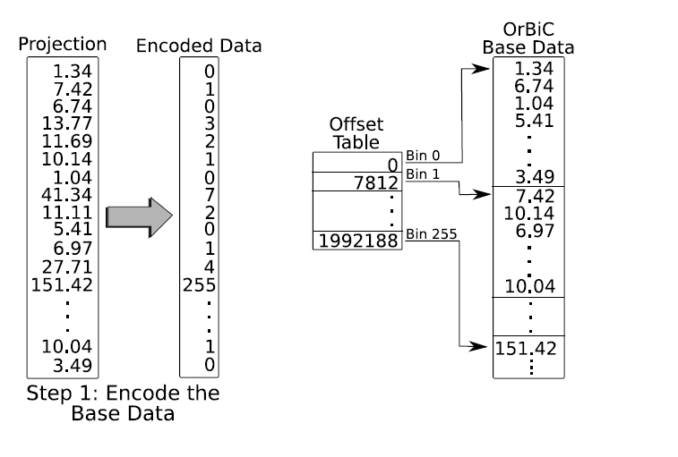
Source: Gosink, L. et al

Slide 19
Data Parallel OrBiC
Designed to work with bitmap vectors.
As it is, it does not offer enough concurrency to take advantage of the GPU
To allow greater data parallelism they append the row-identifier information for the full-resolution data records to the OrBiC data structure, for each record.
The ordering of the row identifiers table corresponds to the ordering of the OrBiC Base Data table.
With the appended table, threads can simultaneously do candidate checks, thus parallelizing the process.

Slide 20
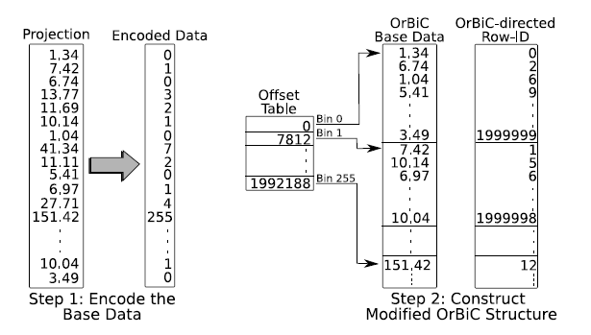
Source: Gosink, L. et al

Slide 21
Outline
Introduction & Previous Work
The Problem with the Previous Work
The Solution: (Index proposed)
Data Structures of that Index.
Algorithm for the Index.
Benchmark against Projection Index

Slide 22
The Algorithm
Select * from table
Where 4 < Area < 16
1-5
15-20
Algorithm 1
…
B₀
B₁₀
B₀ < All bins < B₁₀
Algorithm 2
For B₀
For B₁₀
Area > 4
Area < 16

Slide 23
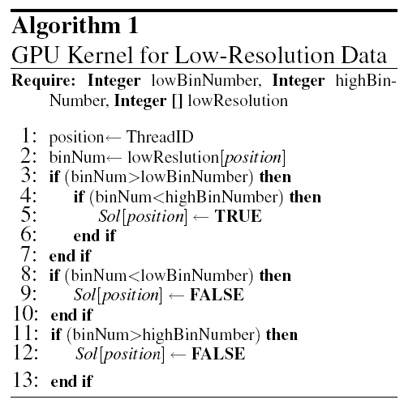
Source: Gosink, L. et al

Slide 24
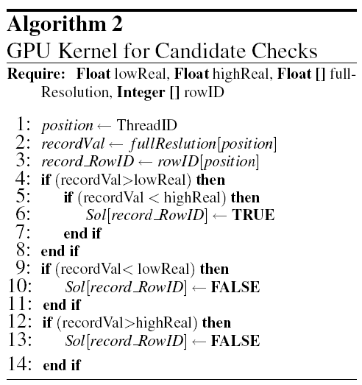
Source: Gosink, L. et al

Slide 25
Stage 1
CPU
Encoded Data Table
Orbic
…
256 OrBiC Base Data
…
256 Offset Tables

Slide 26
Stage 2
CPU
GPU
Encoded Data Table
Solution Vector
2 OrBiC Base Data
2 Offset Tables

Slide 27
Stage 3
Encoded Data Table
Low-Resolution Query
2 OrBiC Base Data
Full-Resolution Query
2 Offset Tables
Combine bit vector solutions
Solution Bit Vector

Slide 28
Benchmarking
The two indexing strategies that were evaluated in I/O and processing performance were the
DP-BIS
In CPU Only
With GPU
Projection Index.
In CPU Only
With GPU

Slide 29
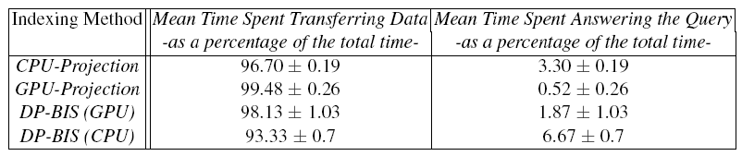
Time Percentages.
Total performance time for each index strategy is composed based on time spent on I/O-related workload and compute-based workload.
Source: Gosink, L. et al

Slide 30
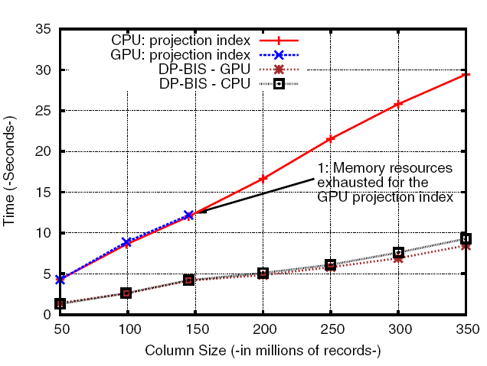
Simple Range Query (Total Time)
Each index strategy
answered a series
of seven simple
range queries
Source: Gosink, L. et al

Slide 31
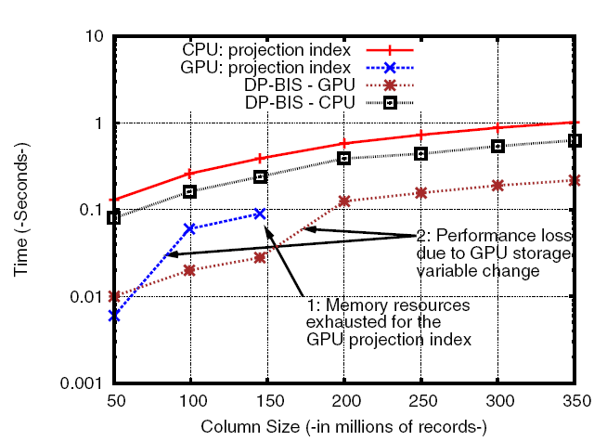
Simple Range Query (Computation Time Only)
Each index strategy
answered a series of
seven simple range
queries
Source: Gosink, L. et al

Slide 32
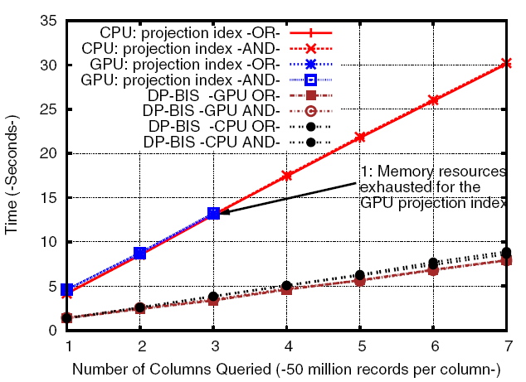
Compound Query Performance (Total Time)
Each index strategy
answered compound
queries with 2, 3… 7
queries. (either using
(AND or OR))
Source: Gosink, L. et al

Slide 33
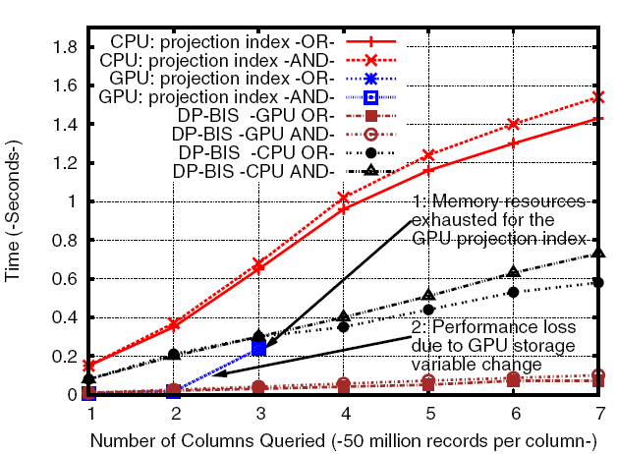
Compound Query Performance (Computation Time Only)
Each index strategy
answered compound
queries with 2, 3… 7
queries. (either
using (AND or OR))
Source: Gosink, L. et al

Slide 34
Conclusions
To take advantage of a GPU, the index must allow to be checked in parallel by several threads.
It must also be small because transferring it to the GPU’s memory is what takes the biggest toll in performance.
There don’t seem to be any synchronization problems because the results of each block or thread are independent of each other.

Slide 35
References
Gosink, L., Kesheng Wu, E. Wes Bethel, John D. Owens, Kenneth I. Joy: Data Parallel Bin-Based Indexing for Answering Queries on Multi-core Architectures. SSDBM 2009: 110-129
Gosink, L., E. Wes Bethel, John D. Owens, Kenneth I. Joy. Bin-Hash Indexing: A Parallel GPU-Based Method For Fast Query Processing. IDAV (2008)
Wu, K., Otoo, E., Shoshani, A.: On the performance of bitmap indices for high cardinality attributes. In: Proc. of VLDB, pp. 24–35 (2004)
O’Neil, P.E., Quass, D.: Improved query performance with variant indexes. In: Proc. of SIGMOD, pp. 38–49 (1997)

