Slide 1
Uncompressing a Projection Index with CUDA
Eduardo Gutarra Velez

Slide 2
Outline
Brief Review of the Problem.
Algorithm Design
First Algorithm
Load Balanced Algorithm
Testing Methodology
Results and Benchmarks
Problems Found
Conclusions
Future work

Slide 3
Brief Review of the Problem
An Index compressed in RLE Encoding is transferred to the GPU as:
1 Array of Frequencies.
1 Array of Symbols (Attribute Values)
The index is then uncompressed in the GPU using a prefix sum algorithm.

Slide 4
Brief Review of the Problem
For this to be effective the following assumptions must be made:
The data in the projection index is previously sorted
The projection index is created on a column that is not unique.
CPU
GPU
F:
3 | 1 | 7
X3Y1Z7
S:
X | Y | Z
XXXYZZZZZZZ
U
C

Slide 5
Prefix Sum
Frequencies
Inclusive Scan
Exclusive Scan
3
1
7
0
1
6
3
3
4
11
11
12
18
21
0
3
4
11
11
12
18

Slide 6
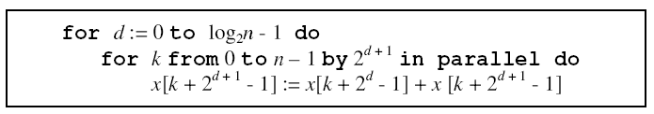
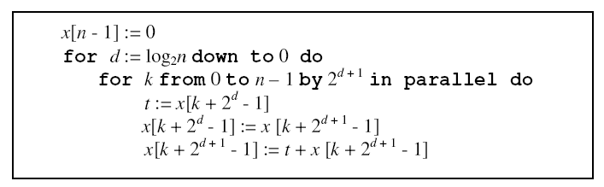
Work-Efficient Parallel Scan
Source: Parallel prefix sum (scan) with CUDA

Slide 7
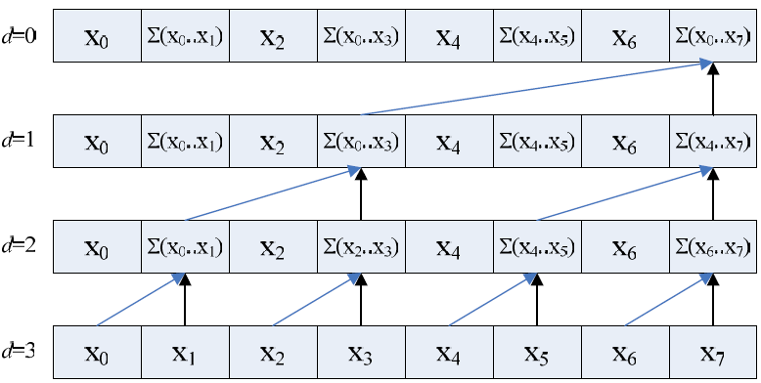
Up-sweep phase
Source: Parallel prefix sum (scan) with CUDA

Slide 8
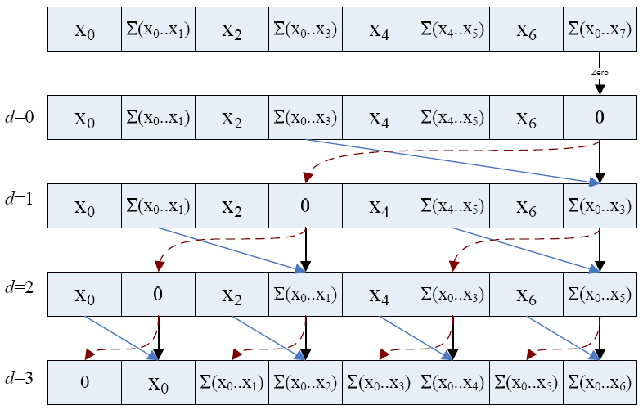
Down-sweep phase
Source: Parallel prefix sum (scan) with CUDA

Slide 9
Outline
Brief Review of the Problem.
Algorithm Design
First Algorithm
Load Balanced Algorithm
Testing Methodology
Results and Benchmarks
Problems Found
Conclusions
Future work

Slide 10

First Algorithm
Stage 1: Calculate the Exclusive Scan array of N+1 elements, allocate the amount of memory necessary.
Stage 2: Use the Exclusive Scan array, to have each thread uncompress each of the array’s attribute values.
Potentially very badly load balanced.

Slide 11
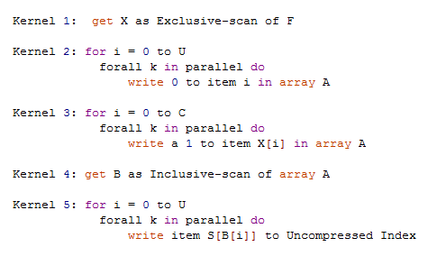
Load Balanced Algorithm
Solves the Load Balancing Problem.
Takes five Kernels to do It.
Uses at least twice more memory!

Slide 12
Load balanced algorithm
A | B | C | D
Symbols: S
1 | 2 | 3 | 4
Frequencies : F
0 | 1 | 3 | 6
Exclusive Scan: X
Array A
0 | 0 | 0 | 0 | 0 | 0 | 0 | 0 | 0 | 0
Phase 2
Array A
0 | 1 | 0 | 1 | 0 | 0 | 1 | 0 | 0 | 0
Phase 3
Array A
0 | 1 | 1 | 2 | 2 | 2 | 3 | 3 | 3 | 3
Phase 4
Array B
A | B | B | C | C | C | D | D | D | D
Phase 5

Slide 13
Outline
Brief Review of the Problem.
Algorithm Design
First Algorithm
Load Balanced Algorithm
Testing Methodology
Results and Benchmarks
Problems Found
Conclusions
Future work

Slide 14
Testing Methodology
Generating synthetic data by creating strings in which the frequency of each element is one more than the previous. 1A2B3C4D5E6F7G8H (Done this)
Strings are not friendly to the First Algorithm.
In Progress …
Projection index with 10 different elements and then double the amount of elements.
Projection index with fixed size of elements and then increasing the number of different elements from 2 different to having all elements with a frequency of 3.

Slide 15
Outline
Brief Review of the Problem.
Algorithm Design
First Algorithm
Load Balanced Algorithm
Testing Methodology
Results and Benchmarks
Problems Found
Conclusions
Future work

Slide 16
Results and Benchmarks
NVIDIA 9400m
16 cores, and 256Mb of Memory
The Implemented Algorithms:
First Algorithm: Not Balanced Uncompression.
Second Algorithm: Load Balanced Uncompression.
Copying Uncompressed Index to GPU.
The Data:
They have been tested with Unbalanced Strings in the form of:
1 A 2 B 3 C …

Slide 17
Current Results

Slide 18
Performance at each Stage

Slide 19
Kernel 4 does not match expected.

Slide 20
Outline
Brief Review of the Problem.
Algorithm Design
First Algorithm
Load Balanced Algorithm
Testing Methodology
Results and Benchmarks
Problems Found
Conclusions
Future work

Slide 21
Problems
Stage 4 of the algorithm takes too long.
Non-coalesced accesses in kernels 3 and 5 of the Load balanced algorithm. (Computability 1.1)
New algorithm uses twice as much memory, running more quickly out of Memory.

Slide 22
Outline
Brief Review of the Problem.
Algorithm Design
First Algorithm
Load Balanced Algorithm
Testing Methodology
Results and Benchmarks
Problems Found
Conclusions
Future work

Slide 23
Conclusions
Transferring the uncompressed Index, is more efficient than both attempts at uncompressing within the GPU.
The most expensive kernels for the load balanced algorithm are:
Kernel 4: Inclusive Scan of the Uncompressed Array 60%
Kernel 5: Uncompression in Parallel. 26%
Kernel 2: Initialization of the Uncompressed Array. 14%

Slide 24
Future Work
Investigate further what is wrong with Kernel 4. (Use Dr. Aubanel’s machine)
Complete the other tests in the testing methodology.
Try other attribute values data types.
To Improve Kernel 5 will look into using Constant memory for reads from array of Symbols.
Try Asynchronous Copy to see if it improves somewhat.

Slide 25
References
Gosink, L., Kesheng Wu, E. Wes Bethel, John D. Owens, Kenneth I. Joy: Data Parallel Bin-Based Indexing for Answering Queries on Multi-core Architectures. SSDBM 2009: 110-129
Guy E. Blelloch. “Prefix Sums and Their Applications”. In John H. Reif (Ed.), Synthesis of Parallel Algorithms, Morgan Kaufmann, 1990.
HARRIS M., SENGUPTA S., OWENS J. D.: Parallel prefix sum (scan) with CUDA. In GPU Gems 3, Nguyen H., (Ed.). Addison Wesley, Aug. 2007, ch. 31.
Horn, Daniel. Stream reduction operations for GPGPU applications. In GPU Gems 2, M. Pharr, Ed., ch. 36, pp. 573–589. Addison Wesley, 2005 http://developer.nvidia.com/object/gpu_gems_2_home.html

Slide 26
Thank You!
Questions?
Suggestions?

Slide 27
1 | 2 | 3 | 4 | 5 | 6 | 7 | i+1 | 500
A | B | C | D | E | F | G | … | N
+500
1 | 2 | 3 | 4 | 5 | 6 | 7 | i+1 | 1000
A | B | C | D | E | F | G | … | N+500
1 | 2 | 3 | 4 | 5 | 6 | 7 | i+1 | 5000
A | B | C | D | E | F | G | … | N+4500

Slide 28
1024 | 1024 | 1024 | 1024 | 1024 | 1024 | 1024 | 1024 | 1024
A | B | C | D | E | F | G | … | N
x 2
2048 | 2048 | 2048 | 2048 | 2048 | 2048 | 2048 | 2048 | 2048
A | B | C | D | E | F | G | … | N
16384 | 16384 | 16384 | 16384 | 16384 | 16384 | 16384 | 16384 | 16384
A | B | C | D | E | F | G | … | N

Slide 29
16384 | 16384 | 16384 | 16384 | 16384 | 16384 | 16384
A | B | C | D | E | F | … 1024 different elements …
x 2
8192 | 8192 | 8192 | 8192 | 8192 | 8192 | 8192
A | B | C | D | E | F | … 2048 different elements …
Number of
different
elements
1024 | 1024 | 1024 | 1024 | 1024 | 1024 | 1024
A | B | C | D | E | F | … 16384 different elements …

