Slide 1
Uncompressing a Projection Index with CUDA
Eduardo Gutarra Velez

Slide 2
Outline
Introduction and Motivation
The Project
RLE Run Length Encoding
Uncompressing the Index
Parallel Prefix Sum Algorithms
Naïve approach
Work-efficient algorithm
Benchmarking

Slide 3
Introduction & Motivation
The projection index supports thread-level parallelism and therefore could potentially make good use of a GPU.
However, most of the time spent when doing query evaluation on projection indexes, is spent in transferring data from the CPU to the GPU
The approach taken to improve on this problem is to reduce the size of the data that needs to be transferred.
Compression could be a good way to reduce the size of data.

Slide 4
Outline
Introduction and Motivation
The Project
RLE Run Length Encoding
Uncompressing the Index
Parallel Prefix Sum Algorithms
Naïve approach
Work-efficient algorithm
Benchmarking

Slide 5
The Project
A compressed projection index will be used.
The compression method is RLE (Run Length Encoding)
For this to be effective the following assumptions must be made:
The data in the projection index is previously sorted
The projection index is created on a column that is not unique.

Slide 6
RLE (Run Length Encoding)
A | A | B | B | B | B | C | C
A | 2 | B | 4 | C | 2

Slide 7
The Project
The Index will be transferred compressed to the GPU
It will then be uncompressed in the GPU using a prefix sum algorithm.
CPU
GPU
3 – 1 - 7
A-B-C
A3B1C7
AAABCCCCCCC

Slide 8
Uncompressing the Index.
An Array of Symbols. (Distinct attribute values)
An Array of Lengths. (Frequencies of each of those attribute values)
Run the Prefix Sum algorithm on the array of lengths, and then obtain an Exclusive Scan

Slide 9
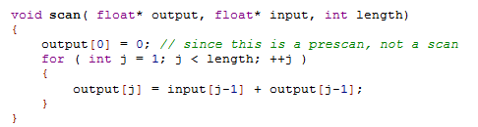
Prefix Sum
3 | 3
1 | 4
7 | 11
0 | 11
1 | 12
6 | 18
3 | 21
0
3
4
11
11
12
18
Sequential Algorithm of
Work complexity of O(n)

Slide 10

Uncompressing the Index.
Use the last element of the prefix sum, allocate the amount of memory necessary.
Use the Exclusive Scan array, to have each thread uncompress each of the array’s attribute values.

Slide 11
Outline
Introduction and Motivation
The Project
RLE Run Length Encoding
Uncompressing the Index
Parallel Prefix Sum Algorithms
Naïve approach
Work-efficient algorithm
Benchmarking

Slide 12
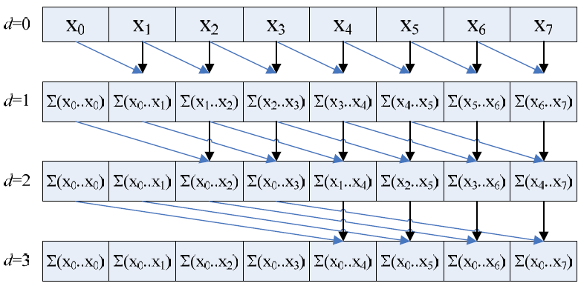
A Naïve Parallel Scan
Source: Parallel prefix sum (scan) with CUDA

Slide 13
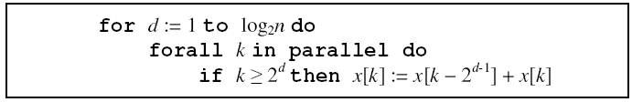

A Naïve Parallel Scan
Source: Parallel prefix sum (scan) with CUDA

Slide 14
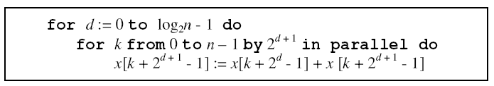
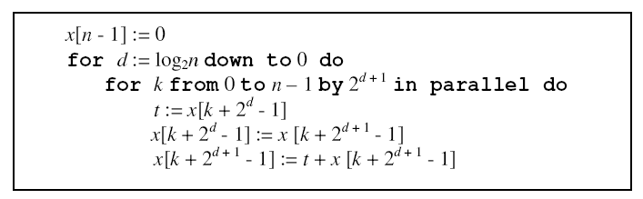
Work-Efficient Parallel Scan
Source: Parallel prefix sum (scan) with CUDA

Slide 15
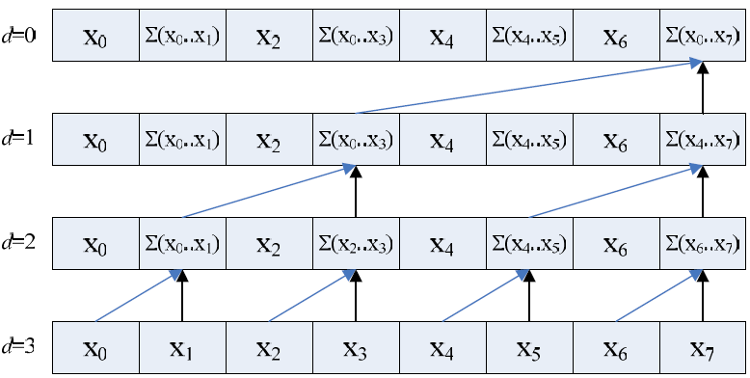
Up-sweep phase
Source: Parallel prefix sum (scan) with CUDA

Slide 16
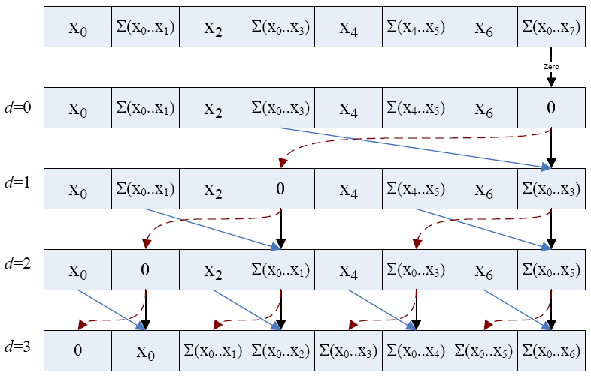
Down-sweep phase
Source: Parallel prefix sum (scan) with CUDA

Slide 17
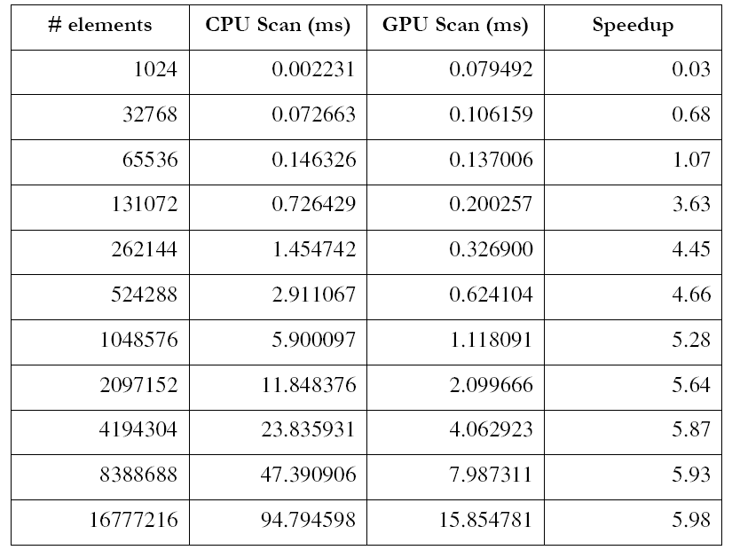
Benchmarks on the Work Efficient Parallel Scan
Source: Parallel prefix sum (scan) with CUDA

Slide 18
Outline
Introduction and Motivation
The Project
RLE Run Length Encoding
Uncompressing the Index
Parallel Prefix Sum Algorithms
Naïve approach
Work-efficient algorithm
Benchmarking

Slide 19
Benchmarking
To conclude the project a benchmark test will compare and find the cases where a compressed index can be more readily available to the GPU by uncompressing as opposed to loading it as an uncompressed index.
Projection index with 10 different elements and then double the amount of elements.
Projection index with fixed size of elements and then increasing the number of different elements from 2 different to having all elements with a frequency of 3.

Slide 20
References
Gosink, L., Kesheng Wu, E. Wes Bethel, John D. Owens, Kenneth I. Joy: Data Parallel Bin-Based Indexing for Answering Queries on Multi-core Architectures. SSDBM 2009: 110-129
Guy E. Blelloch. “Prefix Sums and Their Applications”. In John H. Reif (Ed.), Synthesis of Parallel Algorithms, Morgan Kaufmann, 1990.
HARRIS M., SENGUPTA S., OWENS J. D.: Parallel prefix sum (scan) with CUDA. In GPU Gems 3, Nguyen H., (Ed.). Addison Wesley, Aug. 2007, ch. 31.

Slide 21
Thank You!

