Slide 1
Uncompressing a Projection Index with CUDA
Eduardo Gutarra Velez

Slide 2
Outline
Brief Review of the Problem.
Algorithm Design
Old Algorithm
New Algorithm
Testing Methodology
Results and Benchmarks
Problems Found
Conclusions
Future work

Slide 3
Brief Review of the Problem
The Index will be transferred compressed to the GPU
It will then be uncompressed in the GPU using a prefix sum algorithm.
CPU
GPU
A3B1C7
AAABCCCCCCC

Slide 4

Old Algorithm
Use the last element of the prefix sum, allocate the amount of memory necessary.
Use the Exclusive Scan array, to have each thread uncompress each of the array’s attribute values.
Potentially very badly load balanced.

Slide 5
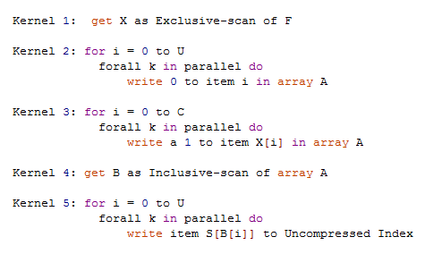
New Load balanced algorithm

Slide 6
A | B | C | D
1 | 2 | 3 | 4
0 | 1 | 3 | 6
0 | 1 | 0 | 1 | 0 | 0 | 1 | 0 | 0 | 0
0 | 1 | 1 | 2 | 2 | 2 | 3 | 3 | 3 | 3
A | B | B | C | C | C | D | D | D | D

Slide 7
Testing Methodology
1A2B3C4D5E6F7G8H
Friendlier strings to Not balanced algorithm.

Slide 8
Problems
Non-coalesced accesses in certain kernels such as the uncompress kernel
New algorithm uses twice as much memory.
Stage 4 of the algorithm takes too long

Slide 9
Results and Benchmarks
I have implemented the algorithm.

Slide 13
Conclusions

Slide 14
Future Work
Plans to do more testing with more complex attribute value types.
Investigate further what is wrong with stage 4.
Build other types of compressed projection indices
Might want to look at using Texture memory for reads from S.
Dr. Aubanel’s Machine

Slide 15
References
Gosink, L., Kesheng Wu, E. Wes Bethel, John D. Owens, Kenneth I. Joy: Data Parallel Bin-Based Indexing for Answering Queries on Multi-core Architectures. SSDBM 2009: 110-129
Guy E. Blelloch. “Prefix Sums and Their Applications”. In John H. Reif (Ed.), Synthesis of Parallel Algorithms, Morgan Kaufmann, 1990.
HARRIS M., SENGUPTA S., OWENS J. D.: Parallel prefix sum (scan) with CUDA. In GPU Gems 3, Nguyen H., (Ed.). Addison Wesley, Aug. 2007, ch. 31.

Slide 16
Thank You!
Questions?
Suggestions?

