Slide 1
Uncompressing a Projection Index with CUDA
Eduardo Gutarra Velez

Slide 2
Outline
Brief Review of the Problem.
Algorithm Design
Old Algorithm
New Algorithm
Testing Methodology
Results and Benchmarks
Future work

Slide 3
Brief Review of the Problem
The Index will be transferred compressed to the GPU
It will then be uncompressed in the GPU using a prefix sum algorithm.
CPU
GPU
A3B1C7
AAABCCCCCCC

Slide 4

Old Algorithm
Use the last element of the prefix sum, allocate the amount of memory necessary.
Use the Exclusive Scan array, to have each thread uncompress each of the array’s attribute values.
Trade-Off between Algorithms

Slide 5
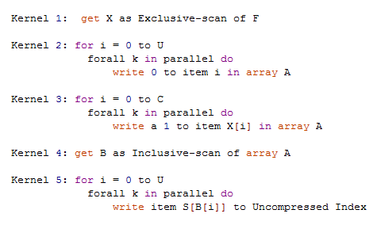
New Load balanced algorithm

Slide 6
A | B | C | D
1 | 2 | 3 | 4
0 | 1 | 3 | 6
0 | 1 | 0 | 1 | 0 | 0 | 1 | 0 | 0 | 0
0 | 1 | 1 | 2 | 2 | 2 | 3 | 3 | 3 | 3
A | B | B | C | C | C | D | D | D | D

Slide 7
Problems
Non-coalesced accesses in certain kernels such as the uncompress kernel
New algorithm twice as much memory.

Slide 9
Future Work
Plans to do more testing with elements that are not characters.
I have implemented the algorithm.
Might want to look at using Texture memory for reads from S
Dr. Aubanel’s Machine

