Slide 1

Regime-scanning with Hävstång AB
Edvin Gunnarsson, Edwards Holmén, Victor Mikkelsen & Lucas Rodgers
LINC, Research & Analysis
0

Slide 2
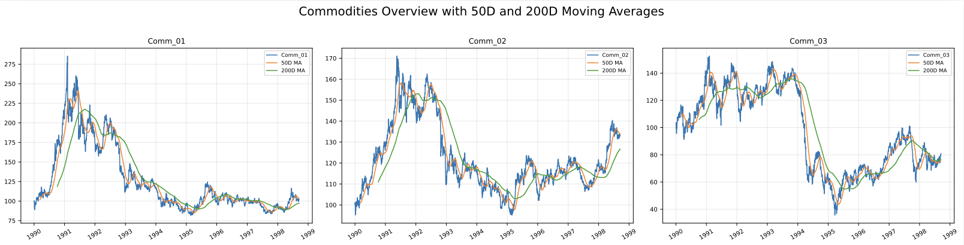
Exploring the Data
Establishing a market overview

Slide 3
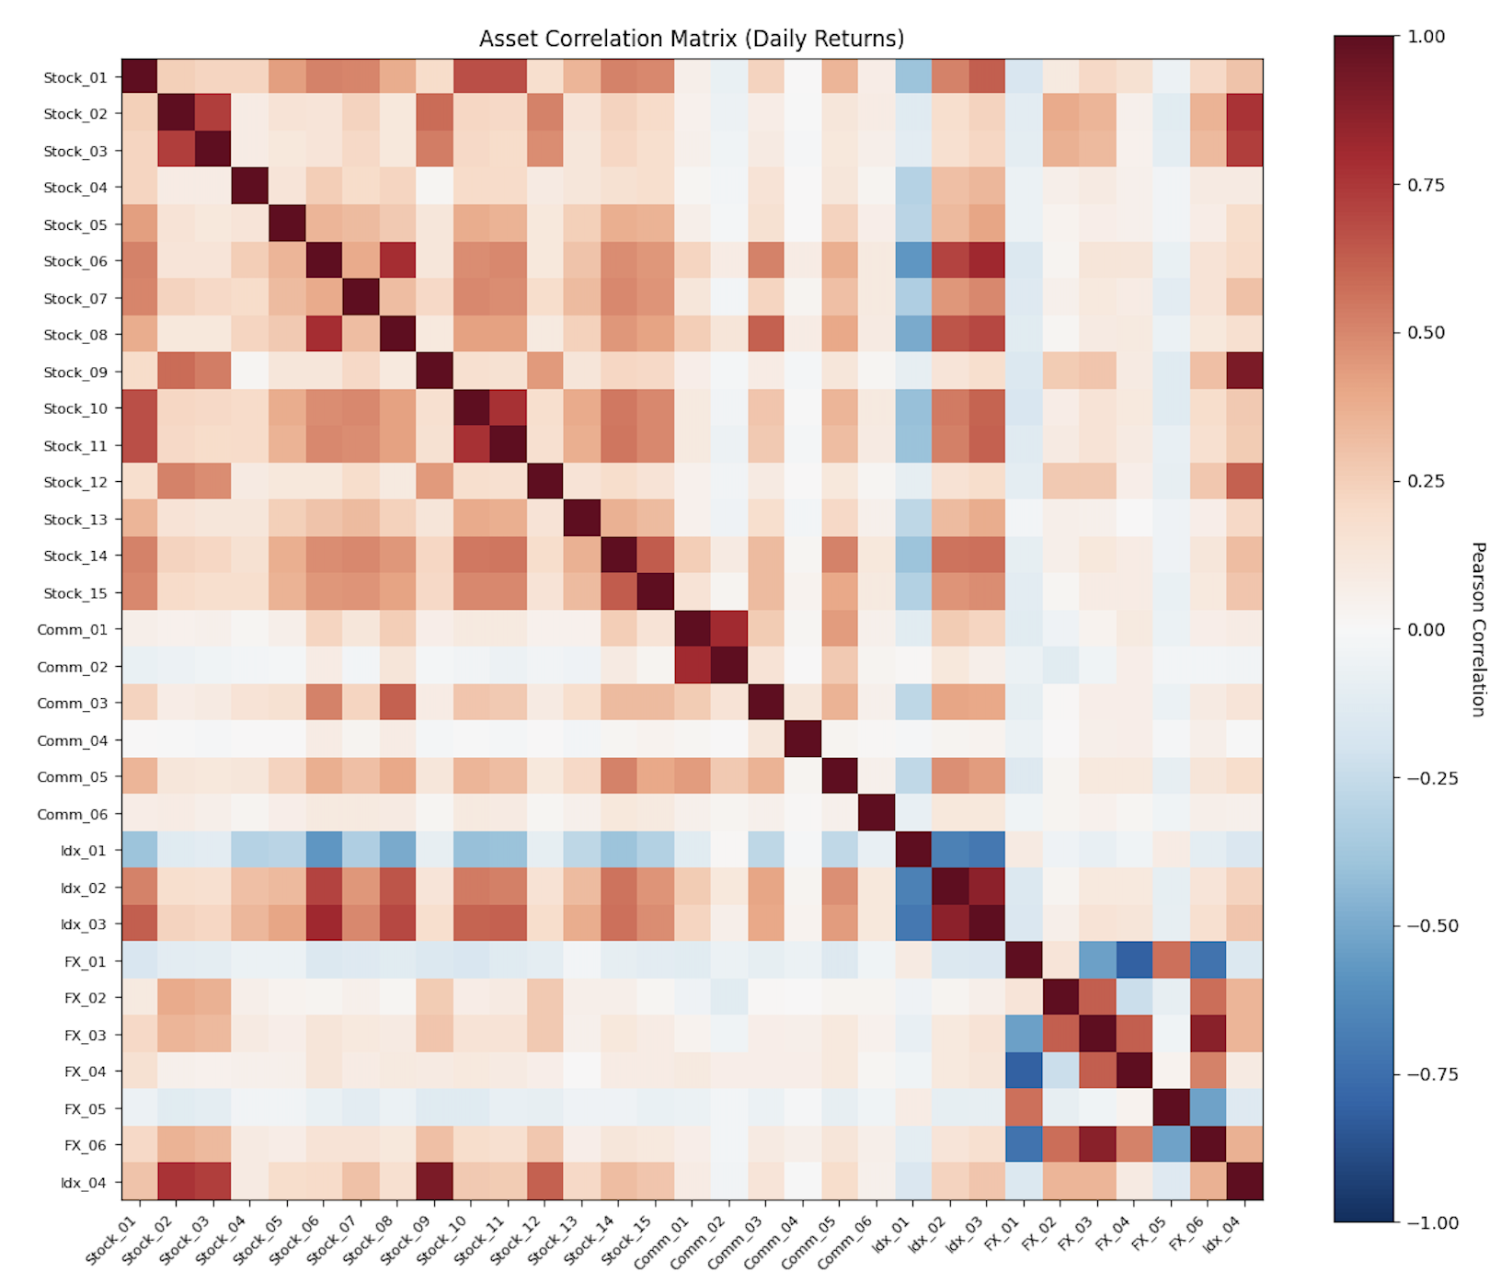
Exploring the Data
Checking correlation between equities, commodities, FX and Indices

Slide 4
Defining The Market

Slide 5
Defining stressed vs calm market conditions
Z-score of index 1 is the signal used for identifying regimes
Z - score > 1.5 implies a stressed market
Z - score < -0.5 implies a calm market
Discrepancy in Z - scores comes from stressed markets reacting more forcefully than calm ones
Condition | Signal
Z > 1.5 | +1
Z < -0.5 | -1
Else | 0
Price - rolling mean
Z =
Rolling std

Slide 6
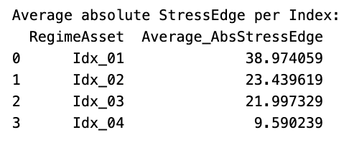
Identifying IDX_01 as the leading indicator
'StressEdge': stress_bps - calm_bps
'CalmEdge': calm_bps - stress_bps
stress_bps: How many point the asset moves on average when Idx_0X is high (Z-score > 1,5)?
calm_bps: How many point the asset moves on average when Idx_0X is low (Z-score < -0,5)
The
Notes:
We used something we called a “stressedge” Calculated by looking at how strong

Slide 7
Creating the Strategy

Slide 8
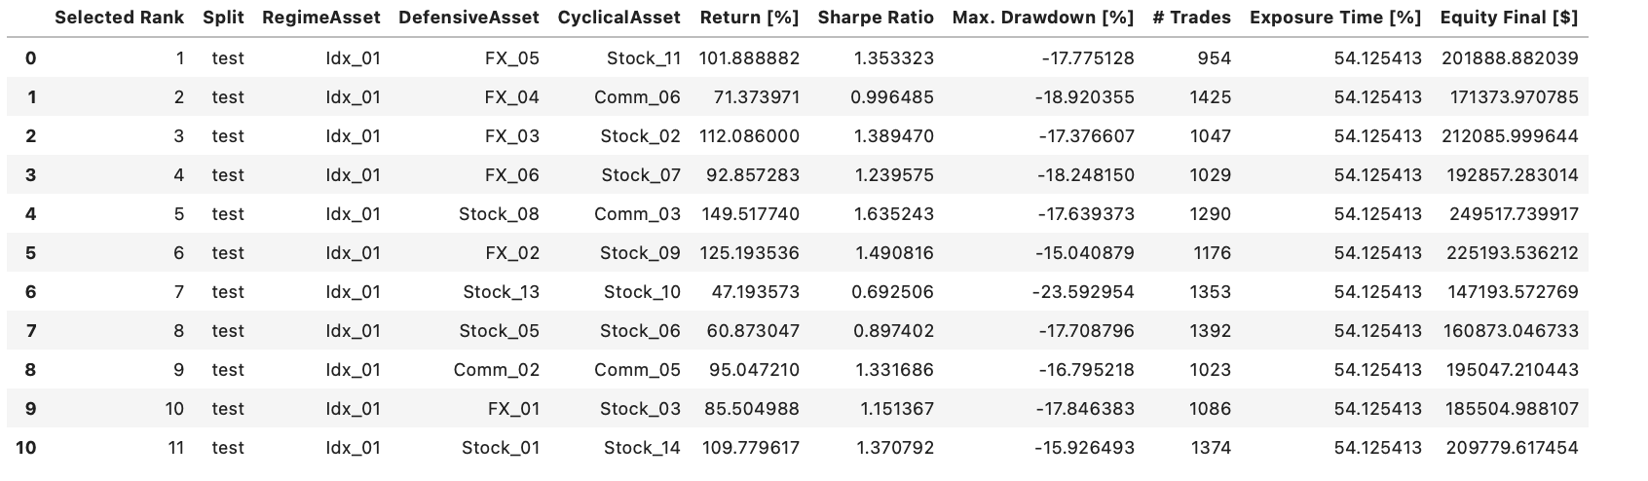
Top 11 triplet combinations
Sharpe Ratio: Amount of profit per risk unit
Total Return: Amount of money generated in total
Max Drawdown: Biggest single loss

Slide 9

Creating the “Triplets”
A triplet is a set of three assets
Regime (index)
Defensive
Cyclical
Determined from backtesting for best “defensive” and “cyclical” (risk-on)
Weighted
0.40 Regime, 1.00 Defensive and -1.00 Cyclical
Volatility Adjusted (we calculated optimal rolling window on 60/40 train test)
(5 days, target 0.012)
Max Gross Exposure
1
Condition | Signal
Z > 1.5 | +1
Z < -0.5 | -1
Else | 0
Price - rolling mean
Z =
Rolling std

Slide 10
From signal to portfolio weights
All 11 triplets weighted equally
Role | Base weight
Regime asset | -0.40
Defensive asset | +1.00
Cyclical asset | -1.00
short regime index (-)
long defensive (+) risk off
short cyclical (-) risk on
Unless the signal flips it

Slide 11
From signal to portfolio weights
So every weight is divided by 2.40
Role | Base weight
Regime asset | -0.40
Defensive asset | +1.00
Cyclical asset | -1.00
These are not yet normalized.
Total absolute weight:
∣−0.40∣+∣1.00∣+∣−1.00∣=2.40∣−0.40∣+∣1.00∣+∣−1.00∣=2.40
Role | Calculation | Normalized weight
Regime asset | -0.40 / 2.40 | -0.17
Defensive asset | 1.00 / 2.40 | +0.42
Cyclical asset | -1.00 / 2.40 | -0.42
∣−0.17∣+∣0.42∣+∣−0.42∣=1 so gross exposure = 1

Slide 12
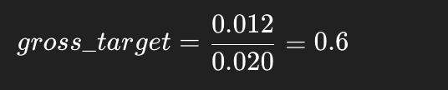
Scale by volatility
Volatility | Exposure
High | Smaller weights
Low | Larger weights
TARGET_VOL = 0.012
basket_vol = 0.020
basket returns = weighted returns of triplet
basket_vol = rolling std (5 days)
weight=signal×base_weight×volatility_scale
multiply all weights by 0.6
Role | Calculation | Normalized weight
Regime asset | -0.17* 0.6 | -0.10
Defensive asset | 0.42 * 0.6 | +0.25
Cyclical asset | -0.42 * 0.6 | -0.25

Slide 13
From signal to portfolio weights
Convert weights to cur_01 exposure, assume we start with 100000$
Role | Weight | Dollar exposure
Regime asset | -0.10 | -$10,000
Defensive asset | +0.25 | $25,000
Cyclical asset | -0.25 | -$25,000
Role | Price
Regime asset | $400
Defensive asset | $50
Cyclical asset | $100
-10000 / 400 = -25 shares
25000 / 50 = 500 shares
-25000 / 100 = -250 shares

Slide 14
Final result in current portfolio
Current portfolio
Target shares based on signal and calculated weights thereof
Asset | Current share
Regime asset | -20
Defensive asset | 400
Cyclical asset | -200
Asset | Current share
Regime asset | -25
Defensive asset | 500
Cyclical asset | -250
Normalization ensure each triplet contributes equal gross exposure
Orders
SELL 5 Index
BUY 100 FX
SELL 50 Stock

Slide 15
Full pipeline summary
prices
↓
compute returns
↓
compute regime z-score (40-day rolling mean/std of index)
↓
apply thresholds
→ z > 1.5 → stress
→ z < -0.5 → calm
↓
signal (-1, 0, +1)
signal (-1,0,+1)
↓
base weights
↓
normalize (sum |w| = 1)
↓
volatility scaling
↓
final weights
↓
currency exposure
↓
shares
↓
trade orders

Slide 16
Algorithmic FX Risk Neutralization and trading:
The bot calculates net exposure across all foreign holdings (Crncy_02–04) per trading day
Executes offsetting trades in FX pairs to ensure P&L is driven by asset performance, not currency fluctuations.
Example:
We buy Stock_01 for 10,000 units. The exchange rate is 1.00. Ourvalue in base currency is $10,000.
Our bot sees that we have a $10,000 exposure in Crncy_03.
The Hedge Trade: The bot Shorts FX_05 for a notional value of $10,000
The bot this for all currency exposures completely neutralizing our FX risk

Slide 17
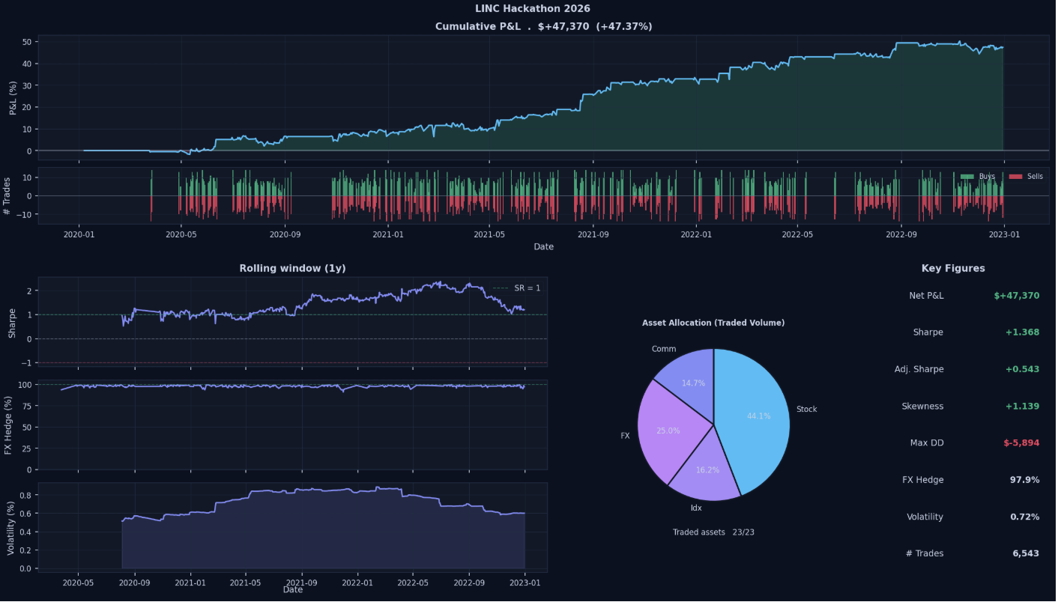
Final result

