Slide 1
NYC 311 Service Requests
Big Data Analysis Using Hadoop, Hive, and Excel 3D Map
Edward Gallegos
CIS 4560: Introduction to Big Data
Professor Jongwook Woo

Slide 2
Agenda
Project Objective
Dataset Overview and Data Source Requirements
Hardware / Cluster Specifications
Hadoop, HDFS, Hive, and Beeline Workflow
Data Cleaning, HiveQL Processing, and Visualizations
Findings, Recommendations, and Deliverables

Slide 3
Project Objective
Analyze NYC 311 service requests from 2020 to present.
Identify common complaint types and request hotspots to prioritize high-volume city service issues.
Use location and time fields to support tempo-spatial analysis.
Process a large dataset with Hadoop/HDFS and Hive.
Create reproducible slides, paper, tutorial, and GitHub deliverables.

Slide 4
Dataset Overview and Data Source
Dataset Details
Required Links
File: 311_Service_Requests_from_2020_to_Present.csv
Dataset size: 12.63 GB
Subset used for visualization: 10,000 records
Columns: 44
Time range: 2020 to present
Data source: Kaggle dataset package
URL: https://www.kaggle.com/datasets/aliafzal9323/los-angeles-crime-data-2020-2026
GitHub: https://github.com/edwaaardgee/311_service_requests_analysis
Note: Kaggle package title differs, but the file used for this project is the NYC 311 Service Requests CSV.

Slide 5
Hardware / Cluster Specifications
Cluster Environment
Experimental Specs
Big Data platform: Hadoop / Hive
Cluster version: Hadoop 3.4.1
Storage: HDFS
Query interface: Beeline
Processing: HiveQL and YARN
Cluster nodes: 5 nodes — 2 master, 3 worker
Memory: 31 GB RAM
CPU: AMD EPYC 7J13 processor
CPU speed: 2.4 GHz

Slide 6
Implementation Workflow / Architecture
Download dataset from Kaggle
Upload CSV to HDFS
Create Hive external table
Run HiveQL cleaning queries
Export subset from Hive
Visualize in Excel 3D Map
This workflow shows the full implementation from raw data to processed visualization output.

Slide 7
Data Cleaning and Preparation
Removed records with missing or invalid latitude and longitude values.
Used created_date fields for time-based analysis in Excel 3D Map.
Focused on service request categories related to infrastructure, sanitation, and public services.
Selected relevant fields: date, agency, complaint type, borough, latitude, and longitude.
Exported a 10,000-record subset for Excel 3D Map due to visualization limits.

Slide 8
Hive Table Creation and Processing
Connected to the Hadoop cluster remotely using SSH.
Created an HDFS project directory for the 311 service request data.
Uploaded the large CSV file into HDFS.
Opened Beeline and selected the Hive database.
Created an external Hive table using OpenCSVSerde for CSV parsing.
Used HiveQL to preview records, count rows, filter fields, and prepare output.

Slide 9
HiveQL Analysis Performed
Main Query Goals
HiveQL
Count total records in the Hive table
Find top service request categories
Compare requests by location and category
Filter rows with valid latitude and longitude
Export a cleaned mapping dataset
SELECT problem, COUNT(*) AS total_requests
FROM service_requests_311
GROUP BY problem
ORDER BY total_requests DESC
LIMIT 10;
Purpose: Ranks service request categories by total count.

Slide 10
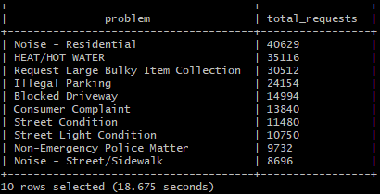
Service Request Category Analysis
Complaint-Type Analysis
Aggregated request totals by complaint/problem type using HiveQL.
Identified the highest-volume categories: Noise - Residential, Heat/Hot Water, Bulky Item Collection, Illegal Parking, and Blocked Driveway.
Used results to compare which city issues appeared most often in the dataset.
This analysis supports the recommendation to prioritize high-frequency complaints.

Slide 11
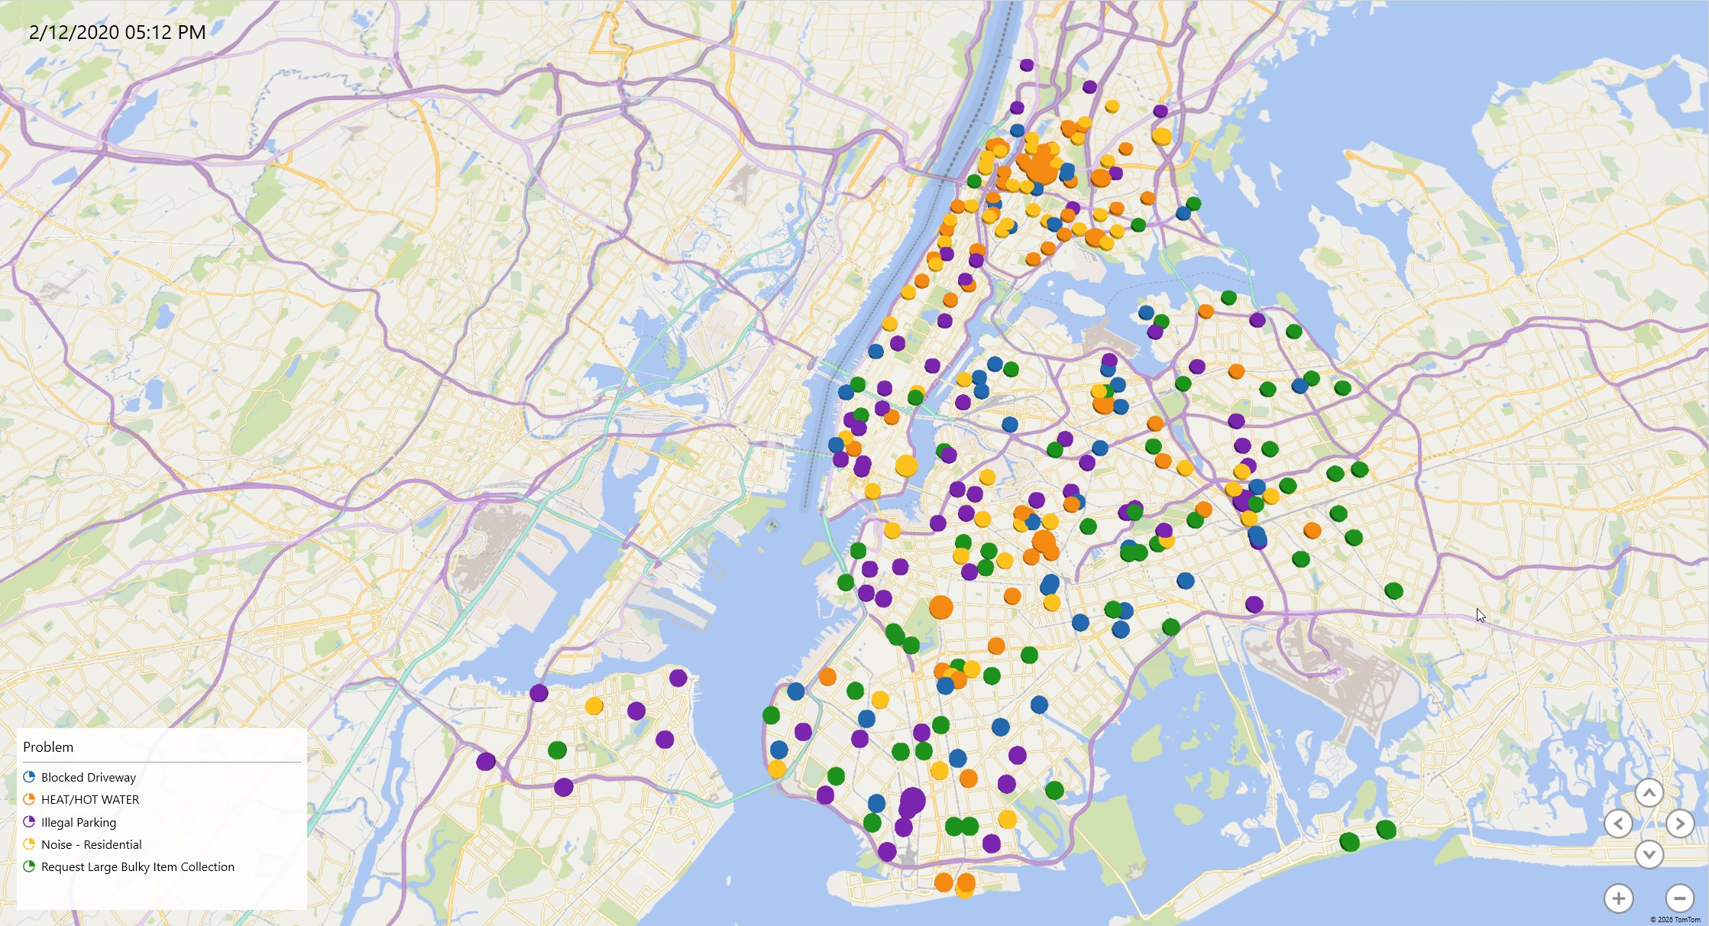
Location fields used: latitude, longitude.
Time fields used: created_date.
Excel 3D Map visualized service requests by location and time.
Goal: show where requests cluster and how request patterns change over time.
Tempo-Spatial Visualization
What the Visualization Shows

Slide 12
Key Findings
Noise - Residential, Heat/Hot Water, and Bulky Item Collection were the top three service request categories based on the HiveQL count query.
High-volume complaints show which city issues should receive the most attention and resources.
Infrastructure and quality-of-life issues appeared repeatedly, including blocked driveways, street conditions, and street light problems.
Combining created_date with latitude and longitude revealed patterns that a basic table would not show.

Slide 13
Recommendations
Prioritize the highest-volume complaint categories first, especially Noise - Residential, Heat/Hot Water, Bulky Item Collection, Illegal Parking, and Blocked Driveway.
Use hotspot locations from the 3D Map to guide staffing, field operations, and resource allocation.
Track repeated complaints over time to identify recurring neighborhood service problems.
Use Hive and HDFS to process large public-service datasets more efficiently than local tools.
Build geospatial dashboards so agencies can monitor service request trends and make faster data-driven decisions.

Slide 14
Thank You
Questions?

