Slide 1
NYC Taxi Trip Data Analysis
Using Elasticsearch, Kibana, and Python
CIS 3200 – Data Processing and Analytics
Instructor: Dr. Woo
Presented by: Ruben Chagollan​
Edward Gallegos​
Jordy Moreno​
Giovanni Clara
May 6, 2026​

Slide 2
Dataset and Data Source
Dataset:
NYC Yellow Taxi Trip Records
Source:
NYC Taxi & Limousine Commission
Month:
March 2026
Original Data:
3,952,451 rows
20 columns
Project Data:
150,000 rows / 12.8 MB
100,000 geo rows / 28.2 MB
Key Fields:
Pickup/drop-off time
Trip distance
Fare amount
Passenger count
Location IDs
Data Source: https://www.nyc.gov/site/tlc/about/tlc-trip-record-data.page

Slide 3
Platform / Environment Specs
Cloud Platform: Elastic Cloud / Kibana
Elasticsearch Indexes: - nyc_taxi - nyc_taxi_geo2 Data Processing: Original Parquet file → cleaned CSV → geo-enhanced CSV
Tools Used:​
Python
Pandas
PyArrow
GeoPandas
Local Environment:​ - Windows 11​ - Python 3.13.13
Purpose: Python prepared the data, Elasticsearch indexed it, and Kibana visualized it.

Slide 4
Workflow / Architecture
NYC TLC Dataset (March 2026 Yellow Taxi Data)
Python Data Cleaning
Cleaned CSV Subset
(nyc_taxi_subset.csv)
Taxi Zone Shapefile Join
Geo-Enhanced CSV
(nyc_taxi_subset_with_geo.csv)
Elasticsearch Indexes
nyc_taxi / nyc_taxi_geo2
Kibana Dashboard + Map
ML Fare Prediction

Slide 5
Elasticsearch Upload and Indexing
Indexes Created:​
nyc_taxi​
nyc_taxi_geo2​
Data Upload Method
Kibana Data Visualizer
Files Uploaded:​
nyc_taxi_subset.csv​
nyc_taxi_subset_with_geo.csv​
Geo Mapping:​
pickup_location → geo_point​
dropoff_location → geo_point​
Purpose:​
Elasticsearch stored and indexed the cleaned taxi data so it could be searched, analyzed, and visualized in Kibana.

Slide 6
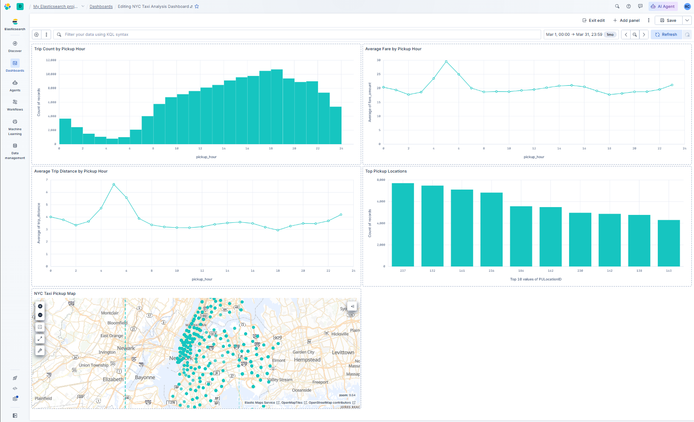
Kibana Dashboard Overview
Dashboard includes: • 4 chart visualizations • 1 geo-temporal map • Time range: March 2026

Slide 7
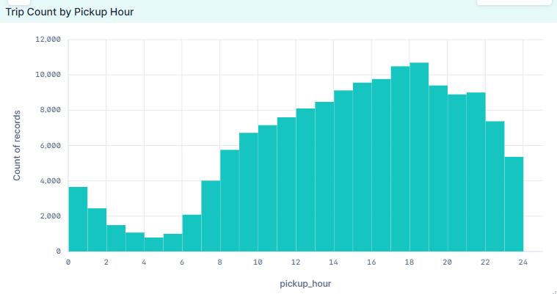
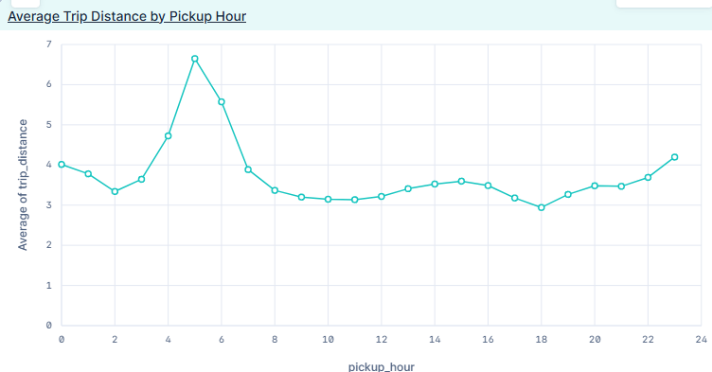
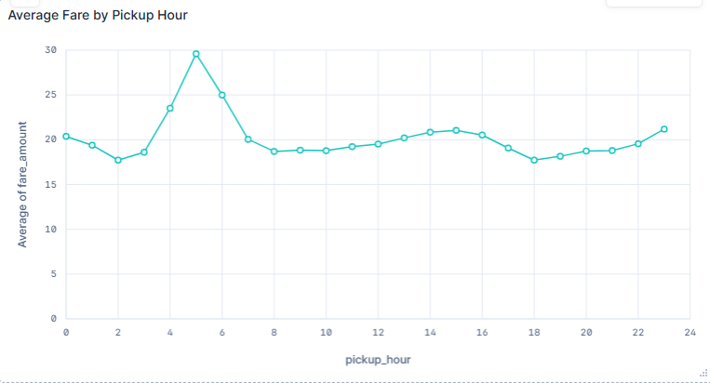
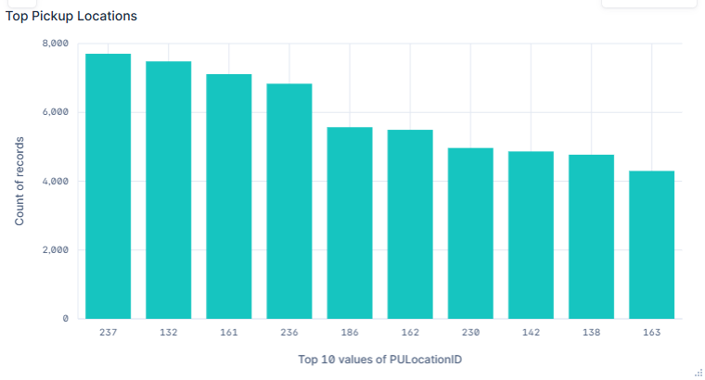
Key Dashboard Insights
Trip Count by Pickup Hour Demand increases after morning hours and peaks later in the day.
Average Trip Distance by Pickup Hour Early morning trips show the longest average distance.
Average Fare by Pickup Hour Average fare spikes around early morning hours.
Top Pickup Location IDs Pickup Location IDs 237, 132, 161, and 236 show the highest activity.

Slide 8
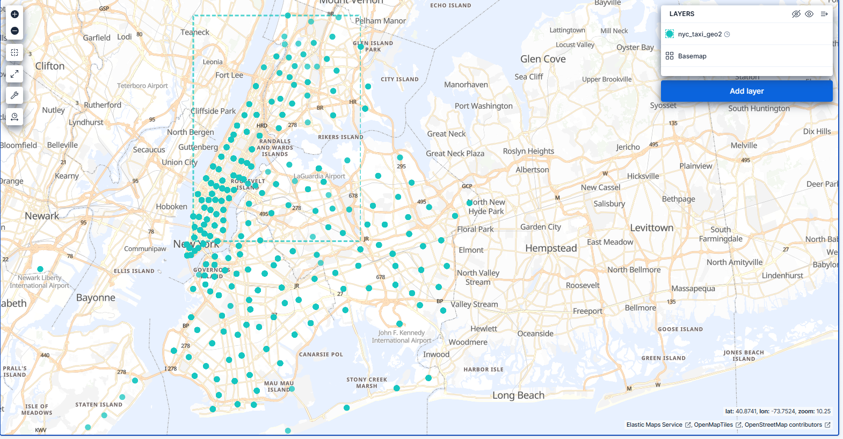
Geo-Temporal Map Analysis
Map Setup: • Data view: nyc_taxi_geo2 • Geo field: pickup_location • Time range: March 2026 • Joined PULocationID with NYC taxi zone shapefile
Main Insight: Pickup activity is concentrated around Manhattan, Queens, Brooklyn, and airport-related zones.

Slide 9
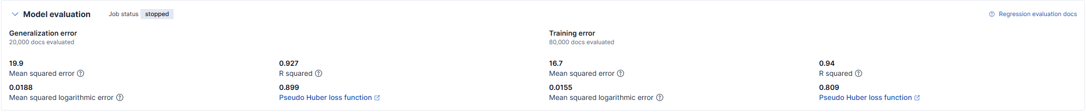
Machine Learning Regression Results
Data Split: • 80,000 training records • 20,000 testing records
Goal: Predict taxi fare amount
Model Type: Regression
Key Results: • Testing R² score: 0.927 • Training R² score: 0.94 • Testing mean squared error: 19.9 • Prediction field: ml.fare_amount_prediction
Interpretation: The model explained about 92.7% of the variation in fare_amount on test data.

Slide 10
GitHub and Project Deliverables
GitHub Repository: https://github.com/edwaaardgee/
nyc-taxi-elasticsearch-project Repository Includes: • Python data preparation code • Geo-field creation code • README tutorial / replication steps • Dataset source instructions • Kibana dashboard and map creation steps
Reproducibility Test:​ • prepare_taxi_data.py successfully recreated nyc_taxi_subset.csv​
• add_geo_fields.py successfully recreated nyc_taxi_subset_with_geo.csv​
​
The README explains how to download the data, run the scripts, upload to Elasticsearch, and recreate the Kibana dashboard.

Slide 11
Conclusion
Elasticsearch and Kibana enabled efficient analysis of large taxi data
Visualization revealed patterns in demand, distance, and fare
Machine learning successfully predicted fare with high accuracy (R² ≈ 0.93)

