Slide 1
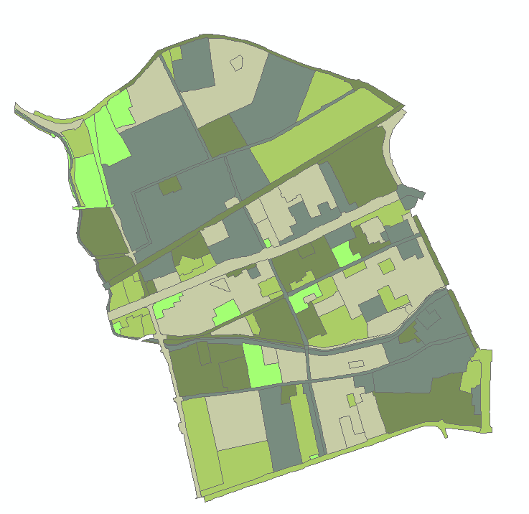
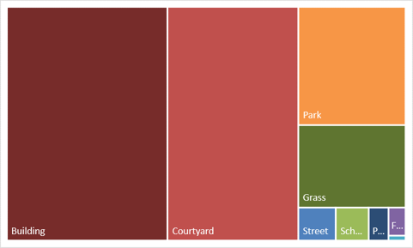
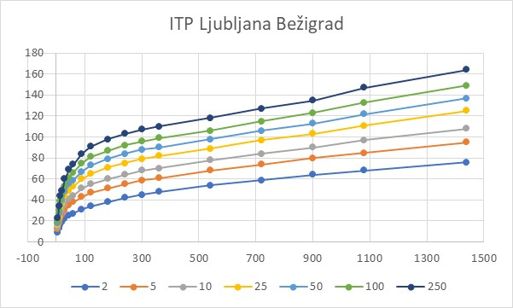
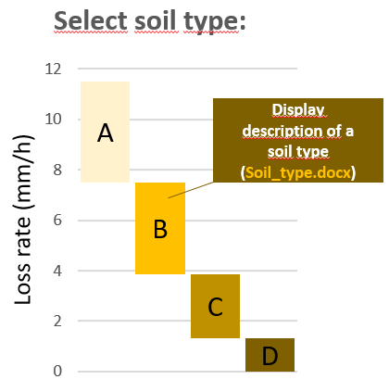
Highlight
Treemap of SPU (VI-287)
UNIT (shp) = Unit (EUP_Select_Class), details about plot of land in terms of urban development status
Map with CN validation values (overview)
Textual Information Per Highlighted Unit
Rain data for nearest rain station
Rain height and volumes calculation
UNIT:
LAND USE:
LAND USE DESCRIPTION:
MIN GREEN AREA:
BUILDING DESCRIPTION:
CURRENT BUILDINGS PER ha:
CURRENT POPULATION DENSITY:
AREA:
CN A:
CN B:
CN C:
CN D:
RAIN STATION:
-
-
-
-
-
-
-
-
50 mm
40 mm
V_{E} (m³)
Precipitation height (mm)
Precipitation volume (m³)
30 mm
P_{E} (m³)
20 mm
V_{U} (m³)
P_{U} (m³)
10 mm
Select climate change prediction value (Cc):
P_{T} (m³)
V_{T} (m³)
No change
5% increase
Retention time:
t_{R (min)}
10% increase
20% increase

Slide 2
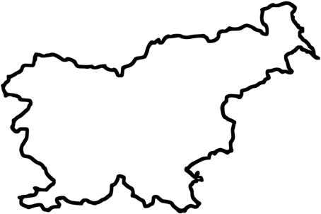
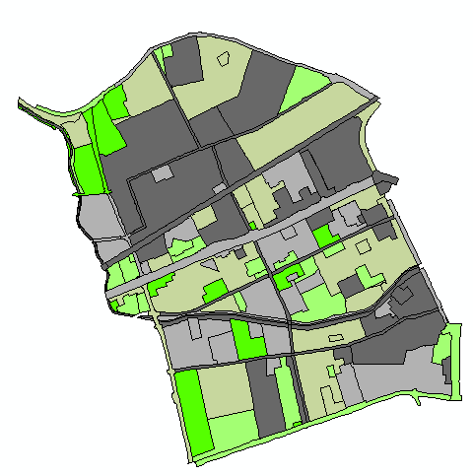
CN valuation
Country Map
Region
Municipalities
Functional Area units
Spatial Planning Unit
(Country.shp)
(Region.shp)
(Municip.shp)
(F_unit.shp)
(EUP_pilot.shp)
Formal Units
Domain Units

Slide 3
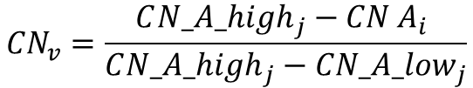
Data are available in EUP_select_CN.xlsx
Legend
Highlight
Green infrastructure (1)
CNv is different (calculated) for each UNIT
*
Gray infrastructure (0)
CNv = Cloropleth value is calculated for each UNIT by rules or equation:
if CN A_{i} < CN_A_low_{j} than CN_{v} = 1
if CN A_{i} > CN_A_high_{j} than CN_{v} = 0
Green/gray infrastructure validation
Land_use_CN_range.xlsx
$${CN}_{v}=\frac{C{N_A_high}_{j}−{CN A}_{i} }{C{N_A_high}_{j}−{CN_A_low}_{j}}$$
LAND_USE | CN_A_low | CN_A_high
A | 44 | 62
BC | 43 | 75
BD | 51 | 90
BT | 51 | 86
i…UNIT
j…LAND USE

Slide 4
Treemap of SPU (VI-287)
UNIT (shp) = Unit (EUP_Select_Class), details about plot of land in terms of urban development status
EUP_CURRENT_LAND_USE.xlsx
LAND_USE | UNIT | CURRENT_LAND_USE_CLASS | AREA
BC | TR-327 | Street | 2356
BC | TR-327 | Courtyard | 378
BC | TR-327 | Forest | 9784
BC | TR-327 | Schrubs | 1908

Slide 5
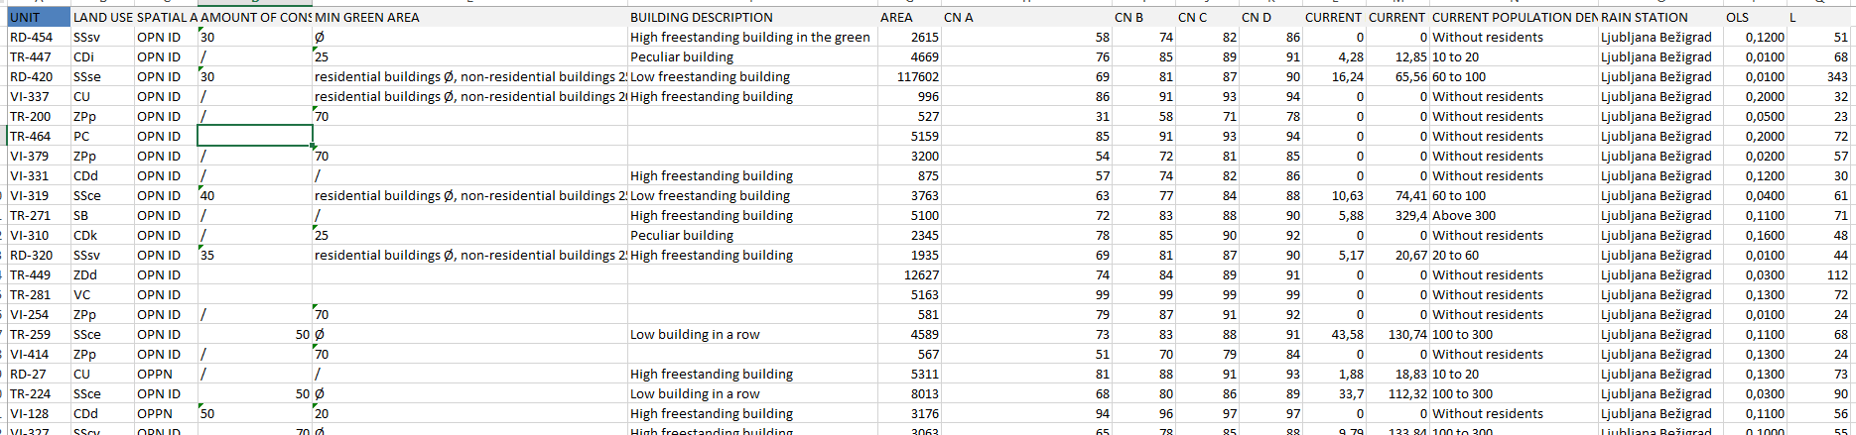
Data are available in EUP_select_CN.xlsx
Sama data are needed only for display but some others are needed for further calculations.
Value CN A is needed for CNv calculation (next sheet).
Values AREA, CN A, CN B, CN C, CN D, OLS, L are needed for rain calculations (sheet 7).
Rain station: for now we have input data for only one rain station (for the prototype area). At future data for other rain stations can be aded.
LAND USE DESCRIPTION is based on LAND USE string, the translation is in LAND_USE_EN and LAND_USE_SI
Textual Information Per Highlighted Unit
EUP_select_CN.xlsx
UNIT:
LAND USE:
LAND USE DESCRIPTION:
MIN GREEN AREA:
BUILDING DESCRIPTION:
CURRENT BUILDINGS PER ha:
CURRENT POPULATION DENSITY:
AREA:
CN A:
CN B:
CN C:
CN D:
RAIN STATION:

Slide 6
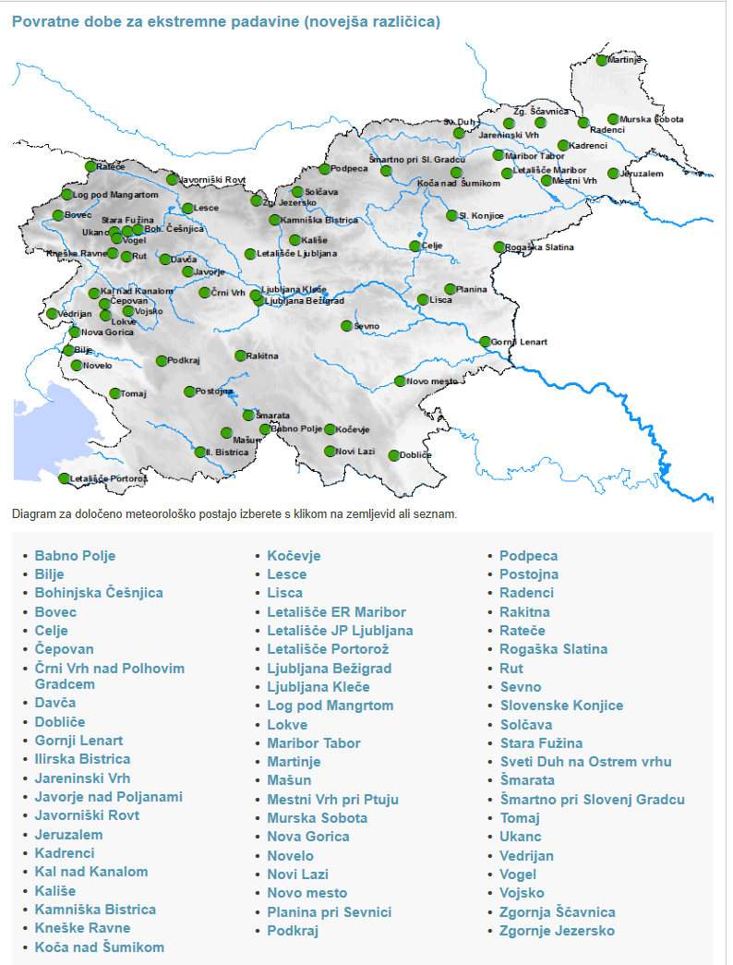
Data are available in Rain_data.xlsx
The same data are available for other rain stations in the country. This particular area (urban data for pilot area) refers to one station. The key between urban data and rain data for other rain stations is field Rain_station in EUP_select_CN.xlsx
There is no need to include all data into visualization – the amount on a diagram below is enough. The selected diagram is commonly used within domain (colors are not defined and can be changed). Since there is a lot of data in the diagram it will be better if a diagram can be zoom able.
Selection of dots on diagram should show data information as displayed below.
Rain data for all other rain station in the country area available at
https://meteo.arso.gov.si/met/sl/climate/tables/precip_return_periods_newer/
Since the pilot area do not refers to other rain stations there is no need to include other rain station data. For the future it will be optimal if there is a direct (online) connection to meteo.arso.gov.si data. From time to time those values changes.
Rain data for nearest rain station
Return period: 100-year
Rain duration: 1440 min
Rain height: 149 mm

Slide 7
Soil type description is in Soil_type.docx. Soil type description is in two languages (SI, EN).
There is already some additional explanation in the document. There is no need to display it. But if it is possible to refer to some additional explanations that are opened in separate window (in pdf or doc format) it will be useful. Also if it is possible to add some links to other internet sources for users to find references or some more detailed information. In my opinion it increases reliability and confidence into data visualization.
Suggested diagram (you can choose other type with simmilar data presentation) an values are in Soil_type.xlsx. Values will be used for final calculations.
Climate change prediction values (Cc) are: no change (Cc value: 1); 5% increase (Cc value: 1,05), 10% increase (Cc value: 1,1), 20% increase (Cc value: 1,2). By Climate change prediction value selection the selected value is included in the final calculation.
Translation:
Soil_type_EN.txt
Soil_type_SI.txt
Select climate change prediction value (Cc):
No change
5% increase
10% increase
20% increase

Slide 8









Values for last visualisation are a result of some simple equations from data that has been already presented on previous slides.
Results that are displayed at the diagram are in blue colour.
CN_{i} value is a value for selected urban area (CN_EUP_selected.xlsx) and selected soil type
AREA, L and OLS values are values that are defined for selected urban area (CN_EUP_selected.xlsx)
Cc value is a value for selected climate change prediction
Select climate change prediction value (Cc):
No change
5% increase
10% increase
20% increase
$$P_{E}=Cc∗\frac{\left(P−I_{a}\right)}{P−I_{a}+S_{r}}$$
$PTi$… values from Rain_data.xlsx
Rain height and volumes calculation
$$I_{a}=2,4$$
CN_{i}…values from CN_EUP_selected.xlsx
According to selected Soil type:
for Soil type A: CN_A
for Soil type B: CN_B
for Soil type C: CN_C
for Soil type D: CN_D
-
-
-
-
-
-
-
-
50 mm
$$P_{U}=P_{Ti}−P_{E}$$
40 mm
V_{E} (m³)
$$S_{r}=\frac{25400−254{CN}_{i}}{{CN}_{i}}$$
Precipitation height (mm)
Precipitation volume (m³)
30 mm
P_{E} (m³)
$V_{T}={AREA}_{i}∗P$_{T}
20 mm
V_{U} (m³)
P_{U} (m³)
$t_{R}=L^{0,8}\frac{{\left(S_{r}+25,4\right)}^{0,7}}{28,14\sqrt{OLS}}$*60
$$V_{E}={AREA}_{i}∗PE$$
10 mm
P_{T} (m³)
V_{T} (m³)
$$V_{U}=V_{T}−VE$$
Retention time:
t_{R (min)}

