Slide 1

Introducing Signals and Systems
The Berkeley Approach
Edward A. Lee
Pravin Varaiya
UC Berkeley
A computer without networking, audio, video, or real-time services.

Slide 2
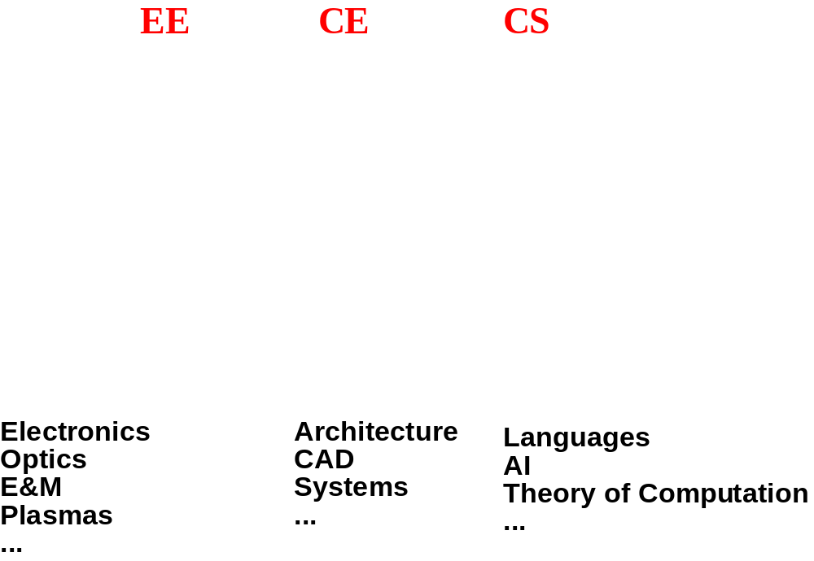
Starting Point
But the juncture of EE and CS is not just hardware.
It is also mathematical modeling and system design.

Slide 3
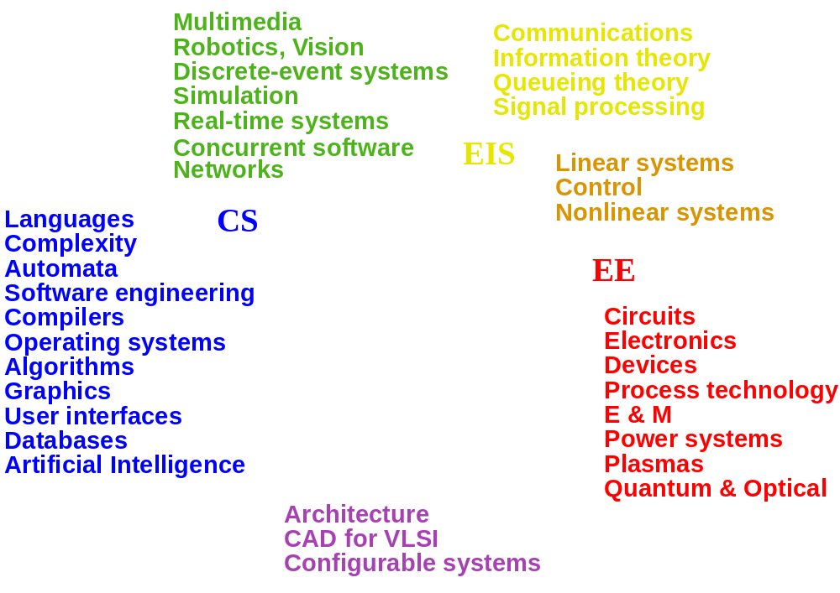
Intellectual Grouping of EE, CE, CS

Slide 4
Six Intellectual Groupings
    Blue: Computer Science
    Green: Computer Information Systems
    Yellow: Electronic Information Systems
    Orange: Electronic Systems
    Red: Electronics
    Purple: Computer hardware

Slide 5
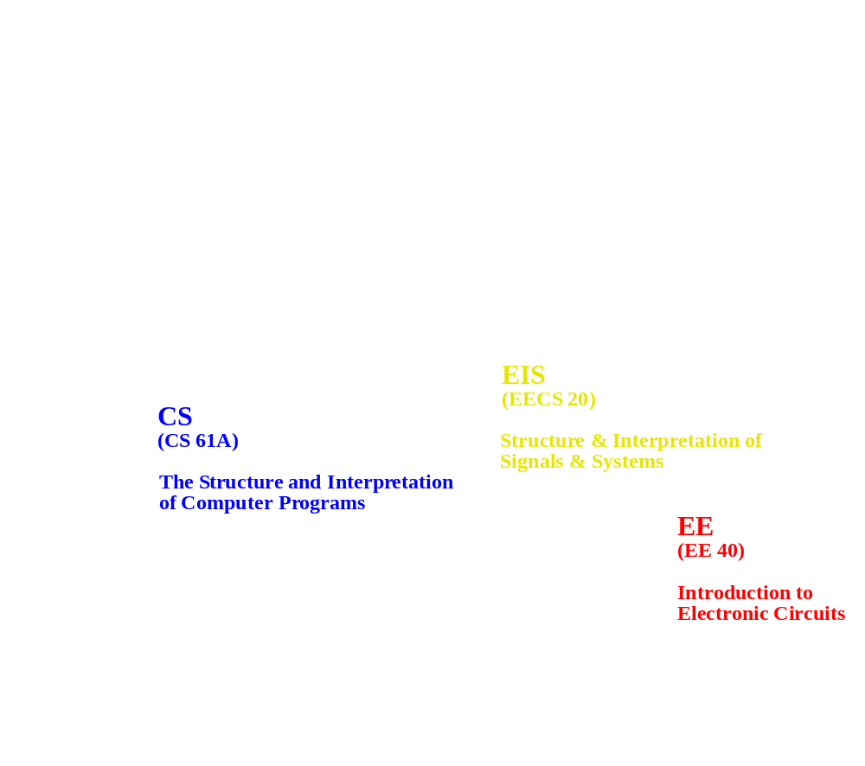
New Introductory Course Needed

Slide 6
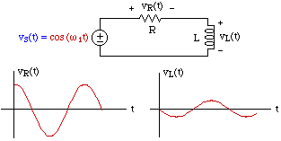
The Roots of Signals and Systems
Circuit theory
Continuous-time
Calculus-based
Major models
Frequency domain
Linear time-invariant systems
Feedback

Slide 7
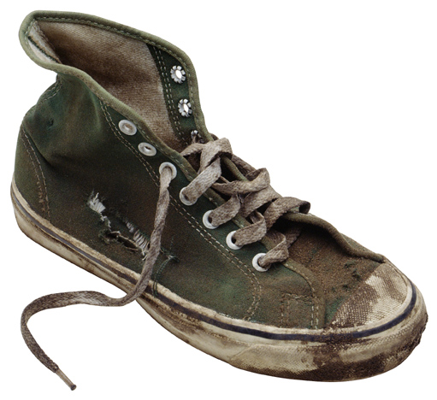
Changes in Content
Signal
    used to be: voltage over time
    now may be: discrete messages
State
    used to be: the variables of a differential equation
    now may be: a process continuation in a transition system
System
    used to be: linear time invariant transfer function
    now may be: Turing-complete computation engine

Slide 8

Changes in Intellectual Scaffolding
Fundamental limits
    used to be: thermal noise, the speed of light
    now may be: chaos, computability, complexity
Mathematics
    used to be: calculus, differential equations
    now may be: mathematical logic, topology,
    set theory, partial orders
Building blocks
    used to be: capacitors, resistors,
    transistors, gates, op amps
    now may be: microcontrollers, DSP cores, algorithms, software components

Slide 9
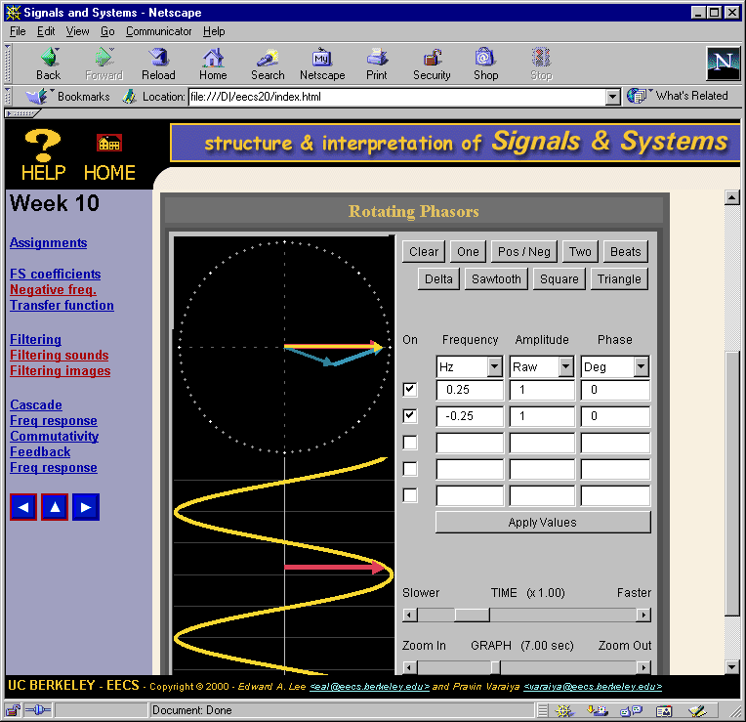
Action at Berkeley
Berkeley has instituted a new sophomore course that addresses mathematical modeling of signals and systems from a very broad, high-level perspective.
The web page at the right contains an applet that illustrates complex exponentials used in the Fourier series.

Slide 10
Themes of the Course
The connection between imperative (Matlab) and declarative (Mathematical) descriptions of signals and systems.
The use of sets and functions as a universal language for declarative descriptions of signals and systems.
State machines and frequency domain analysis as complementary tools for designing and analyzing signals and systems.
Early and often discussion of applications.

Slide 11
Role in the EECS Curriculum
cs 61a
structure and interpretation of computer programs
physics 7a
mechanics & waves
math 1a
calculus
Required courses for all EECS majors.
physics 7b
heat, elec, magn.
math 1b
calculus
cs 61b
data structures
eecs 40
circuits
eecs 20
structure and interpretation of signals and systems
cs 61b
machine structures
math 53
multivariable calculus
math 54
linear algebra & diff. eqs.
math 55 or CS 70
discrete math
Note that Berkeley has no “computer engineering” program.
helpful

Slide 12
Current Role in EE
eecs 20
structure and interpretation of signals and systems
eecs 122
communication networks
eecs 126
probability and random processes
eecs 120
signals and systems
eecs 121
digital communication
eecs 123
digital signal processing
eecs 125
robotics

Slide 13
Future Role in EECS (speculative)
eecs 20
structure and interpretation of signals and systems
eecs 122
communication networks
eecs xxx
real-time systems
eecs 126
probability and random processes
eecs 120
signals and systems
eecs xxx
discrete-event systems
eecs 121
digital communication
eecs 123
digital media & signal processing
eecs 125
robotics

Slide 14
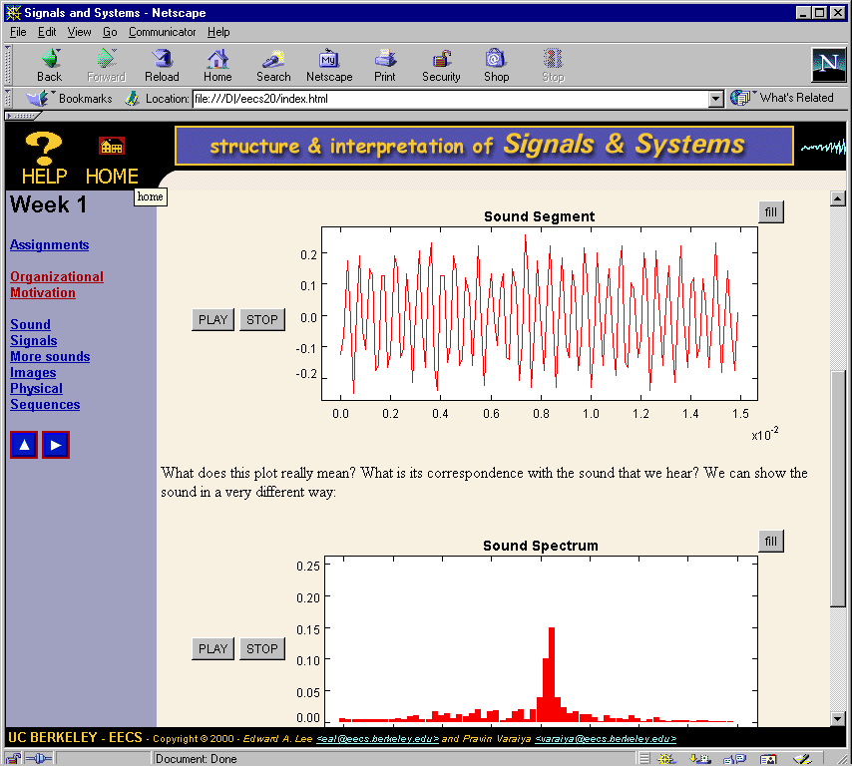
Outline
1. Signals
2. Systems
3. State
4. Determinism
5. Composition
6. Linearity
7. Freq Domain
8. Freq Response
9. LTI Systems
10. Filtering
11. Convolution
12. Transforms
13. Sampling
14. Design
15. Examples

Slide 15
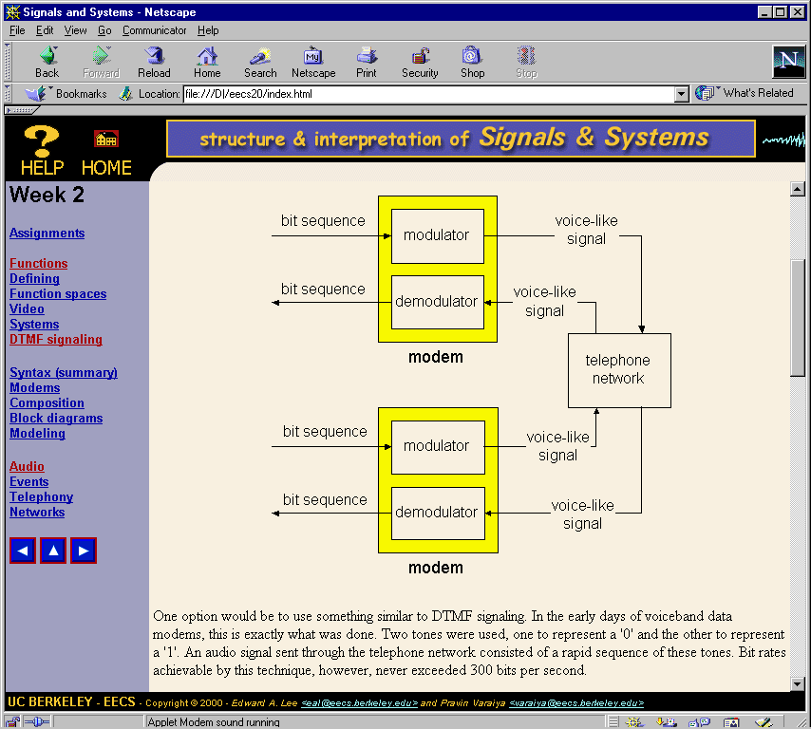
Outline
1. Signals
2. Systems
3. State
4. Determinism
5. Composition
6. Linearity
7. Freq Domain
8. Freq Response
9. LTI Systems
10. Filtering
11. Convolution
12. Transforms
13. Sampling
14. Design
15. Examples

Slide 16
Notation
Sets and functions
  Sound : Reals → Reals
  DigitalSound : Ints → Reals
  Sampler : [Reals → Reals] → [Ints → Reals]
Our notation unifies
  discrete and continuous time
  event sequences
  images and video, digital and analog
  spatiotemporal models

Slide 17
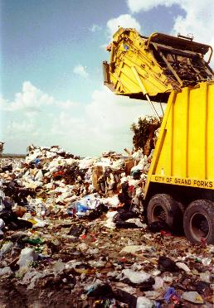
Problems with Standard Notation
The form of the argument defines the domain
  x(n) is discrete-time, x(t) is continuous-time.
  x(n) = x(nT)? Yes, but…
  X(jw) = X(s) when jw = s
  X(e^{jw}) = X(z) when z = e^{jw}
  X(e^{jw}) = X(jw) when e^{jw} = jw? No.
x(n) is a function
  y(n) = x(n) * h(n)
  y(n-N) = x(n-N)*h(n-N)? No.

Slide 18
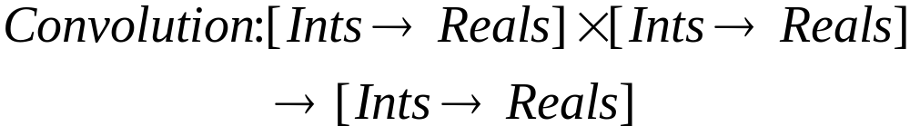
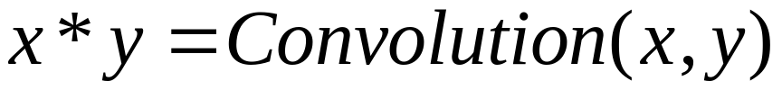
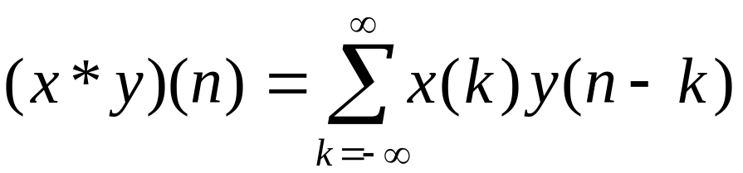
Using the New Notation
Discrete-time Convolution :
Shorthand:
Definition:

Slide 19
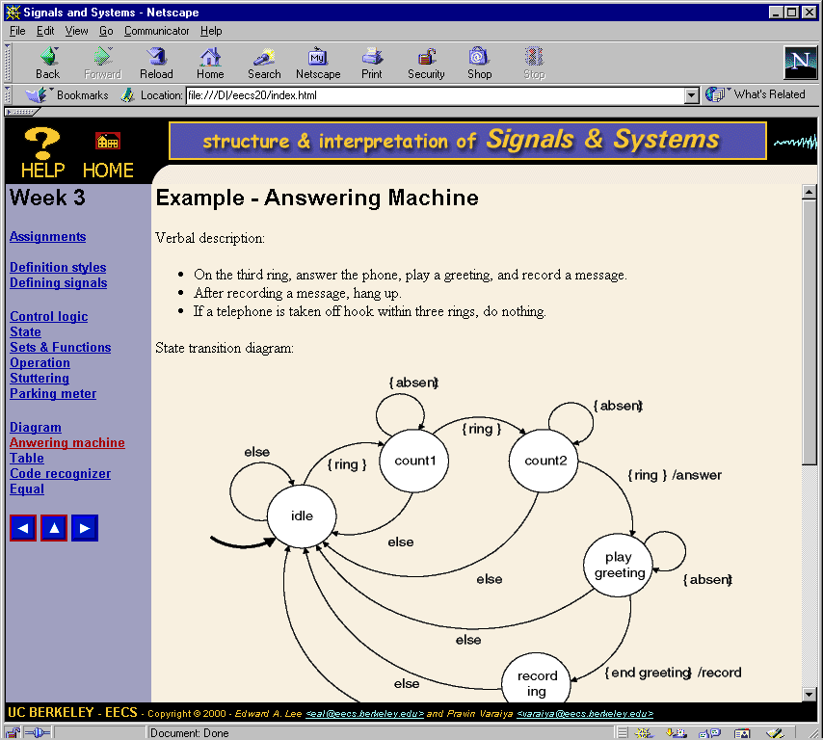
Outline
1. Signals
2. Systems
3. State
4. Determinism
5. Composition
6. Linearity
7. Freq Domain
8. Freq Response
9. LTI Systems
10. Filtering
11. Convolution
12. Transforms
13. Sampling
14. Design
15. Examples

Slide 20
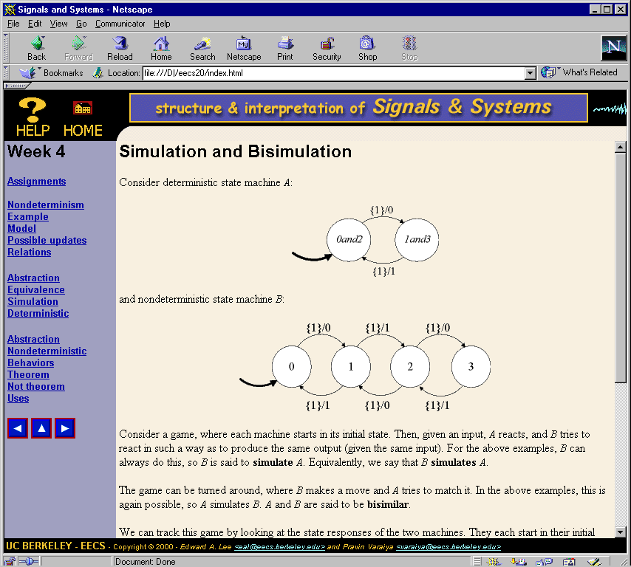
Outline
1. Signals
2. Systems
3. State
4. Determinism
5. Composition
6. Linearity
7. Freq Domain
8. Freq Response
9. LTI Systems
10. Filtering
11. Convolution
12. Transforms
13. Sampling
14. Design
15. Examples

Slide 21
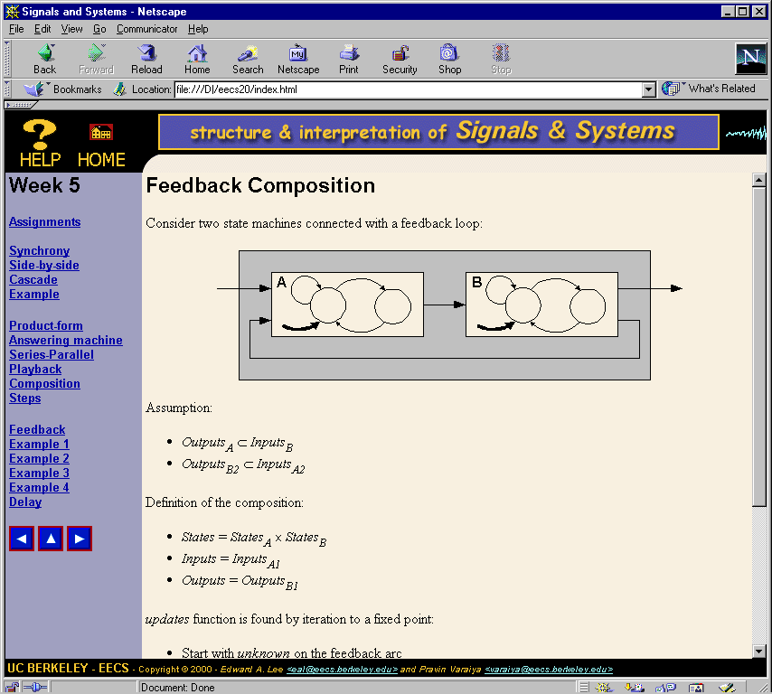
Outline
1. Signals
2. Systems
3. State
4. Determinism
5. Composition
6. Linearity
7. Freq Domain
8. Freq Response
9. LTI Systems
10. Filtering
11. Convolution
12. Transforms
13. Sampling
14. Design
15. Examples

Slide 22
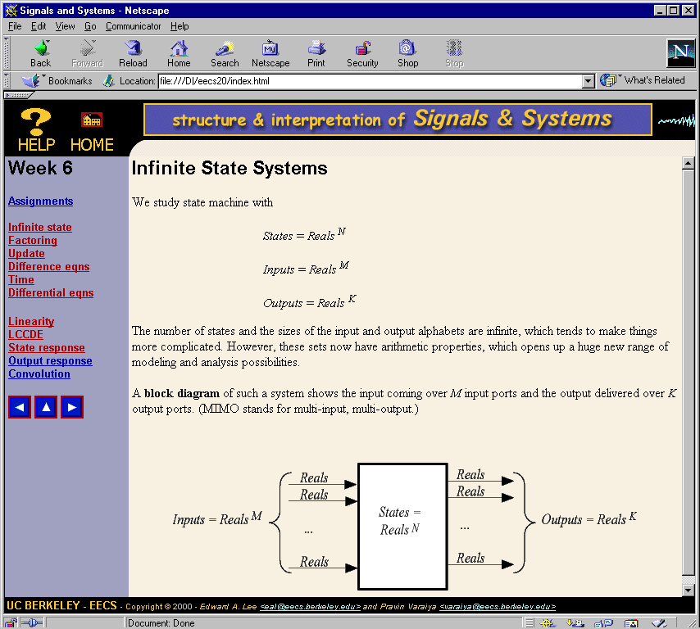
Outline
1. Signals
2. Systems
3. State
4. Determinism
5. Composition
6. Linearity
7. Freq Domain
8. Freq Response
9. LTI Systems
10. Filtering
11. Convolution
12. Transforms
13. Sampling
14. Design
15. Examples

Slide 23
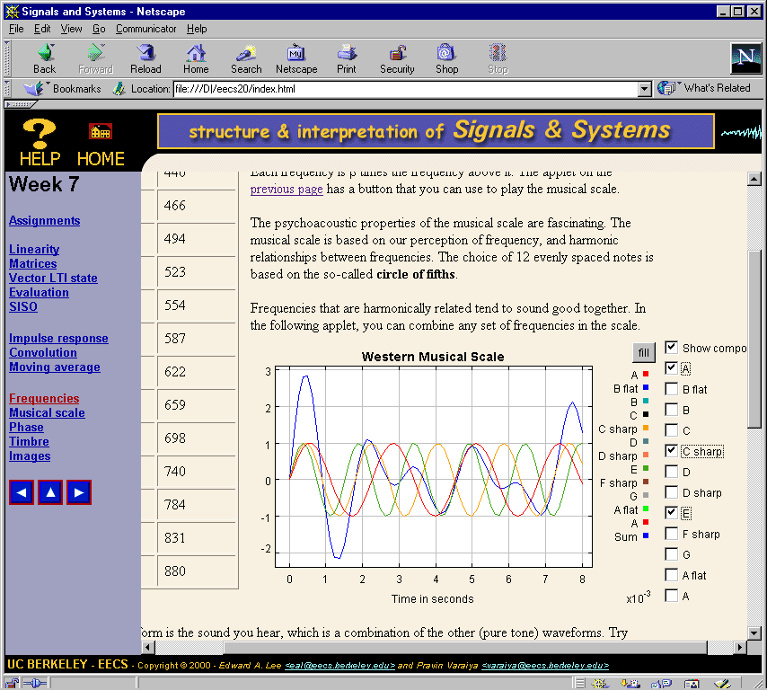
Outline
1. Signals
2. Systems
3. State
4. Determinism
5. Composition
6. Linearity
7. Freq Domain
8. Freq Response
9. LTI Systems
10. Filtering
11. Convolution
12. Transforms
13. Sampling
14. Design
15. Examples

Slide 24
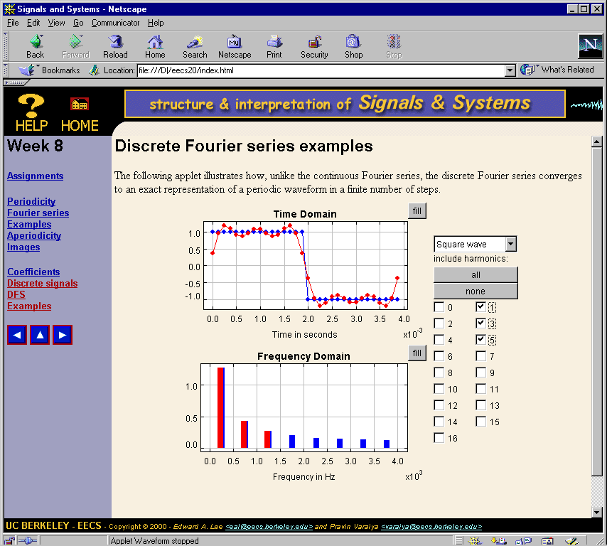
Outline
1. Signals
2. Systems
3. State
4. Determinism
5. Composition
6. Linearity
7. Freq Domain
8. Freq Response
9. LTI Systems
10. Filtering
11. Convolution
12. Transforms
13. Sampling
14. Design
15. Examples

Slide 25
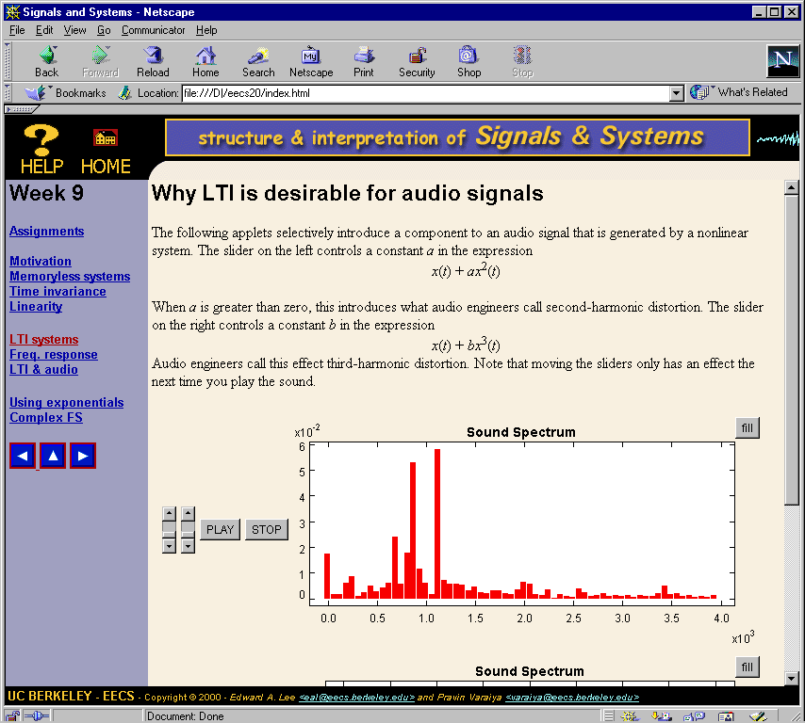
Outline
1. Signals
2. Systems
3. State
4. Determinism
5. Composition
6. Linearity
7. Freq Domain
8. Freq Response
9. LTI Systems
10. Filtering
11. Convolution
12. Transforms
13. Sampling
14. Design
15. Examples

Slide 26
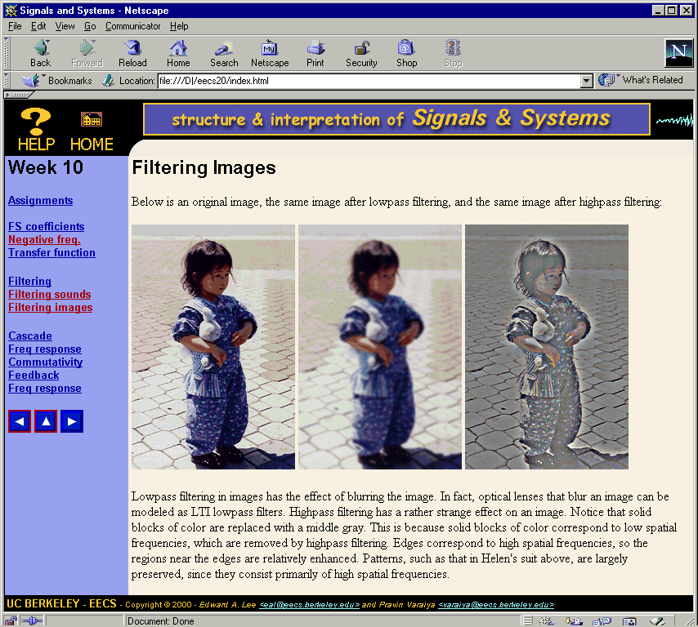
Outline
1. Signals
2. Systems
3. State
4. Determinism
5. Composition
6. Linearity
7. Freq Domain
8. Freq Response
9. LTI Systems
10. Filtering
11. Convolution
12. Transforms
13. Sampling
14. Design
15. Examples

Slide 27
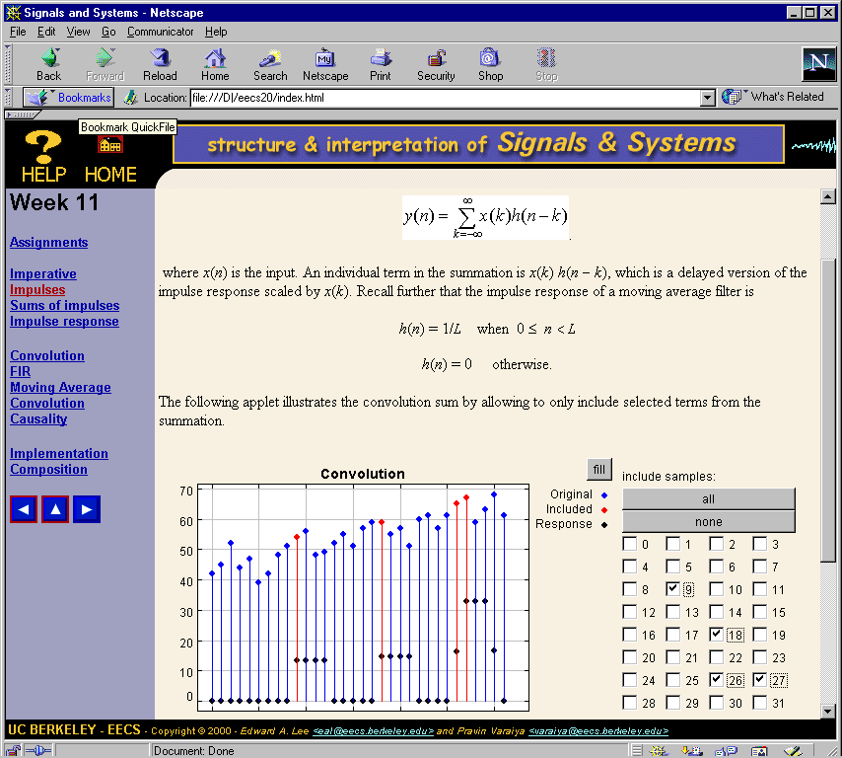
Outline
1. Signals
2. Systems
3. State
4. Determinism
5. Composition
6. Linearity
7. Freq Domain
8. Freq Response
9. LTI Systems
10. Filtering
11. Convolution
12. Transforms
13. Sampling
14. Design
15. Examples

Slide 28
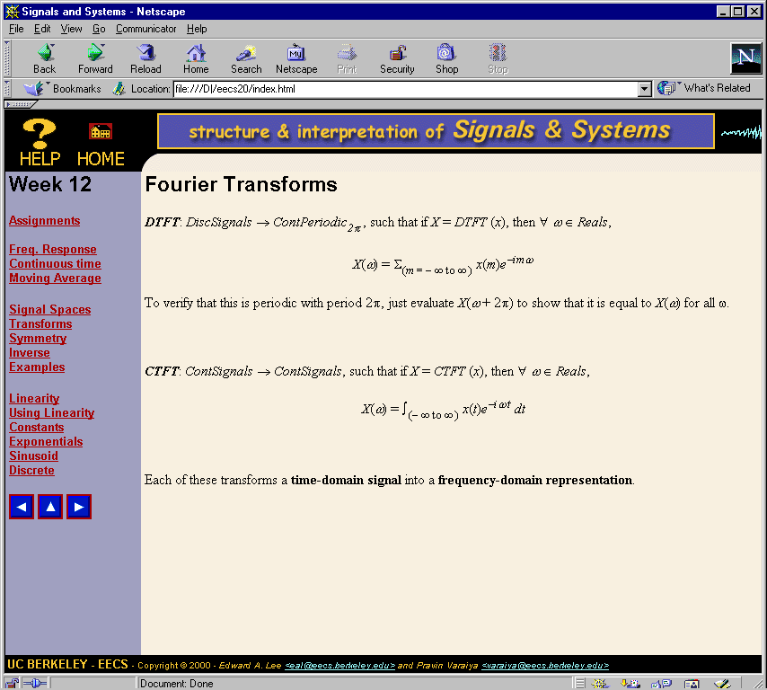
Outline
1. Signals
2. Systems
3. State
4. Determinism
5. Composition
6. Linearity
7. Freq Domain
8. Freq Response
9. LTI Systems
10. Filtering
11. Convolution
12. Transforms
13. Sampling
14. Design
15. Examples

Slide 29
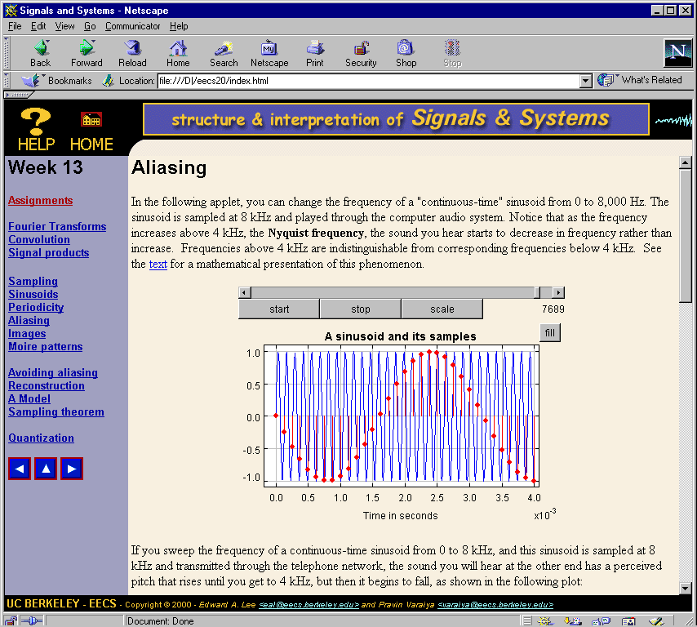
Outline
1. Signals
2. Systems
3. State
4. Determinism
5. Composition
6. Linearity
7. Freq Domain
8. Freq Response
9. LTI Systems
10. Filtering
11. Convolution
12. Transforms
13. Sampling
14. Design
15. Examples

Slide 30
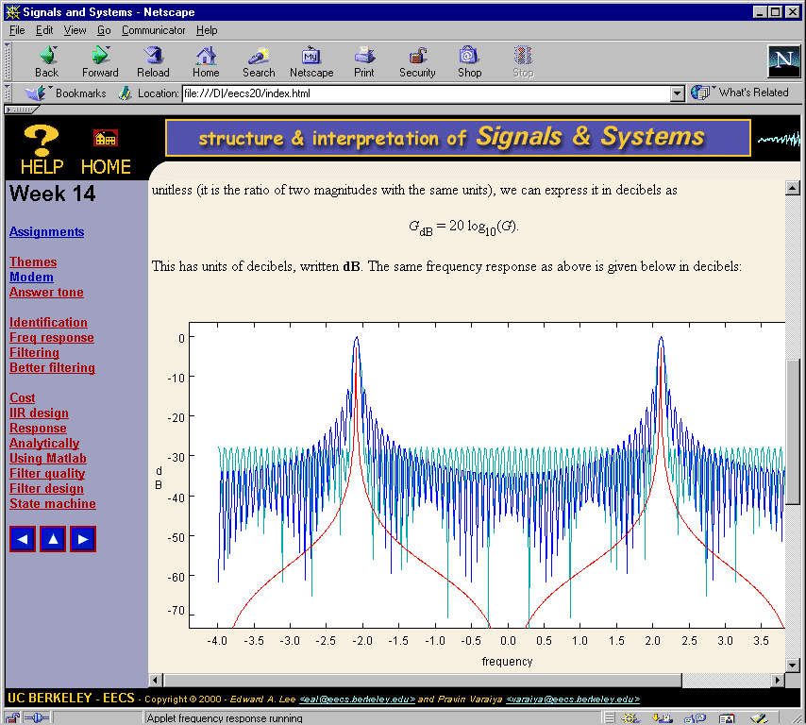
Outline
1. Signals
2. Systems
3. State
4. Determinism
5. Composition
6. Linearity
7. Freq Domain
8. Freq Response
9. LTI Systems
10. Filtering
11. Convolution
12. Transforms
13. Sampling
14. Design
15. Examples

Slide 31
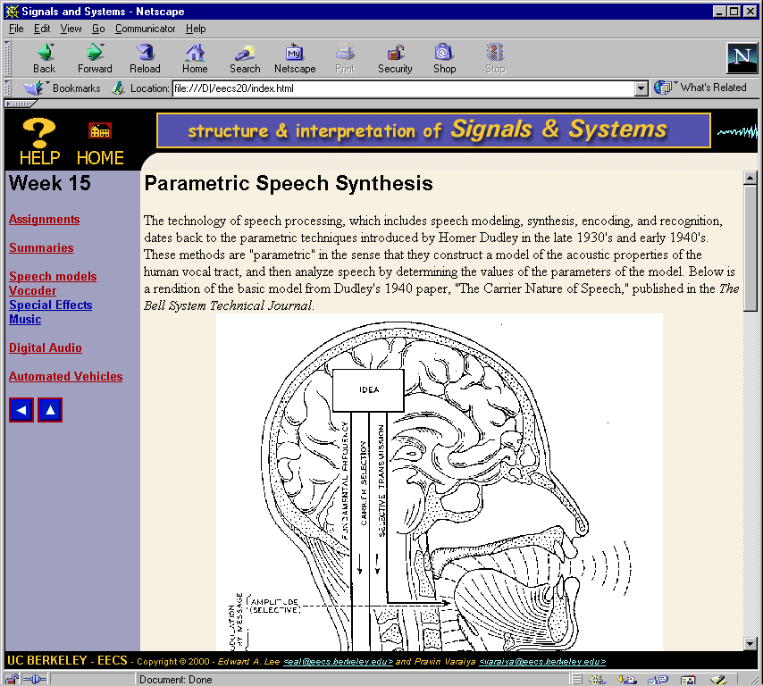
Outline
1. Signals
2. Systems
3. State
4. Determinism
5. Composition
6. Linearity
7. Freq Domain
8. Freq Response
9. LTI Systems
10. Filtering
11. Convolution
12. Transforms
13. Sampling
14. Design
15. Examples

Slide 32
Analysis of Spring 2000 Offering
Class standing had little effect on performance.
On average, the GPA of students was neither lowered nor raised by this class.
Students who attend lecture do better than those that don’t.
Taking at least one of Math 53, 54, or 55 helps by about ½ grade level.
Taking Math 54 (linear algebra & differential eqs.) helps by about 1 grade level (e.g. B to B+).
Computing classes have little effect on performance.

Slide 33
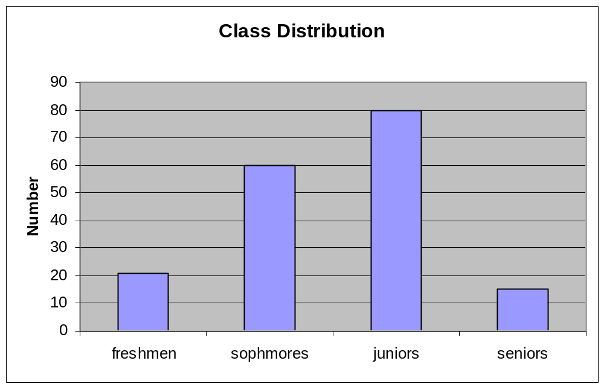
Distribution by Class Standing

Slide 34
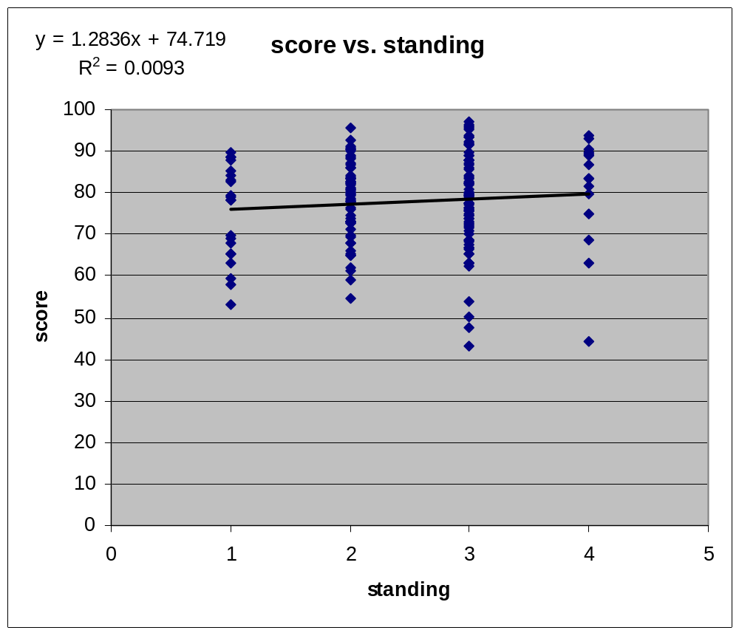
Effect of Class Standing
80 and above: A’s
63 and above: B’s
62 and below: C’s
176 of the 227 students responded (the better ones).

Slide 35
Effect of Showing Up
Students who answered the survey were those that showed up for the second to last lab.
The mean for those who responded was 78, vs. 65 for those who did not respond (two grades, e.g. B to A-).
The standard deviation is much higher for those who did not respond.
A t-test on the means shows the data are statistically very significant.
We conclude that the respondents to the survey do not represent a random sample from the class, but rather represent the diligent subset.

Slide 36
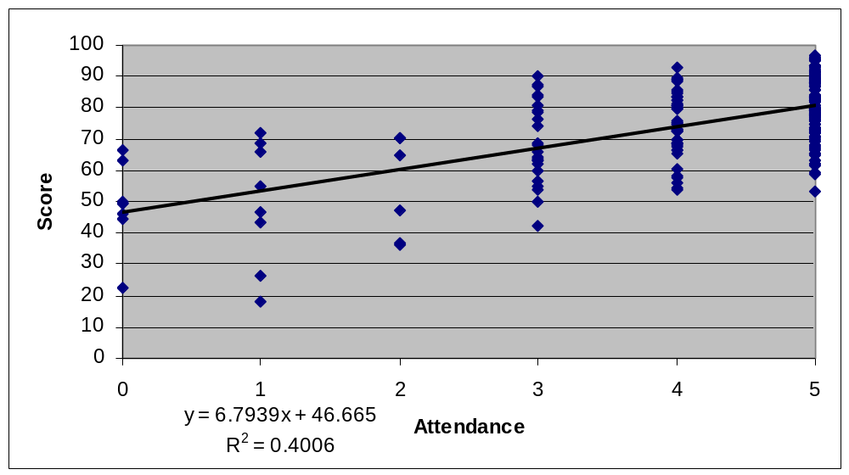
Attendance in Class vs. Score
Attendance is measured by presence for pop quizzes, of which there were five.

Slide 37
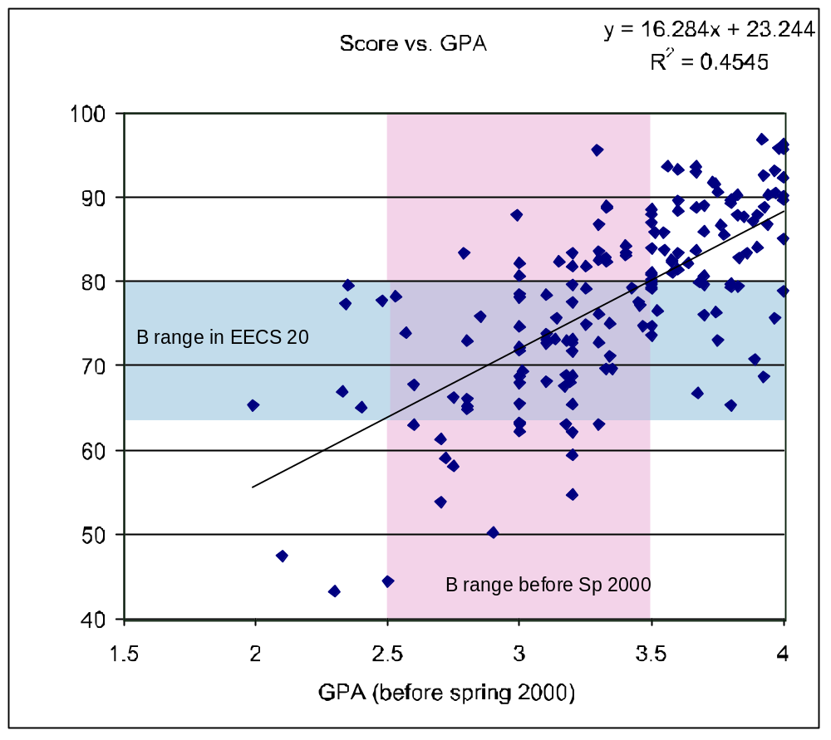
Effect on GPA
On average, students’ GPA was not affected by this class.

Slide 38
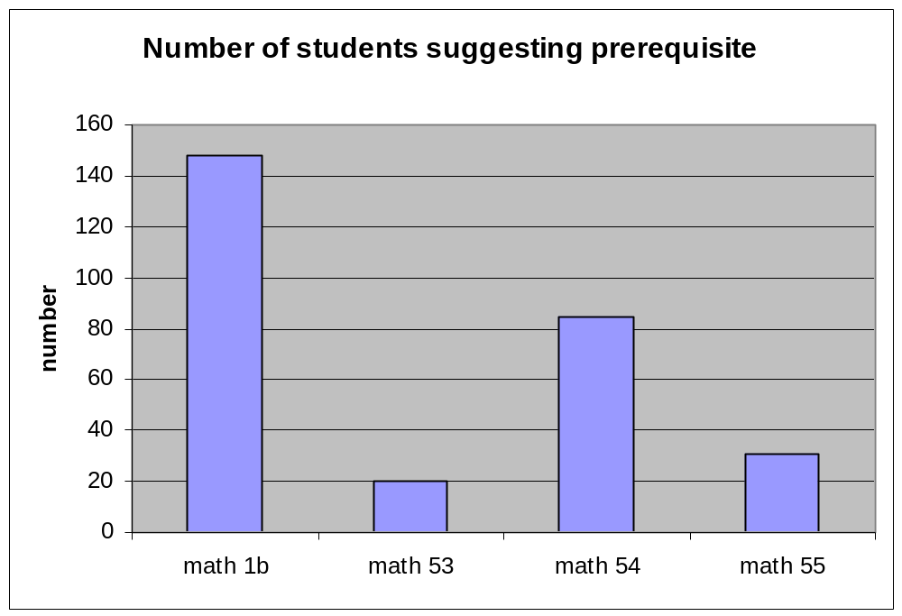
Student Opinion on Prerequisites
series
linear algebra

Slide 39
Differences from Tradition
No circuits
More discrete-time, some continuous-time
Broader than LTI systems
Unifying sets-and-functions framework
Emphasis on applications
Many applets and demos
Tightly integrated software lab
Text draft (Lee & Varaiya) and website available.

Slide 40


Bottom-Up or Top-Down?
Bottom-up:
- foundations first
- derive the applications
Top-down:
- applications first
- derive the foundations

Slide 41
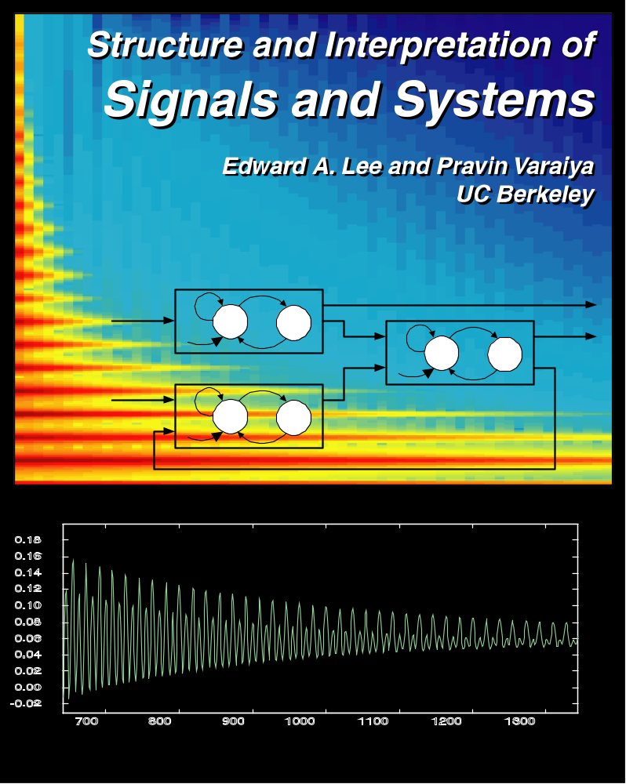
Textbook
Draft available on
the web.

