Slide 1
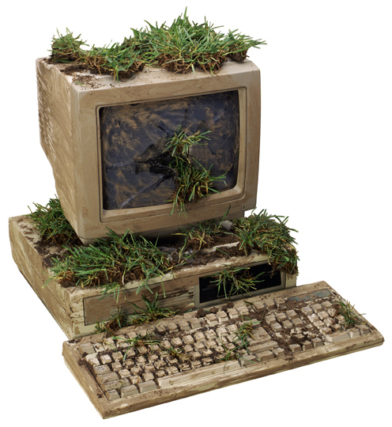
Designing a Relevant Lab for Introductory Signals and Systems
Edward A. Lee
UC Berkeley
A computer without networking, audio, video, or real-time services.

Slide 2
Objectives
Introduce applications before the theory fully supports them.
Connection between a mathematical (declarative) and a computational (imper-ative) view of systems.
Use of software to perform operations that could not possibly be done by hand, operations on real signals such as sounds and images.

Slide 3
Technology
Matlab
  imperative programming language
  finite signals (matrices and vectors)
  discrete signals
Simulink
  block diagram language
  infinite signals
  continuous-time semantics
We view these as complementary.

Slide 4
Organization
3 hour scheduled sessions, once a week
11 labs in 15 week session
  1 organizational, 1 technological, 2 review sessions
In-lab section
  takes about 1 hour, completed with signoff
Independent section
  takes 1-6 hours, completed with a report
Tightly synchronized with the lectures.

Slide 5
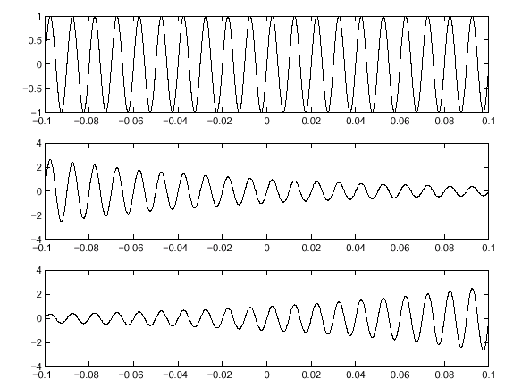
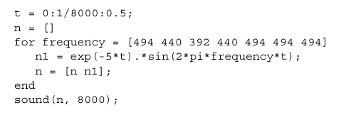
Lab 1 (audio)
Arrays and vectorization in Matlab
Construct finite sound signals

Slide 6
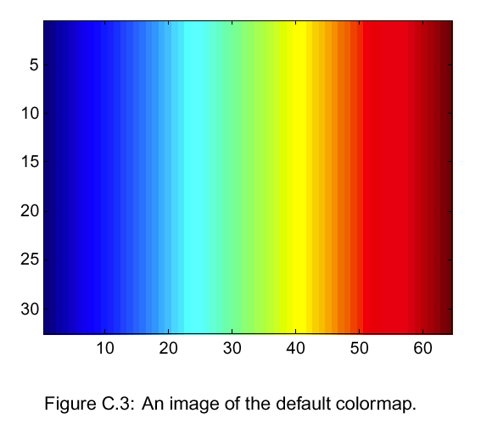

Lab 2 (images)
Colormaps

Slide 7
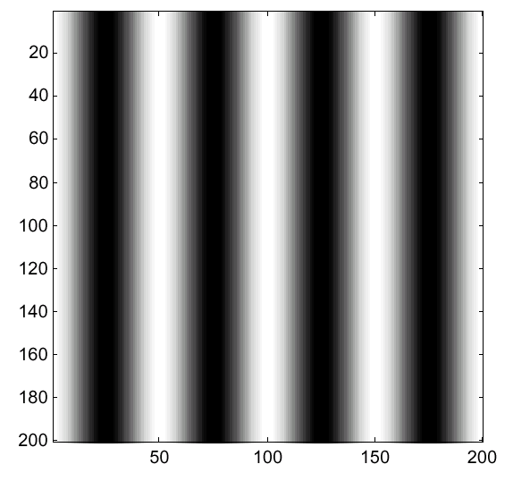
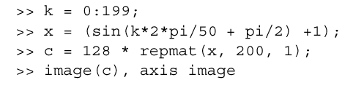
Lab 2 (images)
Sinusoidal images

Slide 8
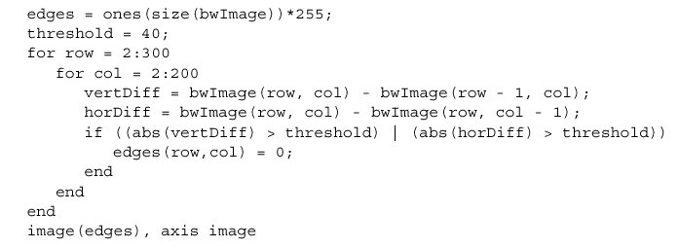
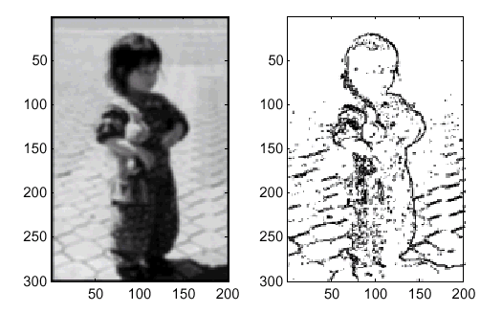
Lab 2 (images)
Images
  blurring (averaging)
  edge detection (first-order differences)

Slide 9
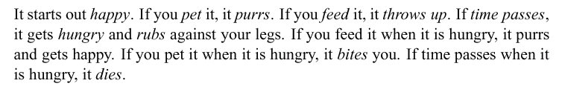
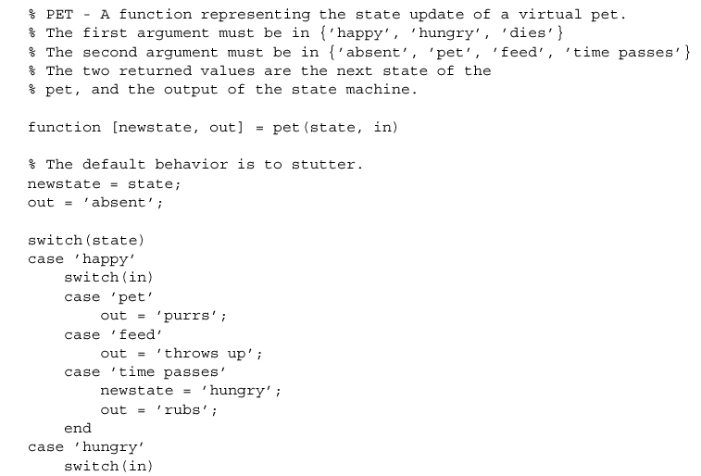
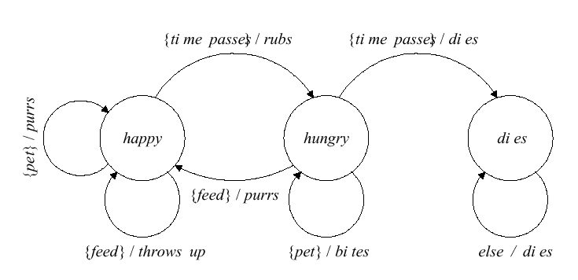
Lab 3 (state)
State machines
  Tamagotchi virtual pet

Slide 10
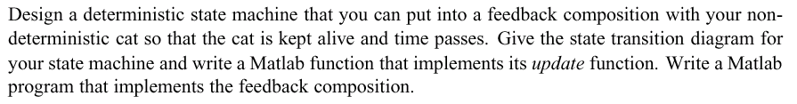
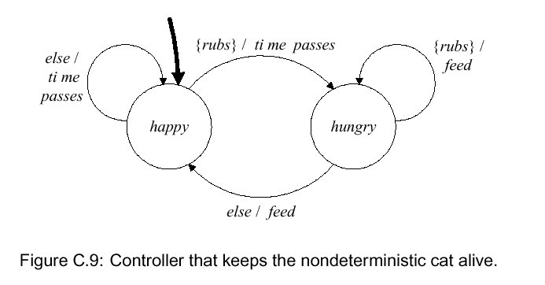
Lab4 (feedback control)
Closed loop control of the virtual pet

Slide 11
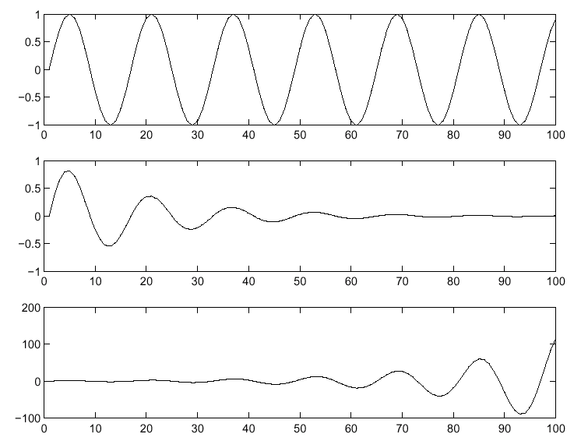
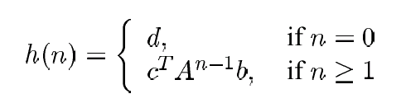
Lab 5 (difference equations)

Slide 12
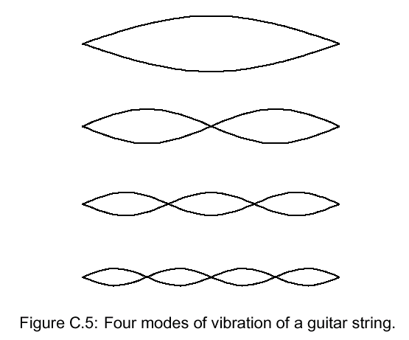


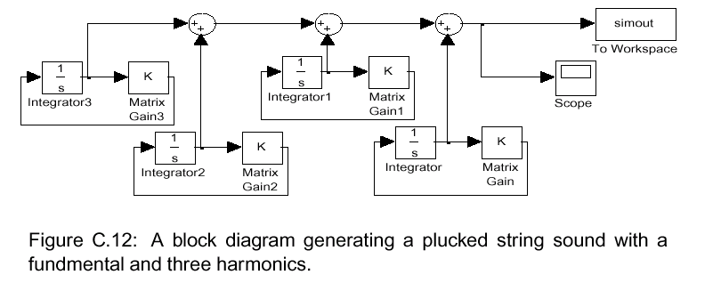
Lab 6 (differential equations)

Slide 13
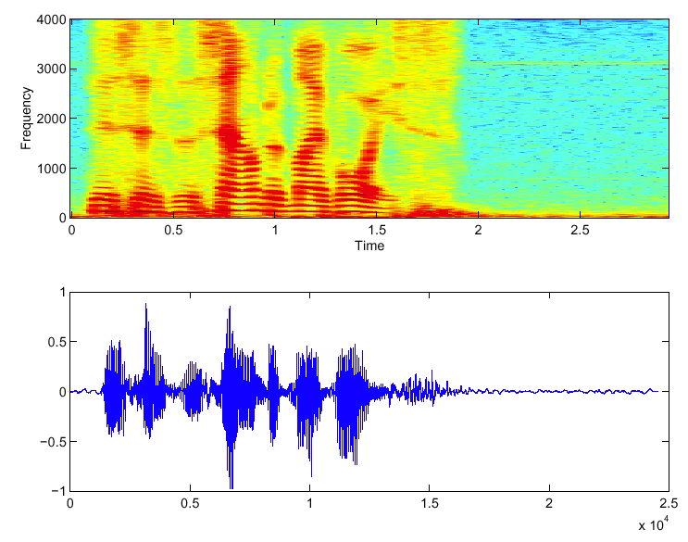
Lab 7 (spectrum)

Slide 14
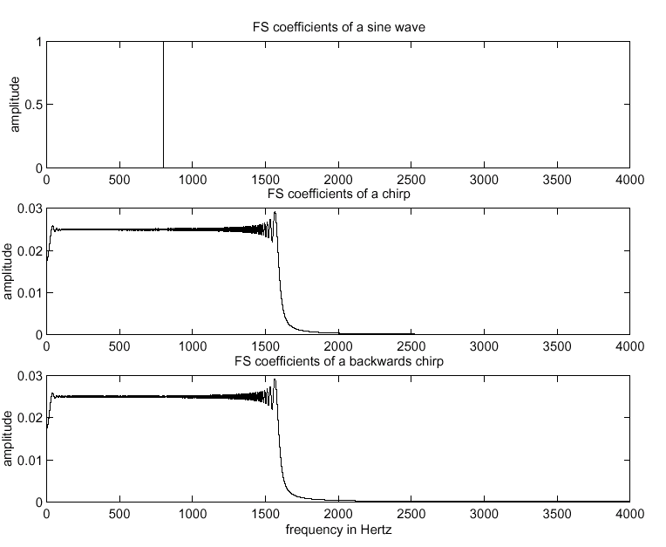
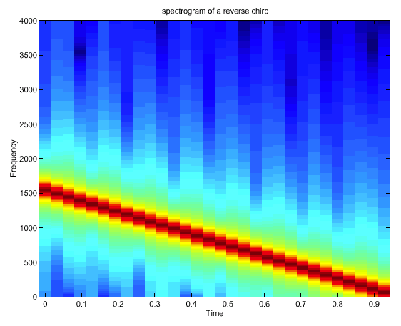
Lab 7 (spectrum)

Slide 15
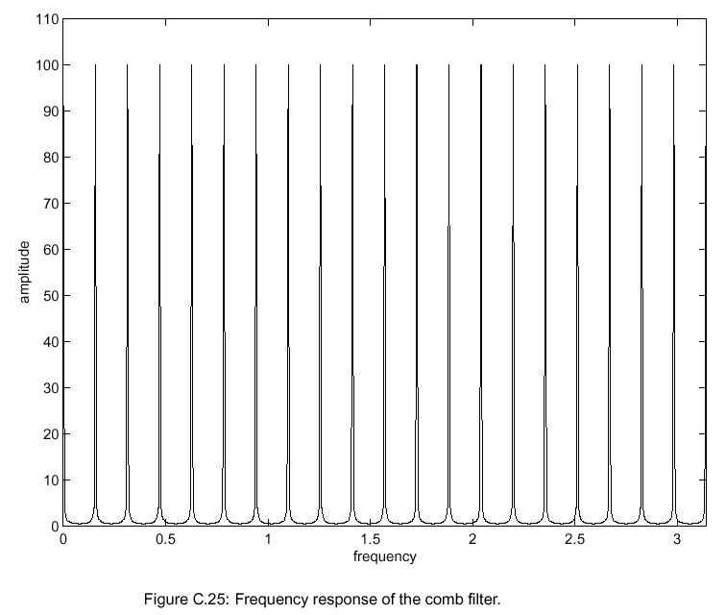
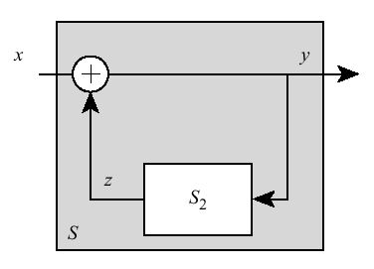
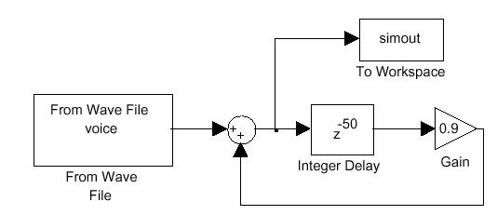
Lab 8 (comb filters)

Slide 16
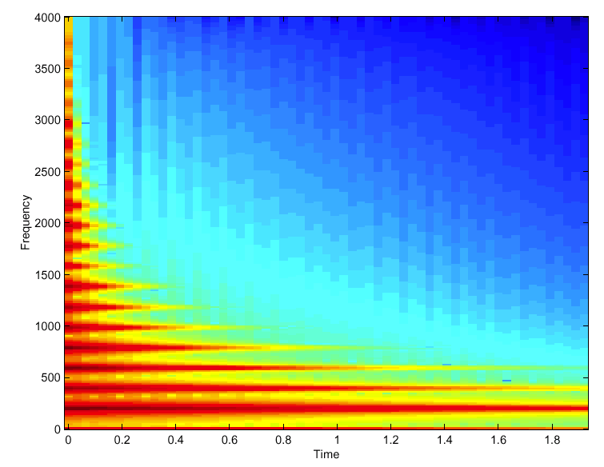
Lab 9 (plucked string model)

Slide 17
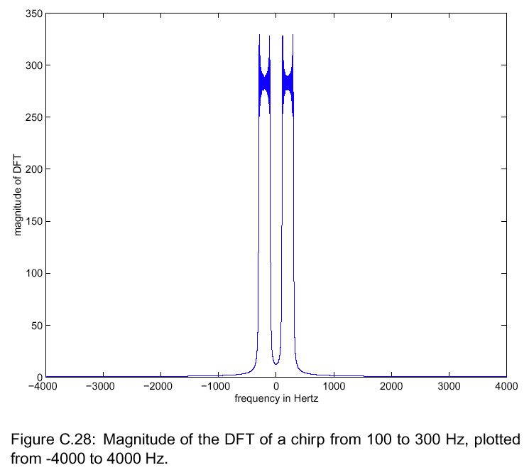
Lab 10 (modulation/demodulation)

Slide 18
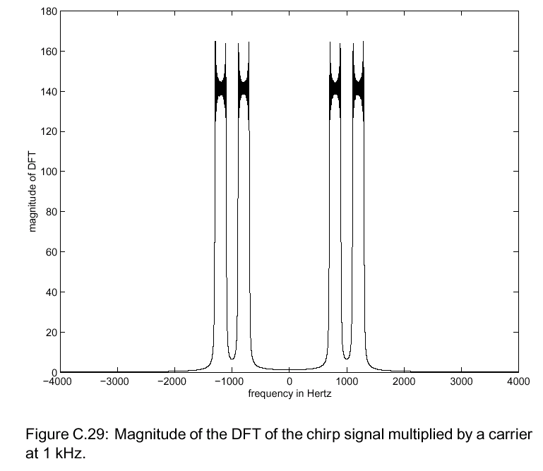
Lab 10 (modulation/demodulation)

Slide 19
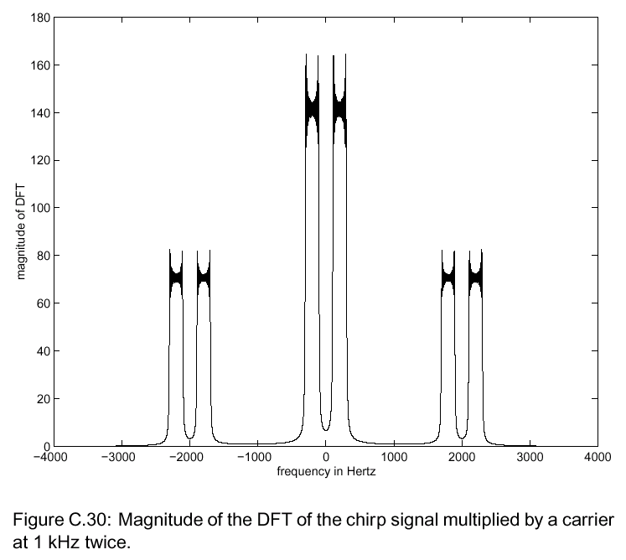
Lab 10 (modulation/demodulation)

Slide 20
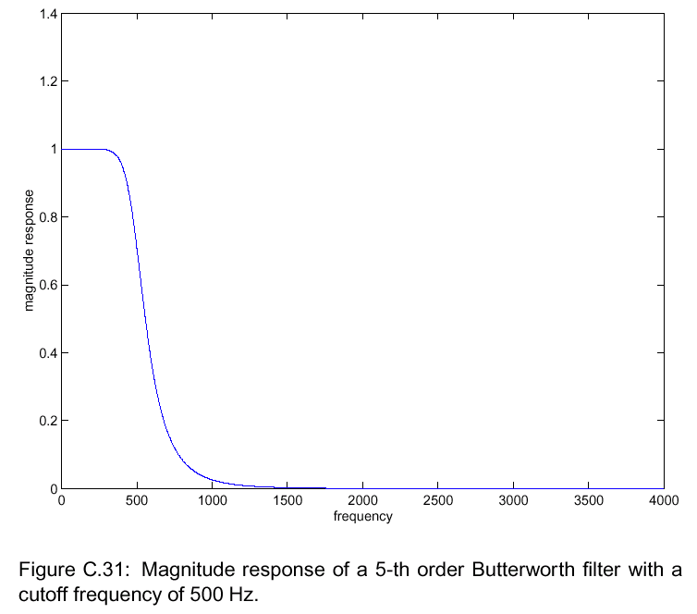
Lab 10 (modulation/demodulation)

Slide 21
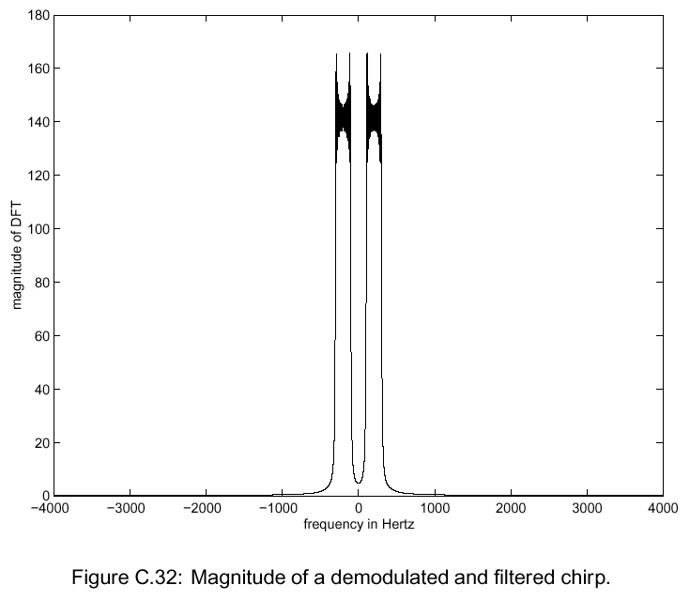
Lab 10 (modulation/demodulation)
Note that the entire exercise remains in the audio band.

Slide 22
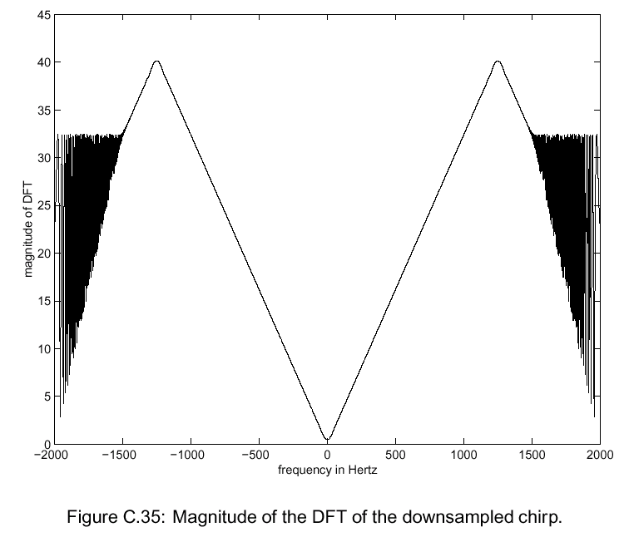
Lab 11 (sampling & aliasing)

Slide 23
Areas for Improvement
Extensive capabilities of the tools can be intimidating.
Requires some programming background.
On-line help for Matlab is much better than for Simulink.
Simulink’s discrete-time models are continuous-time models in disguise.

