Slide 1
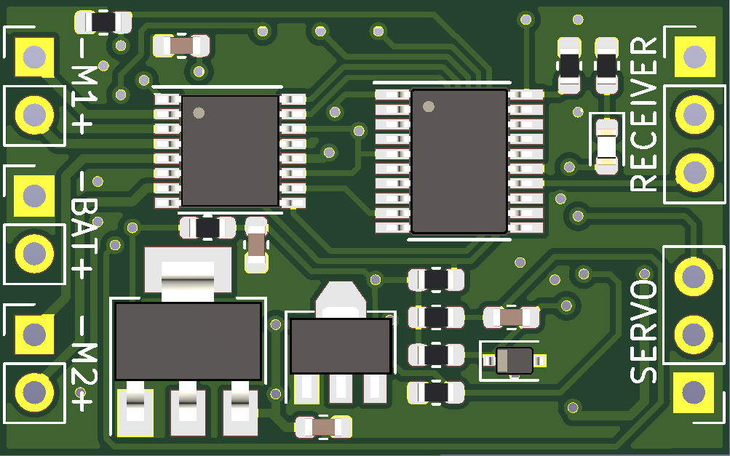
Status LED
Motor 1
Receiver
Battery
Servo or ESC
Motor 2

Slide 2
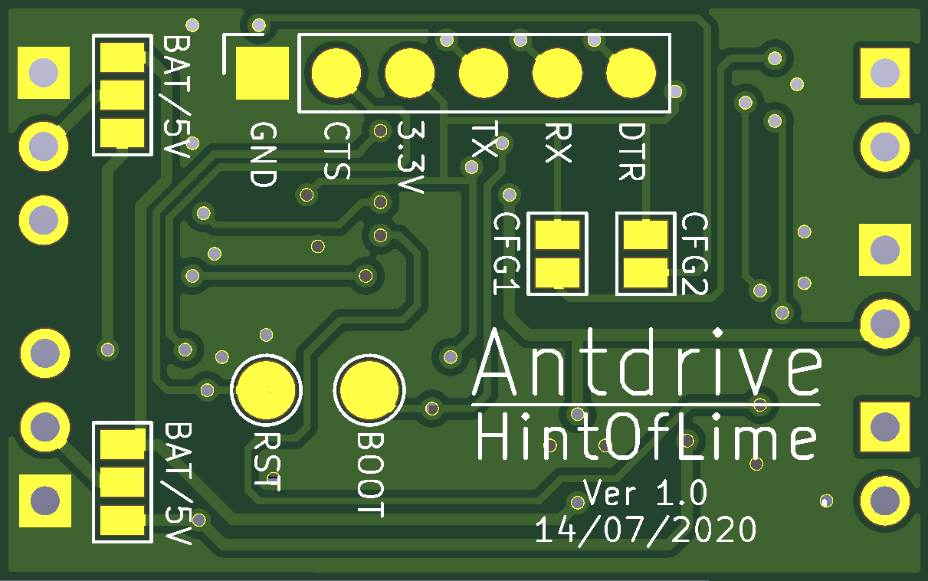
Programming pads
Configuration jumpers
Voltage selection jumpers

