Slide 1
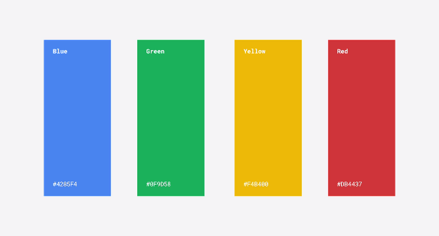

Slide 7

Google Search Favicons

