Slide 1
Data modeling using a Graph Database
Scientific Computing
Notes:
[Mandatory Slide] This would be the introduction slide of the topic that you are covering in this subsection.
When this slide plays, you could talk about the main aim that we’d be covering in this video.

Slide 2
Graph Database
Graph databases store data as nodes and vertexes.
”Querying” or “traversing” is done by navigating recursively from node to node based on conditions.
Notes:
This is a single point slide which can be used for multiple purposes.
Use 1 [Mandatory Slide]:
Before the start of the video, we’d like to highlight what are important topics or pointers that we’d be covering in this video. This slide would immediately follow the intro/name slide. This would just be say 2-3 points for the viewers to know what they are getting into.
Use 2:
This slide can also be used to cover topics that can be represented by an image/graph etc. Information which is half image/half information type. Like shown in the example above.

Slide 3
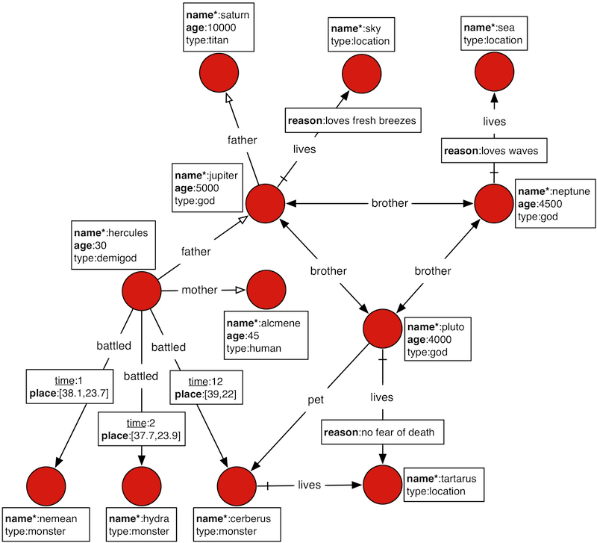
Sample Data Set
http://docs.janusgraph.org/latest/getting-started.html
Notes:
This slide, like mentioned above is for multiple pointers. The information above covers the types of information that can be used in this slide

Slide 4
Example
Step 3
Step 2
Export data to HDFS and run larger OLAP style query
Step 1
Traverse the graph using the gremlin query language (OLTP)
Load schema and graph of the Gods data
Notes:
This is a step-wise graphical info type slide.

Slide 5
When to use a graph database
Many entities are related to each other
Self join is a common on the read path
Objects have varying or arbitrary properties
Clear need for many questions that involve recursion or traversal
Notes:
This slide, like mentioned above is for multiple pointers. The information above covers the types of information that can be used in this slide

Slide 6
Next Video
Failure Prediction
Notes:
[Mandatory Slide]
Here the name of the next video needs to be mentioned. The narration as you guessed it would be just letting the viewer know exactly where we are at and what we’d be taking over next! ☺

