Slide 1
Building a nosql from scratch
Let them know what they are missing!
#ddtx16
@edwardcapriolo
@HuffPostCode

Slide 2
If you are looking for
A battle tested NoSQL data store
That scales up to 1 million transactions a second
Allows you to query data from your IoT sensors in real time
You are at the wrong talk!
This is a presentation about Nibiru
An open source database I work on in my spare time
But you should stay anyway...

Slide 3
Motivations
Why do that?
How this got started?
What did it morph into?
Many NoSQL databases came out of an industry specific use case and as a result they had baked in assumptions. If we have clean interfaces and good abstractions we can make a better general tool with lessed forced choices.
Pottentially support a majority of the use cases in one tool.

Slide 4
A friend asked
Won't this make Nibiru have all the bugs of all the systems?

Slide 5
My response
Jerk!

Slide 6
You might want to follow along with local copy
There are a lot of slides that have a fair amount of code
https://github.com/edwardcapriolo/nibiru/blob/master/hexagons.ppt
http://bit.ly/1NcAoEO

Slide 7
Basics

Slide 8
Terminology
Keyspace: A logical grouping of store(s)
Store: A structure that holds data
  Avoided: Column Family, Table, Collection, etc
Node: a system
Cluster: a group of nodes

Slide 9
Assumptions & Design notes
A store is of a specific type Key Value, Column Family, etc
The API of the store is dictated by the type
Ample gotchas from one man, after work, project
Wire components together, not into a large context
Using string (for now) instead of byte[] for debug

Slide 10
Server ID
We need to uniquely identify each node
Hostname/ip is not good solution
  Systems have multiple
  Can change
Should be able to run N copies on single node

Slide 11
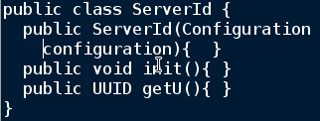
Implementation
On first init() create guid and persist

Slide 12
Cluster Membership

Slide 13
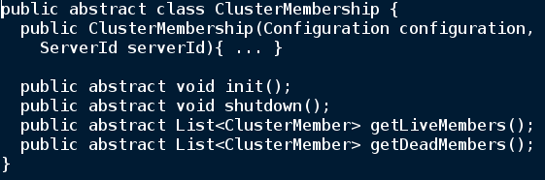
Cluster Membership
What is a list of nodes in the cluster?
What is the up/down state of each node?

Slide 14
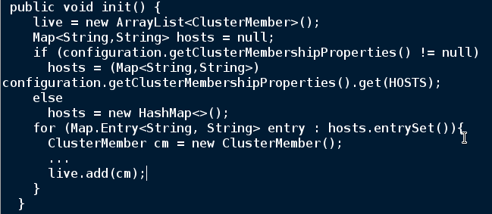
Static Membership

Slide 15
Different cluster membership models
Consensus/Gossip
  Cassandra
  Elastic Search
Master Node/Someone elses problem
  HBase (zookeeper)

Slide 16

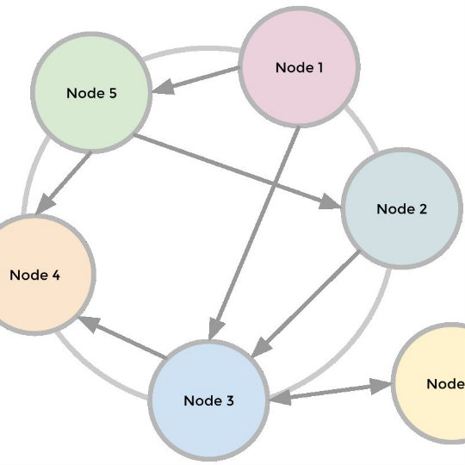
Gossip
http://www.joshclemm.com/projects/

Slide 17
Teknek Gossip
https://github.com/edwardcapriolo/gossip
Licenced Apache V2
Forked from google code project
Available from maven g: io.teknek a: gossip
Great tool for building a peer-to-peer service

Slide 18
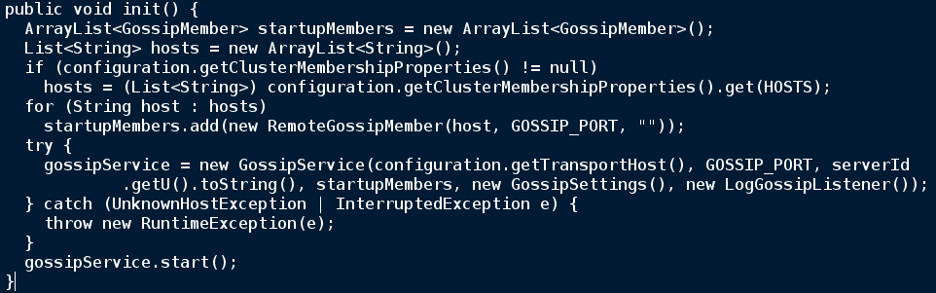
Cluster Membership using Gossip

Slide 19
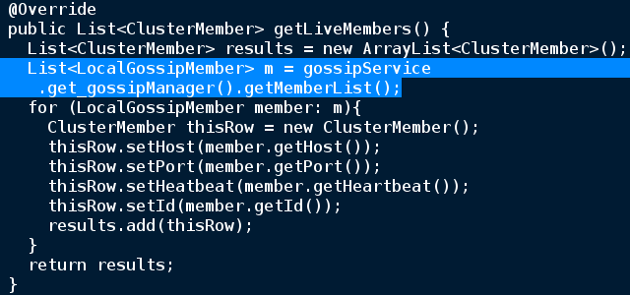
Get Live Members

Slide 20
Gutcheck
Did clean abstractions hurt the design here?
Does it seem possible we could add zookeeper/etcd as a backend implemention?
Any takers? :)

Slide 21
Request Routing

Slide 22
Some options
So you have a bunch of nodes in a cluster,
but where the heck does the data go?
Client dictated - like a sharded memcache|mysql|whatever
HBase - Sharding with a leader election
Dynamo Style - ring topology token ownership

Slide 23
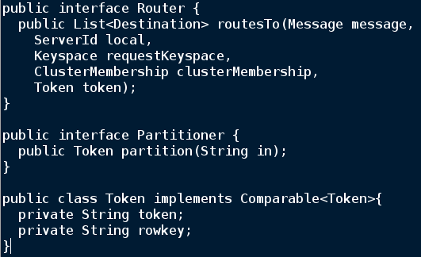
Router & Partitioners

Slide 24
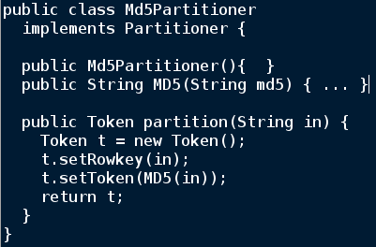
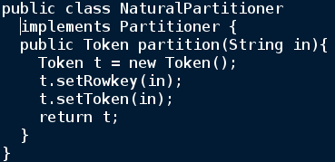
Pick your poison: no hot spots or key locality :)

Slide 25
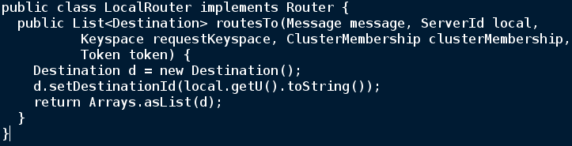
Quick example LocalPartitioner

Slide 26
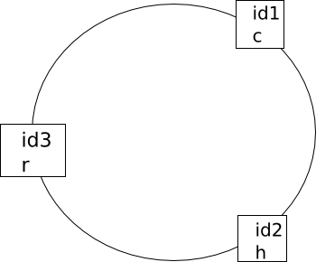
Scenario: using a Dynamo-ish router
Construct a three node topology
Give each an id
Give them each a token
Test that requests route properly

Slide 27
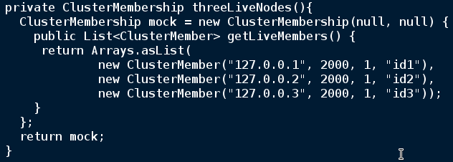
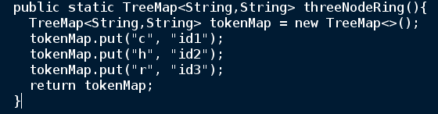
Cluster and Token information

Slide 28
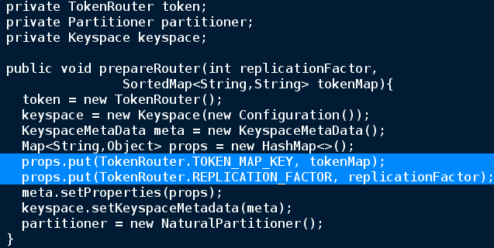
Unit Test

Slide 29
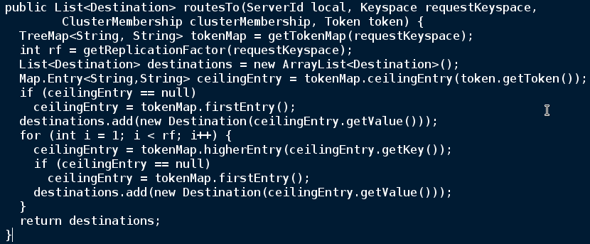
Token Router

Slide 30
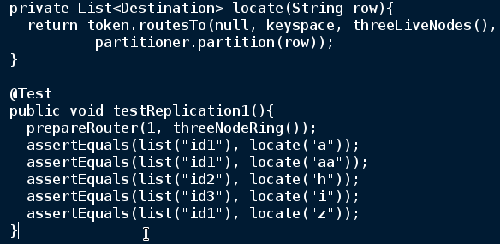
Do the Damn Thing!

Slide 31
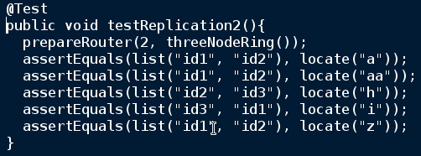
Do the Damn Thing! With Replication

Slide 32
Storage Layer

Slide 33
Basic Data Storage SSTables
SS = Sorted String
{ 'a', $PAYLOAD$ },
{ 'b', $PAYLOAD$ }

Slide 34
LevelDB SSTable payload
Key Value implementation
SortedMap<byte, byte>
{ 'a', '1' },
{ 'b', '2' }

Slide 35
Cassandra SSTable Implementation
Key Value in which value is a map with last-update-wins versioning
SortedMap<byte, SortedMap
<byte, Val<byte,long>>
{ 'a', { 'col':{ 'val', 1 } } },
{ 'b', {
'col1':{ 'val', 1 },
'col2':{ 'val2', 2 }
}
}

Slide 36
HBase SSTable Implementation
Key-Value in which value is a map with multi-versioning
SortedMap<byte, SortedMap
<byte, Val<byte,long>>
{
{ 'a', { 'col':{ 'val', 1 } } },
{ 'b', {
'col1':{ 'val', 1 },
'col1':{ 'valb', 2 },
'col2':{ 'val2', 2 }
}
}
}

Slide 37
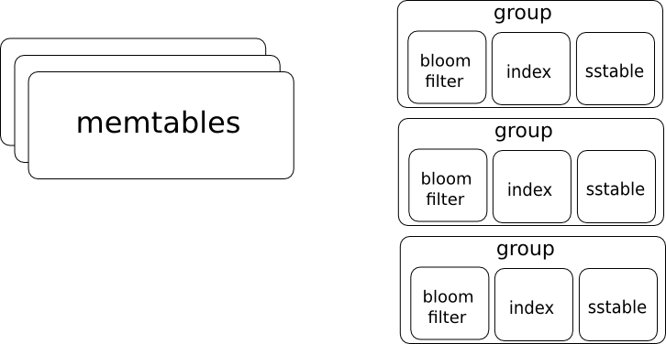
Column Family Store high level

Slide 38
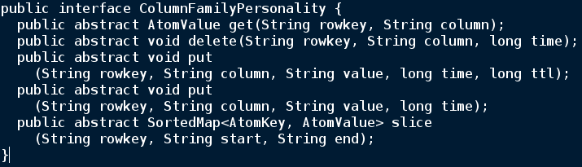
Operations to support

Slide 39
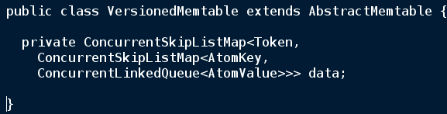
One possible memtable implementation
Holy Generics batman!
Isn't it just a map of map?

Slide 40
Unforunately no!
Imagine two requests arrive in this order:
  set people [edward] [age]='34' (Time 2)
  set people [edward] [age]='35' (Time 1)
What should be the final value?
We need to deal with events landing out of order
Also exists delete write known as Tombstone

Slide 41
And then, there is concurrency
Multiple threads manipulating at same time
Proposed solution: (Which I think is correct)
  Do not compare and swap value, instead append to queue and take a second pass to optimize

Slide 42
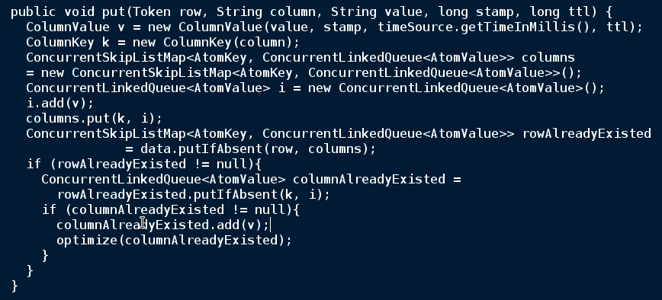

Slide 43
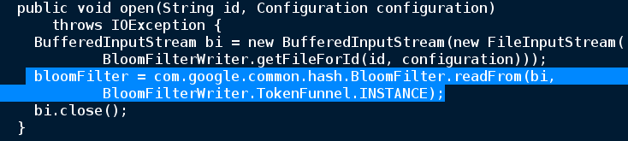
Optimization 1: BloomFilters
Use guava. Smart!
Audiance: make disapointed aww sound because Ed did not write it himself

Slide 44
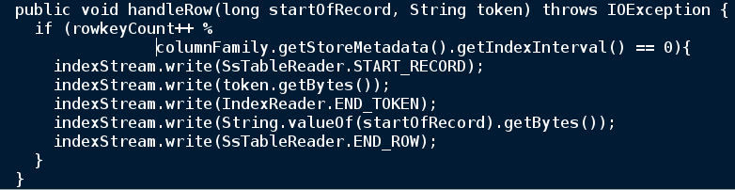
Optimization 2: IndexWriter
Not ideal to seek a disk like you would seek memory

Slide 45
Consistency

Slide 46
Multinode Consistency
Replication: Number of places data lives
Active/Active Master/Slave (with takover)
Resolving conflicted data

Slide 47
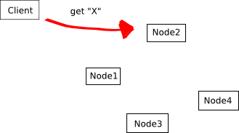
Quorum Consistency
Active/Active Implemantation

Slide 48
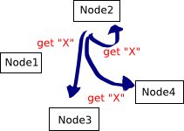
Message dispatched

Slide 49
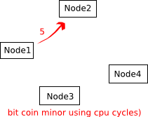
Asyncronos Responses T1

Slide 50
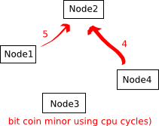
Asyncronos Responses T2

Slide 51
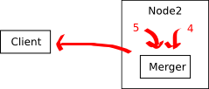
Logic to merge results

Slide 52
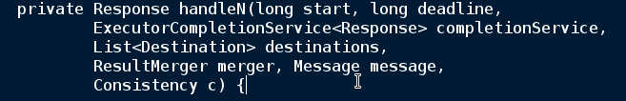
Breakdown of components
Start & dedline : Max time to wait for requests
Message : The read/write request sent to each destination
Merger : Turn multiple responses into single result

Slide 53
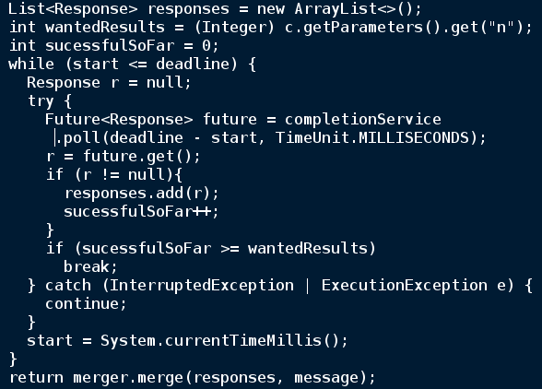

Slide 54
Testing

Slide 55
Challenges of timing in testing
Target goal is ~ 80% unit 20% integetration (e2e) testing
Performance varies in local vs travis-ci
Hard to test something that typically happens in milliseconds but at worst case can take seconds
Lazy half solution: Thread.sleep() statements for worst case
  Definately a slippery slope

Slide 56
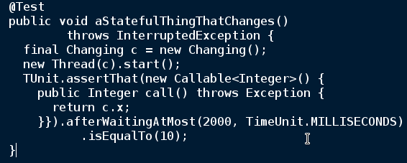
Introducing TUnit
https://github.com/edwardcapriolo/tunit

Slide 57
The End

