Slide 1
NLP Twitter Sentiment Classification
Edward Cheng

Slide 2

Twitter
Our Mission
Twitter is a popular social media platform used by hundreds of millions of people around the globe. In fact, the current estimate of twitter users amount to approximately 330 million monthly active users and 145 million daily active users on Twitter. 63 percent of all Twitter users worldwide are between the ages of 35 and 65. You can find some more statistics about the usage of Twitter around the world below. The CEO of twitter has tasked me with building a model that has the capabilities of analyzing Twitter sentiments about Apple and Google products. The human raters rated the sentiment in over 9,000 Tweets as positive, negative, or neither.
01
11.7 million
02
500 million
03
40%
App store downloads in the first quarter in 2019. Twitter enjoyed a year-over-year increase of 3.6% since 2015.
Tweets are sent each day, which equates to 5.787 tweets per second.
Of Twitter users reported purchasing something after seeing it on the platform.

Slide 3
Process
01
02
03
04
Obtain the Data
Text Pre-processing
Explore the Data
Model the Data
Import the csv file containing over 9000 tweets.
Check for NA values
Stop word Removal:
Removal of punctuation and numbers
Remove capitalization
Regex modifications
Lemmatization
Noise removal
Tokenization
Explore the distribution of the length of tweets
Explore the top 20 most popular words
Explore the top 20 most popular hashtags
Explore the distribution of words based on the tweet’s sentiment
Run 6 different models:
Multinomial NB Classifier
Logistic Regression
Random Forest
Support Vector Classifier
Deep Neural Network (base model)
Deep Neural Network (regularized, with dropout)

Slide 4
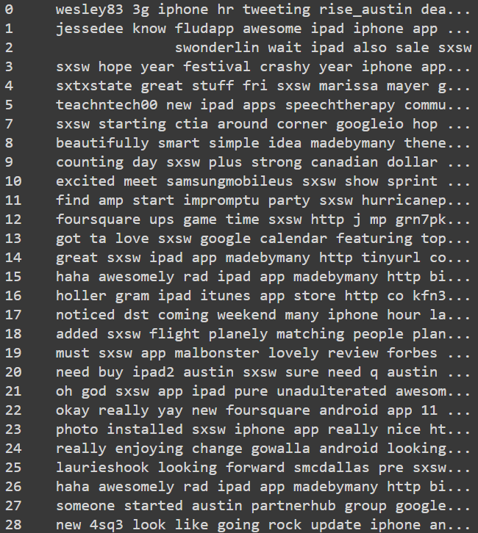
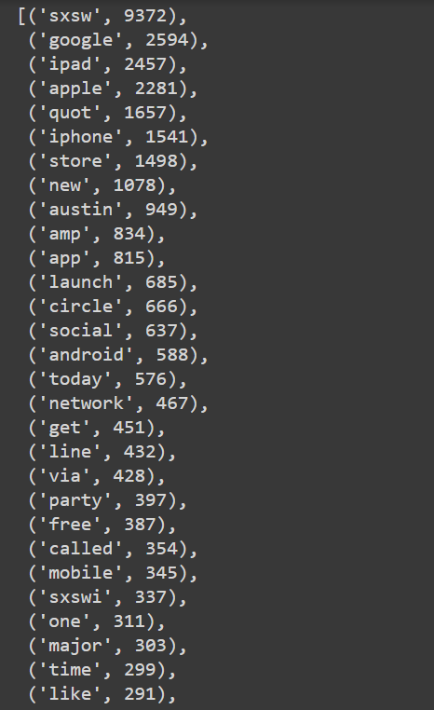
Pre-processed text data
Non-tokenized Version
Tokenized Version

Slide 5
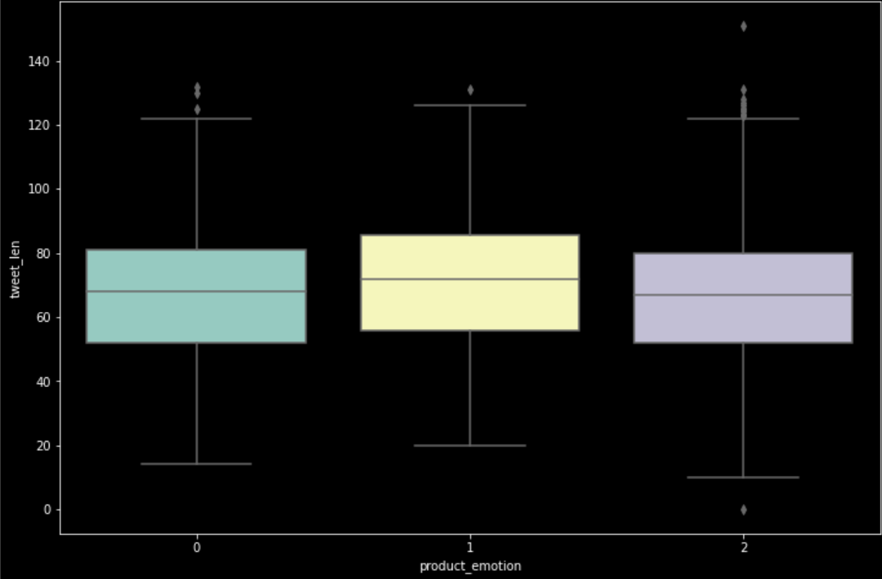
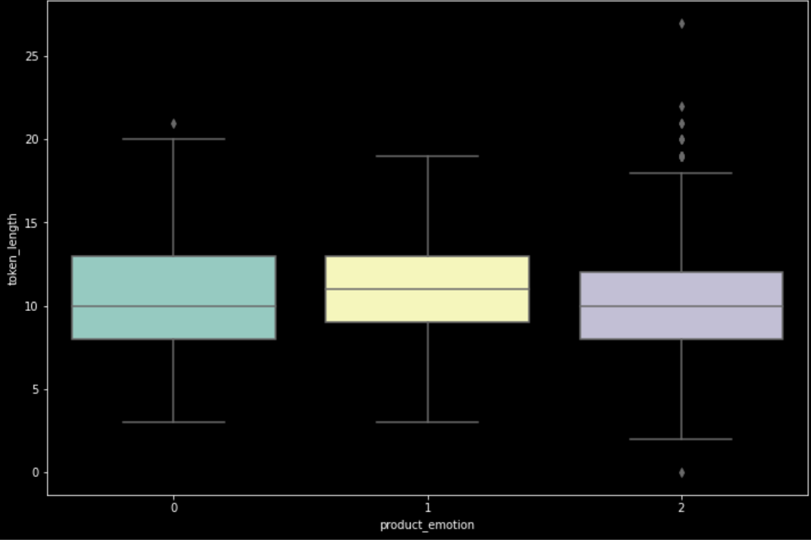
Length of Tweets and Tokenized Words
Tweet Length
Token Length

Slide 6
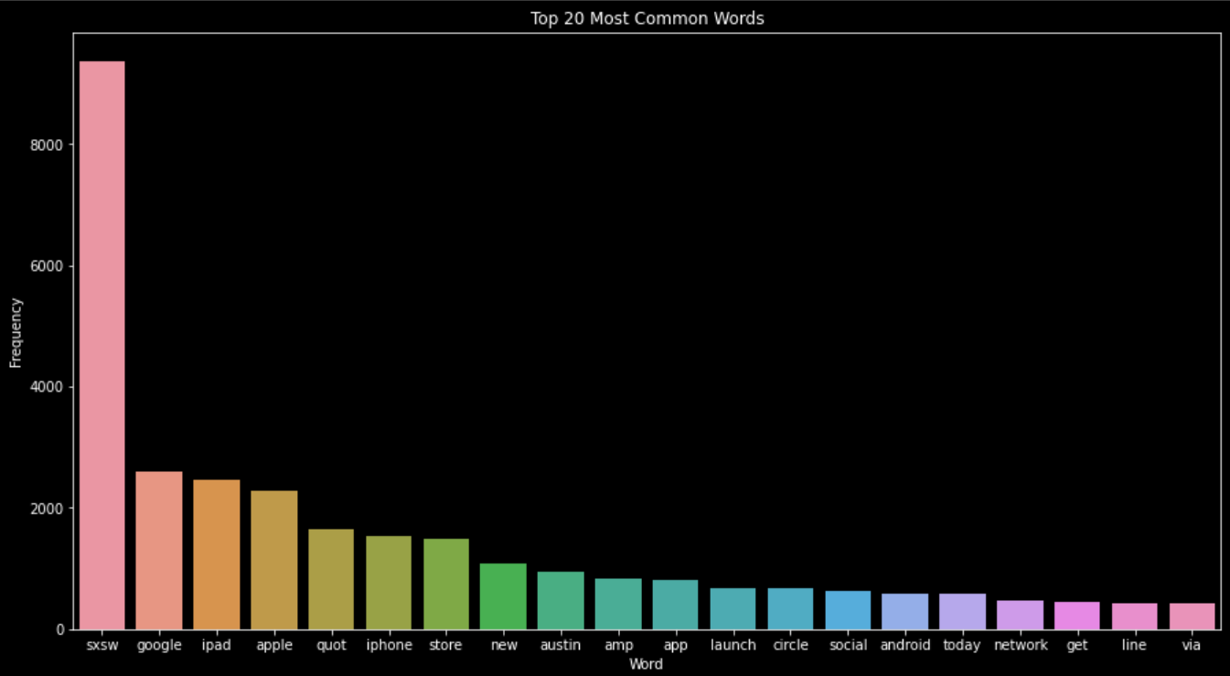
Top 20 Most Popular Words

Slide 7
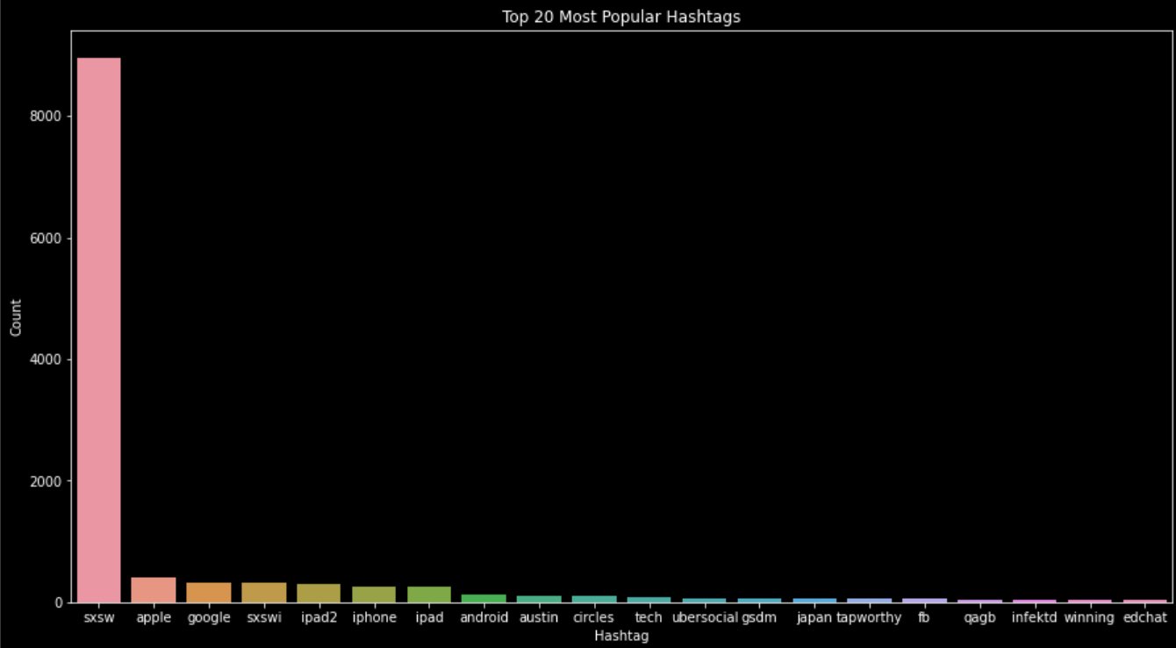
Top 20 Most Popular Hashtags

Slide 8
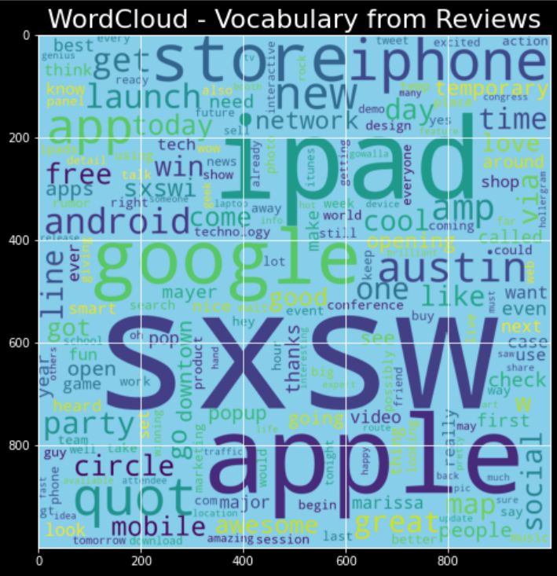
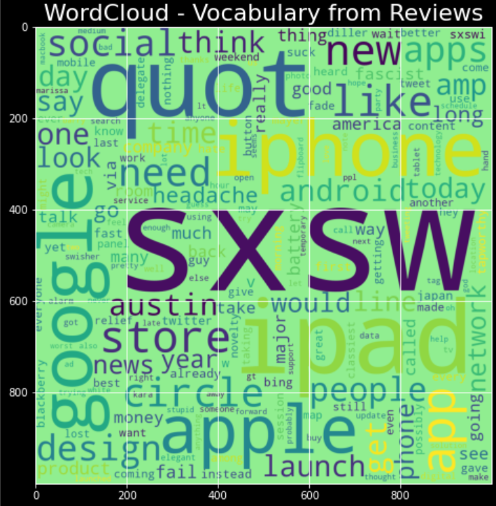
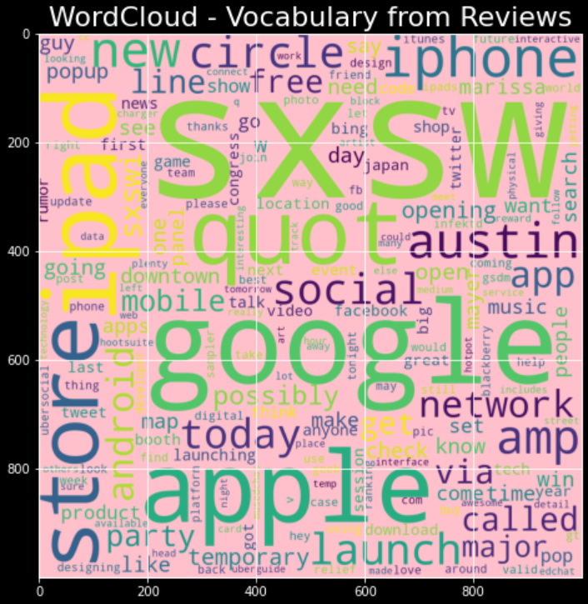
Most Popular Words
By Product Emotion
Positive
Negative
Neutral

Slide 9
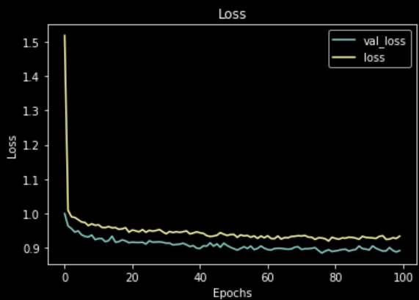
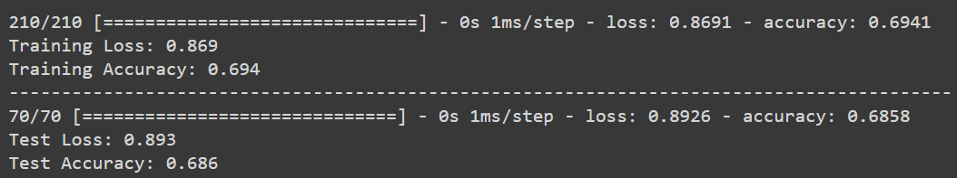
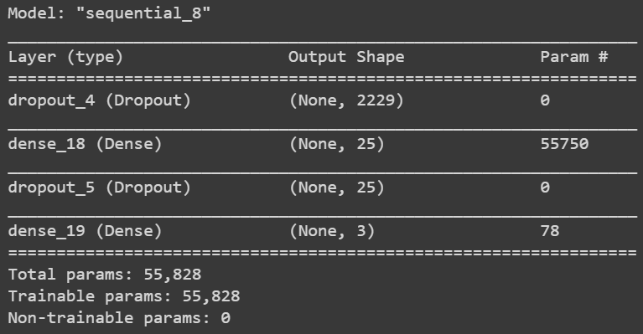
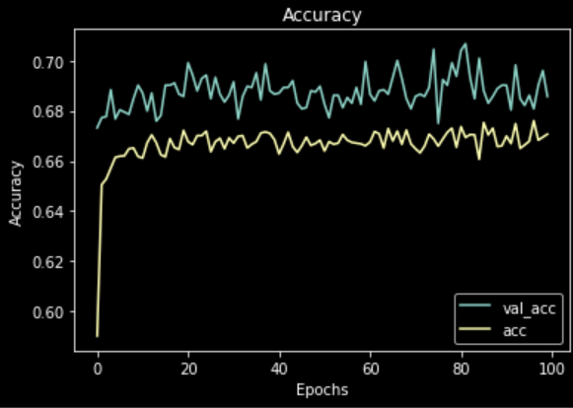
Model Selection
Multinomial NB, Logistic Regression, Random Forest, SVC, Deep Neural Network (base model), Deep Neural Network (regularized)
Best Performing Model: Deep Neural Network (regularized)
69.0% Accuracy Score

Slide 10
Analysis
Final model details:
Two layers
Early stopping
L1 regularization
Dropout layers
Data augmentation
RMS prop optimizer algorithm
Working with a multi-categorical classification problem, our model performed significantly better than random guessing
With random guessing, one would predict the tweet’s sentiment 48% (benchmark accuracy score) of the time correctly
The 48% was calculated by squaring the percentage of values belonging to each of the tweet’s sentiment class: 0.60% ** 2 (neutral sentiment) + 0.33% ** 2 (positive sentiment) + 0.06% ** 2 (negative sentiment) = 48%
With our model, it would predict the tweet’s correct sentiment 69.0% of the time

Slide 11
Future Work
Collect more data to train the models
Spend more time preprocessing the text data
Trying out more modelling algorithms such as XG boost
Applying weight initializations to the neural networks
Trying out more deep neural networks such as GRU

Slide 12
Thank You
Flatiron School Online Data Science Bootcamp

