Slide 1
Tanzanian Water Wells
Edward Cheng

Slide 2

UNICEF
for every child
Our Mission
Clean water, basic toilets and good hygiene practices are essential for the survival and development of children. For children under five, water- and sanitation-related diseases are one of the leading causes of death. Every day, over 800 children die from preventable diseases caused by poor water, and a lack of sanitation and hygiene. UNICEF’s water, sanitation and hygiene (WASH) team works in over 100 countries worldwide to improve water and sanitation services, as well as basic hygiene practices. Last year, UNICEF’s efforts provided nearly 14 million people with clean water and over 11 million with basic toilets. Our current mission is to predict the condition of water wells in Tanzania, as they are facing a massive water crisis. Here are some alarming statistics about the Tanzanian water crisis.
01
24 Million
02
43%
03
17%
People are impacted by the United Republic of Tanzania’s water crisis; that’s almost half the population of Tanzania
Of the Tanzanian population are relying on water that does not meet their standard
Of the Tanzanian population have no place to wash their hands. Without hand washing at critical times, such as after using the bathroom, people are more prone to get sick.

Slide 3
Process
OSEM
01
02
03
04
Obtain the Data
Scrub the Data
Explore the Data
Model the Data
Import the Tanzanian_data_set.csv and Tanzanian_labels.csv
Cast appropriate data types to predictor variables
Clean up NA values
Filter data set to exclude insignificant values
Convert important categorical variables into numerical ones to use for modelling stage
Explore relationships between categorical and continuous predictor variables with the target variable ‘well condition’
Observe for any patterns/trends, which indicates that a certain variable may be useful for the final model
Run 5 different machine learning algorithms:
Logistic Regression
Decision Tree
Random Forest
Ada boosting
Gradient boosting
Select best performing algorithm and perform Randomized Search

Slide 4
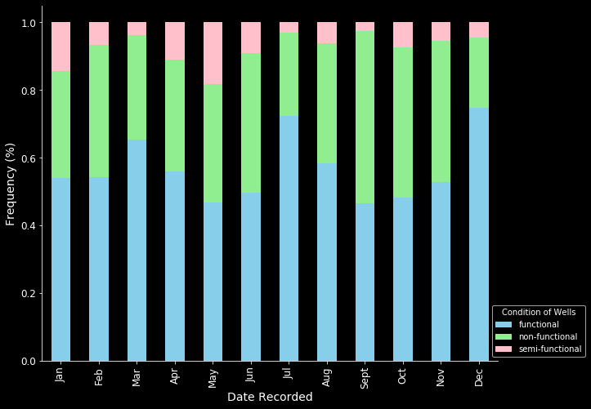
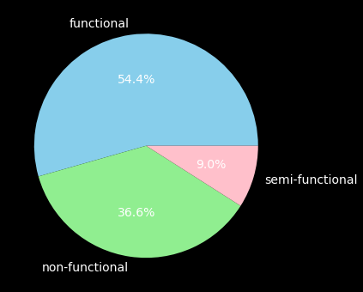
Distribution of Well Conditions
By Date Recorded
54.4%
Of the wells are functional
36.6%
Of the wells are non-functional

Slide 5
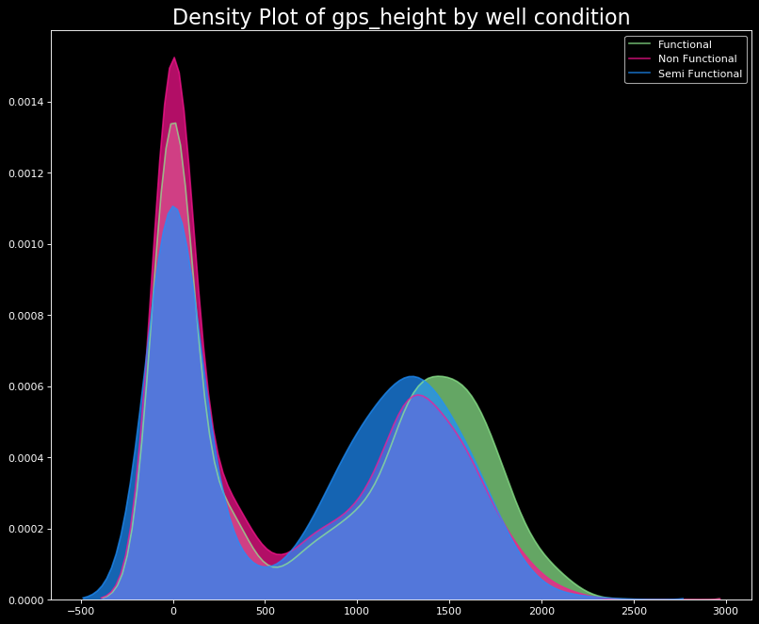
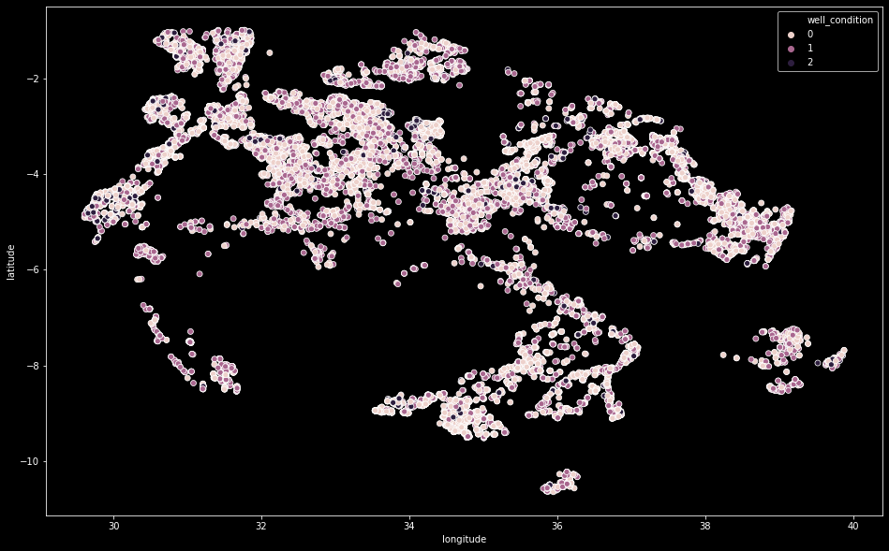
Locations of Wells
And the distribution of its altitude

Slide 6
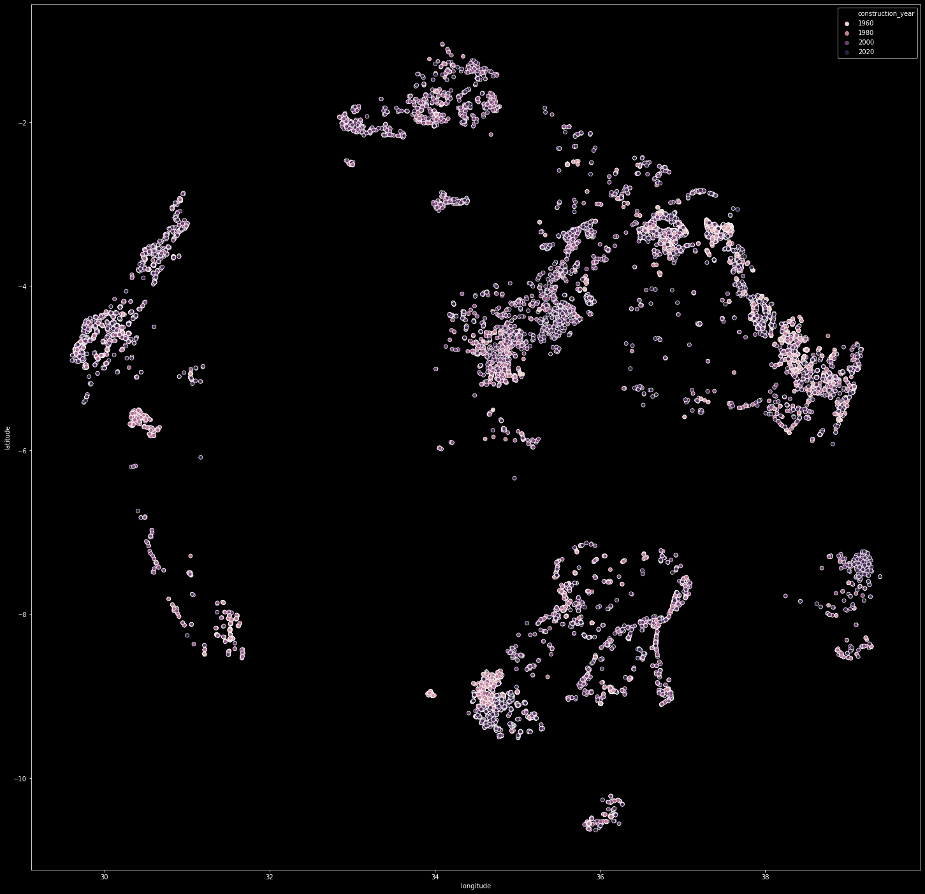
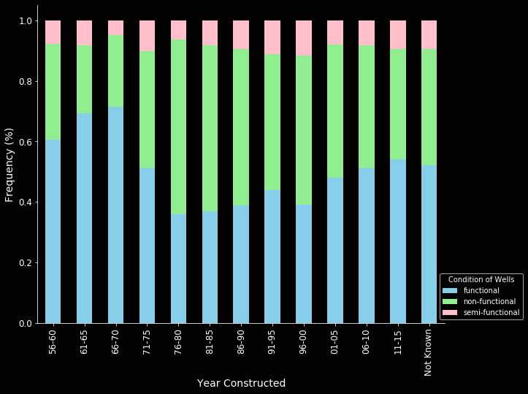
Construction Years of Wells
By Well Condition

Slide 7
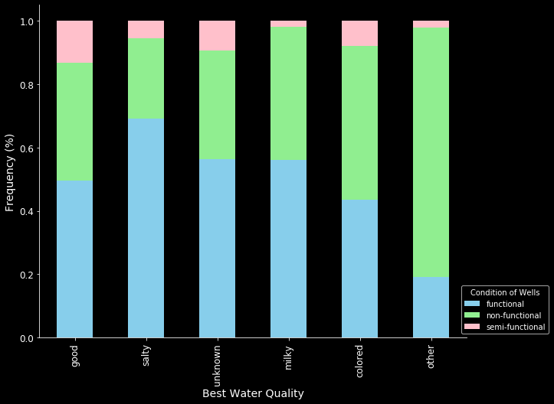
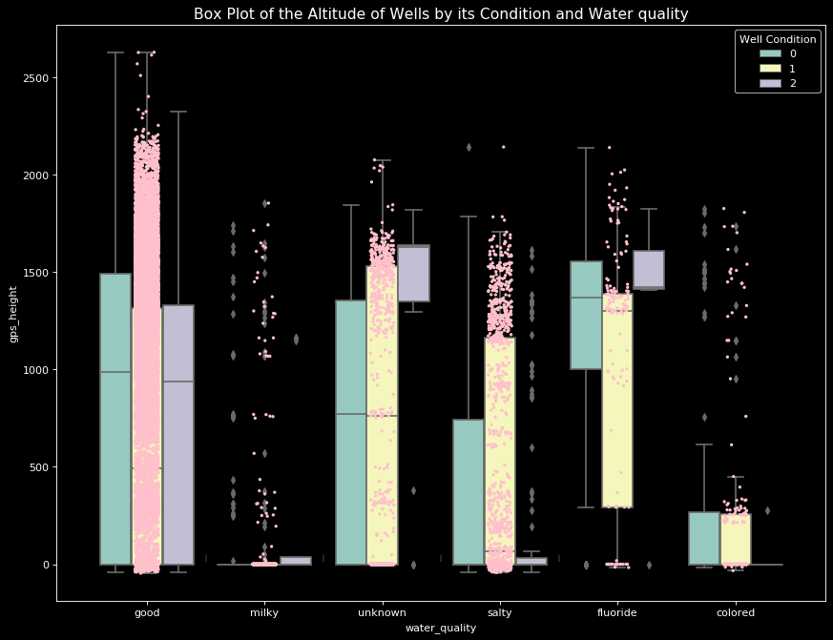
Best Water Quality
By Well Condition

Slide 8
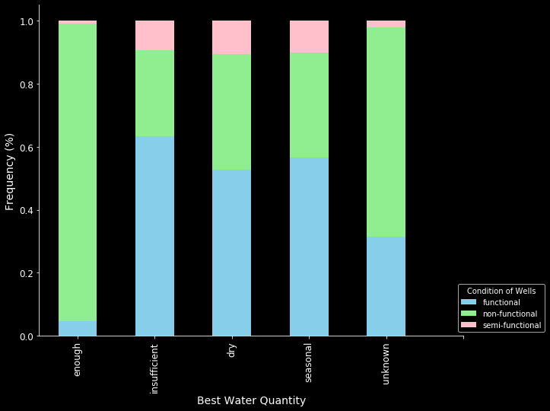
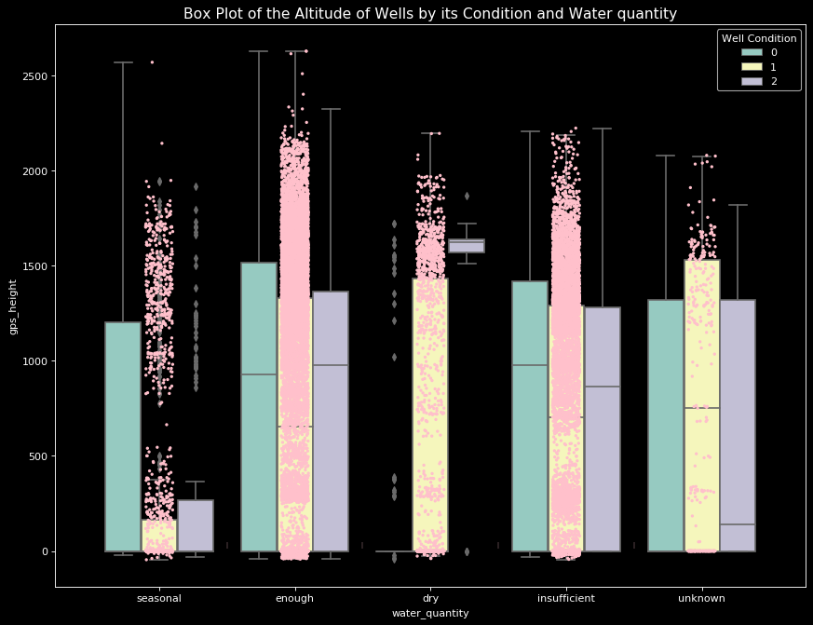
Best Water Quantity
By Well Condition

Slide 9
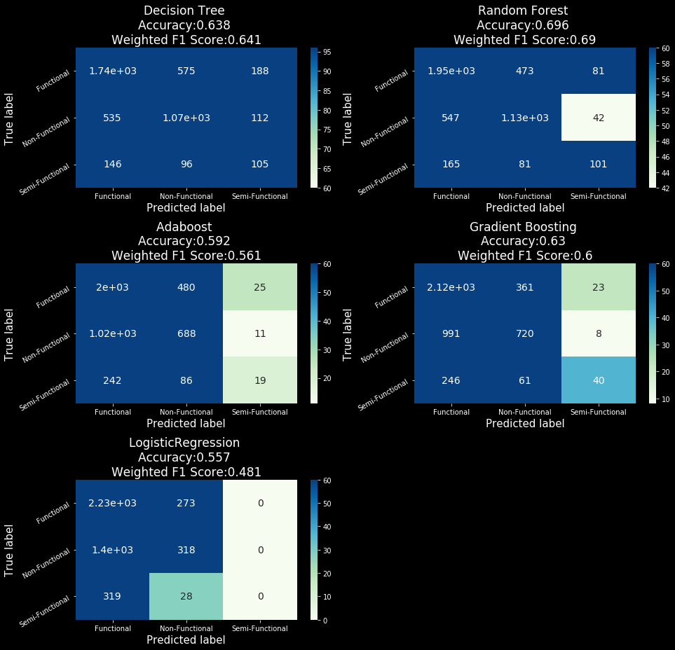

Model Selection Algorithms
Logistic Regression, Decision Tree, Random Forest, Ada Boosting, Gradient Boosting
Best Performing Model: Random Forest
70.2% Accuracy Score (with hyperparameter tuning)
69.0% F1 Score

Slide 10
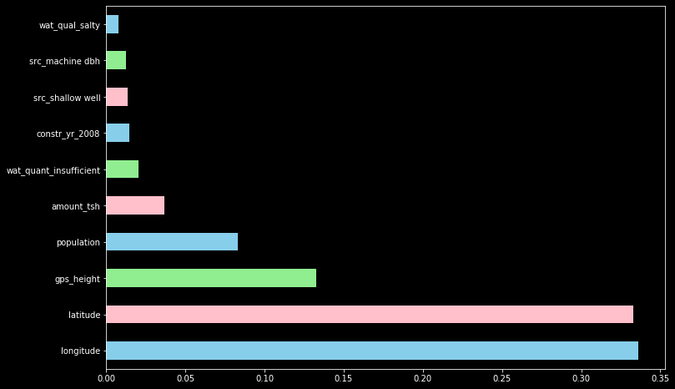
Recommendations
Top 10 Features
01
Longitude
02
Latitude
03
Altitude of the Wells
04
Population
05
Total Static Head
06
Insufficient Water Quantity
07
Wells Constructed in 2006-2010
08
Shallow Well (Water Source)
09
Machine Dbh (Water Source)
10
Salty Water Quality

Slide 11
Future Work
Trying different data cleaning methods
Having more time to play around with combining unused features together
Collect more data to train the model
Transforming more categorical variables into numerical ones for modelling purposes
Making predictions with another modelling algorithm such as XGBoost

Slide 12
Thank You
Flatiron School Online Data Science Bootcamp

