Slide 1
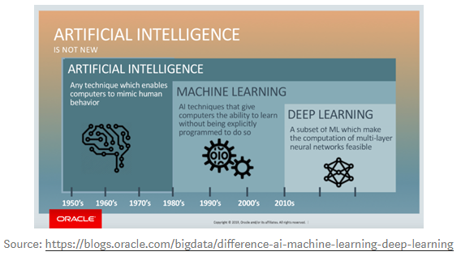
AI / Machine Learning / Deep Learning
https://towardsdatascience.com/notes-on-artificial-intelligence-ai-machine-learning-ml-and-deep-learning-dl-for-56e51a2071c2

