Slide 1
Protein Contact Prediction
Roshan Rao and Eddie Williams

Slide 2
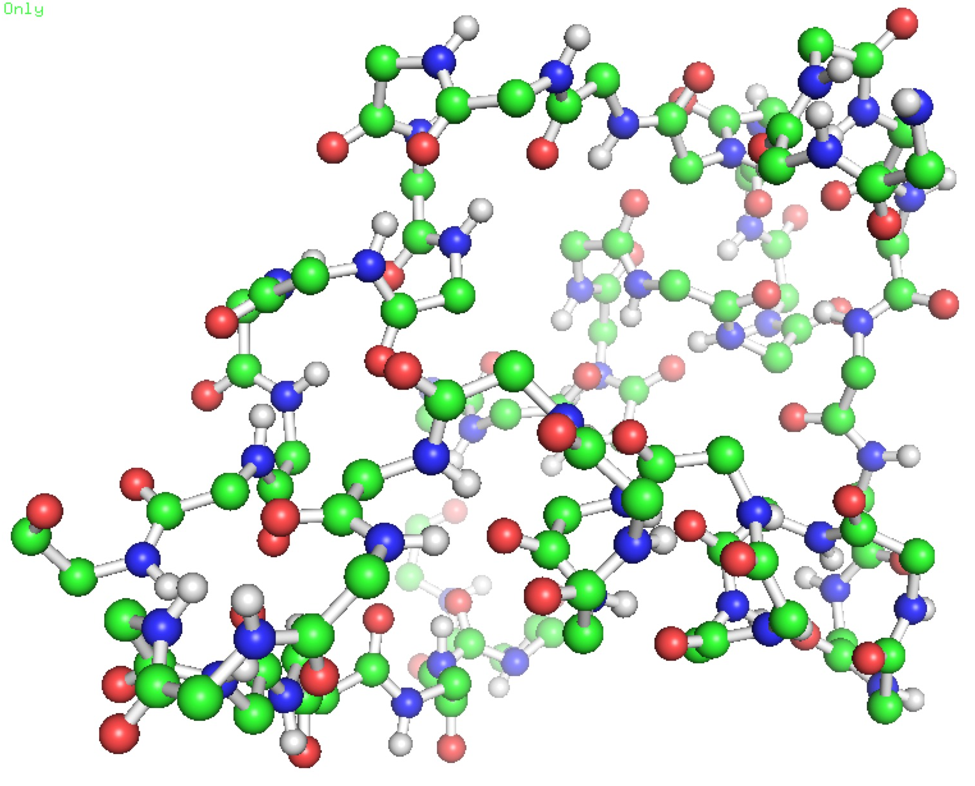
What is Protein Contact Prediction?
Inference
GIVEQCCTS…
Sub-problem of Protein Structure Prediction
Structure prediction estimate 3D structure from amino acid sequence

Slide 3
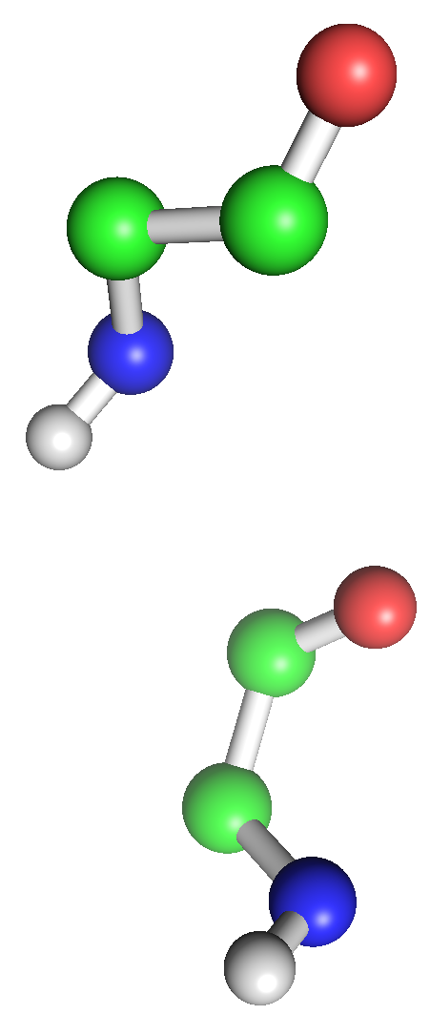
Protein Structure Representation
Model
Pairwise MRF
One variable per amino acid
Edge if distance less than 10Å

Slide 4
Protein Structure Representation
Model
Implies knowledge of full structure
Pairwise MRF
One variable per amino acid
Edge if distance less than 10Å

Slide 5
Protein Contact Prediction
Let y_{i}…y_{N} represent an amino acid sequence
Let x_{ij} be an indicator variable determining if there is an edge between amino acids y_{i} and y_{j}
Goal: Predict adjacency matrix

Slide 6
Protein Features
Amino acid features
20 Amino Acids, 210 indicator variables
Distance features
φ_{dist}(y_{i}, y_{j}) = |i – j|
Seqlen feature
Length of protein sequence (acts as prior)

Slide 7
Three-way Factor Potential
Hypothesis: if y_{i} is close to y_{j} and y_{j} is close to y_{k} then y_{i} is probably close to y_{k}
Model using four features:
Notes:
Include graph of relative probabilities?

Slide 8
Graphical Model

Slide 9
Graphical Model

Slide 10
Mean Field Approximation
Objective function
Runtime O(LN^3)
Muhat calculation takes too long

Slide 11
Speedups
Parallelization
Stochastic Gradient Descent

Slide 12
Pseudo log-likelihood
Objective Function
Faster than Mean Field

Slide 13
Results (not conditioned)
Random
Logistic
Parallel Mean Field
Stochastic Gradient Descent

Slide 14
Results (conditioned if available)
Random
Logistic
Parallel Mean Field
Stochastic Gradient Descent

Slide 15
Problems
Three-factor potentials don’t work well
Bug in code?
Can recover logistic regression
Possible that they create feedback loop
Amino acid potentials don’t provide much knowledge
Use evolutionary data instead

Slide 16
Future Work
Evolutionary Potentials

