Slide 1
Protein Contact Prediction
Roshan Rao and Eddie Williams

Slide 2
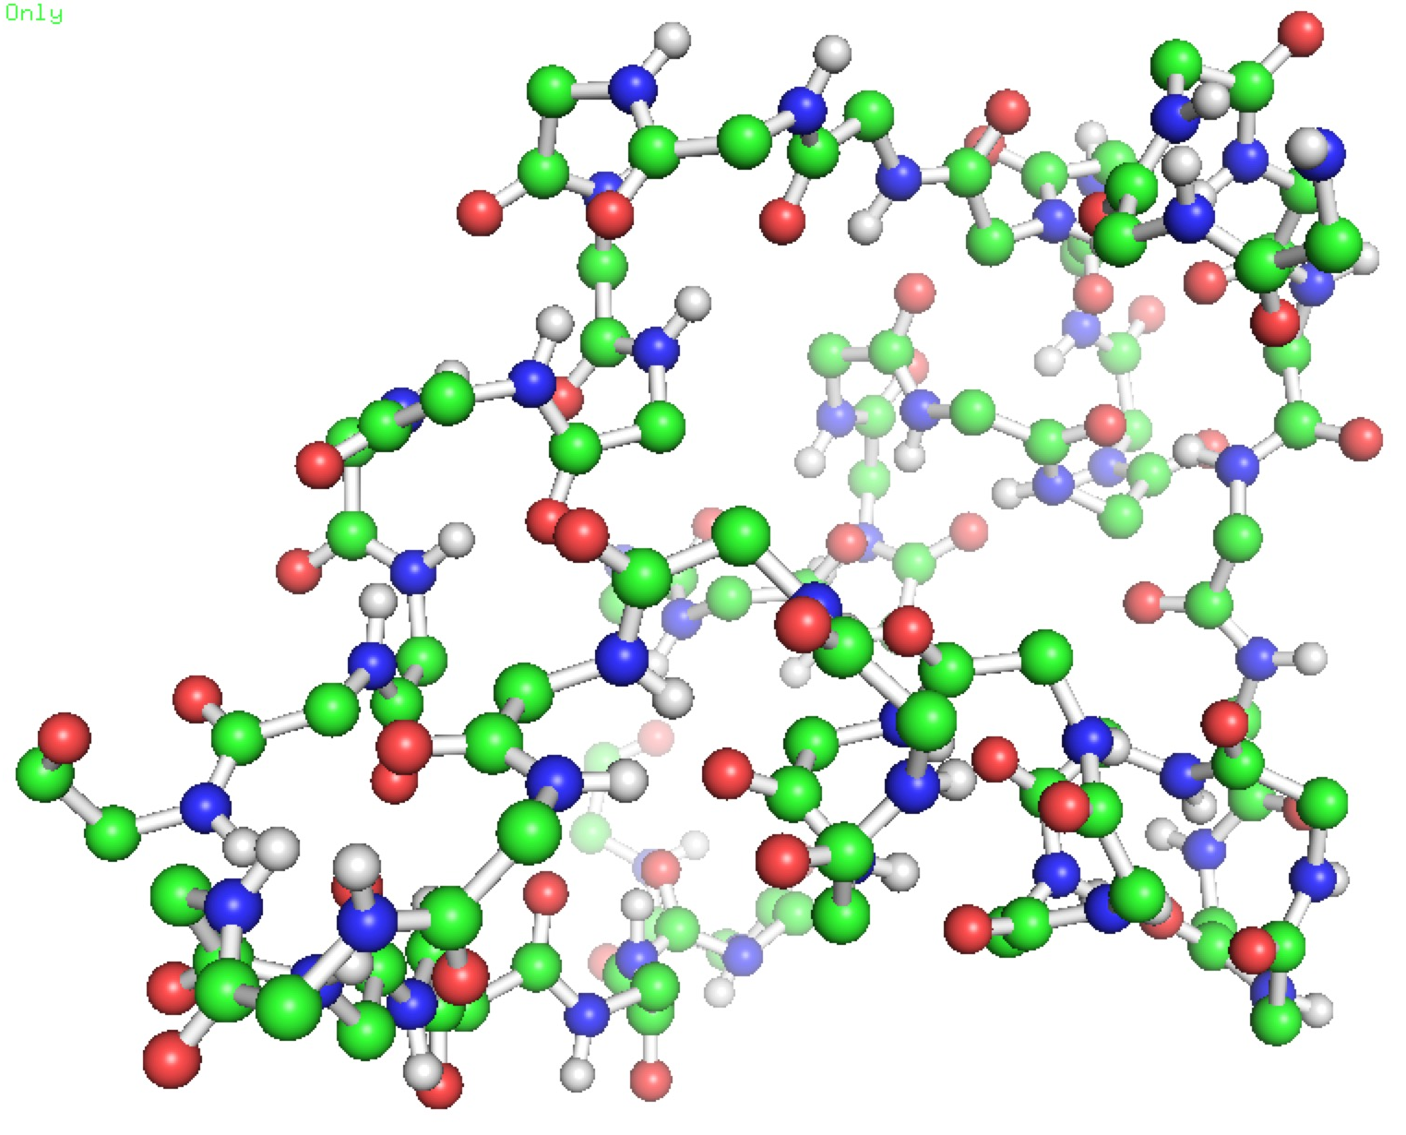
What is Protein Contact Prediction?
Inference
GIVEQCCTS…
Sub-problem of Protein Structure Prediction
Structure prediction estimate 3D structure from amino acid sequence

Slide 3
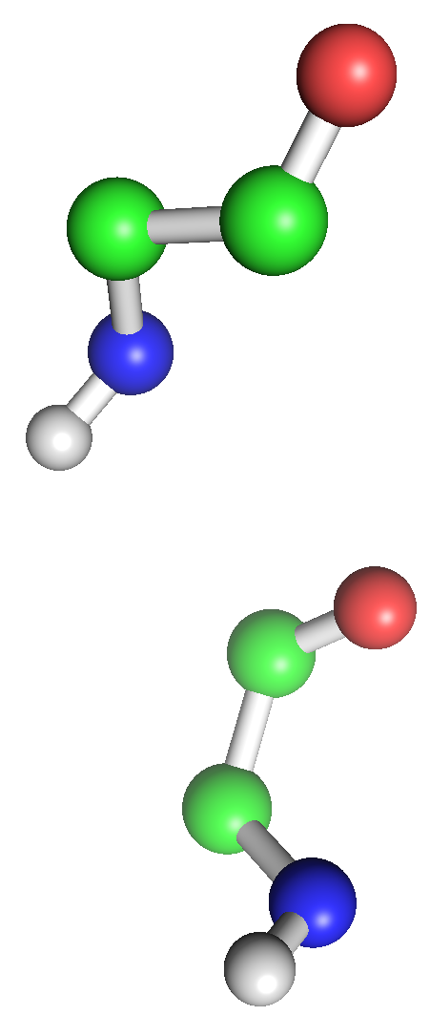
Protein Structure Representation
Model
Pairwise MRF
One variable per amino acid
Edge if distance less than 10Å

Slide 4
Protein Structure Representation
Model
Implies knowledge of full structure
Pairwise MRF
One variable per amino acid
Edge if distance less than 10Å

Slide 5
Protein Contact Prediction
Let y_{i}…y_{N} represent an amino acid sequence
Let x_{ij} be an indicator variable determining if there is an edge between amino acids y_{i} and y_{j}
Goal: Predict adjacency matrix

Slide 6
Protein Features
Amino acid pair features
20 Amino Acids, 210 indicator variables
Distance features
φ_{dist}(y_{i}, y_{j}) = |i – j|
Seqlen feature
Length of protein sequence (acts as prior)

Slide 7
Three-way Factor Potential
Hypothesis: if y_{i} is close to y_{j} and y_{j} is close to y_{k} then y_{i} is probably close to y_{k}
Model using four features:
Notes:
Include graph of relative probabilities?

Slide 8
Graphical Model

Slide 9
Graphical Model

Slide 10
Mean Field Approximation
Approximation
Approximate graphical model as fully disconnected
Perform inference on disconnected distribution
Minimize:
Calculating for all proteins is O(LN³)

Slide 11
Speedups
Parallelization
Muhat calculation for each protein can be performed in parallel
Implemented in C++, interfaced with MATLAB
Stochastic Gradient Descent
Faster than GD, returns same results

Slide 12
Pseudo log-likelihood
Approximation
Maximize conditional likelihood of node given its neighbors
Much faster than Mean Field!

Slide 13

Data
Downloaded protein 3D structure files from PDB
Converted to features and edge indicator variables with Python script
Logistic regression tested on smaller set
Image source: Protein Data Bank

Slide 14
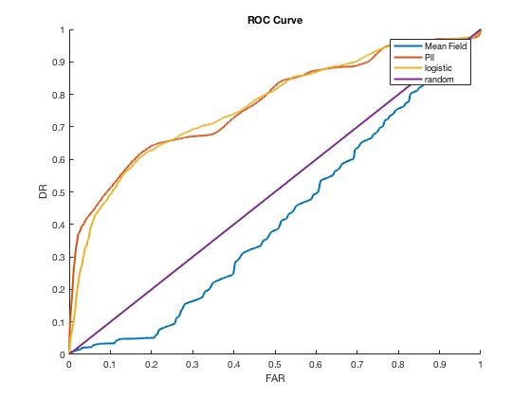
Results

Slide 15
Problems
Three-factor potentials don’t work well
Bug in code? Gradient calculation?
Can recover logistic regression if disabled
Possible that they create feedback loop
Powerful when unary potentials give strong signal
Amino acid potentials don’t provide much knowledge
Use evolutionary data instead

Slide 16
Future Work
Use evolutionary data with three-factor potentials
Conditioning on edges that are close in protein backbone
Test generated graphs with protein folding software
Compare to existing contact prediction models

