Slide 1
Formalising the Informal:
Linking Formal Methods to
Informal Requirements
Jeremy Dick, Telelogic
<number> of 43

Slide 2
Objectives
Demonstrate the benefits of merging ideas from the world of “Requirements Management” into the practice of “Formal Methods”
Particularly the concept of “Traceability”
<number> of 43

Slide 3
Agenda
(Informal) Requirements Management
  Key concepts
“Rich” Traceability
  Adding greater rigour
Tracing the informal to the formal
  Example using DOORS and the B Method
Conclusions
<number> of 43

Slide 4
Agenda
(Informal) Requirements Management
  Key concepts
“Rich” Traceability
  Adding greater rigour
Tracing the informal to the formal
  Example using DOORS and the B Method
Conclusions
<number> of 43

Slide 5
What is a “requirement”?
Anything that impacts the way a product or system is designed and built:
  Capability
  Function
  Performance
  Safety
  Conformance
Complex products have 1000’s of requirements
  Cars, planes, trains, phone systems, banks, …
Synonyms:
  Objectives, goals, aims, regulations, rules, constraints, needs, features, functions, criteria, …
<number> of 43

Slide 6
What is Requirements Management?
The discipline of …
      Gathering
      Expressing
      Organising
      Tracing
      Reviewing
      Agreeing
      Changing
      Validating
… requirement statements and documents
<number> of 43

Slide 7
Key discipline: writing requirements
Expressing requirements in natural language
  Clearly, unambiguously
  Atomically (one requirement per statement)
  In quantified, testable form
  Separating problem from solution
Identifying attributes, such as
  Source, owner
  Type of requirement
  Priority
  Status
  …
<number> of 43

Slide 8
Key discipline: tracing requirements
Ability to trace requirements through layers of design
Understand how requirements are satisfied
Understand impact of requirement change
Understand how requirements are tested
Understand the impact of test failure
<number> of 43

Slide 9
What is tracing for?
Coverage analysis
  Show all requirements have been considered
Derivation analysis
  Show everything has a purpose
Impact analysis
  Show potential cascade of changes
Design analysis
  Show how requirements are satisfied
<number> of 43

Slide 10
Tracing in the lifecycle
Perception of need
Operational use
Stakeholder
validates
Acceptance
Requirements
test
satisfies
System
validates
System
Requirements
test
satisfies
Subsystem
validates
Subsystem
Requirements
test
satisfies
Component
validates
Component
test
Requirements
<number> of 43

Slide 11
Impact Analysis
Perception of need
Operational use
Stakeholder
validates
Acceptance
Requirements
test
satisfies
System
validates
System
Requirements
test
satisfies
Subsystem
validates
Subsystem
Requirements
test
satisfies
Component
validates
Component
test
Requirements
<number> of 43

Slide 12
Derivation Analysis
Perception of need
Operational use
Stakeholder
validates
Acceptance
Requirements
test
satisfies
System
validates
System
Requirements
test
satisfies
Subsystem
validates
Subsystem
Requirements
test
satisfies
Component
validates
Component
test
Requirements
<number> of 43

Slide 13
Coverage Analysis
Statement of need
Operational use
Stakeholder
validates
Acceptance
Requirements
test
satisfies
System
validates
System
Requirements
test
satisfies
Subsystem
validates
Subsystem
Requirements
test
satisfies
Component
validates
Component
test
Requirements
<number> of 43

Slide 14
Benefits of Tracing
Greater confidence
that objectives are being met.
Ability to manage change
through ability to access change impact.
Greater accountability
of subordinate organisations/suppliers.
Ability to track progress / status
particularly in the formative stages of project.
Ability to save costs
through cost/benefit analysis.
<number> of 43
Notes:
Benefits in detail.

Slide 15
Agenda
(Informal) Requirements Management
  Key concepts
“Rich” Traceability
  Adding greater rigour
Tracing the informal to the formal
  Example using DOORS and the B Method
Conclusions
<number> of 43

Slide 16
“Rich Traceability”
Collection rationale on the links
Represents vital design information
Must understand the nature of the traceability relationship:
  Links are bundled
  Cannot understand them individually
Increasing used
Considered the “next step” for many
<number> of 43

Slide 17
Discipline for Compliance
Rail Project
Requirements
UK Standards
Elementary
tracing
Example:
Need to demonstrate compliance
<number> of 43

Slide 18
Discipline for Compliance
Compliance
statement
Rail Project
Requirements
UK Standards
Rich
tracing
Collect and organise the rationale for compliance
Document presenting the compliance argument
Natural place to summarise and trace to models
<number> of 43

Slide 19
Rich Tracing
This rationale …
… explains both of these links
Known as, depending on the relationship:
  “compliance argument”
  “satisfaction argument”
  “verification argument”
  “safety argument”
<number> of 43

Slide 20
Discipline for Satisfaction
Business Reqs
Functional Reqs
Satisfaction
argument
Satisfaction could be considered as an attribute of requirements document
Documents the satisfaction argument
<number> of 43

Slide 21
Bi-Directional Rich Tracing
Satisfaction
argument
Explains how
the requirement
is satisfied
Customer’s perspective
Design
justification
Explains why
the requirement
is necessary
Developer’s perspective
<number> of 43

Slide 22
Bi-directional Rich Tracing Process
Developers create design justification as they create their response
Customers review the design justifications and create satisfaction arguments as a summary
1
1
1
1
2
1
1
1
1
<number> of 43

Slide 23
Tracing Review
Tracing should be reviewed for:
Completeness
  is everything covered?
  quantity related to whole requirements set
Sufficiency
  is the set of responses sufficient to satisfy requirement?
  quality related to individual requirement
Necessity
  is each response necessary to satisfy requirement?
  quality related to individual requirement
<number> of 43

Slide 24
Agenda
(Informal) Requirements Management
  Key concepts
“Rich” Traceability
  Adding greater rigour
Tracing the informal to the formal
  Example using DOORS and the B Method
Conclusions
<number> of 43

Slide 25
System modelling
Requirements management
System modelling and analysis
Statement
of need
Usage
modelling
Induced
traceability
User
requirements
Functional
modelling
Functional
modelling
Domain
specific
Generic
System
requirements
Performance
modelling
Functional
modelling
Functional
modelling
Architectural
design
<number> of 43

Slide 26
Formal models
Requirements management
System modelling and analysis
Statement
of need
Usage
modelling
User
requirements
System
requirements
Architectural
design
<number> of 43
(RM-2652)

Slide 27
DOORS: the informal world
DOORS
Requirements
documents
Traceability
between
documents
Informal world
<number> of 43

Slide 28
B: the formal world
Type checking
Proof
Refinement
Code
generation
B
Relationships between entities
Formal development
Formal world
<number> of 43

Slide 29
Bridge: the informal and formal worlds
DOORS
Requirements
documents
B
Traceability links
Formal development
Formal world
Informal world
<number> of 43

Slide 30
Bridge process step 1:
Development requirements in DOORS
DOORS
<number> of 43

Slide 31
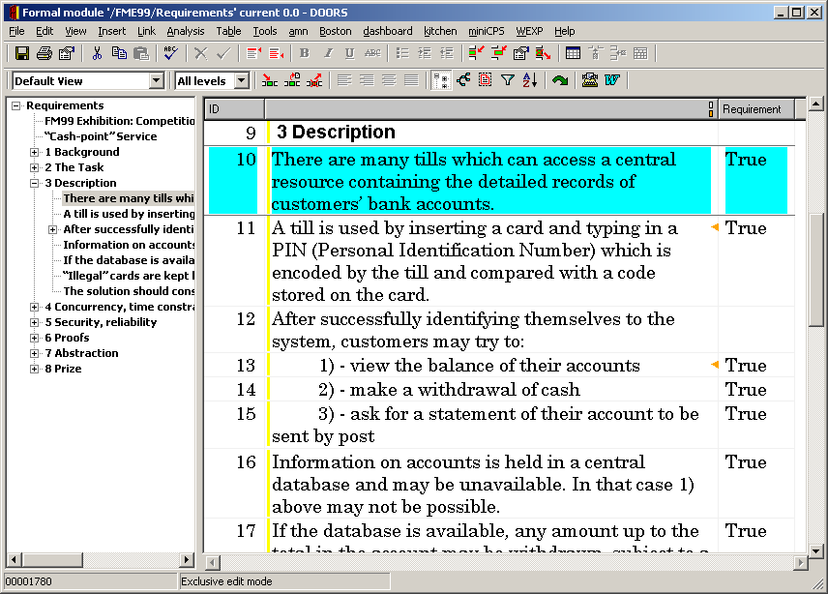
<number> of 43

Slide 32
Bridge process step 2:
Development formal specification in B
DOORS
B
C
<number> of 43

Slide 33
Bridge process step 3:
Import AMN text into DOORS
DOORS
B
C
<number> of 43

Slide 34
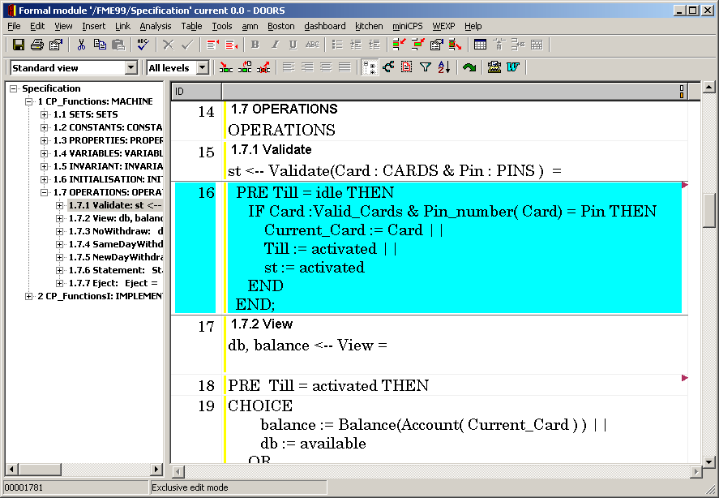
<number> of 43

Slide 35
Bridge process step 4:
Establish traceability
DOORS
B
C
<number> of 43

Slide 36
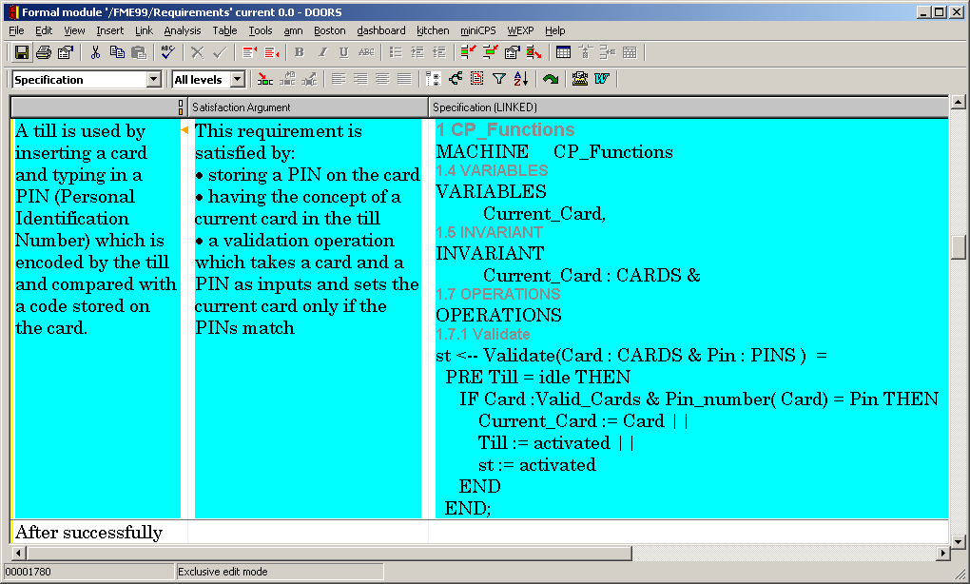
<number> of 43

Slide 37
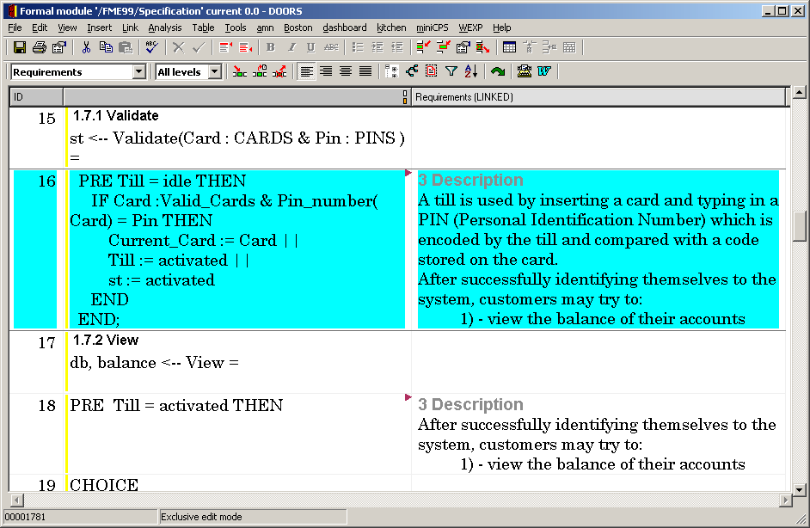
<number> of 43

Slide 38
Bridge process step 5:
Re-export to B-Toolkit
DOORS
B
C
<number> of 43

Slide 39
Bridge process step 6:
Export to HTML
DOORS
Web
B
<number> of 43

Slide 40
(see HTML browser)
<number> of 43

Slide 41
Bridge process step 7:
Can re-import to DOORS and preserve links
DOORS
B
C
<number> of 43

Slide 42
Agenda
(Informal) Requirements Management
  Key concepts
“Rich” Traceability
  Adding greater rigour
Tracing the informal to the formal
  Example using DOORS and the B Method
Conclusions
<number> of 43

Slide 43
Linking the Formal and Informal Worlds
Complete traceability
  From initial requirements in text
  To code (at function level)
Ability to perform impact analysis
Ability to perform derivation analysis
“Rich” traceability explains specification
Formal specification is “self-documenting”
Formal approach is linked into
the overall development process
<number> of 43

