Slide 1

带您认识
真正的面向对象
Guo Chen A
2021/6/3

Slide 2
课程介绍
课程目标
深入理解面向对象开发，澄清面向对象概念，纠正一些认识上的误区，通过产品代码中的的真实例子来认识面向对象的设计模式。
培训对象
C++开发人员，具有一定的C++基础

Slide 3
课程大纲
What is OO
15 Minutes
Why use OO
5 Minutes
OO in Code
40 Minutes

Slide 4
What is OO

Slide 5
What is OO
Object-oriented programming
Programming based on “objects”
What is “Object”
Data
Methods that access and modify the data
Class and Object
Classes – the definitions of object
Objects – instances of classes

Slide 6
5 Principles
SRP 单一责任原则
Single Responsibility Principle
OCP 开放封闭原则
Open Close Principle
LSP 里氏替换原则
Liskov Substitution Principle
ISP 接口分离原则
Interface Segregation Principle
DIP 依赖倒置原则
Dependency Inversion Principle

Slide 7
Encapsulation
Encapsulation is an object-oriented programming concept that binds together the data and functions that manipulate the data
class City
{
public:
void classifyRubbish();
void reduceTax();
private:
vector<Street> streets;
vector<Building> buildings;
vector<Company> companies;
};
class City
{
public:
void classifyRubbish();
void reduceTax();
private:
vector<District> districts;
};

Slide 8
Scope
class service
{
public:
void doSth()
{
HelperClass helper;
helper.convert();
}
};
class service
{
public:
void doSth()
{
helper.convert();
}
private:
HelperClass helper;
};

Slide 9
Scope
class Helper
{
public:
static void convert(){}
};
class service
{
public:
void doSth()
{
Helper::convert();
}
};
namespace Helper
{
void convert(){}
}
class service
{
public:
void doSth()
{
Helper::convert();
}
};
Notes:
面向对象守则要求，数据以及操作数据的那些函数应该捆绑在一起，而上面这个函数显然没有数据。

Slide 10
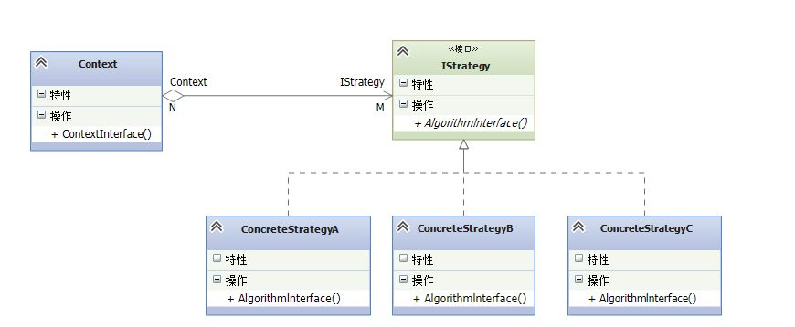
Polymorphism

Slide 11
Composition vs Inheritance
Composition Has – A
Inheritance Is – a
Composition over Inheritance
Cell
Legacy
Multefire
Legacy
CatM
Legacy
CatM

Slide 12
Why use OO

Slide 13
Why OO
Maintainability
Reusability
Readability
Extensibility
Testability

Slide 14
OO In Code

Slide 15
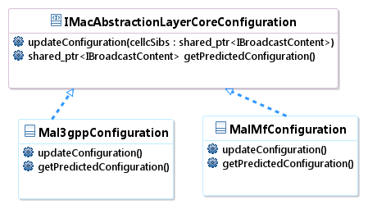
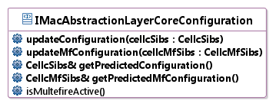
Polymorphism

Slide 16
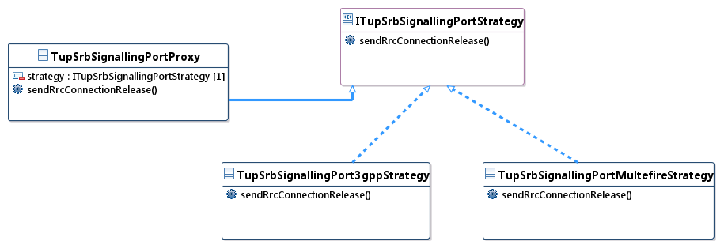
Strategy and Proxy
Define a family of algorithms, encapsulate each one, and make them interchangeable.

Slide 17
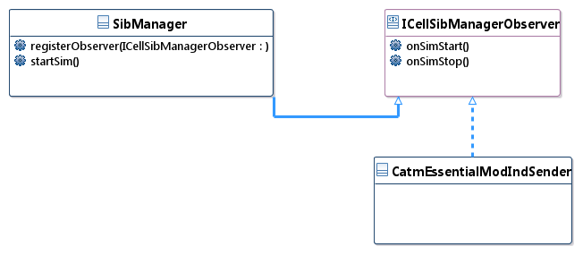
Observer
Define a one-to-many dependency between objects where a state change in one object results in all its dependents being notified and updated automatically.

Slide 18
Factory
Decouple classes with different scope.
Normally factory need not UT except having logic.
class IBoardPortFactory
{
public:
virtual std::shared_ptr<IBoardPort> createPcapPort() = 0;
virtual std::shared_ptr<IBoardPort> createSocketPort() = 0;
virtual ~IBoardPortFactory() = default;
};
class PonUserPlane : public IUserPlane
{
public:
PonUserPlane(const std::shared_ptr<IBoardPortFactory> &boardPortFactory);
};

Slide 19
NullObject
Avoid null references by providing a default object.
struct NullArpBasedQosProfiler : IArpBasedQosProfiler
{
void profileDb(SUecUeDb&) const override
{
throw CellNotSetException("NullArpBasedQosProfiler::profileDb called");
}
};
static std::shared_ptr<IArpBasedQosProfiler> g_nullArpBasedQosProfiler = std::make_shared<NullArpBasedQosProfiler>();
ArpBasedQosProfilerGuardProxy::ArpBasedQosProfilerGuardProxy()
: m_arpBasedQosProfiler(g_nullArpBasedQosProfiler)
{
}

Slide 20
Adapter
Convert the interface of a class into another interface clients expect.
class LteMobilityMeasurementsVoiceQualityAdapter
: public MeasurementConfiguration::IMobilityMeasurements,
public MeasurementConfiguration::IConfigurator
{
public:
bool activate() override;
bool shouldActivate() const override;
void configure() override;
};

Slide 21
Builder
Separate the construction of a complex object from its representation, allowing the same construction process to create various representations.
GeranInfoBuilder& addBandInd(EOaMModimpGeranBandInd l_bandInd)
{
m_info.geranCarFrqBd.geranCarFrqBd.geranBandInd = l_bandInd;
return *this;
}
const SModimpGeranCarFrqL modimpGeranOne
= GeranInfoBuilder<SModimpGeranCarFrqL>()
.addBandInd(geranModimpBandIndOne)
.addWeight(weightOne)
.addDedicatedPrio(dedicatedPrioOne)
.addHasGeranCarFrqBd()
.build();

Slide 22
Summary
Table of contents
What is OO
Why use OO
OO in Code
Objectives
Fully Understanding Object Oriented Programming

Slide 23
Q&A

Slide 24
Exercise
Design a RAC algorithm to cover these scenario
DrbERabSetup​
DrbERabModify
We have 2 kind of cells
3gpp cell
Remain Ul Prb >= Needed Ul Prb and Remain Dl Prb > Needed Dl Prb
Multefire cell
Remain Ul Prb + Dl Prb >= Needed Ul Prb + Dl Prb

