Slide 1

Registration
Prof. Drew Harrison (University of Limerick)
Dr. Edward Gunning (University of Pennsylvania)
ISBS 2024
Functional Data Analysis for Sports Biomechanics
Pre-conference Workshop
July 15th, 2024

Slide 2
Phase Variation

Slide 3
Consequences of Phase Variation
Two main consequences of phase variation:
Mean functions will not be interpretable (see previous slide).
Increased variability due to misalignments.

Slide 4
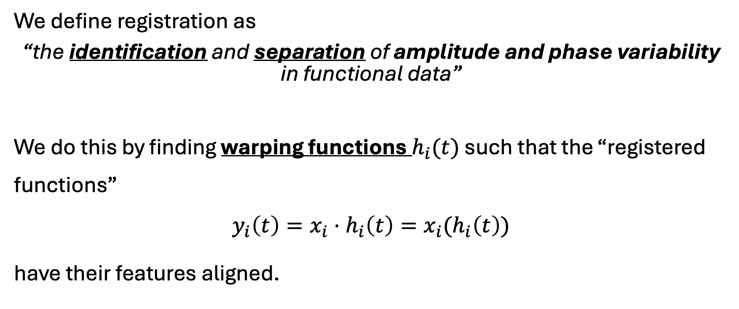
Registration
We define registration as
“the identification and separation of amplitude and phase variability in functional data”
We do this by finding warping functions $h_{i}(t)$ such that the “registered functions”
$$y_{i}\left(t\right)=x_{i}⋅h_{i}\left(t\right)=x_{i}(h_{i}\left(t\right))$$
have their features aligned.

Slide 5
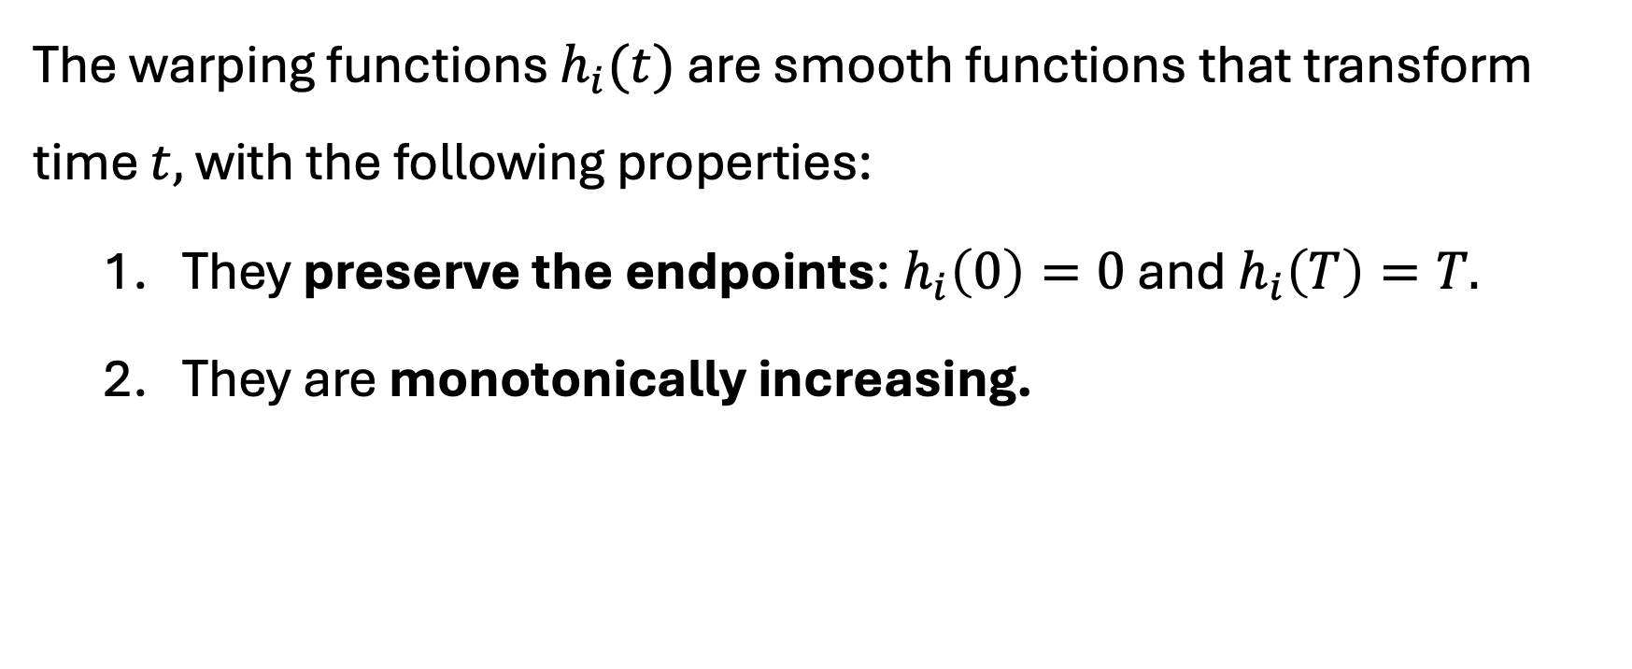
Warping Functions
The warping functions $h_{i}(t)$ are smooth functions that transform time $t,$ with the following properties:
They preserve the endpoints: $h_{i}\left(0\right)=0$ and $h_{i}\left(T\right)=T.$
They are monotonically increasing.

Slide 6
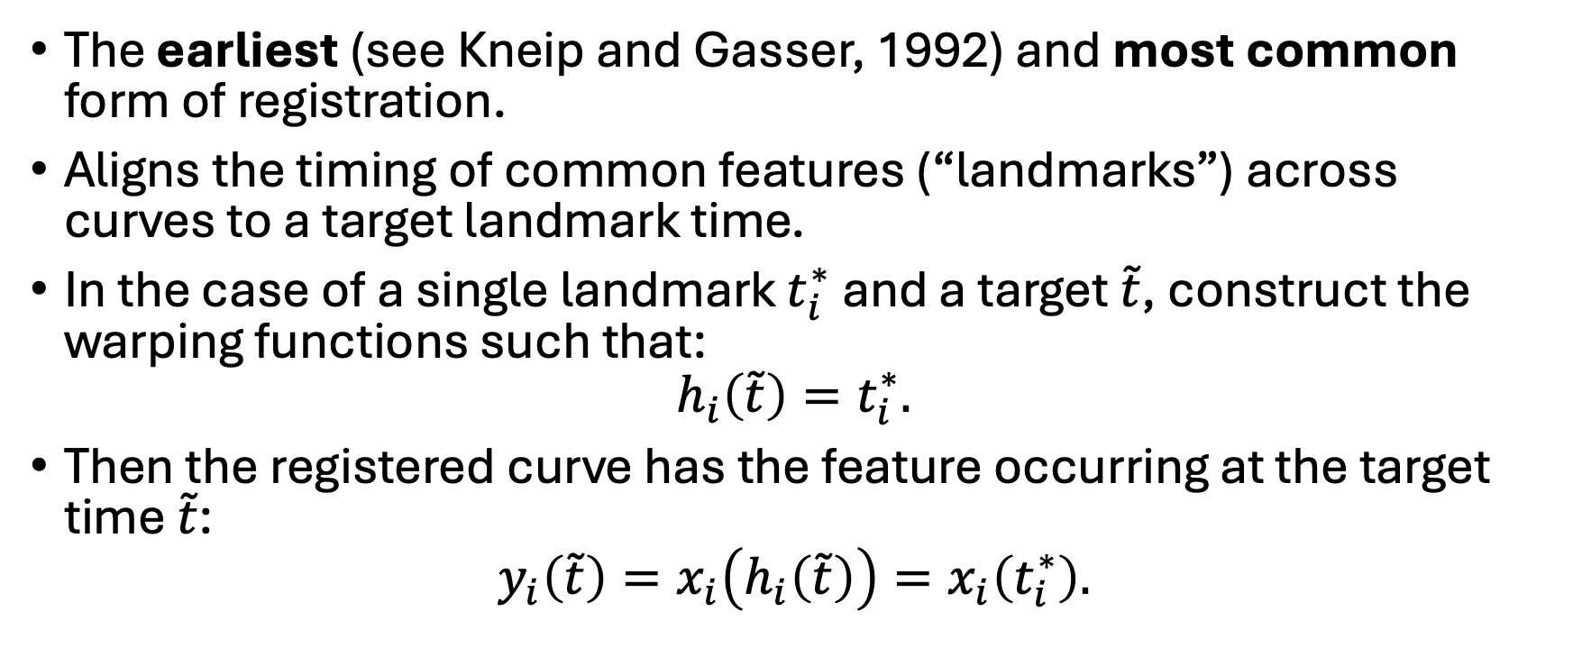
Landmark Registration
The earliest (see Kneip and Gasser, 1992) and most common form of registration.
Aligns the timing of common features (“landmarks”) across curves to a target landmark time.
In the case of a single landmark $t_{i}^{∗}$ and a target $\tilde{t}$, construct the warping functions such that:
$$h_{i}\left(\tilde{t}\right)=t_{i}^{∗}.$$
Then the registered curve has the feature occurring at the target time $\tilde{t}$:
$$y_{i}\left(\tilde{t}\right)=x_{i}\left(h_{i}\left(\tilde{t}\right)\right)=x_{i}\left(t_{i}^{∗}\right).$$

Slide 8
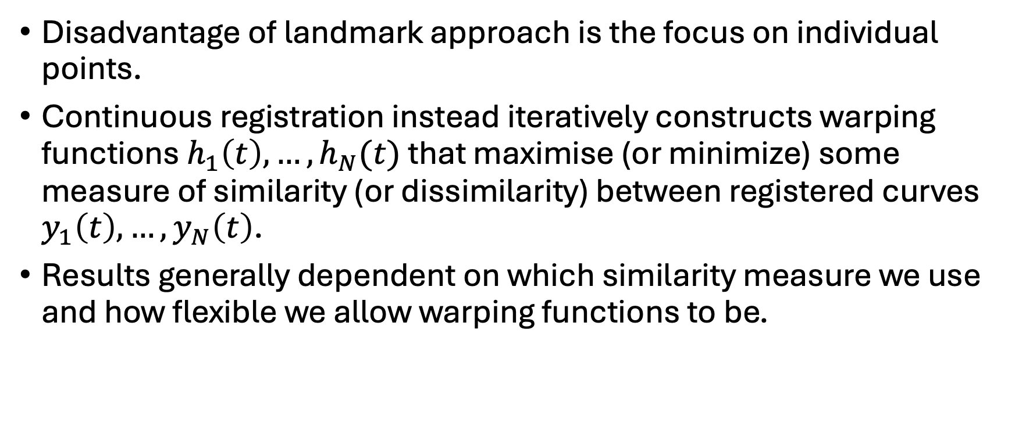
Continuous Registration
Disadvantage of landmark approach is the focus on individual points.
Continuous registration instead iteratively constructs warping functions $h_{1}\left(t\right), …,h_{N}(t)$ that maximise (or minimize) some measure of similarity (or dissimilarity) between registered curves $y_{1}\left(t\right), …,y_{N}\left(t\right)$.
Results generally dependent on which similarity measure we use and how flexible we allow warping functions to be.

Slide 9
References
Ramsay, J. O., & Silverman, B. W. (2005). Functional Data Analysis (2nd ed.). Springer-Verlag. https://doi.org/10.1007/b98888
Ramsay, J. O., Hooker, G., & Graves, S. (2009). Functional Data Analysis with R and MATLAB. Springer-Verlag. https://doi.org/10.1007/978-0-387-98185-7
Kneip, A., & Gasser, T. (1992). Statistical Tools to Analyze Data Representing a Sample of Curves. The Annals of Statistics, 20(3), 1266–1305.

