Slide 1

Functional Regression
Prof. Drew Harrison (University of Limerick)
Dr. Edward Gunning (University of Pennsylvania)
ISBS 2024
Functional Data Analysis for Sports Biomechanics
Pre-conference Workshop
July 15th, 2024

Slide 2
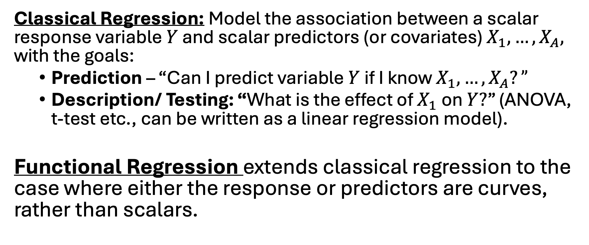
Functional Regression
Classical Regression: Model the association between a scalar response variable $Y$ and scalar predictors (or covariates) $X_{1},…,X_{A},$ with the goals:
Prediction – “Can I predict variable $Y$ if I know $X_{1},…,X_{A}?”$
Description/ Testing: “What is the effect of $X_{1}$ on $Y?$” (ANOVA, t-test etc., can be written as a linear regression model).
Functional Regression extends classical regression to the case where either the response or predictors are curves, rather than scalars.

Slide 3
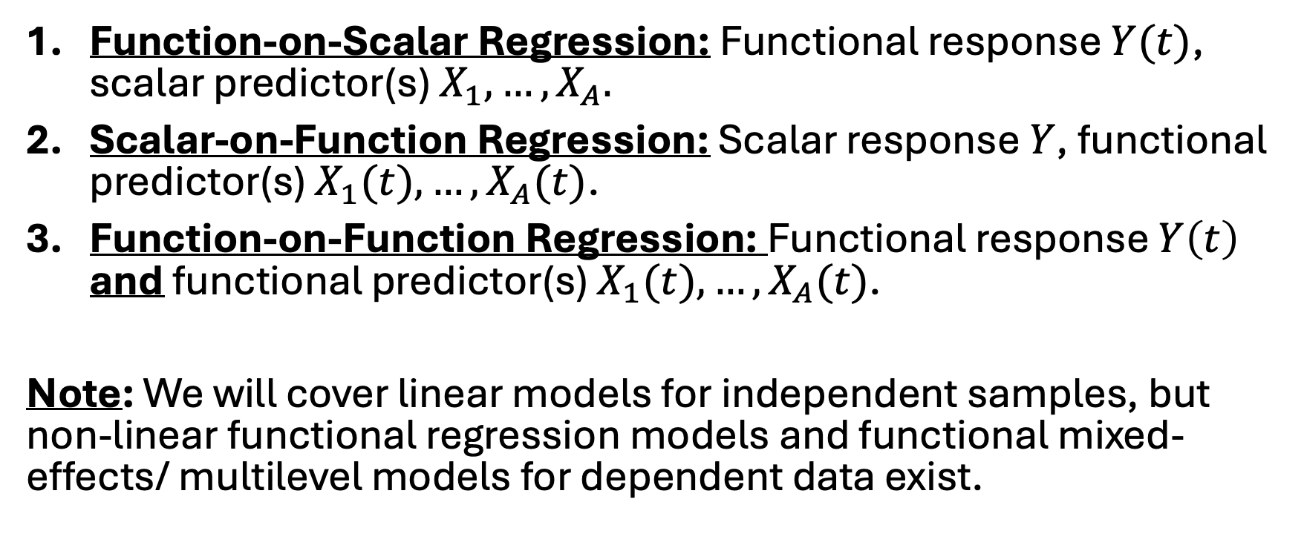
Types of Functional Regression
Function-on-Scalar Regression: Functional response $Y(t)$, scalar predictor(s) $X_{1},…,X_{A}.$
Scalar-on-Function Regression: Scalar response $Y$, functional predictor(s) $X_{1}(t),…,X_{A}(t)$.
Function-on-Function Regression: Functional response $Y\left(t\right)$ and functional predictor(s) $X_{1}(t),…,X_{A}(t)$.
Note: We will cover linear models for independent samples, but non-linear functional regression models and functional mixed-effects/ multilevel models for dependent data exist.

Slide 4
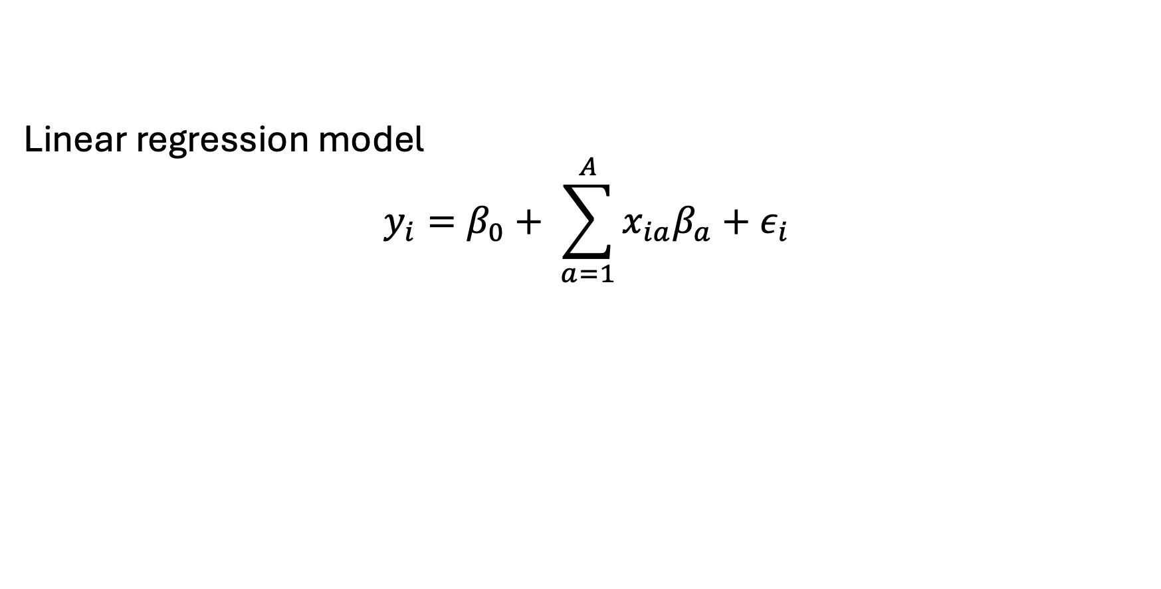
Function-on-Scalar Regression
Linear regression model
$$y_{i}=β_{0}+ \sum_{a=1}^{A}{x_{ia}β_{a}+ε_{i}}$$

Slide 5
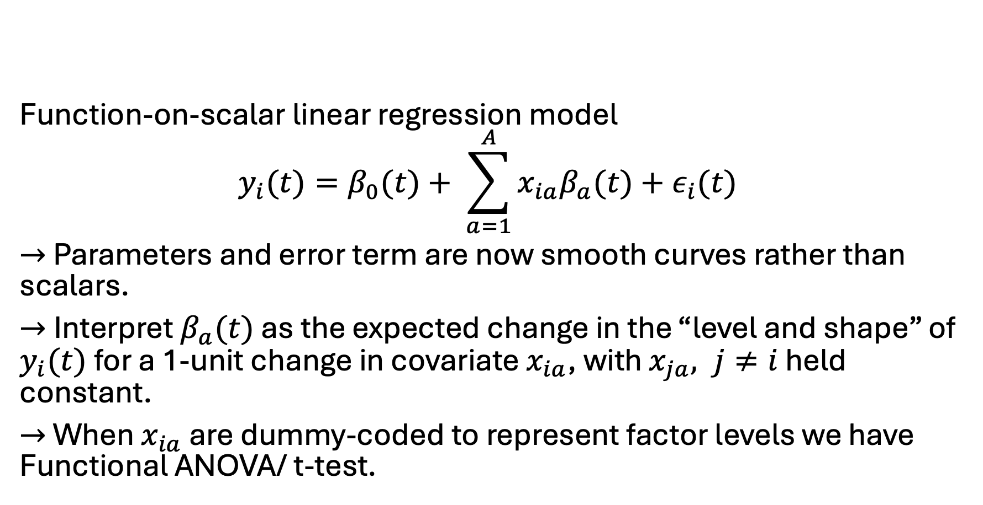
Function-on-Scalar Regression
Function-on-scalar linear regression model
$$y_{i}(t)=β_{0}(t)+ \sum_{a=1}^{A}{x_{ia}β_{a}(t)+ε_{i}(t)}$$
$→$ Parameters and error term are now smooth curves rather than scalars.
$→$Interpret $β_{a}(t)$ as the expected change in the “level and shape” of $y_{i}(t)$ for a 1-unit change in covariate $x_{ia}$, with $x_{ja}, j≠i$ held constant.
$→$ When $x_{ia}$ are dummy-coded to represent factor levels we have Functional ANOVA/ t-test.

Slide 6
Function-on-Scalar Regression

Slide 7
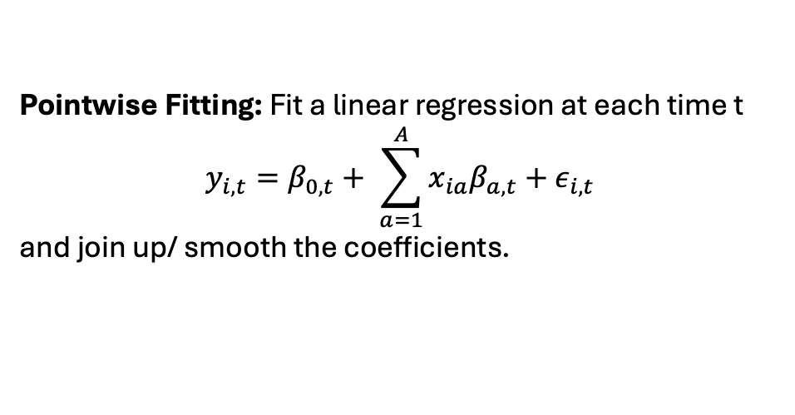
Fitting
But more refined approaches using basis expansions and smoothing penalties are typically used!
Pointwise Fitting: Fit a linear regression at each time t
$$y_{i,t}=β_{0,t}+ \sum_{a=1}^{A}{x_{ia}β_{a,t}+ε_{i,t}}$$
and join up/ smooth the coefficients.

Slide 8
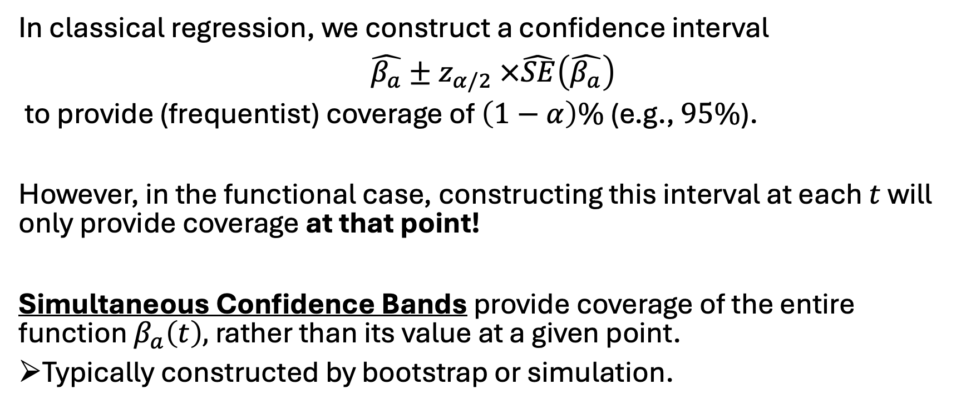
Inference
In classical regression, we construct a confidence interval
$\hat{β_{a}}±z_{α/2} ×\hat{SE}\left(\hat{β_{a}}\right)$
to provide (frequentist) coverage of $\left(1−α\right)\%$ (e.g., $95\%$).
However, in the functional case, constructing this interval at each $t$ will only provide coverage at that point!
Simultaneous Confidence Bands provide coverage of the entire function $β_{a}\left(t\right),$ rather than its value at a given point.
Typically constructed by bootstrap or simulation.

Slide 9
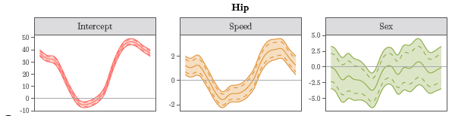
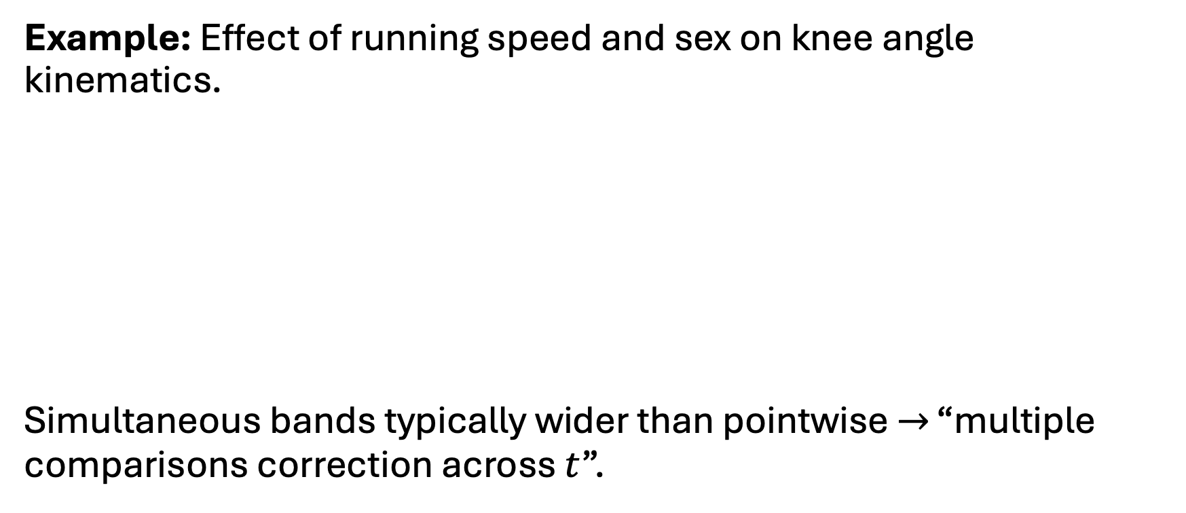
Inference
Example: Effect of running speed and sex on knee angle kinematics.
Simultaneous bands typically wider than pointwise $→$ “multiple comparisons correction across $t$”.

Slide 10
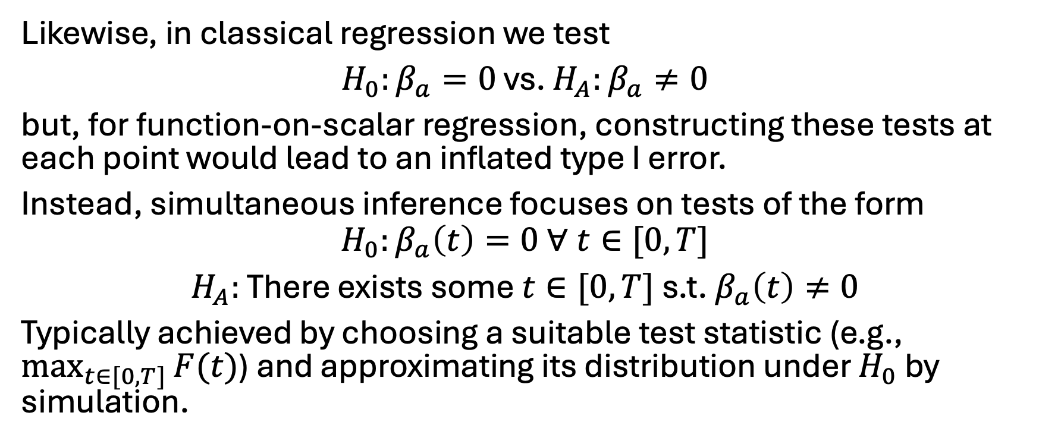
Inference
Likewise, in classical regression we test
$H_{0}:β_{a}=0$ vs. $H_{A}:β_{a}≠0$
but, for function-on-scalar regression, constructing these tests at each point would lead to an inflated type I error.
Instead, simultaneous inference focuses on tests of the form
$$H_{0}:β_{a}\left(t\right)=0 ∀ t∈[0, T]$$
$H_{A}:$ There exists some $t∈[0, T]$ s.t. $β_{a}\left(t\right)≠0$
Typically achieved by choosing a suitable test statistic (e.g., $\max_{t∈[0,T]}{F(t)}$) and approximating its distribution under $H_{0}$ by simulation.

Slide 11
Example
GaitRec Dataset (Horsak et al., 2021)

Slide 12
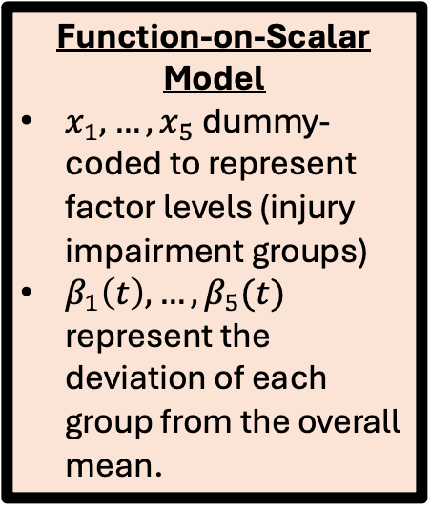
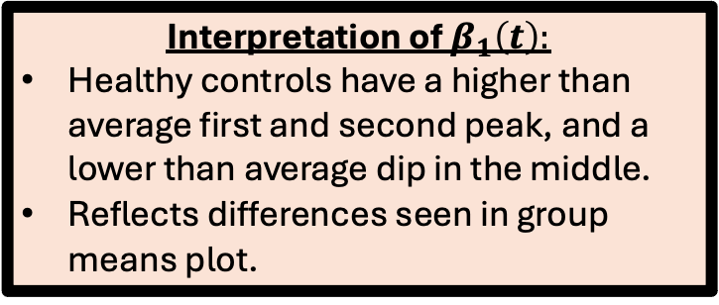
Example
Function-on-Scalar Model
$x_{1},…,x_{5}$ dummy-coded to represent factor levels (injury impairment groups)
$β_{1}\left(t\right),…,β_{5}(t)$ represent the deviation of each group from the overall mean.
Interpretation of $β_{1}\left(t\right):$
Healthy controls have a higher than average first and second peak, and a lower than average dip in the middle.
Reflects differences seen in group means plot.

Slide 13
Example

Slide 14
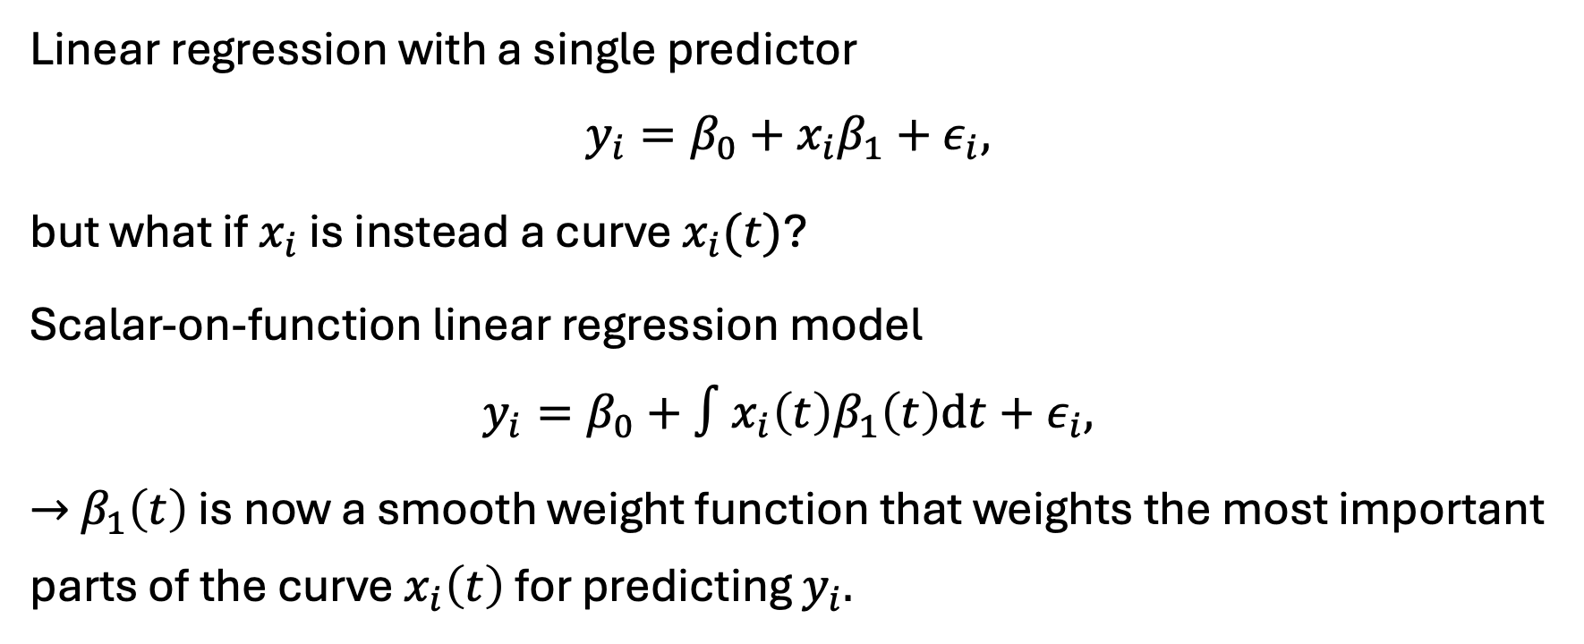
Scalar-on-Function Regression
Linear regression with a single predictor
$$y_{i}=β_{0}+x_{i}β_{1}+ε_{i},$$
but what if $x_{i}$ is instead a curve $x_{i}(t)$?
Scalar-on-function linear regression model
$$y_{i}=β_{0}+∫x_{i}\left(t\right)β_{1}\left(t\right)dt+ε_{i},$$
$→$ $β_{1}\left(t\right)$ is now a smooth weight function that weights the most important parts of the curve $x_{i}\left(t\right)$ for predicting $y_{i}.$

Slide 15
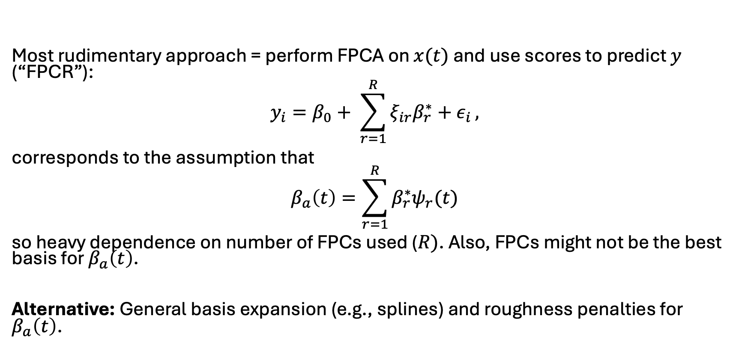
Fitting
Most rudimentary approach = perform FPCA on $x(t)$ and use scores to predict $y$ (“FPCR”):
$$y_{i}=β_{0}+ \sum_{r=1}^{R}{ξ_{ir}β_{r}^{∗}+ε_{i}},$$
corresponds to the assumption that
$$β_{a}\left(t\right)=\sum_{r=1}^{R}{β_{r}^{∗}ψ_{r}(t)}$$
so heavy dependence on number of FPCs used ($R)$. Also, FPCs might not be the best basis for $β_{a}\left(t\right)$.
Alternative: General basis expansion (e.g., splines) and roughness penalties for $β_{a}\left(t\right)$.

Slide 16
Example
Predict maximum anterior-posterior force using the full vertical ground reaction force curve.
Descriptive Analysis
Apply FPCA to Vertical GRF curves and looked at correlation of first two FPC scores with Max. A-P force.

Slide 17
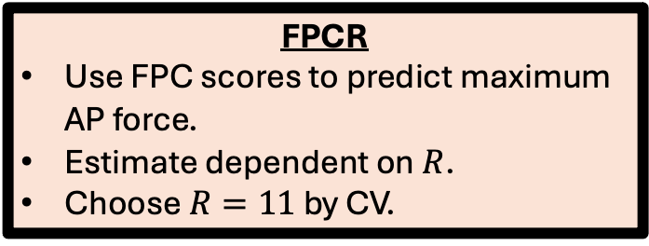
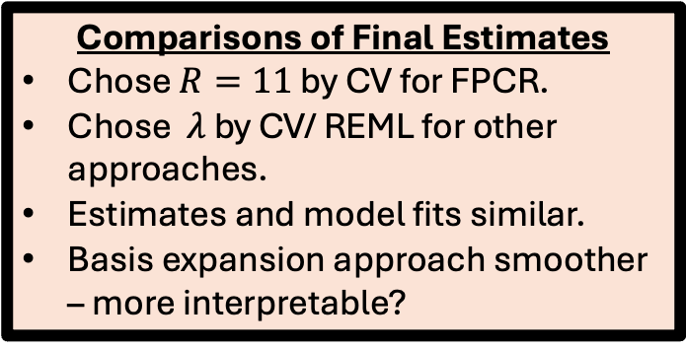
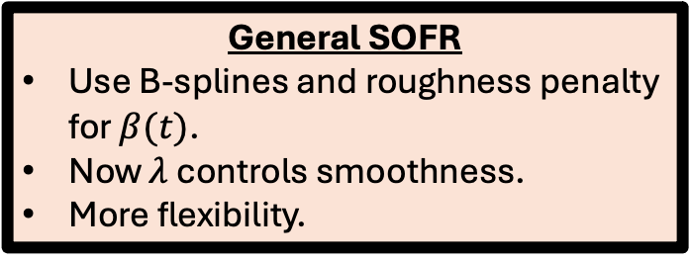
Example
FPCR
Use FPC scores to predict maximum AP force.
Estimate dependent on $R$.
Choose $R=11$ by CV.
Predict maximum anterior-posterior force using the full vertical ground reaction force curve.
General SOFR
Use B-splines and roughness penalty for $β(t)$.
Now $λ$ controls smoothness.
More flexibility.
Comparisons of Final Estimates
Chose $R=11$ by CV for FPCR.
Chose $λ$ by CV/ REML for other approaches.
Estimates and model fits similar.
Basis expansion approach smoother – more interpretable?

Slide 18
References
Chapters 12-16 of Ramsay, J. O., Hooker, G., & Graves, S. (2009). Functional Data Analysis with R and MATLAB. Springer-Verlag. https://doi.org/10.1007/978-0-387-98185-7
Chapters 9 and 10 of Ramsay, J. O., & Silverman, B. W. (2005). Functional Data Analysis (2nd ed.). Springer-Verlag. https://doi.org/10.1007/b98888
Morris, J. S. (2015). Functional Regression. Annual Review of Statistics and Its Application, 2, 321–359.
GaitRec Dataset: Horsak, B., Slijepcevic, D., Raberger, A.-M., Schwab, C., Worisch, M., & Zeppelzauer, M. (2020). GaitRec, a large-scale ground reaction force dataset of healthy and impaired gait. Scientific Data, 7(1), Article 1. https://doi.org/10.1038/s41597-020-0481-z

