Slide 1

Data Representation and Smoothing
Prof. Drew Harrison (University of Limerick)
Dr. Edward Gunning (University of Pennsylvania)
ISBS 2024
Functional Data Analysis for Sports Biomechanics
Pre-conference Workshop
July 15th, 2024

Slide 2
Key Idea
For each curve, we have a series of discrete sampled measurements (typically “noisy”/ with error).
We want to convert these to smooth functions for analysis.
x(t₁) | x(t₂) | … | x(t_{T})
-4.33 | -5.26 | … | -4.11
. . . | . . . | . . . | . . .
-3.95 | -5.96 | … | -2.12
Basis Function Expansions
.
.
.

Slide 3

Basis Functions
Set of $K$ known functions $φ_{1}\left(t\right), …,φ_{K}(t)$
Can use a linear combination (or “weighted sum”) of them to approximate any function to a desired degree by making $K$ sufficiently large.

Slide 4
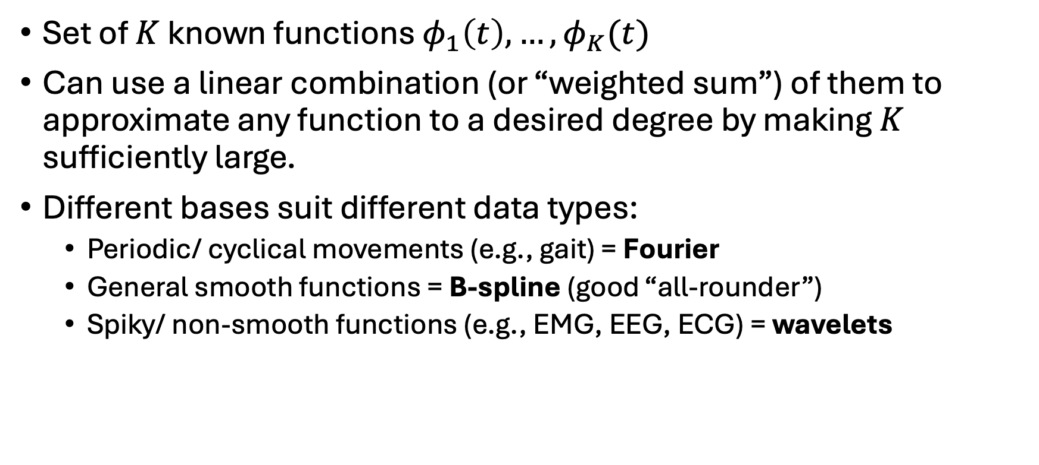
Basis Functions
Set of $K$ known functions $φ_{1}\left(t\right), …,φ_{K}(t)$
Can use a linear combination (or “weighted sum”) of them to approximate any function to a desired degree by making $K$ sufficiently large.
Different bases suit different data types:
Periodic/ cyclical movements (e.g., gait) = Fourier
General smooth functions = B-spline (good “all-rounder”)
Spiky/ non-smooth functions (e.g., EMG, EEG, ECG) = wavelets

Slide 5
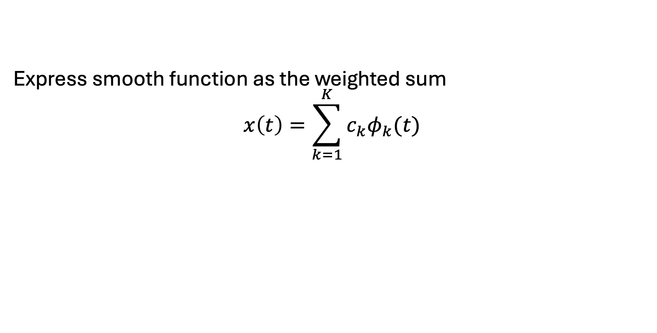
Basis Functions
Express smooth function as the weighted sum
$$x\left(t\right)=\sum_{k=1}^{K}{c_{k}φ_{k}(t)}$$
Fitted Curve
Basis Coefficient
Basis Function

Slide 6
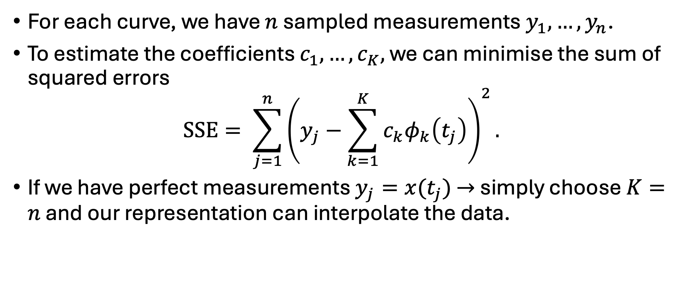

How do we choose $K$?
For each curve, we have $n$ sampled measurements $y_{1},…,y_{n}$.
To estimate the coefficients $c_{1},…,c_{K},$ we can minimise the sum of squared errors
$$SSE= \sum_{j=1}^{n}{{\left(y_{j}−\sum_{k=1}^{K}{c_{k}φ_{k}\left(t_{j}\right)}\right)}^{2}.}$$
If we have perfect measurements $y_{j}=x(t_{j})$ $→$ simply choose $K=n$ and our representation can interpolate the data.

Slide 7
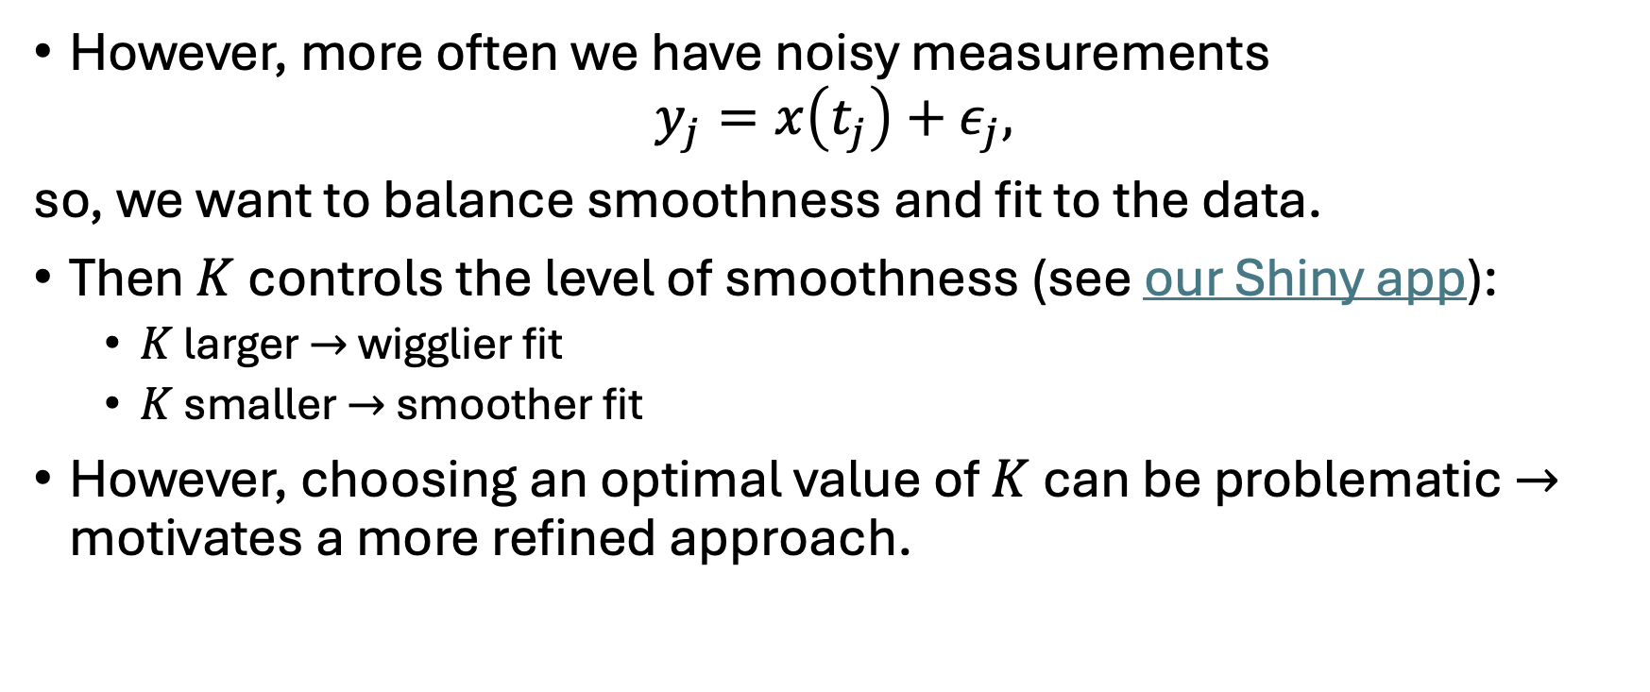
How do we choose $K$?
However, more often we have noisy measurements
$$y_{j}=x\left(t_{j}\right)+ε_{j},$$
so, we want to balance smoothness and fit to the data.
Then $K$ controls the level of smoothness (see our Shiny app):
$K$ larger $→$ wigglier fit
$K$ smaller $→$ smoother fit
However, choosing an optimal value of $K$ can be problematic $→$ motivates a more refined approach.

Slide 8

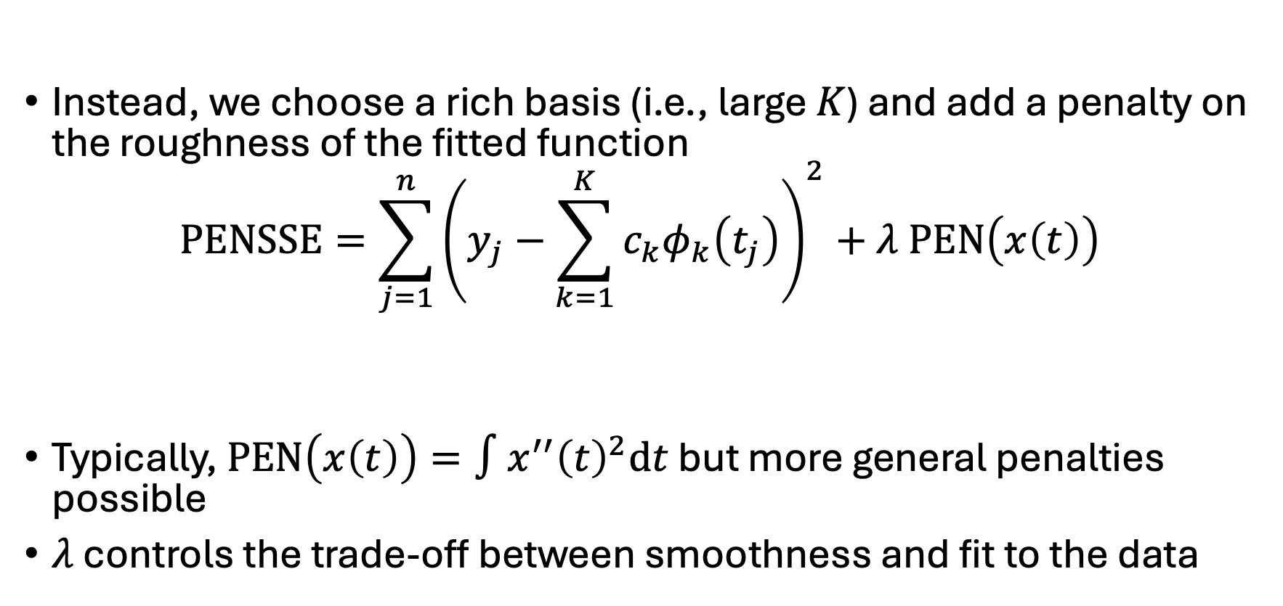


Penalised Least Squares Smoothing
Instead, we choose a rich basis (i.e., large $K$) and add a penalty on the roughness of the fitted function
$$PENSSE=\sum_{j=1}^{n}{{\left(y_{j}−\sum_{k=1}^{K}{c_{k}φ_{k}\left(t_{j}\right)}\right)}^{2}+λ PEN\left(x\left(t\right)\right)}$$
Typically, $PEN\left(x\left(t\right)\right)=∫x^{′′}{\left(t\right)}^{2}dt$ but more general penalties possible
$λ$ controls the trade-off between smoothness and fit to the data
$$Smoothing Parameter$$
$$Penalty$$
$$SSE$$

Slide 9

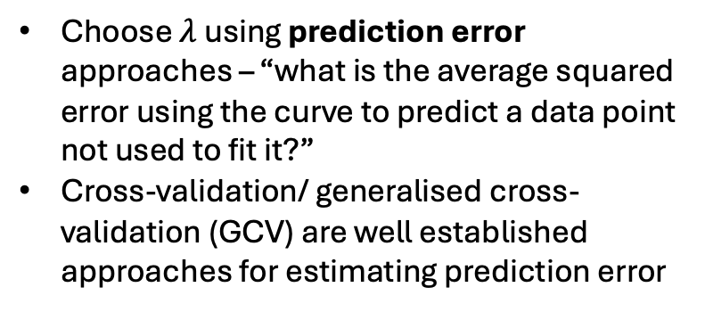
Choosing $λ$
Choose $λ$ using prediction error approaches – “what is the average squared error using the curve to predict a data point not used to fit it?”
Cross-validation/ generalised cross- validation (GCV) are well established approaches for estimating prediction error
Other approaches (e.g., adjusting by eye) also possible (see our Shiny app)

Slide 10
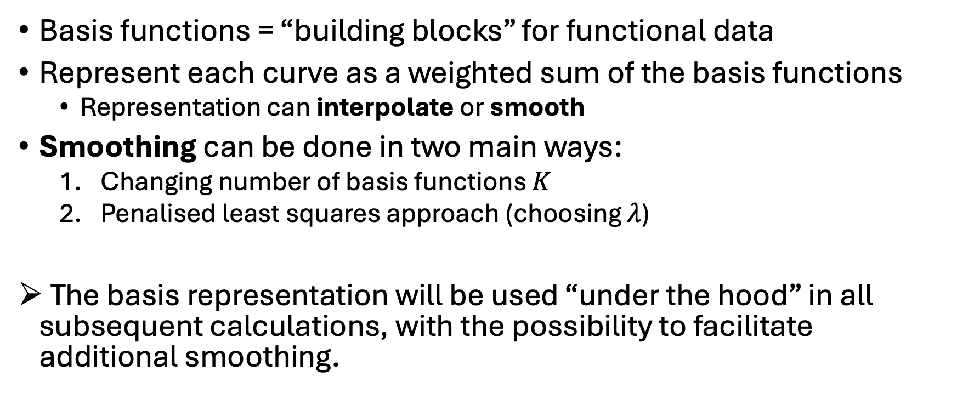
Summary
Basis functions = “building blocks” for functional data
Represent each curve as a weighted sum of the basis functions
Representation can interpolate or smooth
Smoothing can be done in two main ways:
Changing number of basis functions $K$
Penalised least squares approach (choosing $λ$)
The basis representation will be used “under the hood” in all subsequent calculations, with the possibility to facilitate additional smoothing.

Slide 11
References
Chapters 3 - 5 of Ramsay, J. O., & Silverman, B. W. (2005). Functional Data Analysis (2nd ed.). Springer-Verlag. https://doi.org/10.1007/b98888

