Slide 1

Functional Regression
Prof. Drew Harrison (University of Limerick)
Dr. Edward Gunning (University of Pennsylvania)
ISBS 2024
Functional Data Analysis for Sports Biomechanics
Pre-conference Workshop
July 15th, 2024

Slide 2
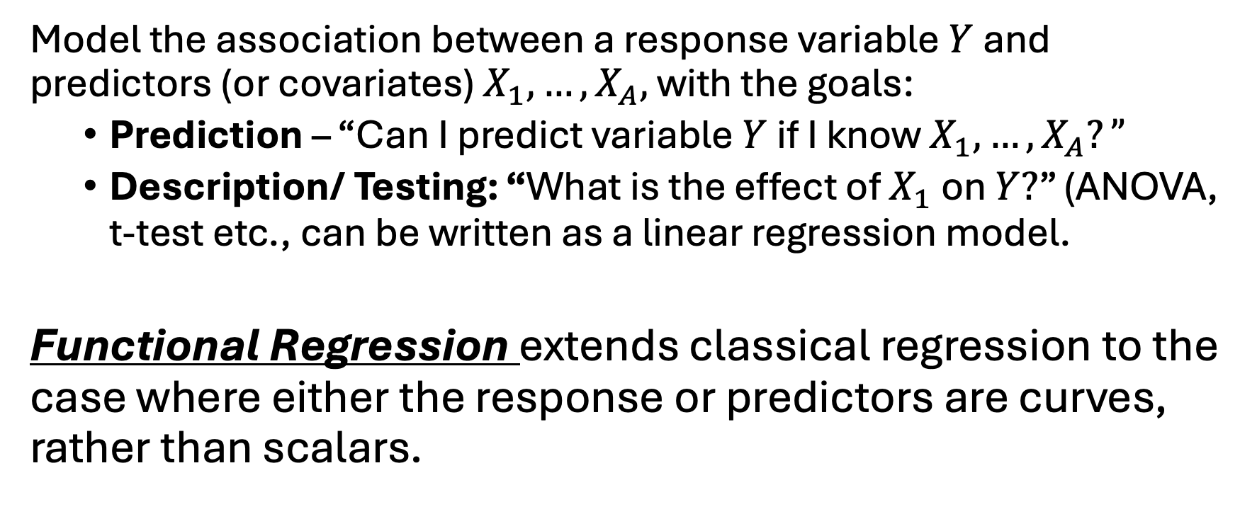
Regression
Model the association between a response variable $Y$ and predictors (or covariates) $X_{1},…,X_{A},$ with the goals:
Prediction – “Can I predict variable $Y$ if I know $X_{1},…,X_{A}?”$
Description/ Testing: “What is the effect of $X_{1}$ on $Y?$” (ANOVA, t-test etc., can be written as a linear regression model.
Functional Regression extends classical regression to the case where either the response or predictors are curves, rather than scalars.

Slide 3
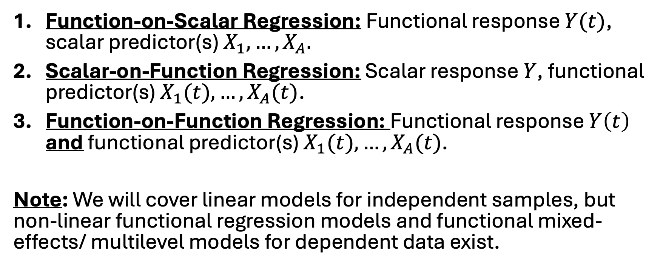
Types of Functional Regression
Function-on-Scalar Regression: Functional response $Y(t)$, scalar predictor(s) $X_{1},…,X_{A}.$
Scalar-on-Function Regression: Scalar response $Y$, functional predictor(s) $X_{1}(t),…,X_{A}(t)$.
Function-on-Function Regression: Functional response $Y\left(t\right)$ and functional predictor(s) $X_{1}(t),…,X_{A}(t)$.
Note: We will cover linear models for independent samples, but non-linear functional regression models and functional mixed-effects/ multilevel models for dependent data exist.

Slide 4
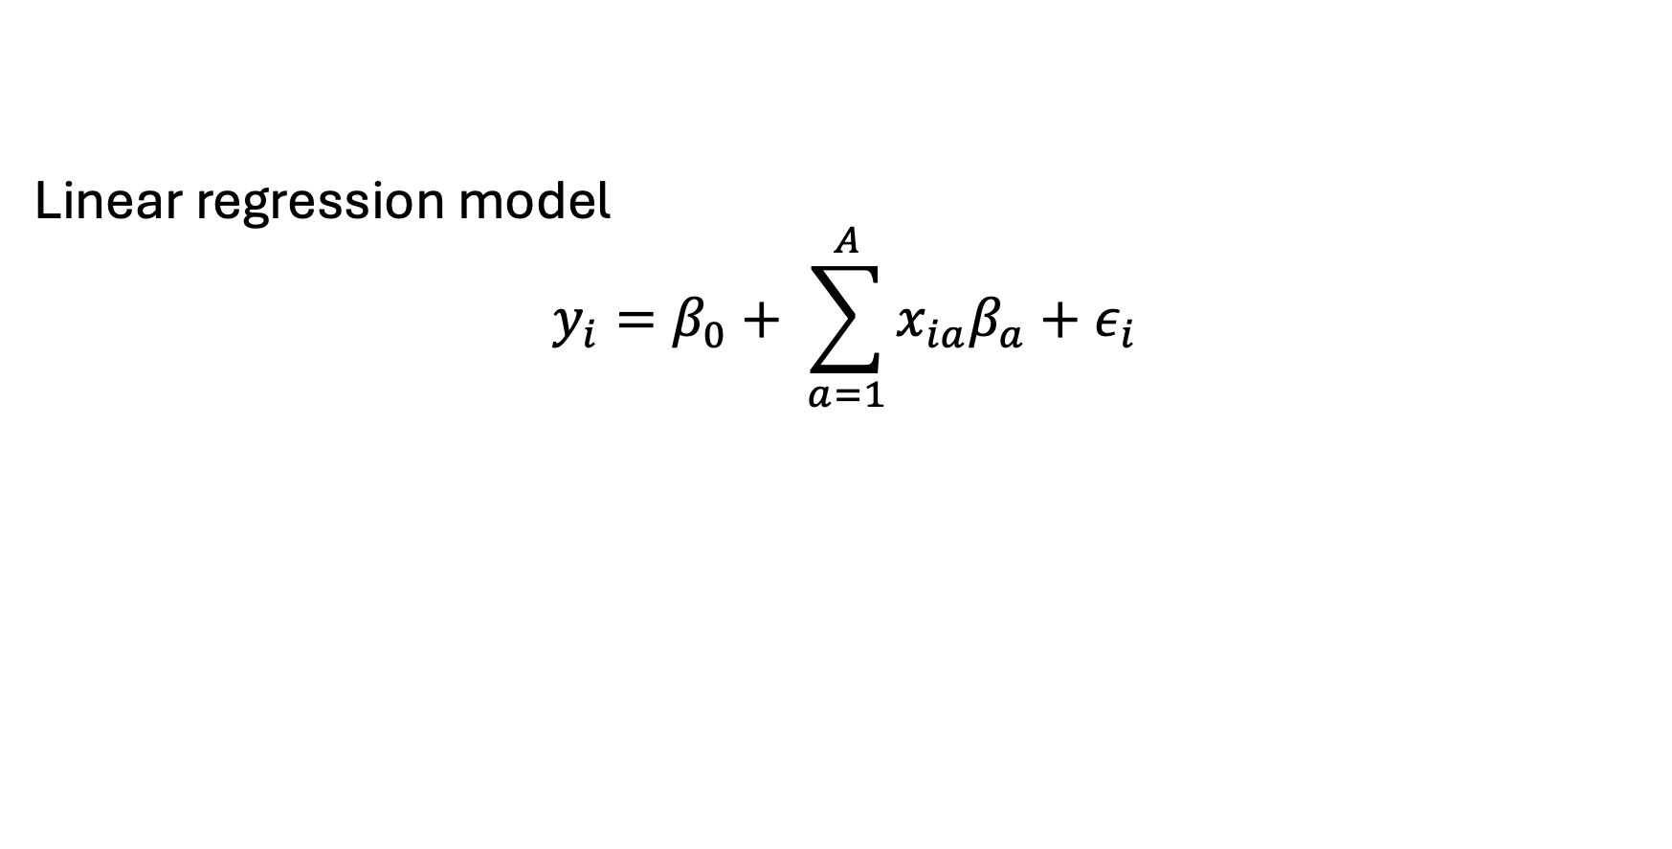
Function-on-Scalar Regression
Linear regression model
$$y_{i}=β_{0}+ \sum_{a=1}^{A}{x_{ia}β_{a}+ε_{i}}$$

Slide 5
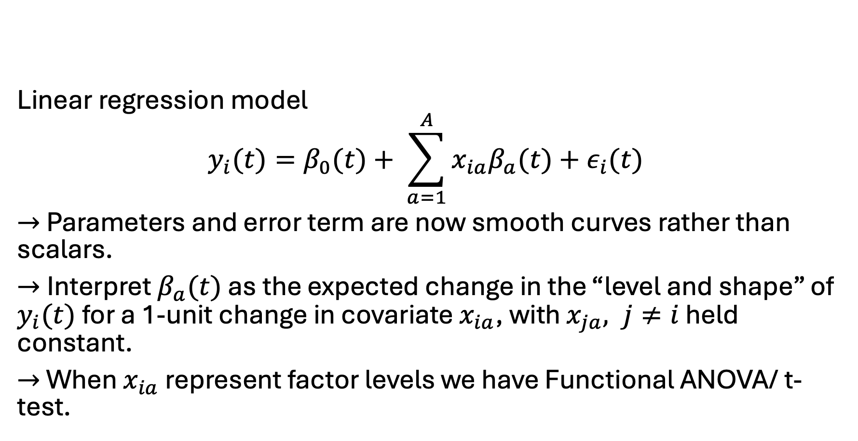
Function-on-Scalar Regression
Linear regression model
$$y_{i}(t)=β_{0}(t)+ \sum_{a=1}^{A}{x_{ia}β_{a}(t)+ε_{i}(t)}$$
$→$ Parameters and error term are now smooth curves rather than scalars.
$→$Interpret $β_{a}(t)$ as the expected change in the “level and shape” of $y_{i}(t)$ for a 1-unit change in covariate $x_{ia}$, with $x_{ja}, j≠i$ held constant.
$→$ When $x_{ia}$ represent factor levels we have Functional ANOVA/ t-test.

Slide 6
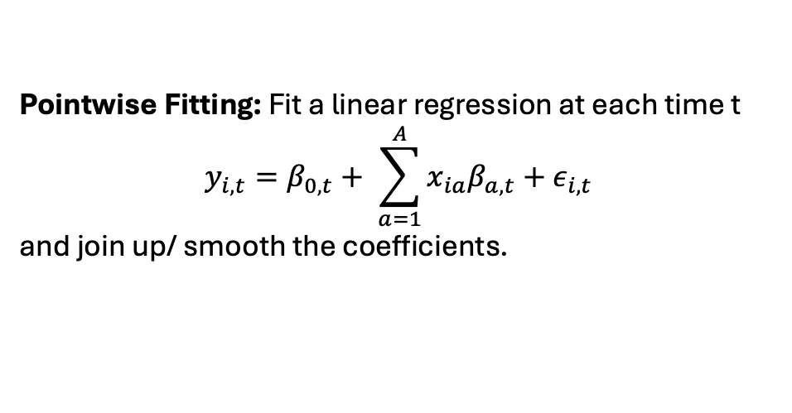
Fitting
But more refined approaches using basis expansions and smoothing penalties are typically used!
Pointwise Fitting: Fit a linear regression at each time t
$$y_{i,t}=β_{0,t}+ \sum_{a=1}^{A}{x_{ia}β_{a,t}+ε_{i,t}}$$
and join up/ smooth the coefficients.

