Slide 1
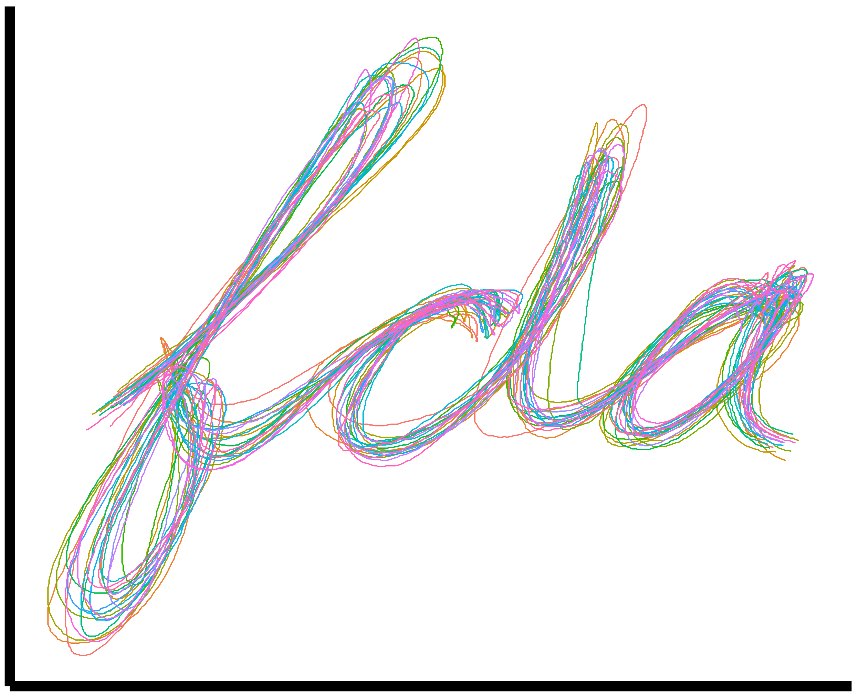
Registration
Prof. Drew Harrison (University of Limerick)
Dr. Edward Gunning (University of Pennsylvania)
ISBS 2024
Functional Data Analysis for Sports Biomechanics
Pre-conference Workshop
July 15th, 2024

Slide 2
Phase Variation

Slide 3
Consequences of Phase Variation
Two main consequences of phase variation:
Mean functions will not be interpretable (see previous slide)
Increased variability due to misalignments

Slide 4
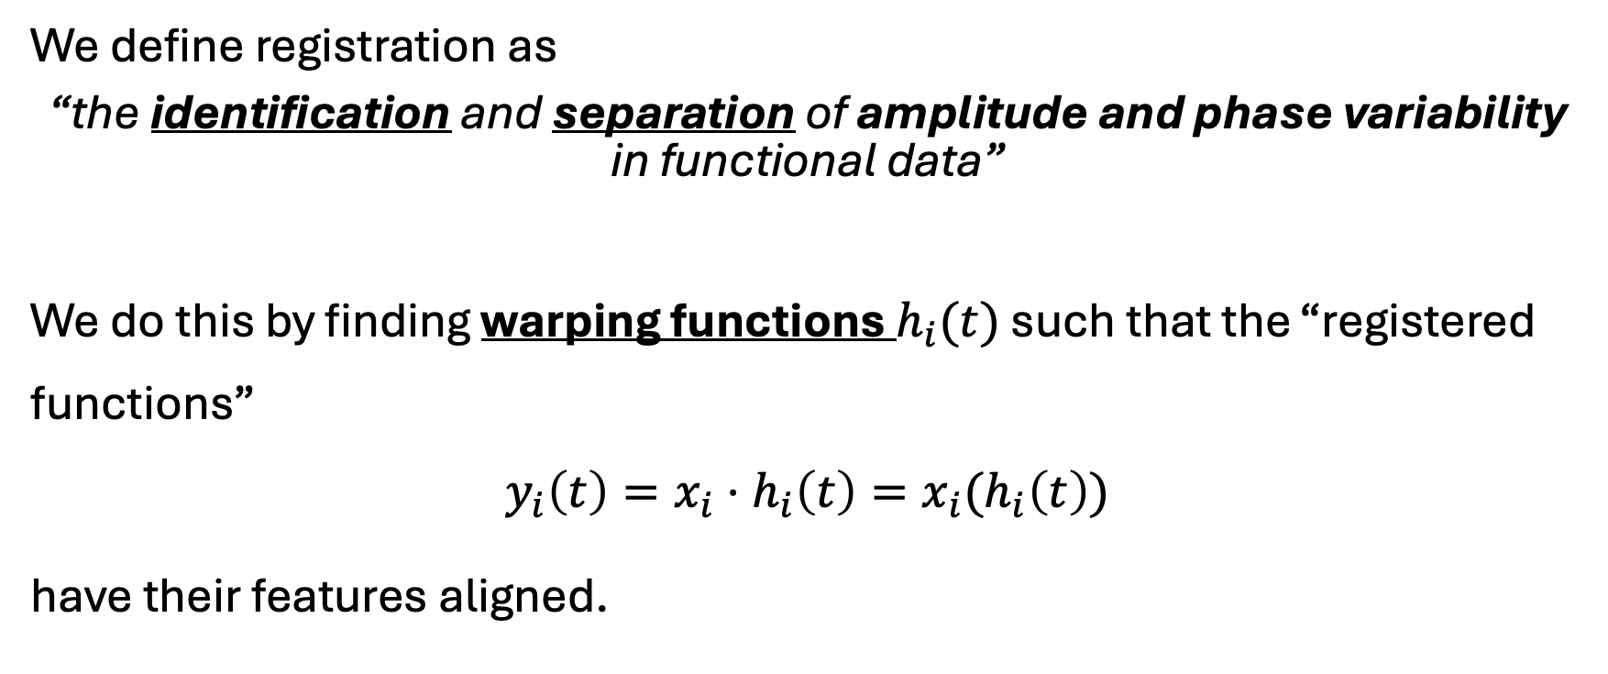
Registration
We define registration as
“the identification and separation of amplitude and phase variability in functional data”
We do this by finding warping functions $h_{i}(t)$ such that the “registered functions”
$$y_{i}\left(t\right)=x_{i}⋅h_{i}\left(t\right)=x_{i}(h_{i}\left(t\right))$$
have their features aligned.

Slide 5
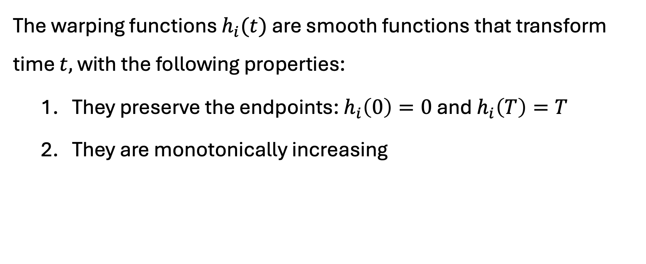
Warping Functions
The warping functions $h_{i}(t)$ are smooth functions that transform time $t,$ with the following properties:
They preserve the endpoints: $h_{i}\left(0\right)=0$ and $h_{i}\left(T\right)=T$
They are monotonically increasing

