Slide 1

Data Representation and Smoothing
Prof. Drew Harrison (University of Limerick)
Dr. Edward Gunning (University of Pennsylvania)
ISBS 2024
Functional Data Analysis for Sports Biomechanics
Pre-conference Workshop
July 15th, 2024

Slide 2
Key Idea
For each curve, we have a series of discrete sampled measurements (typically “noisy”/ with error).
We want to convert these to smooth functions for analysis.
y(t₁) | y(t₂) | … | y(t_{T})
-4.33 | -5.26 | … | -4.11
. . . | . . . | . . . | . . .
-3.95 | -5.96 | … | -2.12
We do this using basis function expansions
.
.
.

Slide 3
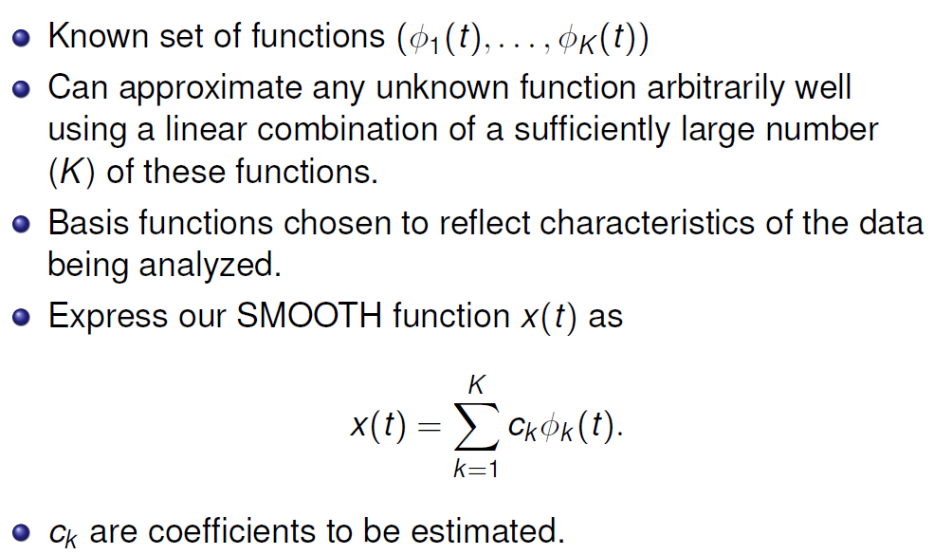

Basis Function Expansions

