Slide 1

Data Representation and Smoothing
Prof. Drew Harrison (University of Limerick)
Dr. Edward Gunning (University of Pennsylvania)
ISBS 2024
Functional Data Analysis for Sports Biomechanics
Pre-conference Workshop
July 15th, 2024

Slide 2
Key Idea
For each curve, we have a series of discrete sampled measurements (typically “noisy”/ with error).
We want to convert these to smooth functions for analysis.
x(t₁) | x(t₂) | … | x(t_{T})
-4.33 | -5.26 | … | -4.11
. . . | . . . | . . . | . . .
-3.95 | -5.96 | … | -2.12
Basis Function Expansions
.
.
.

Slide 3

Basis Functions
Set of $K$ known functions $φ_{1}\left(t\right), …,φ_{K}(t)$
Can use a linear combination (or “weighted sum”) of them to approximate any function to a desired degree by making $K$ sufficiently large.

Slide 4
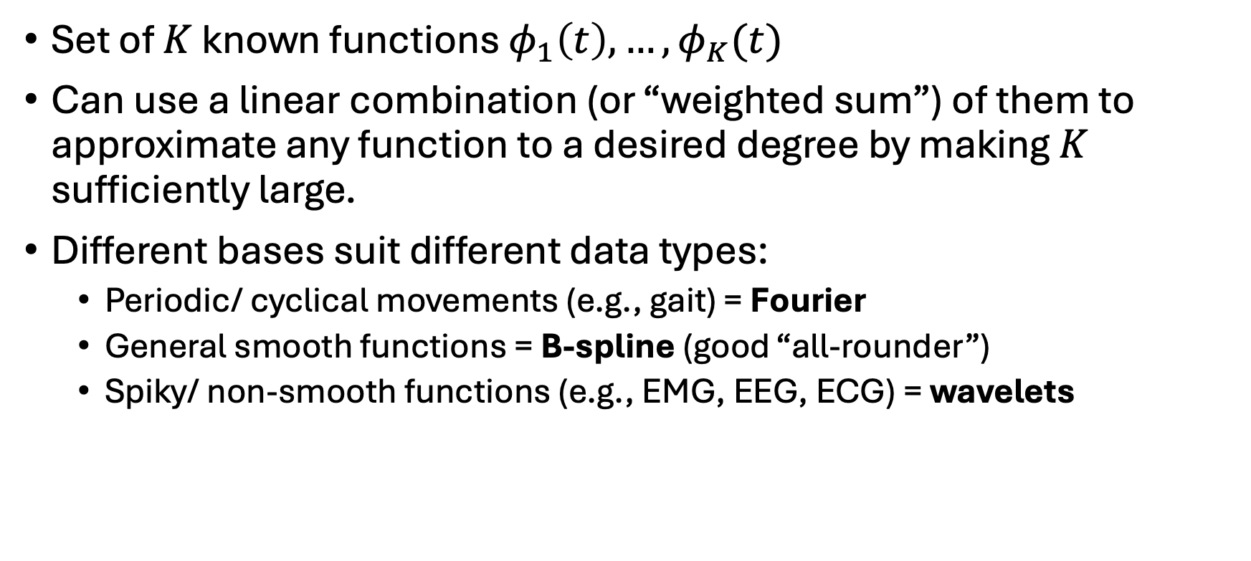
Basis Functions
Set of $K$ known functions $φ_{1}\left(t\right), …,φ_{K}(t)$
Can use a linear combination (or “weighted sum”) of them to approximate any function to a desired degree by making $K$ sufficiently large.
Different bases suit different data types:
Periodic/ cyclical movements (e.g., gait) = Fourier
General smooth functions = B-spline (good “all-rounder”)
Spiky/ non-smooth functions (e.g., EMG, EEG, ECG) = wavelets

Slide 5
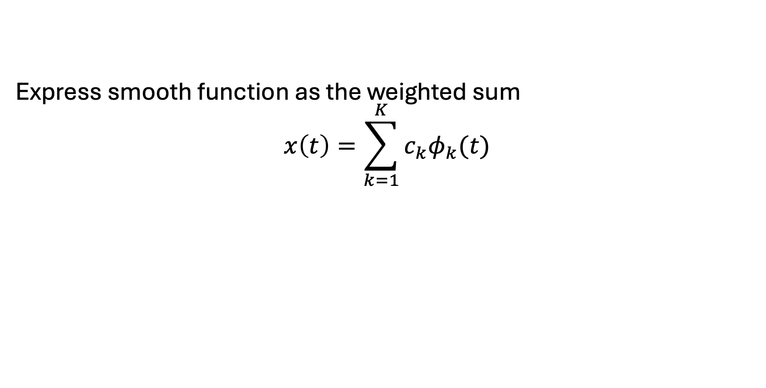
Basis Functions
Express smooth function as the weighted sum
$$x\left(t\right)=\sum_{k=1}^{K}{c_{k}φ_{k}(t)}$$
Fitted Curve
Basis Coefficient
Basis Function

