Slide 1
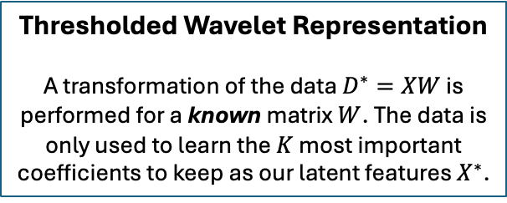
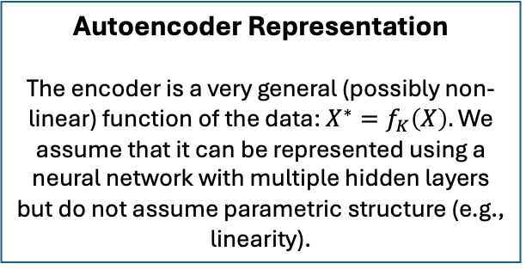
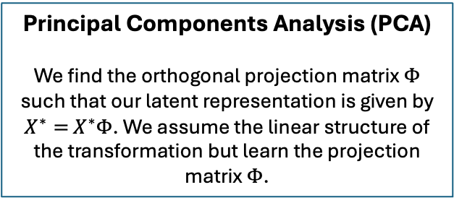
Thresholded Wavelet Representation
A transformation of the data $D^{∗}=XW$ is performed for a known matrix $W$. The data is only used to learn the $K$ most important coefficients to keep as our latent features $X^{∗}$.
Autoencoder Representation
The encoder is a very general (possibly non-linear) function of the data: $X^{∗}=f_{K}\left(X\right).$ We assume that it can be represented using a neural network with multiple hidden layers but do not assume parametric structure (e.g., linearity).
Representation Fixed a-priori
Representation Learned from the Data
Flexibility
Less Reliance on Data
Principal Components Analysis (PCA)
We find the orthogonal projection matrix $Φ$ such that our latent representation is given by $X^{∗}=$ $X^{∗}Φ$. We assume the linear structure of the transformation but learn the projection matrix $Φ$.
Parametric Transformations with Structure and Parameters Completely Specified

