Slide 1

Functional Principal Components Analysis
Prof. Drew Harrison (University of Limerick)
Dr. Edward Gunning (University of Pennsylvania)
ISBS 2024
Functional Data Analysis for Sports Biomechanics
Pre-conference Workshop
July 15th, 2024

Slide 2
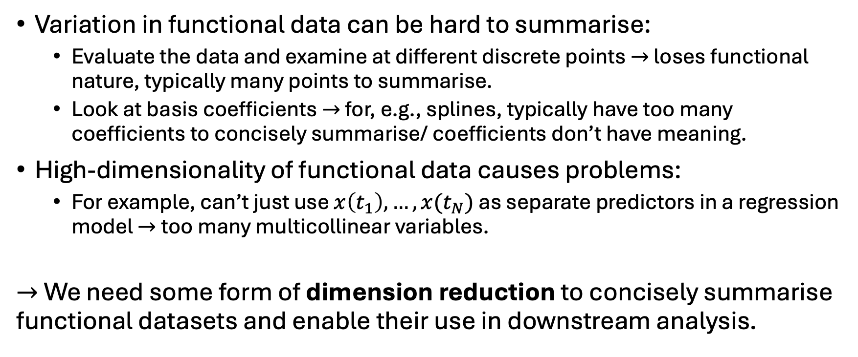
Motivation
Variation in functional data can be hard to summarise:
Evaluate the data and examine at different discrete points $→$ loses functional nature, typically many points to summarise.
Look at basis coefficients $→$ for, e.g., splines, typically have too many coefficients to concisely summarise/ coefficients don’t have meaning.
High-dimensionality of functional data causes problems:
For example, can’t just use $x\left(t_{1}\right), …, x(t_{N})$ as separate predictors in a regression model $→$ too many multicollinear variables.
$→$ We need some form of dimension reduction to concisely summarise functional datasets and enable their use in downstream analysis.

Slide 3
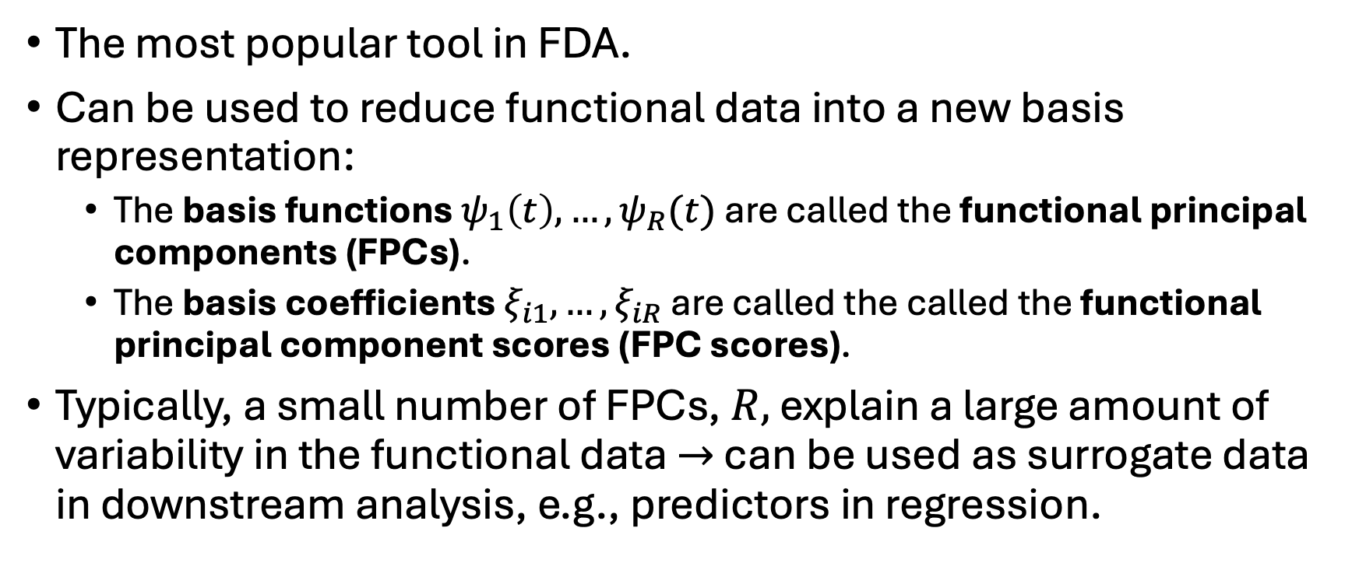
Functional Principal Components Analysis
The most popular tool in FDA.
Can be used to reduce functional data into a new basis representation:
The basis functions $ψ_{1}\left(t\right), …,ψ_{R}(t)$ are called the functional principal components (FPCs).
The basis coefficients $ξ_{i1},…,ξ_{iR}$ are called the called the functional principal component scores (FPC scores).
Typically, a small number of FPCs, $R,$ explain a large amount of variability in the functional data $→$ can be used as surrogate data in downstream analysis, e.g., predictors in regression.

Slide 4
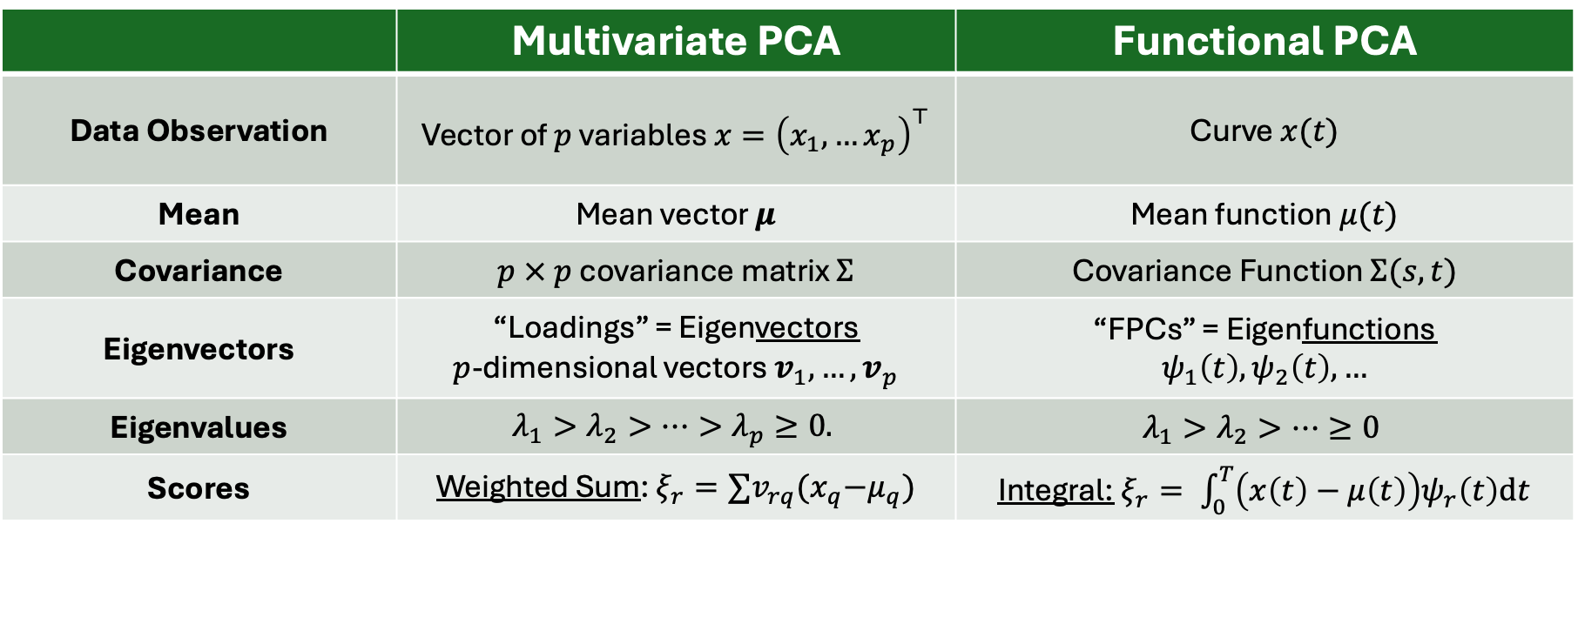
Multivariate vs Functional PCA
 | Multivariate PCA | Functional PCA
Data Observation | Vector of $p$ variables $x={\left(x_{1}, …x_{p}\right)}^{⊤}$ | Curve $x(t)$
Mean | Mean vector $μ$ | Mean function $μ(t)$
Covariance | $p × p$ covariance matrix $Σ$ | Covariance Function $Σ(s, t)$
Eigenvectors | “Loadings” = Eigenvectors $p$-dimensional vectors $v_{1}, …, v_{p}$ | “FPCs” = Eigenfunctions $$ψ_{1}\left(t\right),ψ_{2}\left(t\right), …$$
Eigenvalues | $$λ_{1}>λ_{2}>…>λ_{p}≥0.$$ | $$λ_{1}>λ_{2}>…≥0$$
Scores | Weighted Sum: $ξ_{r}=∑v_{rq}{(x}_{q}−μ_{q})$ | Integral:$ξ_{r}= \int_{0}^{T}{\left(x\left(t\right)−μ\left(t\right)\right)ψ_{r}\left(t\right)dt}$

Slide 5
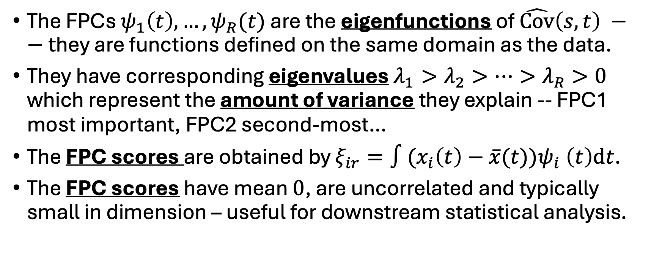
Technical Details of FPCA
The FPCs $ψ_{1}\left(t\right), …,ψ_{R}(t)$ are the eigenfunctions of $\hat{Cov}\left(s, t\right) −−t$hey are functions defined on the same domain as the data.
They have corresponding eigenvalues $λ_{1}>λ_{2}>…>λ_{R}>0$ which represent the amount of variance they explain -- FPC1 most important, FPC2 second-most…
The FPC scores are obtained by $ξ_{ir}=∫{(x}_{i}\left(t\right){− \overline{x}(t))ψ}_{i}\left(t\right)dt$.
The FPC scores have mean $0$, are uncorrelated and typically small in dimension – useful for downstream statistical analysis.

Slide 6
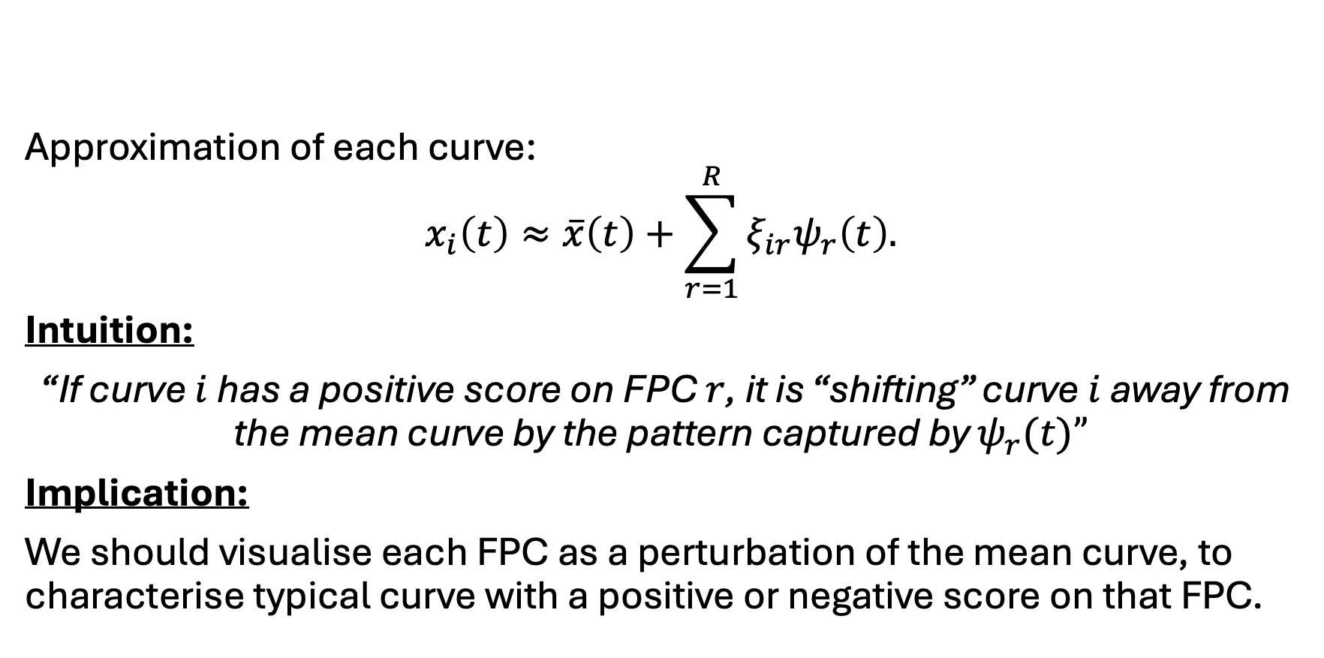
Visualising FPCA
Approximation of each curve:
$$x_{i}\left(t\right)≈\overline{x}\left(t\right)+\sum_{r=1}^{R}{ξ_{ir}ψ_{r}\left(t\right).}$$
Intuition:
“If curve $i$ has a positive score on FPC $r$, it is “shifting” curve $i$ away from the mean curve by the pattern captured by $ψ_{r}(t)”$
Implication:
We should visualise each FPC as a perturbation of the mean curve, to characterise typical curve with a positive or negative score on that FPC.
Mean curve
FPC
FPC Score

Slide 7
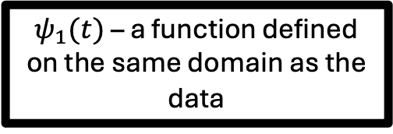
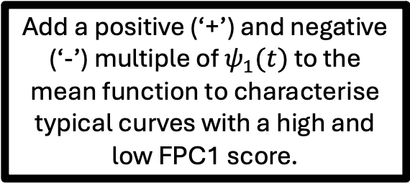
Visualising FPCA
Add a positive (‘+’) and negative (‘-’) multiple of $ψ_{1}(t)$ to the mean function to characterise typical curves with a high and low FPC1 score.
The curves in the dataset with the largest (blue) and smallest (red) FPC1 scores – these are the extrema of the curves typified in the middle plot!
$ψ_{1}(t)$ – a function defined on the same domain as the data

Slide 8
Some Case Studies
FPCA can:
Be used to concisely summarise the main modes of variation in functional data
Produce new variables (FPC scores) that can be used in downstream analysis (e.g., predictors in regression, comparisons between groups)
Let’s look at another real application in sports biomechanics

Slide 9
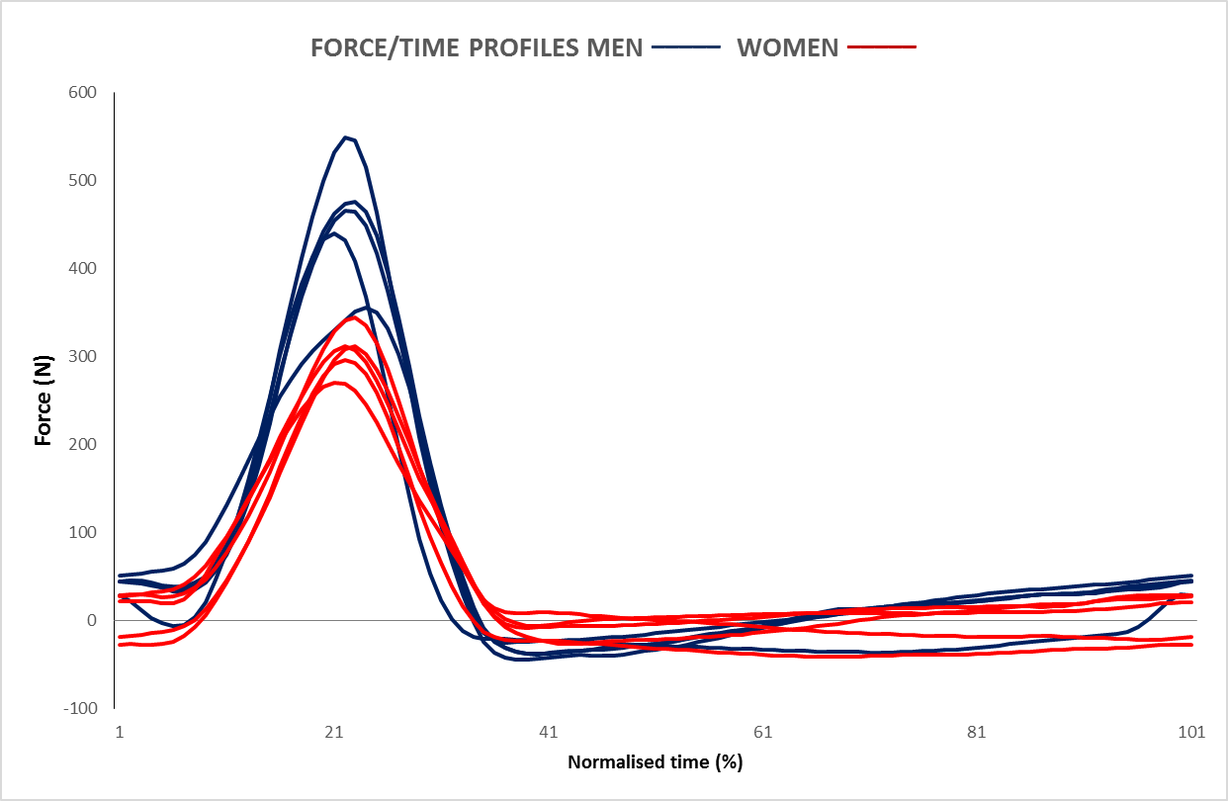
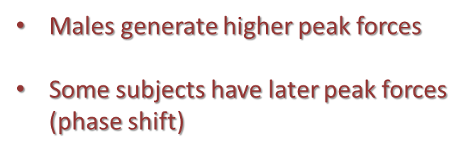
Applying FPCA to a limited data set in rowing biomechanics
What do we see?
Thanks to:
John Warmenhoven, Richard Smith & Connie Draper

Slide 10
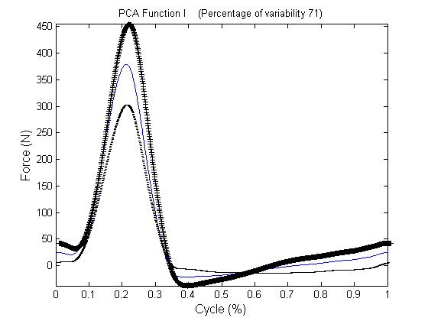
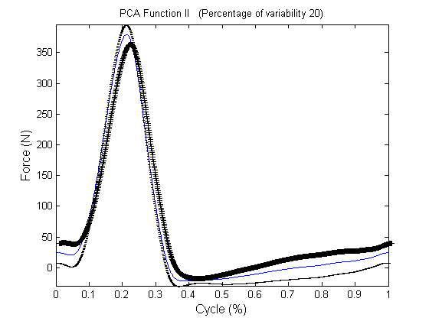
FPC1 and FPC2 account for >90% variance in force
FPC1 : high scorers (+) show higher than average peak forces and greater force range
FPC2 : high scorers (+) show later than average peak forces and general phase shift

Slide 11
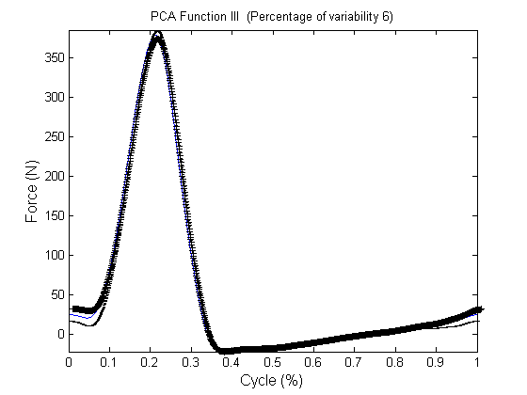
FPC3 accounts for 6% variance in force
FPC3 describes increased variation at the start of the cycle

Slide 12

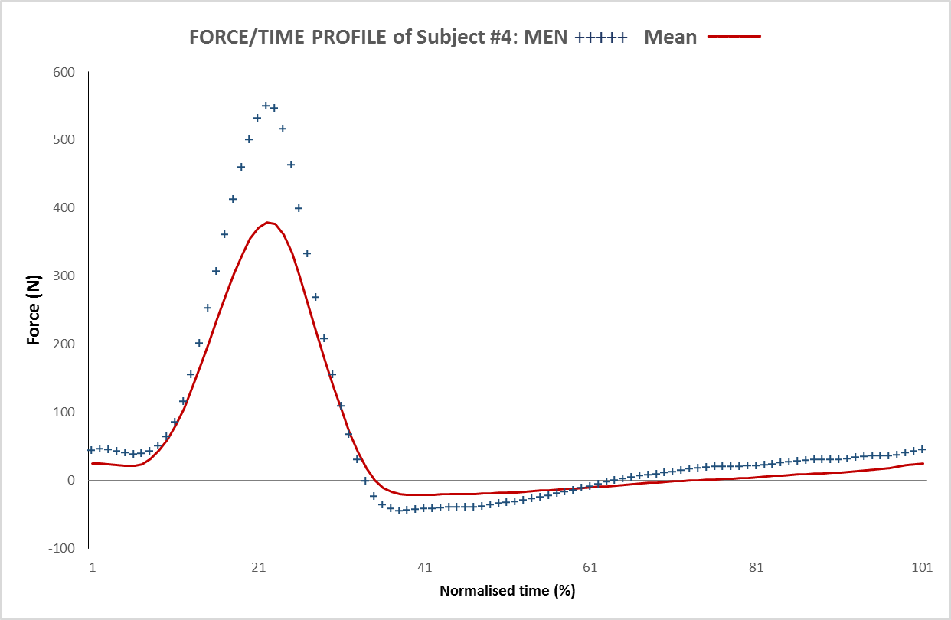
FPC1 and mean force function for subject #4
FPC1: high scorers represented by
+marks; low scorers by - marks
FPC scores relate to real subjects:
Male subject #4 has highest FPC1 score

Slide 13
FPC scores and real subjects
 | fPC1 | fPC2 | fPC3
Male | 2.134078 | -28.8862 | 14.40326
 | 29.6124 | 1.449802 | -3.05844
 | 8.108196 | 17.53892 | 6.56476
 | 45.63799 | -6.45741 | -1.82911
 | 32.86823 | 1.898835 | -7.09603
Female | -9.00321 | 8.545193 | -2.72248
 | -29.8595 | -2.47577 | -13.1602
 | -35.9693 | -20.343 | -5.75385
 | -15.4052 | 15.00169 | 4.344112
 | -28.1237 | 13.72799 | 8.307957
t-test male v female | p=0.001 | p=0.580 | p= 0.524
FPC scores relate to real subjects:
Male subject #4 has highest fPC1 score

Slide 14
FPC scores male vs female
 | fPC1 | fPC2 | fPC3
Male | 2.134078 | -28.8862 | 14.40326
 | 29.6124 | 1.449802 | -3.05844
 | 8.108196 | 17.53892 | 6.56476
 | 45.63799 | -6.45741 | -1.82911
 | 32.86823 | 1.898835 | -7.09603
Female | -9.00321 | 8.545193 | -2.72248
 | -29.8595 | -2.47577 | -13.1602
 | -35.9693 | -20.343 | -5.75385
 | -15.4052 | 15.00169 | 4.344112
 | -28.1237 | 13.72799 | 8.307957
t-test male v female | p=0.001 | p=0.580 | p= 0.524
FPC scores compared by group using t-tests or ANOVA etc..

Slide 15
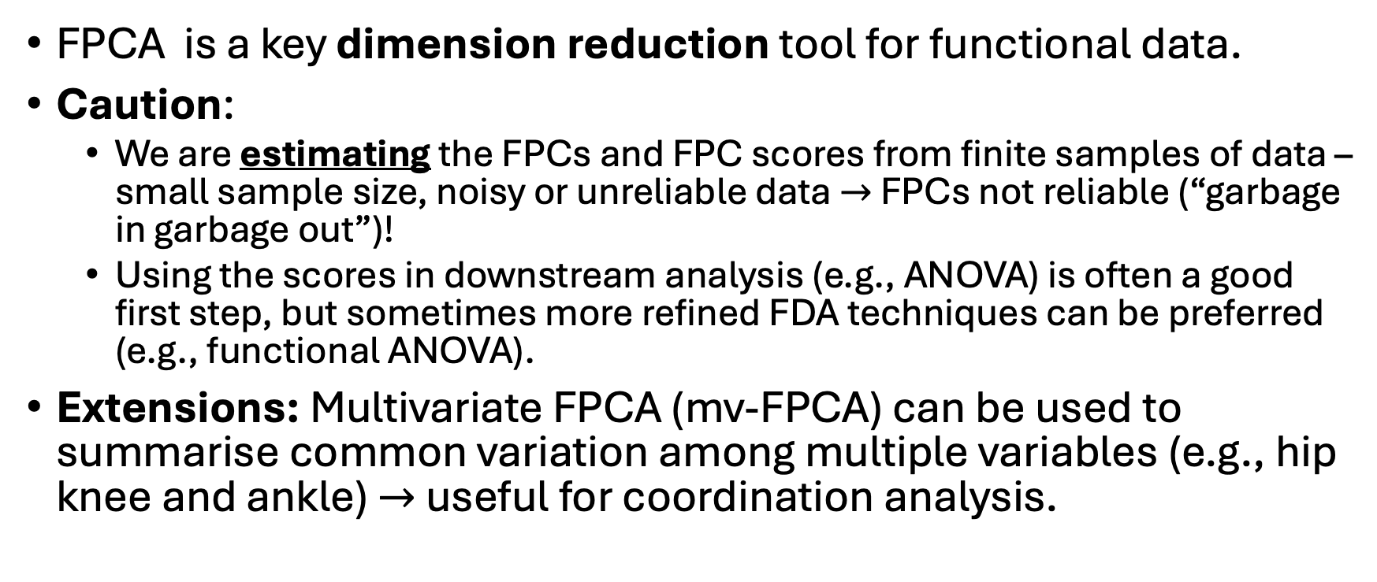
Summary
FPCA is a key dimension reduction tool for functional data.
Caution:
We are estimating the FPCs and FPC scores from finite samples of data – small sample size, noisy or unreliable data $→$ FPCs not reliable (“garbage in garbage out”)!
Using the scores in downstream analysis (e.g., ANOVA) is often a good first step, but sometimes more refined FDA techniques can be preferred (e.g., functional ANOVA).
Extensions: Multivariate FPCA (mv-FPCA) can be used to summarise common variation among multiple variables (e.g., hip knee and ankle) $→$ useful for coordination analysis.

Slide 16
References
Chapter 7 of Ramsay, J. O., Hooker, G., & Graves, S. (2009). Functional Data Analysis with R and MATLAB. Springer-Verlag. https://doi.org/10.1007/978-0-387-98185-7
Chapters 8 and 9 of Ramsay, J. O., & Silverman, B. W. (2005). Functional Data Analysis (2nd ed.). Springer-Verlag. https://doi.org/10.1007/b98888
Rice, J. A., & Silverman, B. W. (1991). Estimating the Mean and Covariance Structure Nonparametrically When the Data are Curves. Journal of the Royal Statistical Society. Series B (Methodological), 53(1), 233–243. JSTOR.

