Slide 1
AI and EO for the Prediction of Malaria Outbreak Risk
Edward Pearce (University of Sheffield) empearce1@sheffield.ac.uk
Emma Southall (Warwick University) e.r.southall@warwick.ac.uk
Shelan Jeawak (Cardiff University) Jeawakss@cardiff.ac.uk
Steven Schockaert (Cardiff University) schockaerts1@cardiff.ac.uk
Yuhua Li (Cardiff University) liy180@cardiff.ac.uk
David Pearson (PHE) sporadic.group@gmail.com
Yazmin Ibanez-Garcia (Cardiff University) ibanezgarciay@cardiff.ac.uk
Ann Smith (Cardiff University) smitha53@cardiff.ac.uk
Víctor Gutiérrez-Basulto (Cardiff University) gutierrezbasultov@cardiff.ac.uk
Federico Cerutti (Cardiff University) CeruttiF@cardiff.ac.uk

Slide 2
Background: Malaria
Malaria is a vector-borne disease transmitted by mosquitoes
Approximately 212 million malaria cases in 2015 (WHO)
90% of malaria cases and 92% of malaria deaths were in Sub-Saharan Africa
Control for malaria involves identifying suitable habitats for mosquitoes and their proximity to villages
Can we use earth observation data to identify mosquitoes which:
Reproduce in water puddles + standing water, created soon after rainfall
Ideal hatching water temperature: 24–30°C

Slide 3
Motivations for the study group
Initial Aim: Map of locations at a high risk to Malaria
Challenges: identifying suitable locations
detecting such small patches (1m wide) of water
spatial gaps of meteorological data to look at precipitation & humidity
Challenges: malaria cases
Underreporting
Data access
Spatial resolution (district, province level)

Slide 4
Background: data availability
Initially wanted to use EO data to predict risk of malaria infection.
Data
NASA's MODIS/Terra Land Surface Temperature/Emissivity Daily L3 Global 1 km SIN Grid, from 2016-09-15 to 2019-05-24
ESA's Soil Moisture and Ocean Salinity (SMOS), or
NASA's SMAP Enhanced L3 Radiometer Global Daily 9 km EASE-Grid Soil Moisture, Version 2, from 2016-09-17 to 2019-05-17 (3 day resolution)
Recent Malaria outbreaks: 5 locations with outbreaks, 3 locations with no outbreaks

Slide 5
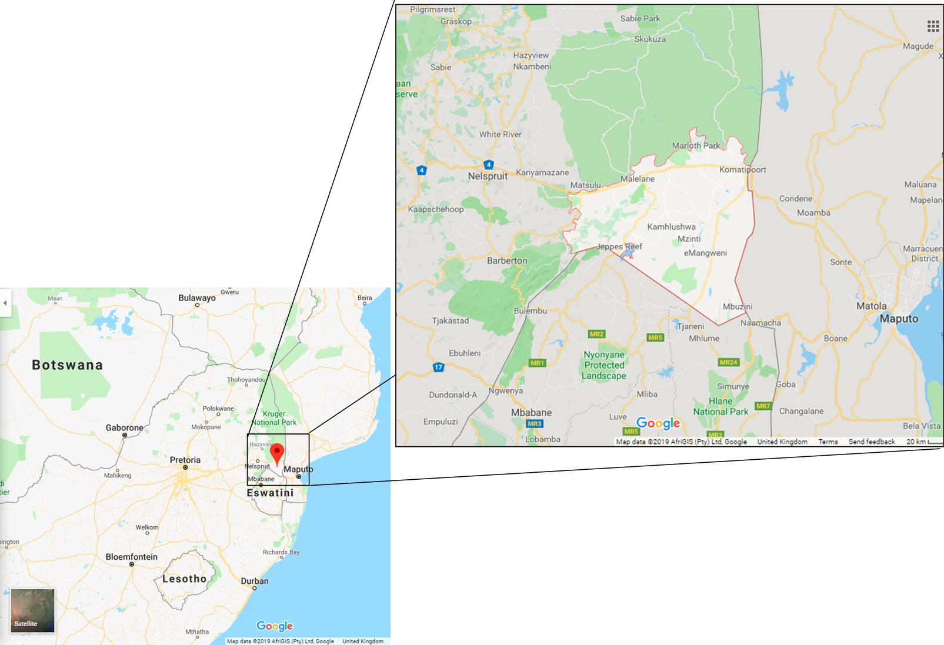
Case study: Nkomazi
Area: 4,787 km^2 Population (2011): 390,610 Data: • Monthly malaria cases, • Daily rainfall

Slide 6
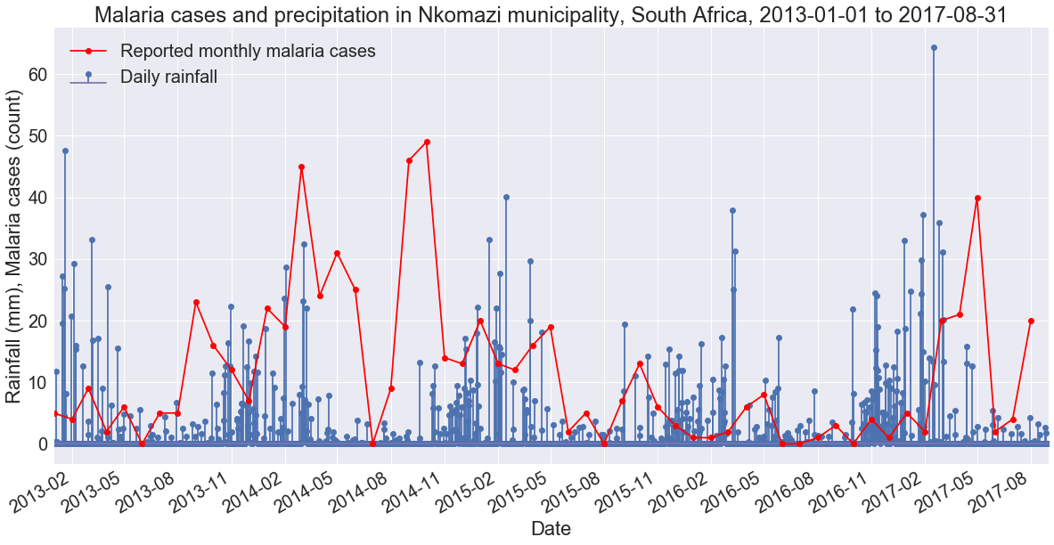

Slide 7
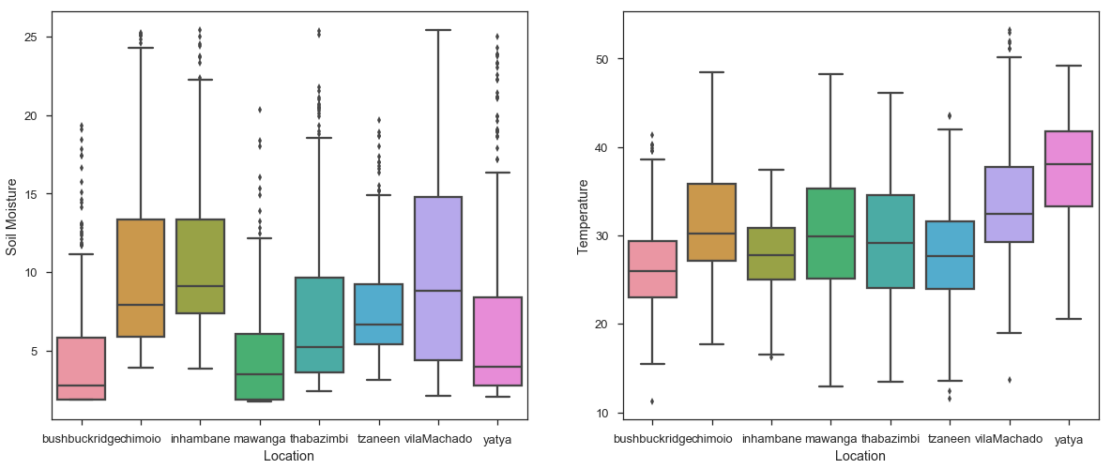
Day 1 data overview
Notes:
In combination, we have 980 rows of data. Soil moisture is measured in intervals of 3 days from 17th September 2016 to 17th May 2019, giving 325 soil moisture measurements per location. Temperature is measured daily from 15th September 2016 to 22nd May 2019, however cloud cover occasionally prevents taking meaningful measurements, leading to missing values. Thus the number of available temperature measurements at each of the 8 study locations ranges from 425 to 666 measurements.

Slide 8
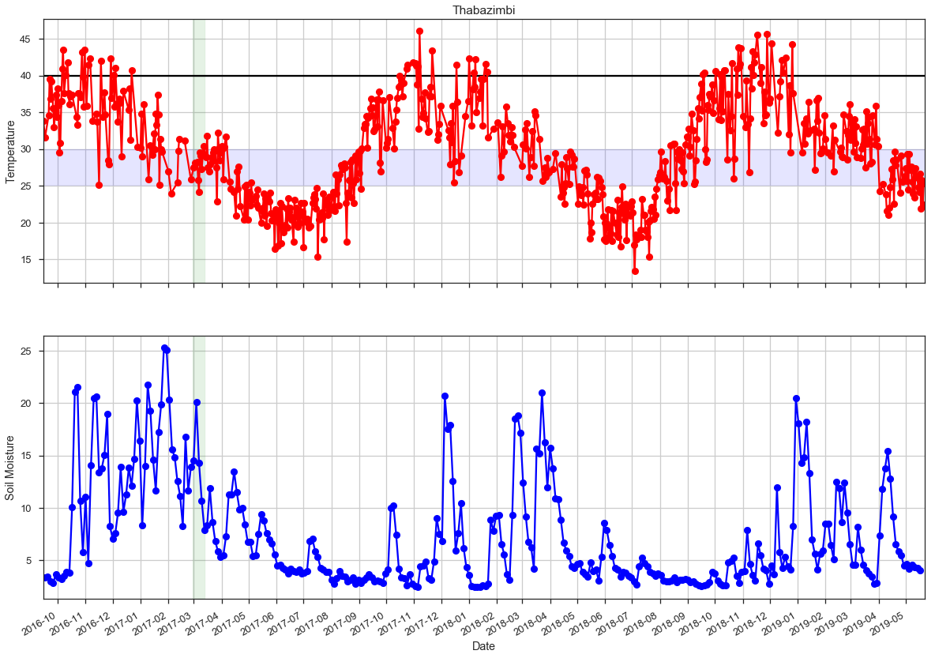
Notes:
Thabazimbi, Latitude -24.6, Longitude 27.4, Outbreak on 14/03/2017

Slide 9
Limitations
Cannot explain why malaria outbreaks don’t happen with current data
Malaria risk maps should take human populations into account
Need to consider more features of the problem
More data on malaria prevalence needed
Time to consider more data!

Slide 10
Updated aim of the project
Use waveform signals from a single point in Mozambique to predict precipitation
Aim: to inform early warning signals of standing water
Data sets:
NASA cross sensor precipitation data set
ESA Sentinel-3 Radar Altimeter Waveforms

Slide 11
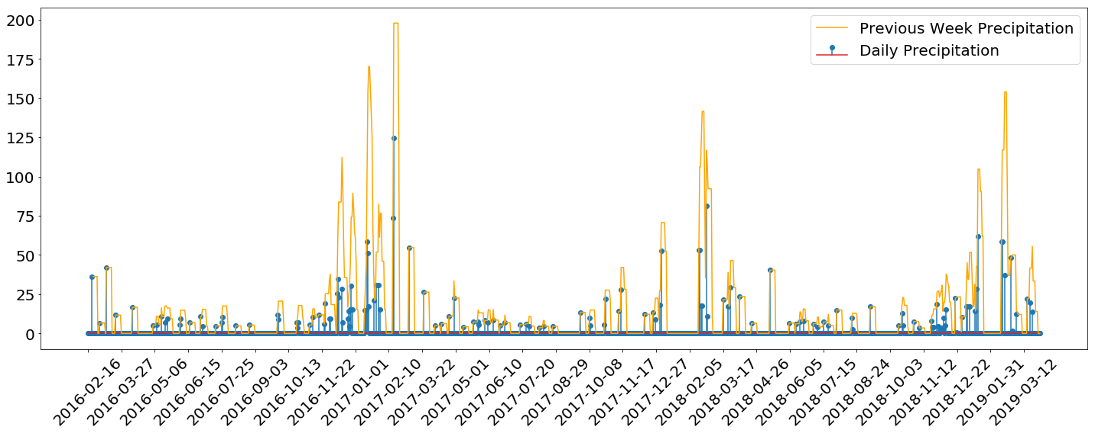
Data: Precipitation
Collected daily from 2016, ≅ 1140 points

Slide 12
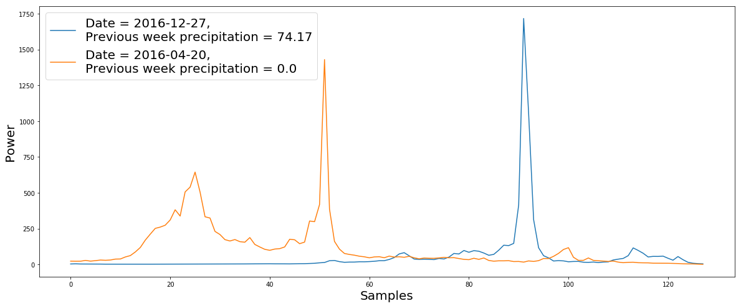
Data: WaveForm
Each waveform - signal from 128 samples (attributes)
Collected bi-monthly (both directions) from 2016, ≅ 110 waveforms

Slide 13
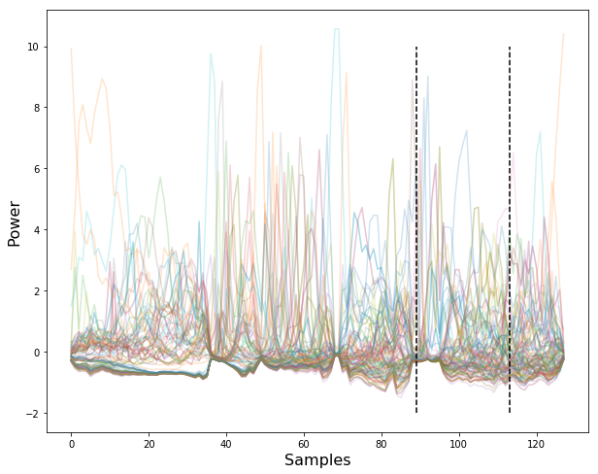
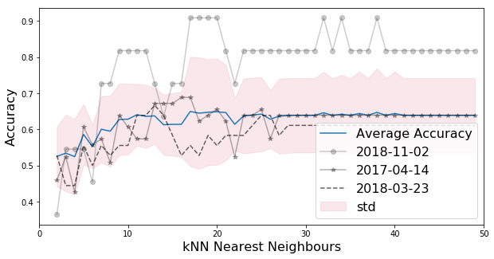
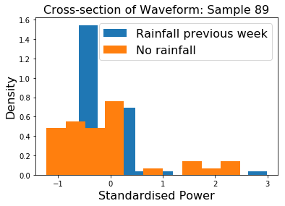
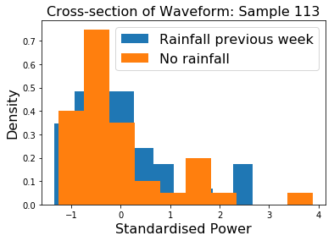
Methods - Simple Binary Classifier to predict precipitation
Class 1: ≅72 precipitation >1mm in the week preceding waveform
Class 0: ≅39 precipitation ≦1mm
Training on data up various dates (from April 2017) - changing size of training set. Testing on data collected from.

Slide 14
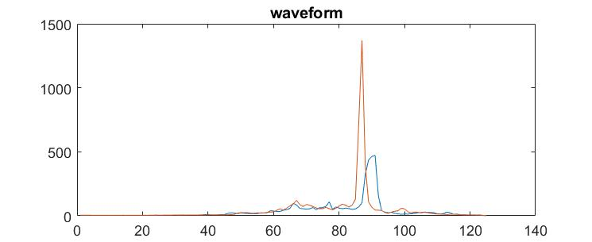
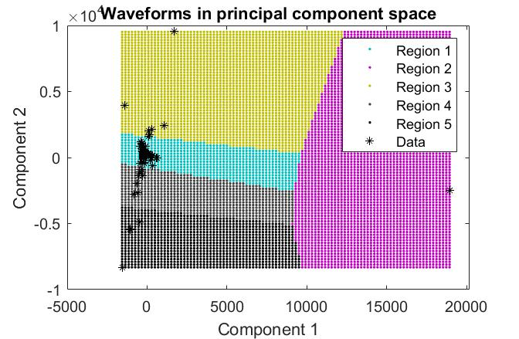
Methods - Clustering of Radar Waveforms
Hypothesis: patterns of radar waveforms depends on land surface types, e.g., water, bare rock, etc.
Clustering could be used to group waveforms of water covered surface from others.
Principal component analysis is used for feature extraction

Slide 15
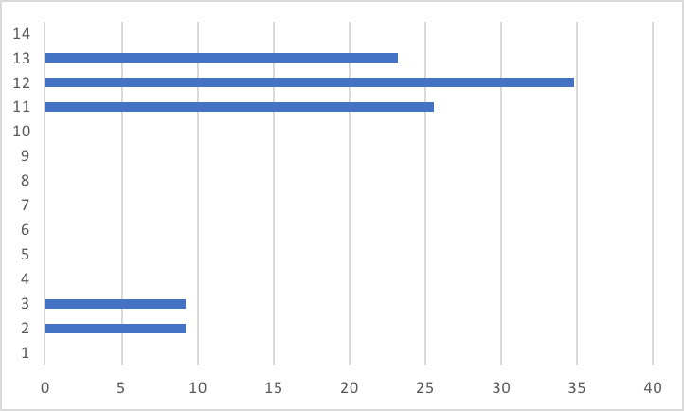
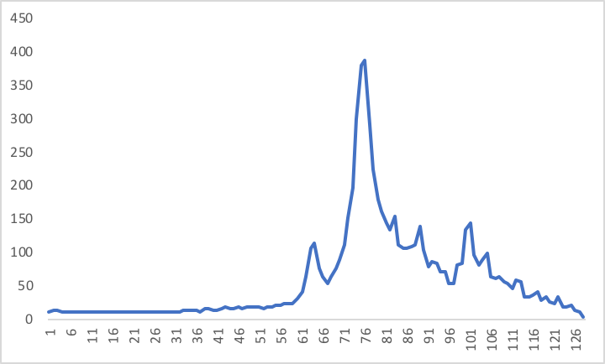
Predicting precipitation from radar waveforms
Same day?

Slide 16
Predicting precipitation from radar waveforms
True examples, combine the 128 signals of each waveform with the amount of precipitation in the last 14 days.
False examples, combine the 128 signals of each waveform with 14 randomly selected precipitation values.
Train binary classifier using Support Vector Machines (SVMs) and Decision Trees (DTs).
Split the data into 70% for training and 30 for testing.

Slide 17
Results of the binary classifiers
 | SVMs | DTs
128 signal + 14 days prec | 0.5072 | 0.528
128 signal + 7 days prec | 0.5072 | 0.532
16 signal + 14 days prec | 0.5072 | 0.528
16 signal + 7 days prec | 0.5072 | 0.542

Slide 18
Future work for waveforms
Future work for malaria outbreaks
Look at improving radar pre-processing
Use fully-focussed SAR processing to reduce the size of the radar footprint
Increase the size of the dataset
Retrieve data from other missions: Cryosat-2, Sentinel-6, …
Look at multiple locations
Find more data for malaria incidence

