Slide 1
SQL Summative Lab
IMDB exploratory analysis
Initial exploration • Business question • Data cleaning
Movies analyzed within the assignment window: 2010–2019
Edward Mwangi
Notes:
[Sources]
- SQLSummativeLab.html
- Visual on this slide was generated with Microsoft Copilot.

Slide 2
1. Initial data exploration
The executed notebook shows changing volumes, ratings and engagement across 2010–2019.
6,792
8,721
2,180
6.26 → 6.70
rated movies in 2010
rated movies in 2016
rated movies in 2019
mean rating, 2010 → 2019
• Rated-movie counts rose through 2016, then were substantially lower in 2019.
• Mean rating rose from 6.26 in 2010 to 6.70 in 2019.
• Total votes peaked at 35,638,577 in 2013; the 2019 total was 3,070,541.
• These patterns motivate analysis that considers both audience satisfaction and engagement.
Source: SQLSummativeLab.html (executed notebook)
Notes:
[Sources]
- SQLSummativeLab.html: year_summary outputs and initial exploration.

Slide 3
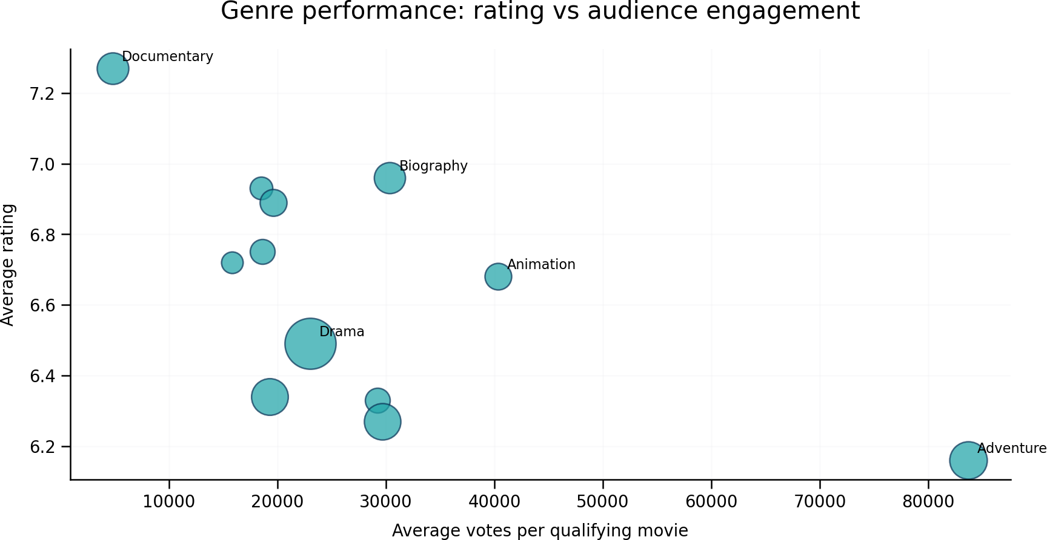
2. Business question supported by the data
Genre comparison requires both strong ratings and meaningful audience engagement.
BUSINESS QUESTION
Which genres combine strong audience ratings with substantial engagement, making them stronger candidates for studio development investment?
• Documentary: 7.27 rating, 741 qualifying movies, 4,823 average votes.
• Biography: 6.96 rating and 30,358 average votes.
• Adventure: 83,667 average votes but 6.16 rating.
• Drama: 116,066,741 total votes, the highest total shown in the genre table.
Source: SQLSummativeLab.html (executed notebook)
Notes:
[Sources]
- SQLSummativeLab.html: genre_performance table and business question.
- Chart recreated from the executed notebook values.

Slide 4
3. Potential data cleaning tasks
The notebook identifies normalization, null handling, duplicate review and validity checks before deeper analysis.
• Split comma-separated genres into one genre per row before genre aggregation.
• Trim whitespace and standardize text capitalization when labels are compared.
• Verify start_year is numeric and restrict analysis to 2010–2019.
• Review duplicate movie-person relationships in directors, writers, principals and known_for.
• Inspect implausible runtime values and apply a defensible analysis range.
• Use a vote threshold when comparing ratings to reduce instability from lightly rated movies.
NULL HANDLING
146,144
movie_basics records
31,739
missing runtime
5,408
missing genres
73,856 → 65,720
date-range join before → after required-field filtering
Rule: exclude missing values only when required for the analysis. Do not impute missing movie information.
Source: SQLSummativeLab.html (executed notebook)
Notes:
[Sources]
- SQLSummativeLab.html: Potential Data-Cleaning Tasks and null-handling outputs.

