Slide 1

University
Of
Benin
Project
Proposal
Defense
PRESENTED BY OBOH EDWARD OSARETIN
ENG1503587
DEPARTMENT OF COMPUTER ENGINEERING

Slide 2

PROJECT ON
CONTROL DESIGN AND HARDWARE IMPLEMENTATION OF
A MULTI-ROTOR SYSTEM
(JULY 2021)
BY
EDWARD OSARETIN OBOH
ENG1503587
UNDER
ENGR. J.A. IGIMOH,
DEPARTMENT OF COMPUTER ENGINEERING,
FACULTY OF ENGINEERING,
UNIVERSITY OF BENIN.

Slide 3
Presentation Outline
01
Introduction
02
Objective
03
Scope
04
Methodology
05
Result
06
Conclusion
07
Future Work

Slide 4
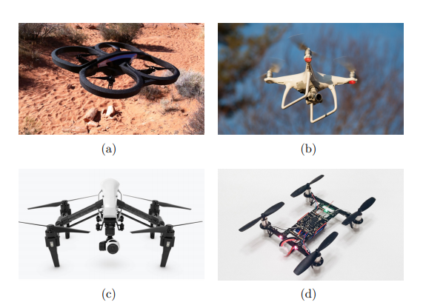
Introduction
4
About Multi-Rotor Systems (Quadcopters)
Unmanned aerial vehicles (UAVs) are being increasingly used today than ever before in both military and civil applications. The rapid advancement in miniature sensors, actuators and processors has led to the development of powerful autopilot systems which play a major role in UAVs control by making the flight safer and more efficient. These gave a rise to small sized, interestingly featured commercial UAVs, one of which is the quadcopter.
The history of Quadcopters starts in the beginning of the 20th century. The first ever quadcopter built was "Gyroplane n: 01" in 1907. This quadcopter had many limitations. Its stabilization was achieved by control of people on the ground. During the 1920’s, other quadcopters with much improved performance were built by engineers who targeted the vertical flight.

Slide 5
Objective
5
Problem Statement
When building a multi-rotor vehicle (drone), designers are faced with the choice of paying for a custom designed aerial vehicle, building their own vehicle from scratch, or sacrificing controllability for an inexpensive off-the-shelf system. While numerous inexpensive off-the-shelf multi-rotor platforms are available, they often consist of proprietary modules even when advertised as open-source. Common examples of these black-box modules are sensor-less brushless motor controllers, flight controllers, and radios. These modules are often proprietary and have limited hardware specifications (Clean Flight, “Clean Flight”, 2016), (Open Pilot, “Open Pilot”, 2016). Consequently, for a researcher, the control and the modifiability of these modules is limited.

Slide 6
Objective
6
About the Project
A main objective of this work is to provide researchers with a functional, fully specified, and stabilized quadcopter. This system will be specified from scratch hardware and software with the intent of eliminating as many black box components as possible. In addition, this flight system will have an emphasis on theoretical control as well as IMU data collection making it a prime candidate for future research.

Slide 7
Scope
7
About the Project
From the dynamic equations of the quadcopter system, a Proportional, Integral and Derivative (PID) based control system was designed to achieve stability of the system. The designed controller was able to control and stabilize the attitude (Roll, Pitch and Yaw). The designed controller was then be implemented on the hardware.
A
Other control strategies are not explored in this project. Altitude control and autonomous navigation are not part of the project, altitude and position of the vehicle in an inertial frame are controlled by the pilot commands.
B
Components manufacturing process, materials and detailed working are not concerned with the purpose of the project
C

Slide 8
Methodology
8
Control Objective
Hardware Components
IMU Sensor Implementation
Control System Implementation
Software Architecture
Hardware Implementation

Slide 9
Methodology
8
Control Objective
A primary control objective for the quadcopter is to be able to control orientation. With this in mind, the first set of control goals can be summarized in the equation below where θc, φc, φc represent a user commanded rotation, where ˙θ, φ,˙ ψ˙ represent the rotational velocities of the quadcopter, and where Tc represents the user commanded throttle.
˙θ = 0 φ˙ = 0 ψ˙ = 0
θ → θc φ → φc ψ → ψc, T → Tc
These control parameters, θc, φc, ψc, Tc, allow a user to maneuver the quadcopter to anywhere in three dimensional space. Consequently, many commercial systems give users these four degrees of freedom to operate a quadcopter. However, the user must also act as a control system in order to regulate the quadcopter’s height to keep it above the ground. To achieve this, the user must observe the quadcopter’s height and constantly adjust the throttle, Tc, such that the height with respect to ground, z, is roughly constant.

Slide 10
Methodology
9
Frame | DJI F450 Quadcopter Frame
Propellers/Rotors | 10x4.5 Propellers (4)
Motors | A2212 2200KV BLDC motors
ESCs | Hobby King 30A Brushless ESC
Battery | 11.1V (3S) Li-po Battery
Transmitter | NRF24L10 PA (power amplifier) LNA (low noise amplifier)
Receiver | NRF24L10
Inertial Measurement Unit (IMU) | MPU 6050 6dof IMU
Arduino Boards | Arduino UNO (1), Arduino Nano (2)
Components

Slide 11
Methodology
10
IMU Implementation
In order to meet the control goals, estimation of the quadcopter’s orientation is required. With modern advancements in electronics, determining orientation can be done inexpensively, efficiently, and quickly with micro electrical mechanical system (MEMS) based sensors.
Unfortunately, currently, there is no single affordable MEMS sensor that directly measures θ, φ, ψ. Consequently, the combination of multiple MEMS sensors is required in order to accurately estimate orientation.

Slide 12
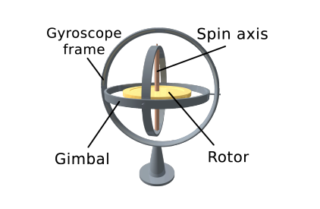
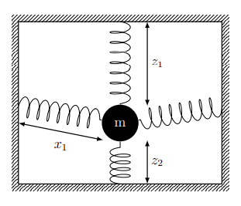
Methodology
11
IMU Implementation
Gyroscope
Accelerometer

Slide 13
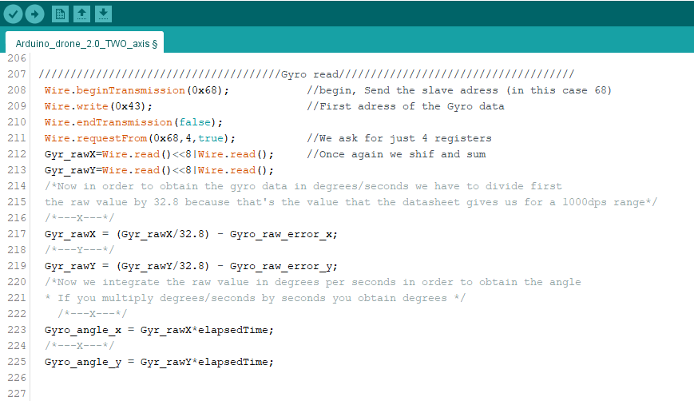
Gyroscope

Slide 14
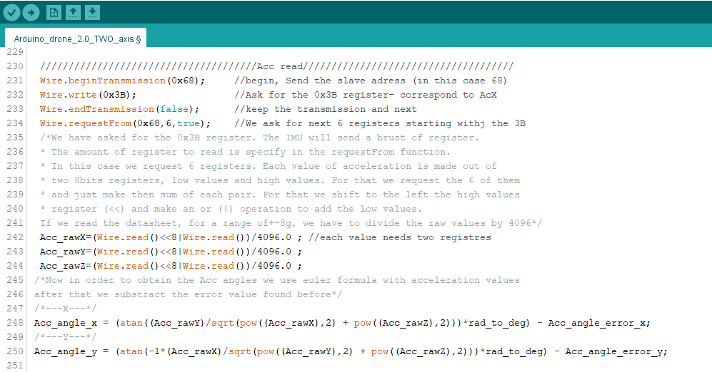
Accelerometer

Slide 15
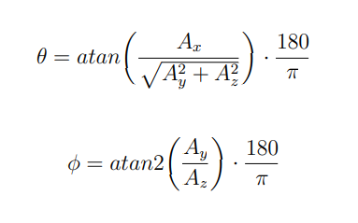
Methodology
14
IMU Implementation
Sensor Fusion
Gyroscopes have good dynamic response and noise immunity, they have long term drift. In contrast, accelerometers have poor dynamic response but are not susceptible to drift in the same manner. Consequently, a high pass filter is used on the gyroscope data and a low pass filter is used on the accelerometer data.

Slide 16
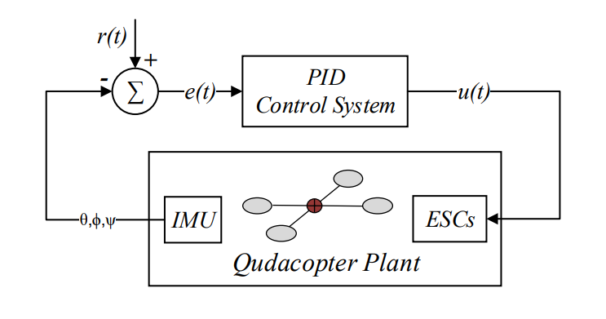
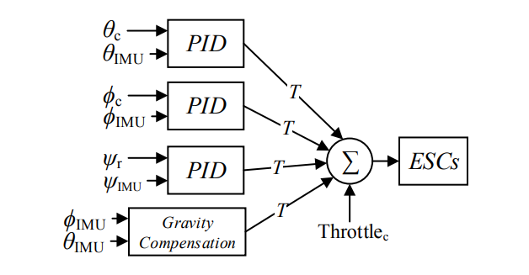
Methodology
15
Control System Implementation
This control system was needed in order to handle real world disturbances and to account for unknown offsets. In order to drive the quadcopter’s orientation (θ, φ, ψ) to desired values, a series of proportional integral derivative (PID) controllers were implemented.
u(t) = Kp · e(t) + Ki · Z t 0 e(τ )dτ + Kd de(t) dt

Slide 17
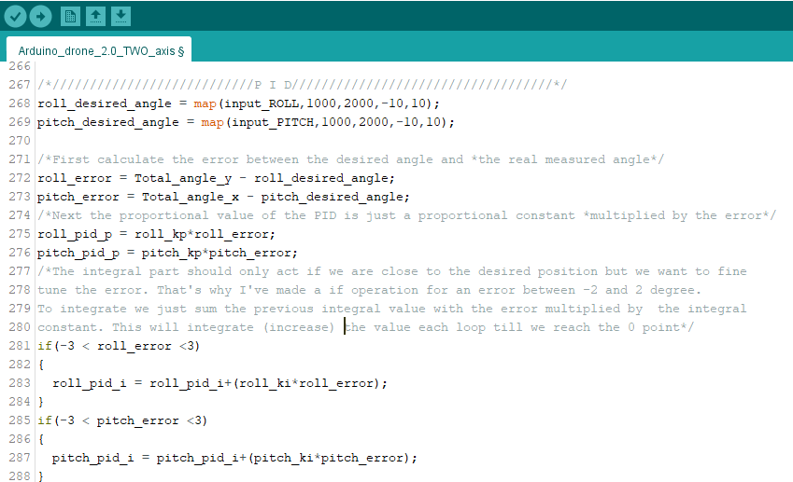

Slide 18
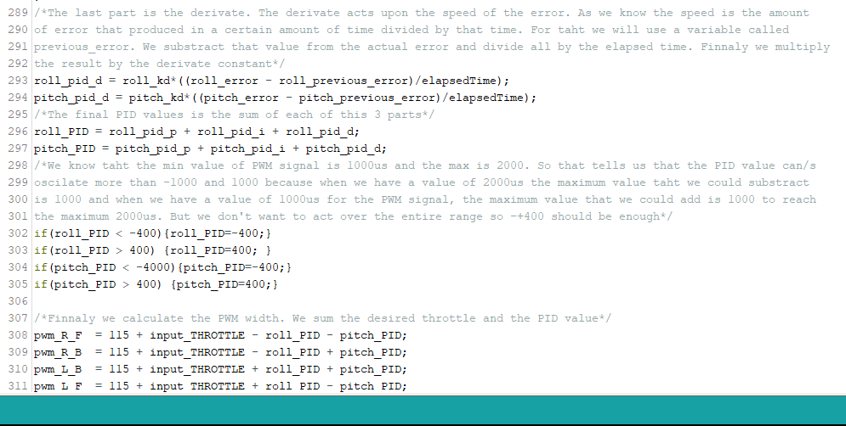

Slide 19
Methodology
18
Software Architecture
The control loop along with the IMU code account for the majority of flight critical code running on the quadcopter. To keep control timing and IMU collection constant, the software was implemented in three separate threads. These threads primarily manage IMU filter updates, control system updates, and radio link updates.

Slide 20
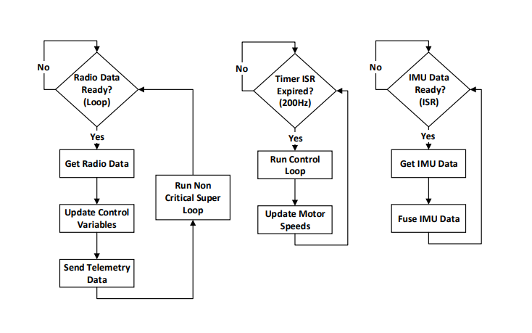
Methodology
19
Software Architecture - Flowchart

Slide 21
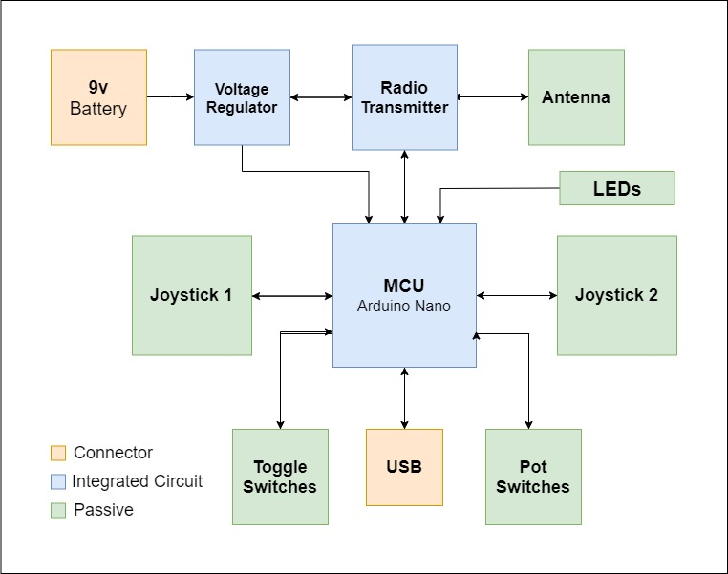
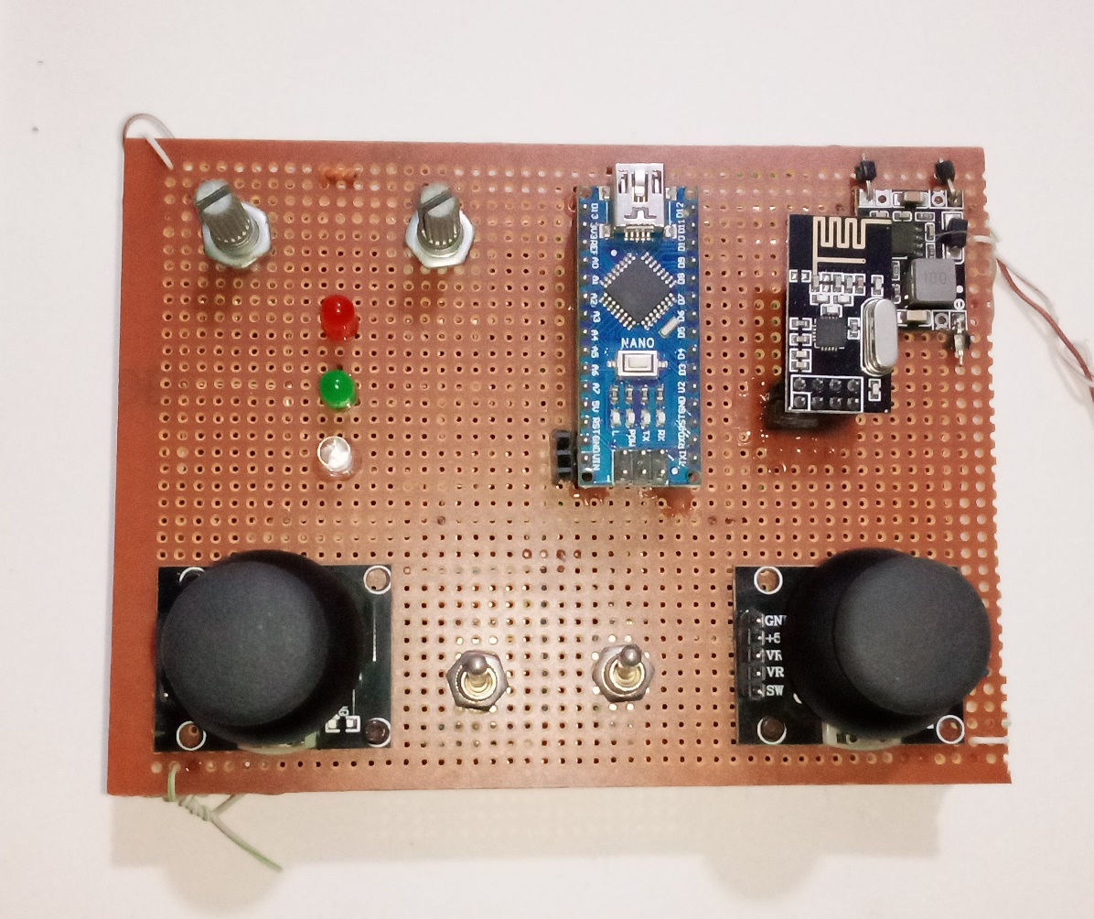
Methodology
20
Hardware Implementation
Remote Controller

Slide 22
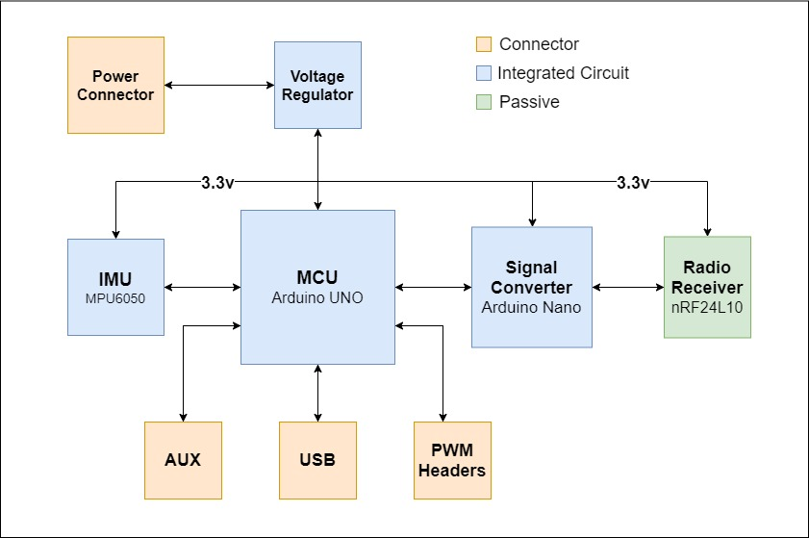
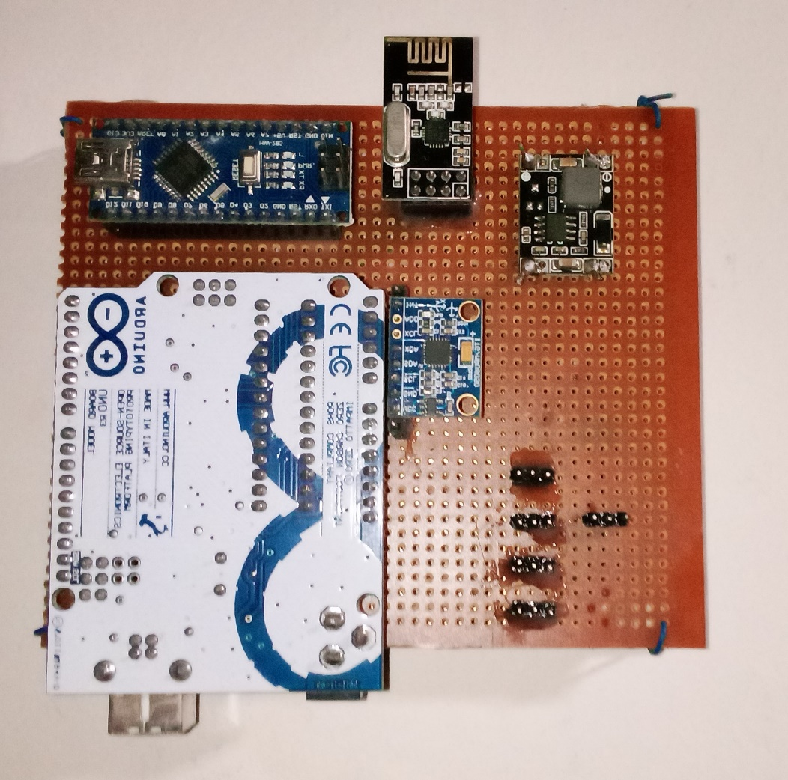
Methodology
21
Hardware Implementation
Flight Controller

Slide 23
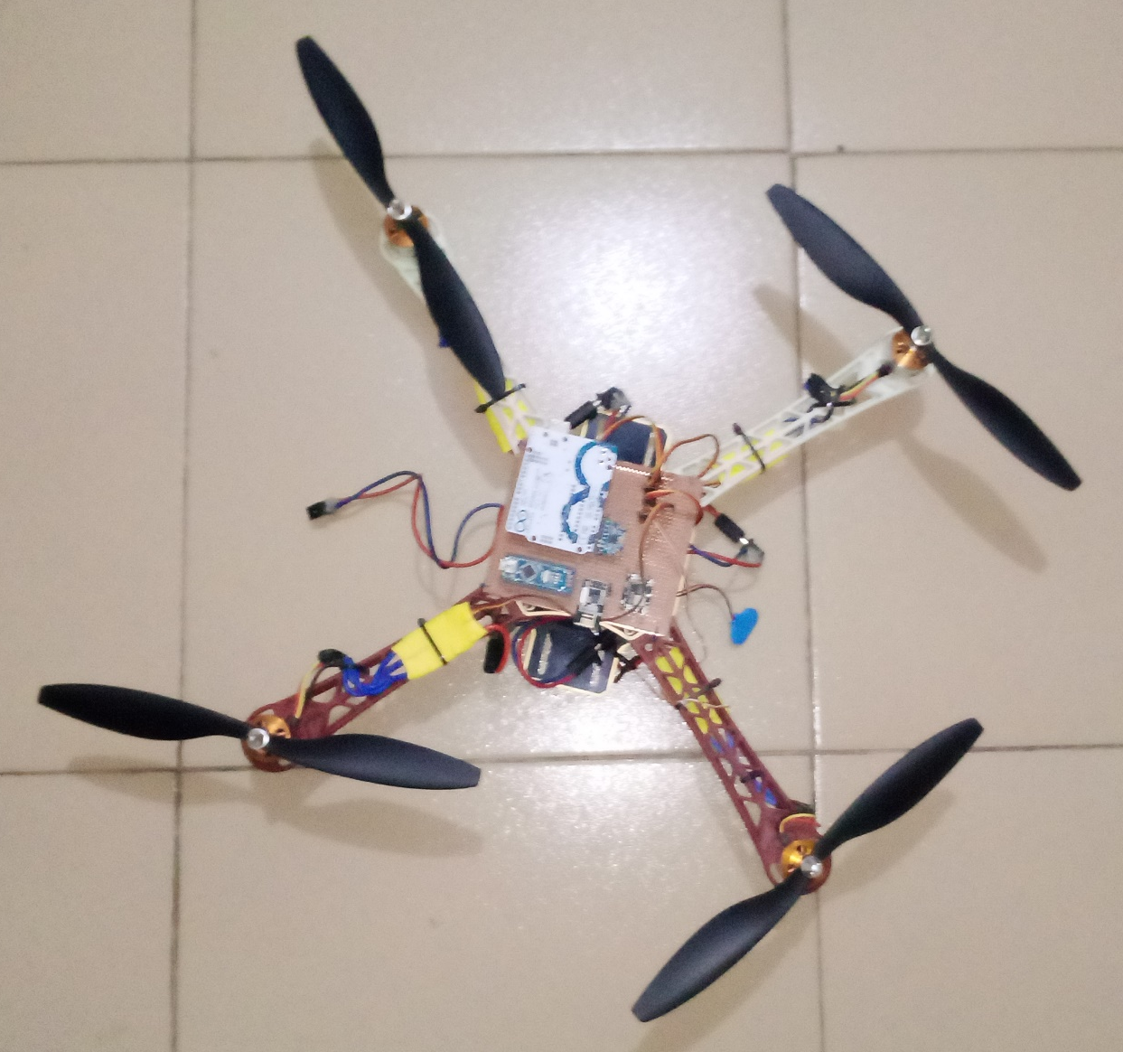
Result
22
Drone Build

Slide 24
Result
23
For safety and verification purposes, experimental setup is designed to examine the controller response before applying it to a real flight test. An experimental testbench was used. On the test bench, the quadcopter is held firmly from the top and the bottom allowing only rotational motion, i.e., three degrees of freedom. Various reference signals are sent via RC to explore the system reference tracking
At the end of testing, as expected, the multirotor system (Quadcopter in this case) was controlled by the electronic Remote controller using RF signal. The flight controller was able to control roll, pitch, yaw, altitude and motion in x or y direction. As expected, the multirotor system balanced itself using commands in the control software written to its microcontroller, when there were no changes to inputs sent from the remote controller.

Slide 25
Result
24
Bill of Engineering Measurement and Evaluation
Component | Specification | Number | Cost
Frame | DJI F450 Quadcopter Frame | 1 | 8000
Propellers/Rotors | 10x4.5 Propellers | 4 | 4 x 1500
Motors | A2212 BLDC motors | 4 | 4 x 3500
ESCs | Hobby King 30A Brushless ESC | 4 | 4 x 3000
Battery | 11.1 V Li-po Battery | 1 | 8000
Transmitter | NRF24L10 PA(power amplifier) LNA(low noise amplifier) | 1 | 3500

Slide 26
Result
25
Receiver | NRF24L10 | 1 | 3000
Inertial Measurement Unit (IMU) | MPU 6050 6dof IMU | 1 | 2400
Arduino UNO | Arduino UNO Artmega MCU | 1 | 8000
Arduino Nano | Arduino Nano, Atmega MCU | 2 | 4200
Vero Board | Dotted Copper Vero Board | 2 | 2 x 400
Joystick | 2 Axis Joystick Potentiometer | 2 | 2 x 3500
Other Components for soldering, connections, testing and binding | Switches, LEDs, Potentiometers, header connectors, connecting wires, Glue, solder, Battery cap | - | 3500
Shipping and Delivery fee | - | - | 7000
 | TOTAL |  | 87,400

Slide 27
Conclusion
26
In this Project we,
developed a control update laws as well as control objectives
developed a 6 degrees of freedom fusion filter to provide accurate estimations of orientation
demonstration a control system to achieve stable auto leveling flight using a series of PID controllers
overviewed the RF hardware involved in creating the transcieving link between the remote and the quadcopter
specified other hardware involved in the system such as the flight controller and electronic speed controllers

Slide 28
Future Work
27
Currently, the IMU filter operates on Euler angles when ideally it should be based upon quaternions to avoid singularities.
With regards to the control system, the first thing that would be improved is the PID control system performance. The current balancing action is somewhat noisy and the yaw control is lacking.
In addition to PID control, other control techniques could be implemented such as linear quadratic regulator (LQR) as well as model predictive control (MPC).
A final improvement would be the addition of an onboard GPS sensor and a Lidar sensor to facilitate autonomous navigation in both indoor and outdoor environments
Addition of a camera to enable the system to be used for aerial surveillance or for gathering data.

Slide 29
Thank You
For Listening To This Presentation

