Slide 1

HIVM - An Application for Prediction of HIV Drug Resistance using Support Vector Machine Algorithms
Ed Johnson
December 2006
Notes:
Hello everyone.
Thanks for attending my oral defense. I’ll be giving a presentation today on my master’s project, hivm. An Application for Prediction of HIV Drug Resistance using Support Vector Machine Algorithms. That’s quite a mouthful, and hopefully you will have a good understanding of what it all means by end of this presentation.

Slide 2
Outline
Problem Description
Software development and challenges
Results and Analysis
Conclusions and future works
Notes:
Here’s topics I will cover.
First, some background information on the problem that hivm attempts to solve.
Followed by talk about the software itself.
Then, present our results and my methods for analysis
Finally, I will summarize the project and talk about the future of hivm.
PROBABLY A GOOD IDEA TO GO BACK AND INTRODUCE THE POINTS ONE BY ONE ON EACH SLIDE SO READER DOESN’T READ AHEAD AND LOSE FOCUS ON YOU.
Problem Description
Software development and challenges
Results and Analysis
Conclusions and future works

Slide 3
Problem Description
How an HIV drug works
HIV mutates
Drug Resistance
Notes:
So, launching into problem description…
Drug resistance is a critically important open problem in HIV treatment today.
What is it?
A drug works by binding to HIV enzymes involved in reproduction of HIV.

Slide 4
HIV Drug Resistance
Live indefinitely
Quality of life and HIV drug dosages
Who is in danger of resistance today?
Notes:
Beat drug resistance, you can live indefinitely with HIV.
Sooner suppress it, lower the dosage of drugs. Less side effects.
Higher quality of life.

Slide 5
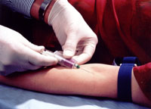
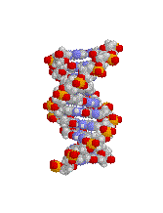
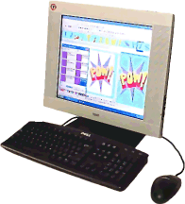
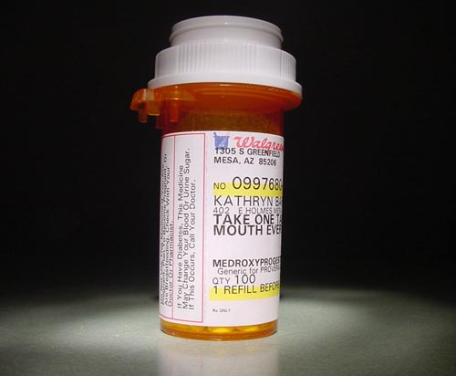
Drug Resistance Prediction Steps
Resistance Prediction Tests
Better HIV Drug Therapy
Blood Sample
Extract HIV Sequence
Notes:
Address each point here? Or need to have covered background first? Either way, this could be a good slide here or later on w/ these bullet points.
New way of predicting resistance on individual level.
The long-term goal of the hivm project is prediction of patient response to HIV
drug therapy given a genotype of the virus found in the patient. Ultimately, this
would lead to a diagnostic test which may aid a physician in prescribing a most
efficient HIV drug regimen for a particular patient.
This would be another step towards the goal of Personalized Medical treatment for all persons based on their unique genetic profile.

Slide 6
Resistance Prediction
Phenotypic
Genotypic
Machine Learning
Notes:
Problems with these types of tests.
Phenotypic occurs in test tube, blood sample. Takes 4-6 weeks to get results. Expensive test $1000.
Put each drug in test tube, and see how many times normal dose it takes to stop it.
Genotypic requires the database to have already spotted the mutation before and also already associated that with a level of resistance for each drug.
Turnaround results in a week. 1/3 cost.
Good job with predicting reverse transcriptase inhibitors.
Does poorly for protease inhibitors b/c mutation around Protease enzyme are not consistent.

Slide 7
Goals of HIVM
Fast
Affordable
Accurate with Unexpected Mutations

Slide 8
Limitations of hivm
Simplified Model
Input Data
Notes:
Complex cross-resistance to multiple drugs, and human body is a complex environment. Other factors could impact results.
Phenotypic data vs Clincial Trial data

Slide 9
Support Vector Machine Advantages
Memory Use
Speed
Avoids Overfitting
Notes:
We propose that beginners try the following procedure first:
• Transform data to the format of an SVM software
• Conduct simple scaling on the data
• Consider the RBF kernel K(x, y) = e−kx−yk2
• Use cross-validation to find the best parameter C and
• Use the best parameter C and to train the whole training set5
Test
--
There are many advantages inherent in SVM's. SVM can classify large data sets of several thousand points while making very efficient use computer memory. They can predict previously unseen data well (generalization) by avoiding overfitting to training data. They have a fast training time compared to competing learning methods such as neural networks.

Slide 10

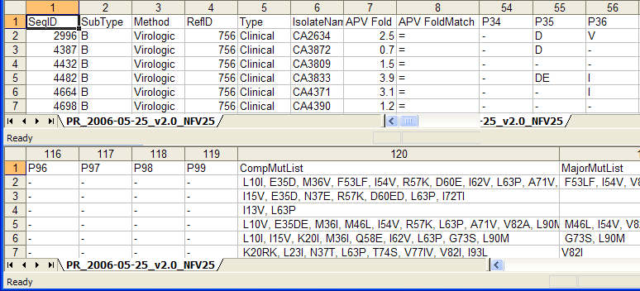
Stanford HIVDB
Sample Data
Notes:
Add picture?
HIVDB –
Virologic Clinical does not mean ‘clinical trial’.
These are phenotypic test results.
HIVDB wrote clinical in there and did not explain it further.
aspartic acid D
glutamic acid E

Slide 11
Outline of Steps in HIVM
Map input data
Scale data
Search for Optimal Parameters
Model Selection via Cross Validation
Model Validation
Notes:
This is an outline.
Details in next slides.

Slide 12
Hivm Model Validation Demo

Slide 13
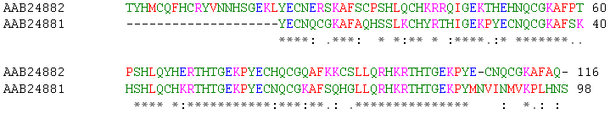
Mapping Data to SVM Format
Amino Acid to Numeric
Local Alignment
Pairwise Comparison
Notes:
= LA Score of 640.

Slide 14
Optimal Parameter Search
Lowest
Accuracy
Highest
Accuracy
64%
92%
Notes:
Cost = SVM Penalty Parameter for wrongly classified data in the training set
Gamma = Radial Basis Function Kernel Parameter for width (aka bandwidth). This function affects generalization ability of RBF kernel. i.e. overfitting of data vs ability to correctly identify new unseen data.
Grid Search
Example from RTV Model Selection Threshold 2, No Probability

Slide 15
Software Implementation and Challenges
Caching
Scientific computing
First failure
Test Driven Development
Boost
Cross-Validation
Notes:
I ran the gnu profiler
on the code and found the two functions where 95 percent of the execution took
place.
Using the cached
values can speed up a single parameter pair cross-validation operation on our test
server from 25 - 30 minutes to 10 seconds on a 3GHZ machine.
We test approximately 4225
different cost, gamma pairs for each drug.

Slide 16
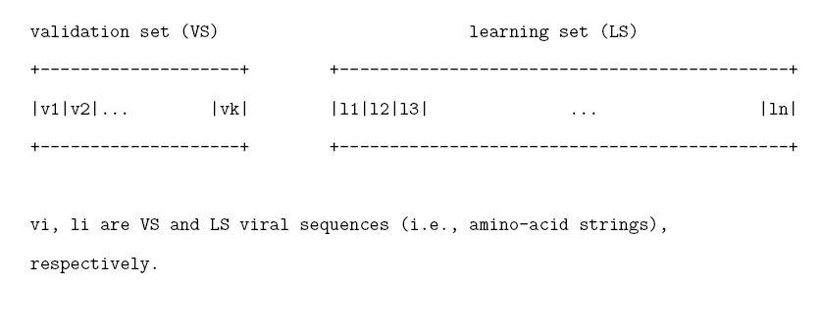
Cross-Validation
Notes:
Libsvm overlly optimistic b/c mixed learning and validation sets for our particular problem.

Slide 17
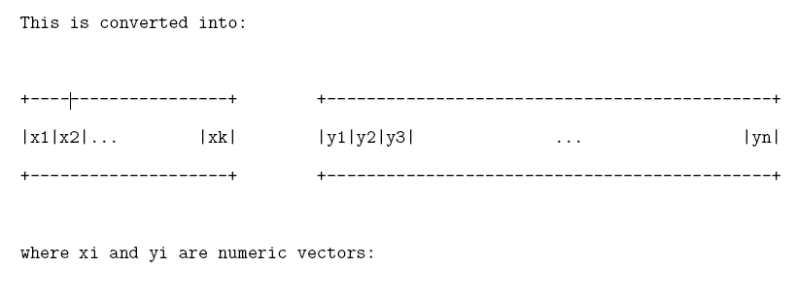
Cross-Validation
Notes:
Svm format of numceric vectors.
Using local alignment. Similiarity of sequencne.
Function follows structure follows sequence.
Sequence determines structure which determines function.

Slide 18
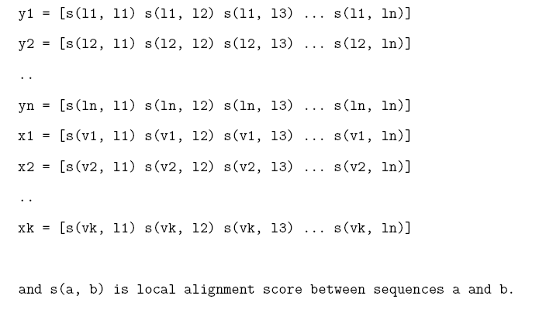
Y is Learning Set.
X is Validation Set.
Notes:
Critical thing to note:
Learning set has no information from the validation set.
Pairwise comparison is a published technique for mapping sequence data into svm format.
Don’t repeat so much about the mapping to svm format. Talk about cross-validation.

Slide 19
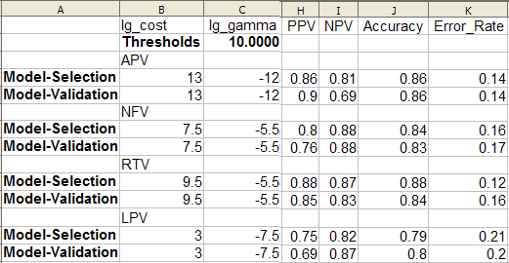
Model Selection Results
Notes:
Optimal Parameters generated lowest error rate.
Note APV
Crossvalidation is NOT A VALIDATION METHOD. It evaluates the variability of regression results when some data from the given set are omitted. This method does not attempt to predict the variability of regression results in other possible data sets characterized by the same autocorrelation.

Slide 20
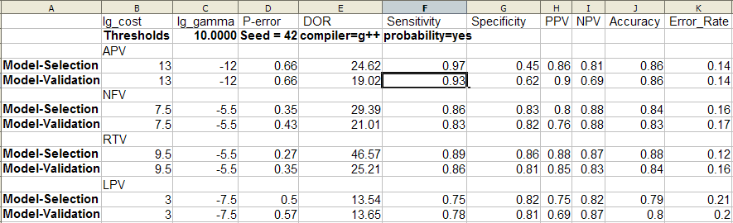
Model Selection Results
Notes:
Sensitivity
However, this can be misleading by itself, or just a low error rate.
Then low Specificity.
Note APV again vs NFV, etc.

Slide 21
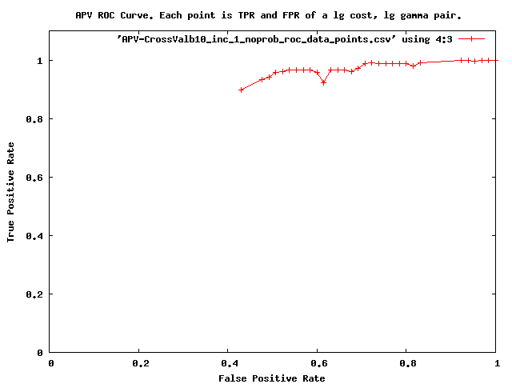
ROC Curve Analysis
Notes:
Physicians Need a way to view sensitivity and specificity together and view tradeoffs, which leads to ROC
Refer to APV issue.
APV not so good.

Slide 22
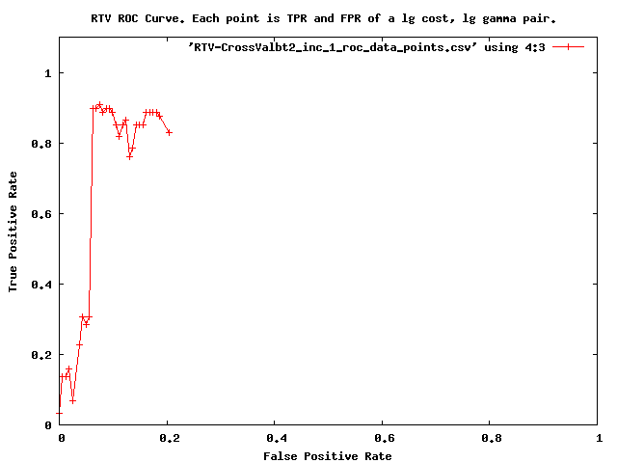
ROC Curve Analysis
Notes:
Better results here.
You can use the script to find the parameter pair that produced the point you want to have.

Slide 23
Analysis
Comparison to Other Software
  Incompatible Datasets
  Multiple Classification
Clinical Statistics
Notes:
We used clinical statistics., particularly sensitivity and specificity and error rate.
Despite this, we can say that hivm has exhibited promise for certain drugs more
than others. In particular, IDV, RTV, SQV, NFV may be of further research interest.
They all exhibited sensitivity and specificity greater than 90% in some of our tests. In
addition, they did not have particularly bad results in any of the tests. In contrast,
ATV, APV, and LPV showed less promise. They did not typically reach the 90%
mark and occasionally exhibited very poor results.
Have to explain about these in order to interpret results.
i.e.
Sensitivity, Specificity, etc.
Looking for not really bad reuslts, and above 80%

Slide 24
Conclusions
Promising for some drugs
IDV, RTV, SQV, NFV
Not so well for others
ATV, LPV and APV
Why?
Notes:
why?
Best ones had more data.
Worst 2 had lowest data by far.
APV? Unknown, but perhaps problem with HIVDB dataset, since they are cleaning it up.

Slide 25
Future Work
Comparison to Similar Software
Multiple Classification
Clinical Trial Data
Source Forge
Web Service, GUI
Sampling Distribution
Notes:
Sampling Distribution
Commenting on design of experiments, Cherkassky and Mulier note, ``Further it is important to make sure that past (training) data used for model estimation, and the future data used for predictions, come from the same (unknown) sampling distribution. If this is not the case, then (in most cases) predictive models estimated from the training data alone cannot be used for prediction with the future data.''\cite{learningfromdata} pg. 5\newline
Once we obtain some clinical trial data with patient responses, we need to analyze the data and make sure we are putting the correct prior knowledge into the SVM training model.
Is 80’s drug resistance same sampling distribution as 2005 drug resistance? 1 or 2 drugs back then, vs at least 3 today. Cross resistance, multi drug resistance.
Hypothesis:
Use newer training data for patients infected since 2000’s. (and actually probably for patients from early 90’s too b/c they have modern cross-resistance, etc.)
Compare using all data vs newest data.
Compare clinical trials from similar time periods, using one as model selection and the other for model validation.

Slide 26
Acknowledgements
Ljubomir Buturovic
Dragutin Petkovic
Rahul Singh
Thanks!!
Notes:
I appreciate the guidance, support and supervision provided by Dr. Petkovic, Dr. Singh and especially Ljubomir Buturovic during this project.

Slide 27
Questions?

