Slide 1

Little Learners Preschool
ThePhoto by PhotoAuthor is licensed under CCYYSA.

Slide 2
Summary
Decision process through data:
Median rates of childcare cost by state
Median household income against poverty rates
States with Poverty rate about MHI
Those states filtered by variables
Total umemployment 20-60
Female unemployment 20-60
Median earnings
Female median earnings
H_Under6_BothWork/H_6to17_BothWork
H_Under6_SingleM/H_6to17_SingleM
create top 3 selection based on variables

Slide 3
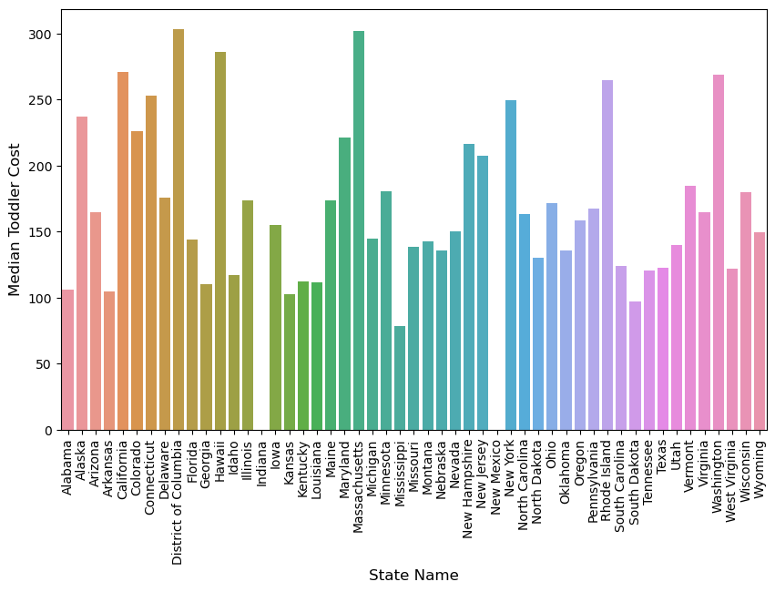
Infant Care Cost
Highest: $304 in D.C.
Average: $171
Lowest: $79 in Mississippi
Notes:
Gives an idea of cost

Slide 4
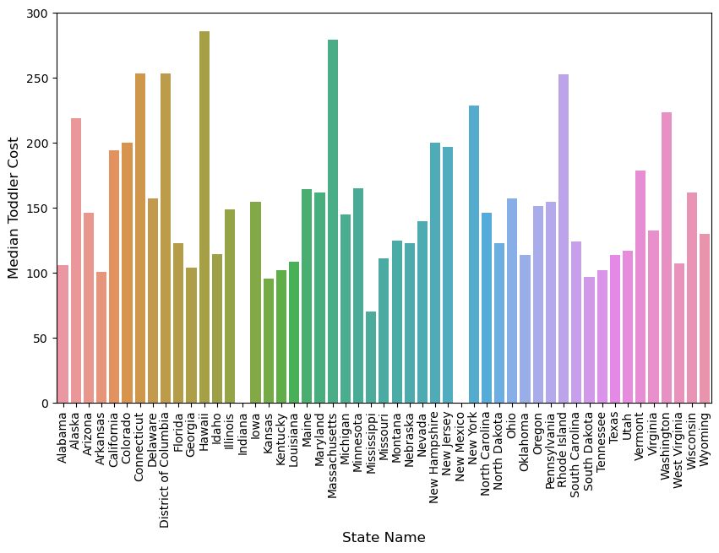
Toddler Care Cost
Highest: $286 in D.C
Average: $154
Lowest: $70 in Mississippi

Slide 5
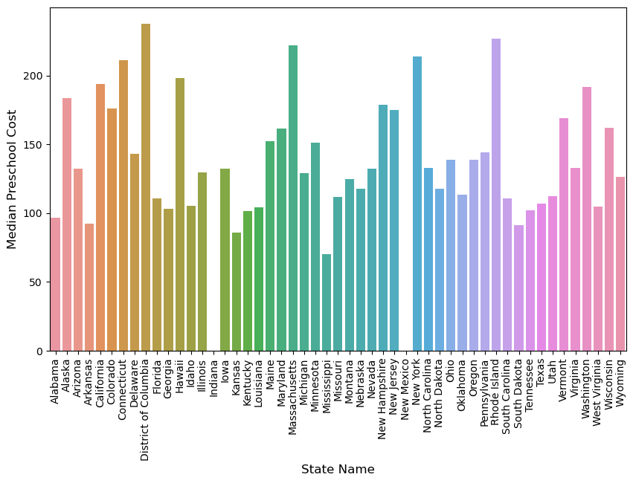
Preschool Care Cost
Highest: $238 in D.C
Average: $140
Lowest: $70 in Mississippi

Slide 6
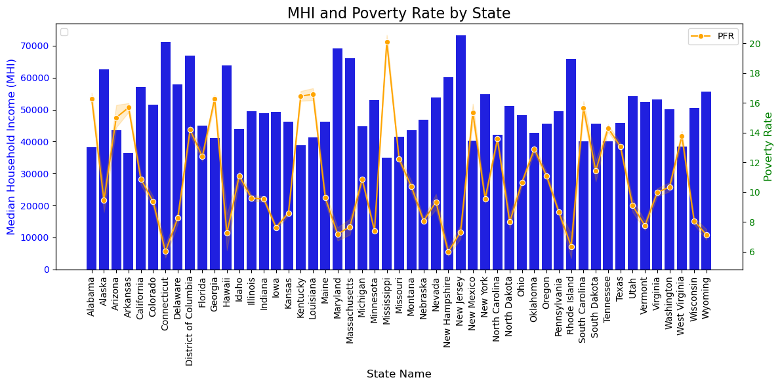
Notes:
To determine states of Interest

Slide 7
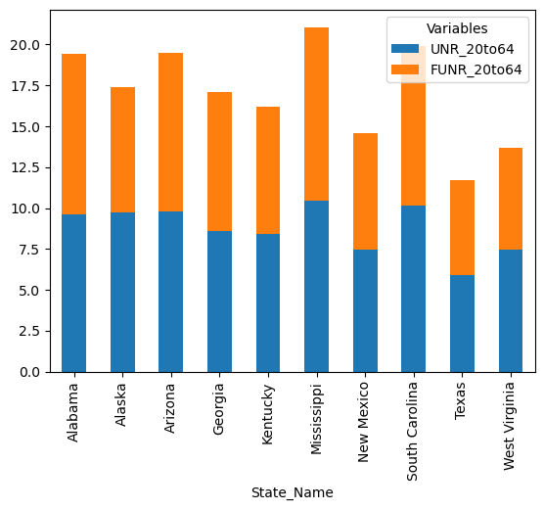
Total Unemployment to Female Unemployment
States of interest based on median average income to poverty rates compared
Notes:
compare to single mom chart
Mississippi, South Carolina, Alabama, Arizona

Slide 8
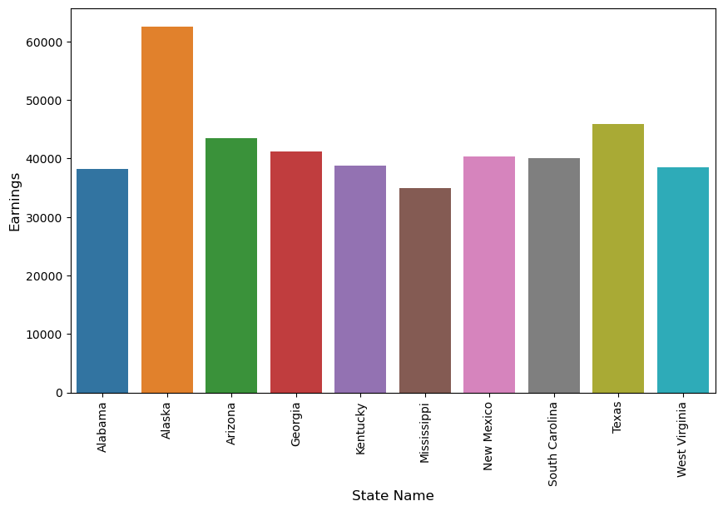
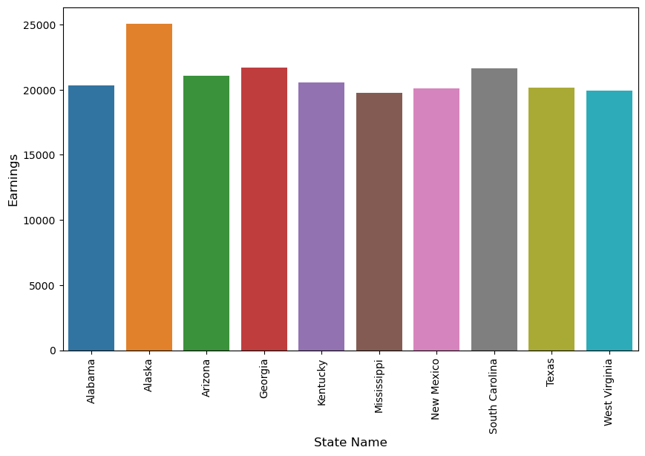
Median Earnings vs Female Earnings
Notes:
Arizona : 43527.3/25074.3
South Carolina: 39992.6/21624.3
Alabama: 38158/20330.4

Slide 9
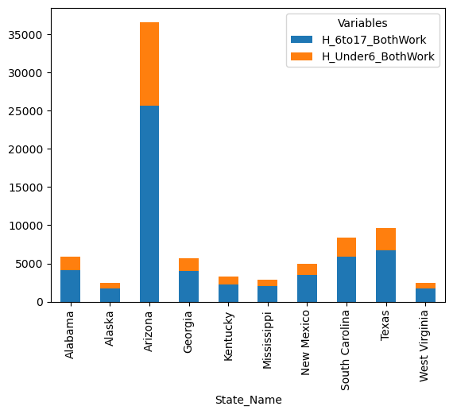
Both Parents Work
Notes:
Alaska, West virginia, Mississippi, Kentucky, New Mexico, Georgia
Arizona : 43527.3/25074.3
South Carolina: 39992.6/21624.3
Alabama: 38158/20330.4

Slide 10
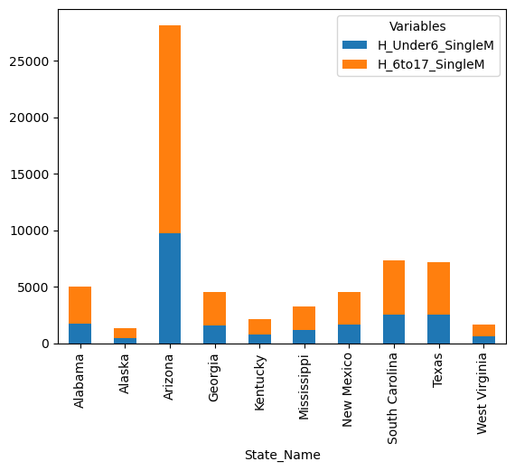
Single Mom
Notes:
Arizona, South Carolina,
Arizona : 43527.3/25074.3
South Carolina: 39992.6/21624.3
Alabama: 38158/20330.4

Slide 11
Top 3 States of Interest
State 1
State 2
State 3

Slide 12
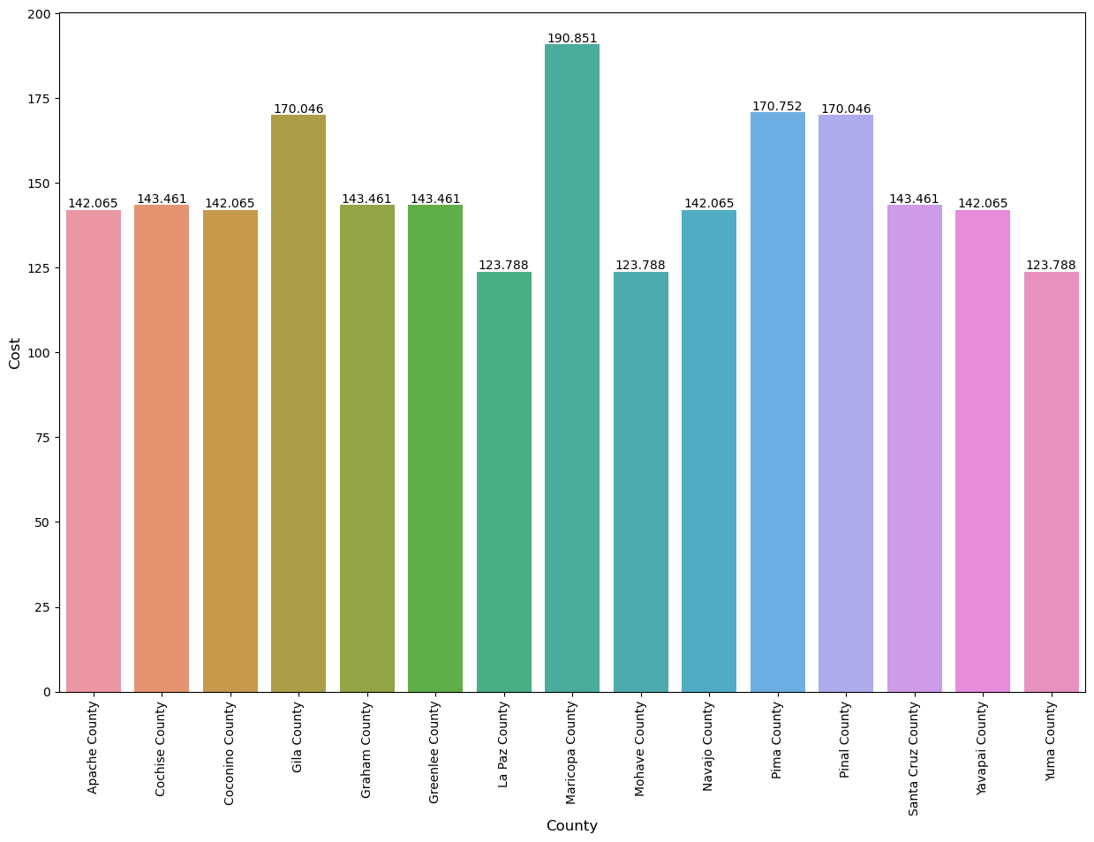
State 1
Highest: $childcare cost
Average: $childcare cost
Notes:
Average 170

Slide 13
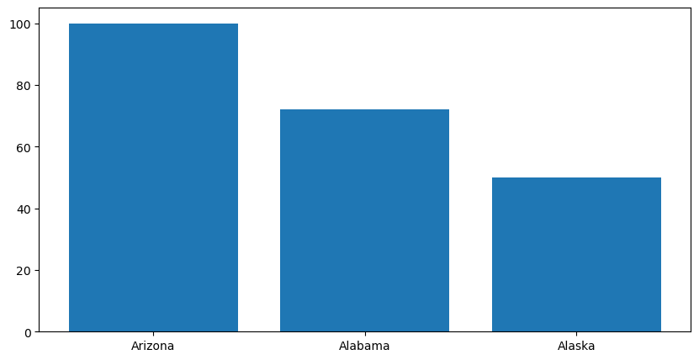
State 1
Unemployment rate vs female unemployment rate
Notes:
Gila county top pick

Slide 14
State 1
Median household income vs female median income
Notes:
Gila county top pick

Slide 15
State 1
Two working parent household
Notes:
Gila county top pick

Slide 16
State 1
Single mom household
Notes:
Gila county top pick

Slide 17
State 2
Highest: $childcare cost
Average: $childcare cost
Notes:
Average 170

Slide 18
State 2
Unemployment rate vs female unemployment rate
Notes:
Gila county top pick

Slide 19
State 2
Median household income vs female median income
Notes:
Gila county top pick

Slide 20
State 2
Two working parent household
Notes:
Gila county top pick

Slide 21
State 2
Single mom household
Notes:
Gila county top pick

Slide 22
State 3
Highest: $childcare cost
Average: $childcare cost
Notes:
Average 170

Slide 23
State 3
Unemployment rate vs female unemployment rate
Notes:
Gila county top pick

Slide 24
State 3
Median household income vs female median income
Notes:
Gila county top pick

Slide 25
State 3
Two working parent household
Notes:
Gila county top pick

Slide 26
State 3
Single mom household
Notes:
Gila county top pick

Slide 27
Top 6 Counties of Interest
County1
County2
County3
County 4
County 5
County 6

Slide 28
Conclusion
Decision process through data:
State comparison
Total Childcare Cost
Unemployment rate to female unemployment rates
Median income to median female income
Two Working Parent
Single Mom
Top 3 States of Interest
Total Childcare Cost
Unemployment rate to female unemployment rates
Median income to median female income
Two Working Parent
Single Mom
Top 6 Counties of Interest
Comparison of all counties for decision on primary location of interest

