Slide 1

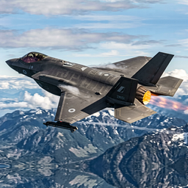
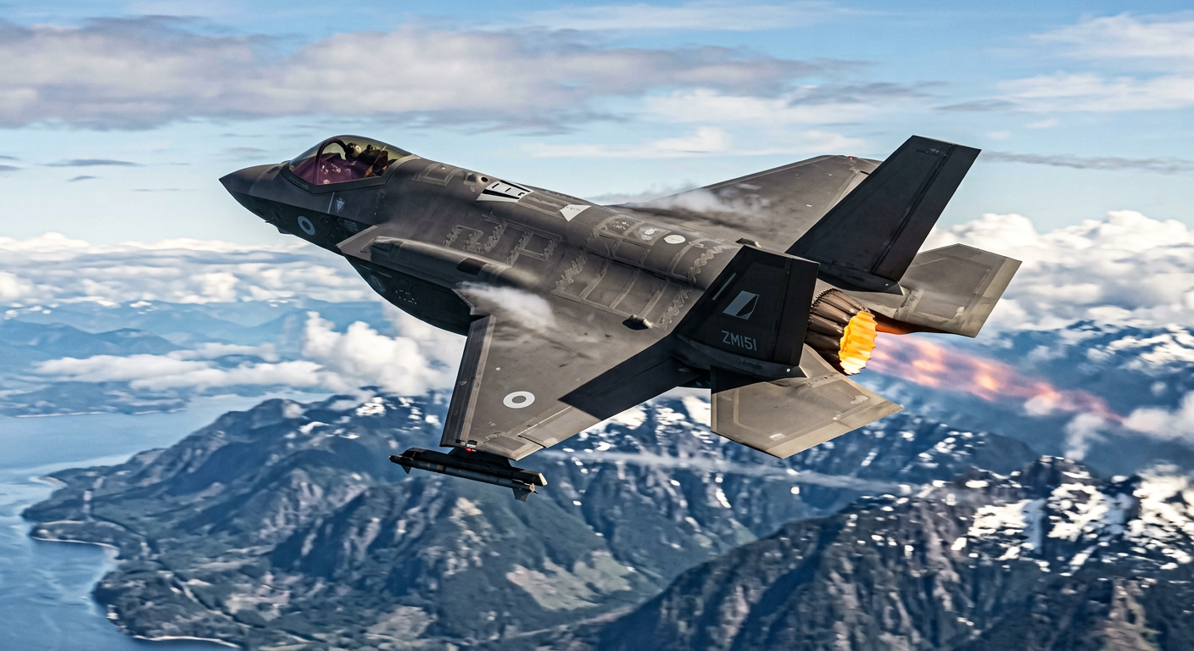
F-35 Fleet Sustainment: The Intelligent Action Layer
Compressing a Morning of Carrier Strike Group Sustainment from 90 Minutes into 4 Minutes
OPERATIONAL SCOPE: RAF MARHAM & CARRIER STRIKE GROUP
Joint fleet operations across 617 Sqn ('The Dambusters'), 207 OCU at RAF Marham, and 809 NAS embarked aboard HMS Queen Elizabeth.
MISSION MANDATE: 07:30Z 4-SHIP COMBAT SORTIE LAUNCH
Protecting the morning flying programme under DEF STAN 00-970 airworthiness regulations without administrative flight scrubs.
OPERATIONAL VELOCITY: REAL-TIME NATURAL LANGUAGE ACTION
Direct conversational interrogation of the live F35 Data Warehouse and S1000D manuals, rendering Spreadsheet Cards and briefing slides in seconds.
RAF Lightning Force · F-35B Short Take-Off · HMS Queen Elizabeth Flight Deck
ROYAL AIR FORCE · CARRIER STRIKE GROUP · F-35 SUSTAINMENT AGENTS
Slide 1 of 12
Notes:
[SPEAKER SCRIPT — 30 SECONDS]
"Good morning, leadership team. Today we are demonstrating the Intelligent Action Layer for F-35 Fleet Sustainment.
In military aviation, flight-line readiness wins wars. Right now, across RAF Marham and the Carrier Strike Group, frontline maintainers and engineering commanders face an invisible enemy: disconnected data silos, static dashboards, and the manual drag of spreadsheet exports.
Over the next few minutes, we will show you how autonomous agents running directly on top of the F-35 Data Warehouse turn hours of administrative friction into decisive operational velocity—compressing a morning of Carrier Strike Group sustainment from 90 minutes into just 4 minutes."

Slide 2
CURRENT STATE
⏱ 06:30Z
The Villain: The 06:30Z 'Oracle-to-Excel' Ritual
How Frontline Maintainers Become Human ETL Pipelines Before Turning a Wrench
⏰ TIME SINK: 45–90 MIN
⚠️ VERSION DRIFT
🔴 AIRWORTHINESS RISK
Stale on Export
Spreadsheet Roulette
Compliance Exposure
• Morning ERP dumps exported at 06:30Z are immediately frozen in time.
• Completely blind to overnight pilot debriefs, late-night carrier recoveries, and emergency depot parts arriving at 06:45Z.
• Maintainers make critical life-limited part decisions on obsolete snapshots, risking airworthiness breaches.
• Disconnected .xlsx files proliferate across Avionics, Airframe, and Carrier bays.
• Broken =VLOOKUP formulas and inconsistent column formatting lead to conflicting fleet readiness figures.
• Maintainers spend 30–45 minutes arguing over whose spreadsheet has the real numbers instead of prepping jets.
• Uncontrolled desktop workbooks lack cryptographic audit trails and access control.
• High operational risk of releasing an over-hour aircraft or violating DEF STAN 00-970 / MAA regulations.
• Central data analyst ticket queues backlog ad-hoc operational inquiries by 24–48 hours.
OPERATIONAL IMPACT: 45 TO 90 MINUTES LOST PER SHIFT
Treating senior non-commissioned officers and aerospace engineers as human ETL pipelines burns hundreds of engineering hours every week, delays shift handovers, and introduces unacceptable flight safety risk.
ROYAL AIR FORCE · CARRIER STRIKE GROUP · F-35 SUSTAINMENT AGENTS
Slide 2 of 12
Notes:
[SPEAKER SCRIPT — 45 SECONDS]
"Here is the operational reality today. Every morning at 06:30Z, 15 minutes before the shift stand-up, maintenance managers log into Oracle—the transactional system of record—and dump thousands of rows into Microsoft Excel.
Technicians spend up to 90 minutes formatting rows, copying tabs, and writing fragile VLOOKUP formulas.
The moment that spreadsheet is exported, it is dead on arrival. If a pilot reports a defect at 06:40Z, or an emergency actuator arrives at the depot at 06:45Z, the spreadsheet is completely blind to it.
Even worse: disconnected spreadsheets circulate across bays, creating conflicting numbers. And if someone makes a typo in an Excel cell, we risk releasing an over-hour jet in violation of MAA airworthiness regulations.
This is the drag we are eliminating."

Slide 3
TARGET ARCHITECTURE
The Target State: The Intelligent Action Layer
Democratising Real-Time Analytics to the Flight Line Without Replacing Oracle
TIER 1: TRANSACTIONAL SYSTEM OF RECORD (ORACLE ERP/MRO)
• Remains untouched as the transactional single source of truth—zero multi-million pound rip-and-replace risk.
• Records work orders, depot supply chains, and maintenance history with full compliance integrity.
• Continuously streams updates without locking operational transactional databases.
TIER 2: HIGH-PERFORMANCE F35 DATA WAREHOUSE
• Continuous change data capture (CDC) replication from the transactional layer.
• Partitioned, clustered F35 Data Warehouse tables (600+ records) uniting telemetry, depot stock, sorties, and bay tooling.
• High-throughput analytical query engine across the entire Carrier Strike Group and allied fleet.
TIER 3: THE INTELLIGENT ACTION LAYER — AGENTS (F35 SUPPORT)
• Frontline maintainers interrogate fleet readiness with Agents (F35 Support) in plain English—no SQL or BI training required.
• Deterministic 3-layer semantic canonicalizer maps military slang ('Lizzy', 'fit to fly') with zero SQL errors.
• Blends structured F35 Data Warehouse data with S1000D technical manuals and renders live Spreadsheet Cards.
CORE VALUE: Democratises Data Analytics directly to the flight line without altering existing ERP infrastructure.
ROYAL AIR FORCE · CARRIER STRIKE GROUP · F-35 SUSTAINMENT AGENTS
Slide 3 of 12
Notes:
[SPEAKER SCRIPT — 40 SECONDS]
"We do not need to replace Oracle. Replacing an aerospace ERP costs tens of millions of pounds and takes five to seven years.
Instead, Google Cloud Agents sit directly on top of the continuously replicated F-35 Data Warehouse as a non-disruptive 'Intelligent Action Layer'.
Oracle continues doing what it does best—recording transactions. The F-35 Data Warehouse handles high-speed analytical replication.
And Agents democratise data analytics directly to the flight-line engineer in natural language. Maintainers ask questions in plain English, and in real time, the agent executes read-only SQL, references S1000D technical manuals, and delivers auditable operational answers. Zero hallucination. Let's see this live."

Slide 4
ACT 1 DEMO
⏱ 06:45Z
✓ LIVE DEMO
Act 1: Morning Stand-Up & Shift Dispatch
Triage Grounded Lead Jet ZM151, Uncover Hidden Defects & Verify Bay Readiness
🔴 THE TRIAGE DILEMMA: LEAD JET ZM151 GROUNDED
🟢 BAY READINESS: QUALIFIED CREW & CALIBRATED TOOLS
• Grounded on Board: Lead jet ZM151 is assigned to the 07:30Z combat sortie but flagged red on the status board.
• Actuator Limit Exceeded: Horizontal Tail Actuator reached 1,000.4 hrs (exceeding the strict 1,000.0-hr life limit).
• Unexplained Defect: Night pilot reported a stiff canopy latch, but ODIN/PMA logged ZERO BIT fault codes (repeat CND defect).
• Mechanical Bay 1: Certified maintenance team assigned and ready to receive ZM151.
• Independent QA: Certified Quality Assurance Representative (QAR) on-shift for dual sign-off.
• Calibrated Tooling: Digital Micro-Torque Spanner (JTD-53-30-T14) verified calibrated and staged.
• The Mission Dilemma: Bay is ready—but ZM151 cannot fly the 07:30Z launch wave.
👉 LIVE DEMO — SWITCH TO LIVE SCREEN NOW
⚡ ACTION: LIVE SPREADSHEET CARD
PROMPT 1 (TRIAGE CSG): "What are our most urgent maintenance jobs and grounded aircraft across the Carrier Strike Group right now, ordered by how long they will take to fix?"
PROMPT 2 (DEEP DIVE ZM151): "What faults or pilot-reported issues were raised on ZM151 after its last flight, and are any repeat unconfirmed faults?"
PROMPT 3 (BAY READINESS): "Which of our open maintenance jobs are ready to start on this shift, with both qualified crew and calibrated tools staged?"
ROYAL AIR FORCE · CARRIER STRIKE GROUP · F-35 SUSTAINMENT AGENTS
Slide 4 of 12
Notes:
[STAGE DIRECTION: 👉 SWITCH TO LIVE SCREEN NOW]
[SPEAKER SCRIPT — 60 SECONDS]
"👉 SWITCH TO LIVE SCREEN NOW.
It is 06:45Z at RAF Marham. The Squadron Maintenance Officer begins the morning stand-up.
Instead of hunting through spreadsheets, watch how we query the entire Carrier Strike Group in natural language.
(Paste Prompt 1): 'What are our most urgent maintenance jobs and grounded aircraft across the Carrier Strike Group right now, ordered by how long they will take to fix?'
In real time, the agent returns an interactive Spreadsheet Card with status badges and formula totals. Notice the top row: flight lead ZM151 is grounded with an actuator over its life limit.
Now let's ask what happened on its overnight flight.
(Paste Prompt 2): 'What faults or pilot-reported issues were raised on ZM151 after its last flight...?'
The agent immediately flags two issues: the actuator hour exceedance, plus an unexplained canopy latch defect that logged zero fault codes.
Finally, we verify if our bay crew and calibrated spanners are ready.
(Paste Prompt 3): 'Which of our open maintenance jobs are ready to start on this shift...?'
Everything is verified and ready for ZM151 in Bay 1. But with ZM151 entering the hangar, our 07:30Z combat launch is down a lead jet. Let's move to Act 2 to protect the sortie."

Slide 5
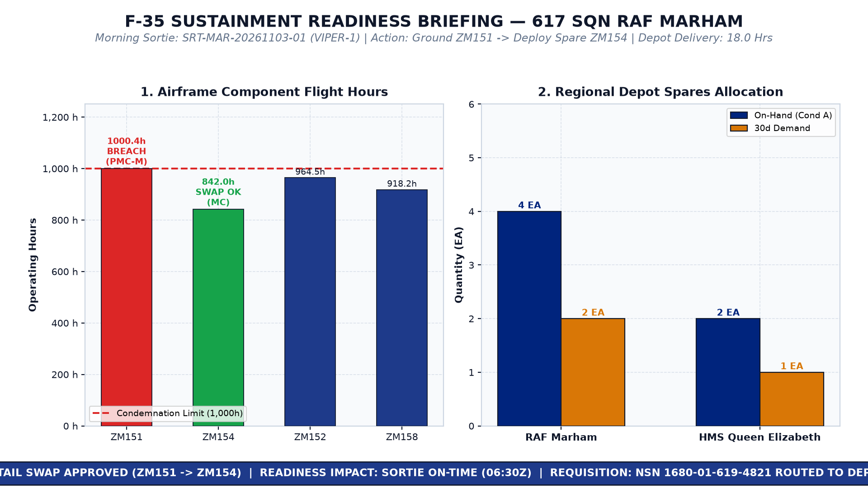
ACT 2 DEMO
⏱ 06:52Z
✓ LIVE DEMO
Act 2: Mission Protection & Leadership Briefing
Swap Aircraft to Protect the 07:30Z Sortie & Render Wing Briefing Charts on Demand
🔄 SORTIE PROTECTION & DEPOT ALLOCATION
📊 ON-DEMAND WING COMMAND BRIEFING CHART
• Recommended Tail Swap: Reallocate Flight Lead Henderson from grounded ZM151 (1,000.4 hrs) to clean spare ZM154 (842.0 hrs · FMC).
• Sortie Protected: Morning 4-ship combat sortie SRT-MAR-20261103-01 launches at 07:30Z on schedule with zero delay.
• Depot Replenishment: Marham Depot stock verified (4 actuators, 18-hr fulfillment window). Work order dispatched automatically.
👉 LIVE DEMO — SWITCH TO LIVE SCREEN NOW
⚡ ACTION: FULL HD 16:9 PRESENTATION GRAPHIC
PROMPT 4 (TAIL SWAP & DEPOT): "Check RAF Marham F-35 horizontal tail actuator hours against our 30-day spare parts stock, and recommend an aircraft swap for morning sortie SRT-MAR-20261103-01."
PROMPT 5 (BRIEFING SLIDE): "Render the full Executive Briefing Dashboard for my presentation slide deck."
ROYAL AIR FORCE · CARRIER STRIKE GROUP · F-35 SUSTAINMENT AGENTS
Slide 5 of 12
Notes:
[STAGE DIRECTION: 👉 SWITCH TO LIVE SCREEN NOW]
[SPEAKER SCRIPT — 50 SECONDS]
"👉 SWITCH TO LIVE SCREEN NOW.
It is now 06:52Z. We have 38 minutes until the 07:30Z combat launch wave. The Logistics Officer must protect the mission.
Watch how the agent solves this in seconds.
(Paste Prompt 4): 'Check RAF Marham F-35 horizontal tail actuator hours against our 30-day spare parts stock, and recommend an aircraft swap for morning sortie SRT-MAR-20261103-01.'
The agent correlates component hours, depot inventory, and the flying programme. It allocates a replacement actuator from Marham Depot and reallocates flight lead Henderson to clean spare ZM154 with 842 hours. The sortie is saved!
Now, the Wing Commander needs an executive briefing slide for the 07:00Z air wing meeting.
(Paste Prompt 5): 'Render the full Executive Briefing Dashboard for my presentation slide deck.'
On demand, the agent paints a 16:9 Full HD presentation graphic and uploads it to Cloud Storage. The sortie is protected, the depot is staged, and leadership is briefed."

Slide 6
ACT 3 DEMO
⏱ 06:56Z
✓ LIVE DEMO
Act 3: Allied Fleet Memory & Defect Resolution
Unlock 5 Years of Coalition Flight Logs to Solve the Zero-Code Canopy Latch Defect
🔍 DIAGNOSTIC MYSTERY & COALITION PRECEDENT
📖 100% GROUNDED S1000D CHECKLIST
• The Diagnostic Mystery: Night pilot reported canopy release handle binding on pre-flight, but ODIN/PMA shows ZERO_BIT_FAULT_LOGGED.
• Cross-Service Dialect Normalization: Agent maps UK terminology ('catch', 'spanner') to US technical standards ('latch', 'wrench').
• Allied Fleet Memory: Unlocks 5 years of coalition logs to locate a USMC VMFA-211 squadron log (DOC-02): cured PR-1776M sealant debris in forward roller track.
• Verbatim Engineering Citation: Grounded in S1000D Section 53-30-01 (DOC-01) technical manual.
• Exact Torque Specification: Verified re-torquing specification is 18.5 N·m using the Digital Micro-Torque Spanner staged in Act 1.
• Zero Guesswork, Zero Hallucination: Maintainers execute the certified procedure with zero delay, restoring ZM151 to full airworthiness.
👉 LIVE DEMO — SWITCH TO LIVE SCREEN NOW
⚡ VERIFIED: 100% GROUNDED S1000D CITATIONS
PROMPT 6 (ALLIED DEFECT LOOKUP): "On ZM151, our night-sortie pilot reported a stiff canopy release handle that hesitated to latch, with no fault codes logged on the jet. Have allied squadrons seen this before, and what is the approved fix?"
ROYAL AIR FORCE · CARRIER STRIKE GROUP · F-35 SUSTAINMENT AGENTS
Slide 6 of 12
Notes:
[STAGE DIRECTION: 👉 SWITCH TO LIVE SCREEN NOW]
[SPEAKER SCRIPT — 60 SECONDS]
"👉 SWITCH TO LIVE SCREEN NOW.
It is 06:56Z. Back in the maintenance bay, technicians are standing in front of ZM151. Why did the canopy handle stick if there are zero fault codes?
A static dashboard is completely useless here—dashboards cannot read text paragraphs or foreign flight logs.
(Paste Prompt 6): 'On ZM151, our night-sortie pilot reported a stiff canopy release handle that hesitated to latch, with no fault codes logged on the jet. Have allied squadrons seen this before, and what is the approved fix?'
Watch what happens: the agent searches 5 years of coalition logs across the RAF, Royal Navy, and US Marine Corps. It normalizes terminology—translating British 'catch' to American 'latch'.
It finds an exact precedent from a USMC squadron in Yuma: cured silicon sealant debris in the roller track.
And look at the clickable citation: it links directly to S1000D Section 53-30-01, giving our maintainers the verified 18.5 N·m torque spec for the spanner staged in Act 1. Zero guesswork. Zero hallucination."

Slide 7
STRATEGIC VALUE
Why Agents Beat Static BI Dashboards
Closing the Operational Gap Between Passive Observation and Decisive Flight-Line Action
1. ACTION VS. PASSIVE DISPLAY
2. WORKFORCE DEMOCRATISATION
• Static BI Dashboards: Passive rearview mirrors displaying red tiles. An officer must open 4 different systems (SAP, GOLDesp, Excel, PDFs) to take action.
• Autonomous Agents: Active reasoning systems that cross-correlate component limits, recommend tail swaps, and stage depot inventory in a single turn.
• Static BI Dashboards: Locked to pre-built filters. Any ad-hoc operational query requires submitting a ticket to a central data analyst with a 48-hour delay.
• Autonomous Agents: Frontline flight sergeants ask ad-hoc questions in everyday English and receive verified, governed answers immediately.
3. MULTIMODAL INTELLIGENCE
4. AIRWORTHINESS DETERMINISM
• Static BI Dashboards: Strictly restricted to structured database tables. Completely blind to technical manuals, debrief texts, and foreign logs.
• Autonomous Agents: Seamlessly fuse live F-35 Data Warehouse telemetry with 10,000-page S1000D PDF publications, pilot debrief narratives, and coalition logs.
• Static BI Dashboards: Unvetted desktop spreadsheets suffer silent formula bugs, version drift, and unverified data entries that breach airworthiness.
• Autonomous Agents: Deterministic SQL canonicalization, read-only safety envelopes, and 100% verbatim citations ensuring DEF STAN compliance.
ROYAL AIR FORCE · CARRIER STRIKE GROUP · F-35 SUSTAINMENT AGENTS
Slide 7 of 12
Notes:
[SPEAKER SCRIPT — 45 SECONDS]
"Leadership frequently asks: 'Why can't our data science team just build this in PowerBI or Tableau?'
Here is the fundamental difference. Dashboards are passive rearview mirrors. They tell you a plane is broken, but they cannot tell you what to do.
To solve lead jet ZM151 in a dashboard, an engineering officer has to open SAP, open GOLDesp, open three Excel files, and thumb through a 10,000-page manual.
Agents collapse that four-screen swivel-chair into a single natural conversation.
Moreover, agents democratise analytics: maintainers don't need to wait 48 hours for a central BI developer to build a new report. They simply ask the agent, get an instant Spreadsheet Card, and take decisive action."

Slide 8
SEMANTIC GOVERNANCE
Semantic Governance in Action: Military Vernacular
Deterministic Interpretation of Colloquial Slang with Zero SQL Errors
THE EXECUTIVE INQUIRY: NATURAL MILITARY SLANG
Commander's Prompt: "Tell me what tails on Lizzy are fit to fly"
THE 3-LAYER SEMANTIC GOVERNANCE ENGINE
• Vernacular Resolution: 'Lizzy' ➔ Deterministically canonicalized to base_location = 'HMS Queen Elizabeth'.
• Airworthiness Mapping: 'fit to fly' ➔ Deterministically mapped to mission_readiness_code = 'FMC' (Fully Mission Capable).
• Read-Only Guardrail: Strict SELECT whitelist execution against the live F-35 Data Warehouse with zero SQL injection risk.
GOVERNED OUTPUT: EMBARKED SERVICEABLE FLEET (SPREADSHEET CARD)
Tail: ZM166 | Sqn: 809 NAS | Loc: Carrier Bay 1 | Status: 🟢 FMC | Faults: 0 Open Faults | READY FOR LAUNCH
Tail: ZM172 | Sqn: 809 NAS | Loc: Flight Deck | Status: 🟢 FMC | Faults: 0 Open Faults | READY FOR LAUNCH
Tail: ZM136 | Sqn: 809 NAS | Loc: Carrier Bay 2 | Status: 🟢 FMC | Faults: 0 Open Faults | READY FOR LAUNCH
Tail: ZM142 | Sqn: 809 NAS | Loc: Flight Deck | Status: 🟢 FMC | Faults: 0 Open Faults | READY FOR LAUNCH
Tail: ZM148 | Sqn: 809 NAS | Loc: Carrier Bay 3 | Status: 🟢 FMC | Faults: 0 Open Faults | READY FOR LAUNCH
ROYAL AIR FORCE · CARRIER STRIKE GROUP · F-35 SUSTAINMENT AGENTS
Slide 8 of 12
Notes:
[SPEAKER SCRIPT — 40 SECONDS]
"What happens when a commander or admiral asks a question in everyday military vernacular?
If an executive asks: 'Tell me what tails on Lizzy are fit to fly'—an unconstrained LLM might hallucinate or fail to understand the colloquialism.
Our Semantic Governance Layer intercepts the query, deterministically maps 'Lizzy' to HMS Queen Elizabeth and 'fit to fly' to Fully Mission Capable (FMC), and executes a verified read-only SQL query against the warehouse.
Immediately, it renders a spreadsheet card showing the five serviceable aircraft aboard Queen Elizabeth.
That is enterprise governance in action: natural conversational flexibility paired with military-grade determinism."

Slide 9
TRANSFORMATION
Mission Impact: From 90 Minutes to 4 Minutes
Eliminating Administrative Drag to Deliver Decisive Operational Velocity
90m ➔ 4m
100%
0
95% TIME SAVINGS
GROUNDED & AUDITABLE
SORTIE LAUNCH SCRUBS
Morning triage, spreadsheet wrangling, and shift dispatch compressed from 90 minutes of manual friction into a 4-minute conversation.
Zero hallucination. Every procedure, torque specification, and part number is anchored to S1000D technical publications and DEF STAN standards.
100% combat wave protection via autonomous tail swap recommendations, live depot part staging, and qualified crew verification.
RECOMMENDED NEXT STEPS: OPERATIONAL SQUADRON PILOT
PHASE 1: SQUADRON PILOT
PHASE 2: EMBARKED CSG
PHASE 3: ALLIED FLEET MEMORY
RAF Marham (617 Sqn)
HMS Queen Elizabeth
Coalition Interoperability
• Deploy Intelligent Action Layer alongside Oracle for 617 Sqn.
• Validate morning stand-up triage in live hangar environments.
• Measure maintainer time savings and user adoption.
• Extend deployment to 809 NAS aboard HMS Queen Elizabeth.
• Integrate carrier hangar bay tooling and weapon load constraints.
• Verify air-gap and hybrid offline replication scenarios.
• Connect 5-year narrative logs across USMC and USAF squadrons.
• Establish automated cross-service defect resolution memory.
• Full integration into MOD digital sustainment ecosystem.
ROYAL AIR FORCE · CARRIER STRIKE GROUP · F-35 SUSTAINMENT AGENTS
Slide 9 of 12
Notes:
[SPEAKER SCRIPT — 45 SECONDS]
"To summarize what you have seen today: in just four minutes, we transformed a double-grounding crisis into a protected combat sortie wave, staged depot replenishment, and certified a verified repair procedure.
We eliminated 90 minutes of spreadsheet drag, verified 100% compliance with military airworthiness standards, and protected the mission.
We are ready to transition this capability into an operational pilot with 617 Squadron at RAF Marham, followed by Carrier Strike Group embarked deployment.
Thank you for your time, and we welcome your questions—or we can dive into the technical architecture in our appendix."

Slide 10
APPENDIX
Appendix: Architecture & Technical Foundations
Multi-Agent Runtime, Warehouse Replication & Semantic Security Governance
TECHNICAL ARCHITECTURE & IMPLEMENTATION DEEP-DIVE
The following slides provide themed architecture diagram canvases detailing the engineering foundations of the F-35 Sustainment Platform:
SLIDE 11: SYSTEM ARCHITECTURE & RUNTIME
SLIDE 12: DATA FLOW & SEMANTIC GOVERNANCE
• ADK 2.0 Reasoning Engine & Coordinator Topology
• Domain Sub-Agent Boundaries:
- @F35-Maintenance-Data (Text-to-SQL)
- @F35-Sustainment-Analytics (Telemetry & Charts)
- @F35-JTD-Search (Technical Documentation & Citations)
• Pre-Warmed Singletons & High-Throughput Execution
• Open Canvas for System Topology Diagram
• Oracle ERP/MRO Continuous CDC Ingestion
• High-Performance Analytical Data Warehouse
• 3-Layer Semantic Canonicalizer & Vernacular Ontology
• Read-Only Safety Envelopes & SQL Guardrails
• Open Canvas for Data & Security Pipeline Diagram
ROYAL AIR FORCE · CARRIER STRIKE GROUP · F-35 SUSTAINMENT AGENTS
Slide 10 of 12
Notes:
[SPEAKER SCRIPT — 30 SECONDS]
"Moving into our technical appendix. For system architects, security officers, and engineering leadership who want to inspect the underlying mechanics, the next two slides provide dedicated architecture canvases.
Slide 11 covers the end-to-end multi-agent orchestration runtime, detailing how front-of-house intent routing delegates into specialized sub-agents with strict domain separation.
Slide 12 covers the continuous data replication pipeline and 3-layer semantic governance layer that guarantees read-only airworthiness safety."

Slide 11
APPENDIX · ARCHITECTURE CANVAS
Solution Architecture & Multi-Agent Orchestration
High-Level System Topology, ADK 2.0 Agent Runtime & Domain Tooling Boundaries
KEY ARCHITECTURAL HIGHLIGHTS
PRESENTATION & UI TIER
• Interactive Spreadsheet Cards
• Vega-Lite Chart Specs
• On-Demand 16:9 Presentation Slides
[ ARCHITECTURE DIAGRAM CANVAS — SYSTEM TOPOLOGY & AGENT RUNTIME ]
ADK 2.0 AGENT RUNTIME
• Root Coordinator Router
• Tier 1/2 Fast-Path Interception
• Deterministic Intent Routing
Paste System Architecture Diagram Here
(ADK 2.0 Agent Runtime, Root Coordinator, Specialized Domain Sub-Agents,
Pre-Warmed Data Warehouse & Document Search Singletons & Cloud Storage Tier)
SPECIALIZED SUB-AGENTS
• Agents (F35 Support) Multi-Agent Fleet
• @F35-Maintenance-Data, @F35-Sustainment-Analytics
• @F35-JTD-Search (S1000D Manuals)
PERFORMANCE & SECURITY
• Pre-warmed analytical & search clients
• In-memory credential caching
• Strict EU / europe-west1 residency
ROYAL AIR FORCE · CARRIER STRIKE GROUP · F-35 SUSTAINMENT AGENTS
Slide 11 of 12
Notes:
[SPEAKER SCRIPT — 45 SECONDS]
"This slide provides the full solution architecture topology for the F-35 Fleet Sustainment platform.
The core design principle is strict domain separation across three specialized sub-agents. The front-of-house coordinator never generates SQL directly—it classifies intent and delegates to the appropriate specialist agent.
Notice the performance engineering: in-memory credential caching and pre-warmed singleton clients eliminate cold-start overhead, guaranteeing high-performance responsiveness across the board. All data storage, search datastores, and compute run in strict compliance with EU data residency."

Slide 12
APPENDIX · DATA ARCHITECTURE
Data Flow, Continuous Replication & Semantic Governance
Transactional ERP/MRO Ingestion, Data Warehouse Pipeline & Read-Only Safety Envelopes
SECURITY & GOVERNANCE CONTROLS
CONTINUOUS CDC INGESTION
• Real-time change data capture
• Zero locks on transactional ERP
• Continuous multi-region consistency
[ ARCHITECTURE DIAGRAM CANVAS — DATA FLOW & SECURITY GOVERNANCE ]
3-LAYER CANONICALIZER
• Military slang ontology resolution
• Regex SQL dialect normalization
• Zero-row auto-recovery logic
Paste Data Flow & Security Architecture Diagram Here
(Oracle CDC Ingestion, High-Performance F35 Data Warehouse Tables, 3-Layer Semantic
Canonicalizer, Read-Only Safety Envelopes & S1000D Verbatim Citation Pipeline)
READ-ONLY SAFETY ENVELOPE
• Strict SELECT-only whitelist
• AST parsing prevents injections
• Automated table partition pruning
S1000D CITATION ANCHORING
• Verbatim snippet grounding
• Direct links to PDF publication
• Zero hallucination guarantee
ROYAL AIR FORCE · CARRIER STRIKE GROUP · F-35 SUSTAINMENT AGENTS
Slide 12 of 12
Notes:
[SPEAKER SCRIPT — 45 SECONDS]
"This slide details the data replication pipeline and semantic security controls.
The architectural challenge in defence aviation is ensuring analytical speed without risking operational transactional integrity. Our continuous change-data replication stream replicates records from Oracle into the F-35 Data Warehouse continuously without impacting frontline transactional performance.
When an engineer or executive submits a natural language query, our 3-layer semantic canonicalizer validates that the query is strictly read-only, checks against our aerospace ontology, and executes against the warehouse. All maintenance procedures are verified against official S1000D documentation, ensuring total regulatory airworthiness compliance."

