Slide 1
L1: Introduction to Financial Markets
Lecturer: Justin Thomas (MC 2017)
September 24th, 2015 – 9:30 P.M.
LC 102

Slide 2
Welcome to YUDI!
Freshman pool most competitive, 150+ applications
Make the most out of this opportunity
Attend all lectures and guest speaker events
1 excused absence + special cases
Valuation projects next semester will be assigned
Group assignment for company valuation
Special Freshman speaker event: Former Goldman partner of 15 years coming in Oct./Nov.

Slide 3
1st and 2nd semester lecture outline
1st Semester timeline:
Introduction to Financial Markets: Stocks & Bonds
Approaching a Vast and Lucrative Career in Finance
The Importance of Developing an Investment Philosophy
Principles of Accounting I
Principles of Accounting II
2nd Semester timeline:
Principles of Valuation I: Fundamental vs. Technical
Principles of Valuation II: Intrinsic (DCF) vs. Relative (Comparable Companies)
Application of Accounting and Valuation Principles: In The Context of Equity Investments
Portfolio Construction and Management: Understanding the Concepts
TBA

Slide 4
A little about myself
Morse College 2017
Pursuing Chemical Physics, Intensive B.S.
Former premedical student
Hate the cut throat attitude and doing research
Manage a small portfolio across US Markets
Currently going through IB recruitment season (junior year)
Email: justin.t.thomas@yale.edu
Phone #: 708-738-4230

Slide 5
Introduction to financial markets
A comprehensive look at the stock market

Slide 6
Goals of meeting #1
Understanding the structure and foundation of the Stock Market
Understanding the Top-Down Approach
Recognizing company valuation

Slide 7
Introduction to assets classes
Two common ways to raise capital ($):
Bonds
Loans
Coupon payments
Stocks
Ownership
Benefit from growth
Benefits from interest
Profit from dividend

Slide 8
Stocks versus bonds
Stocks
Bonds
Equity ownership in a company
Indefinite ownership
Common shares or preferential shares
Profit from:
Appreciation
Dividends
Advantage: more profitable
Disadvantage: very volatile, can lose all value!
Loan money to a company
Receive back initial loan at maturity date
Come in all shapes and sizes
Profit from:
Coupon dates (interest)
Advantage: safer, low risk low reward investments
Disadvantage: risk of default, no voting rights, low reward

Slide 9
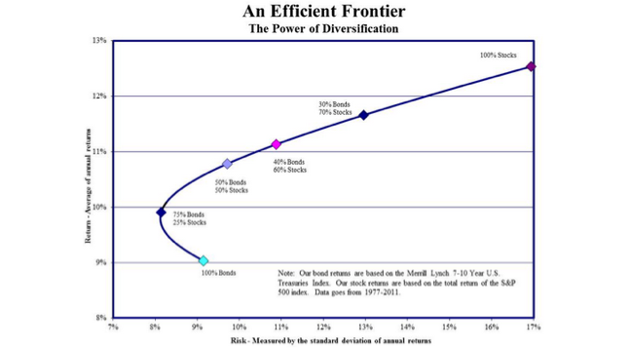
The Power of Diversification

Slide 10
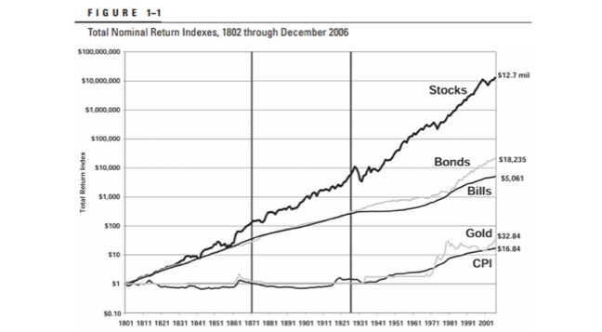
The Power of Risk

Slide 11
Answer: Stocks (equity)
Question: What will we primarily focus on?

Slide 12
Answer: at our age, the power of risk is minimal and we can benefit from larger, riskier investments.
Question: Why will we primarily focus on stocks (equity)?

Slide 13
Major United States indices
DJIA (‘Dow Jones’), an Industrial Average:
Tracks the 30 largest companies
S&P 500:
Tracks the 500 largest companies in terms of Market Capitalization
Considered the best representation of US market
The NASDAQ Composite
Indicator of the performance of technology companies and growth companies
NYSE
Contains a large variety of different types of stocks
Notable because trades actually occur here, right in NY!
RUSSEL 2000
Measures the performance of “small-cap” companies
Considered the best measure for performance of small-mid tier sized companies

Slide 14
More “obscure” World Indices
FTSE 100:
Measures the performance of the top 100 companies on the London Stock Exchange.
Nikkei 225:
Like the DJIA, a price-weighted Japanese Stock Average.
The leading and most-respected index of Japanese stocks.
The Hang Seng:
A market capitalization-weighted index of 40 of the largest companies that trade on the Hong Kong Exchange.

Slide 15
Our Next Step
Checkpoint: we know what a stock is, how to make money from them, and where to look at them
Forward: how do we go about choosing which stock we should invest in, when there are thousands that exist?

Slide 16







Should we play the slots instead?
3
2
1

Slide 17
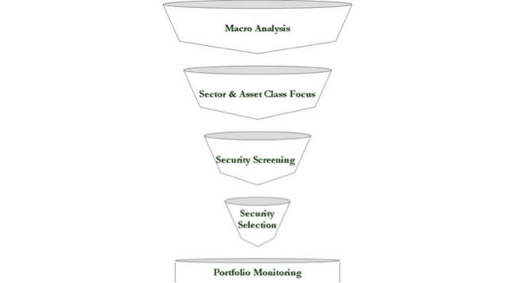
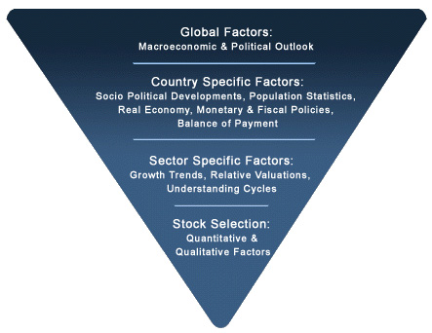
The Top-Down Approach

Slide 18
The Top-Down Approach
What is the TDA?
Guideline to find quality stocks to invest into
Start by analyzing the macro-economy at large
End with equity investment determined to provide return on investment (ROI)
Must exceed the cost of the investment!
NOT comprehensive look at an individual company!

Slide 19
The Top-Down Approach
Evaluating systematic risks, which is a function of macroeconomic conditions
What is the economic outlook for the future?
Look towards the Index Leading Economic Indicators
Average weekly hours for workers
Average number of initial application for unemployment insurance
The amount of new building permits
The inflation-adjusted monetary supply (M2)
Other economic conditions: war, disease (Ebola, Syria), the exchange rate, weather (El Niño).
Good book to read: “The Black Swan”

Slide 20
Different Asset Classes
What is an asset class?
A group of securities that exhibit similar characteristics and risk/return qualities.
Each asset class performs differently.
Examples of asset classes:
Equity (stocks)
Private Equity (private companies)
Fixed Income (bonds)
Cash (currencies)
Real Estate (REITs)
Commodities (metals and other resources)
Collectibles (paintings, old coins, sports memorabilia)

Slide 21
Answer: equity (stocks)
Question: What will asset class will YUDI focus on?

Slide 22

Step 1: CHOOSE A SECTOR

Slide 23
Step 2: CHOOSE AN INDUSTRY
Once you have decided which sector(s) will be hot in the near future…
Use a screening technique, such as Porter’s “Five Forces” to determine which industry may be attractive in the future.

Slide 24
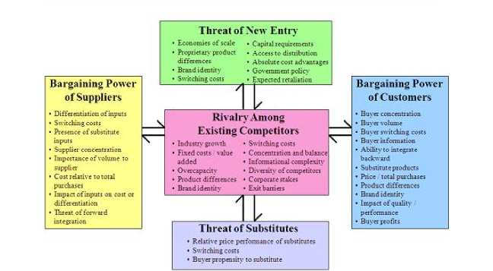

Slide 25
Step 3a: SECURITY SCREENING
Arguably the most complicated and important process of the TDA!
This is the heart of investing; if you’re a prodigy, this is where you will shine.
The great become separated from the good
Many ways to analyze a security, but we will split into two trees:

Slide 26
Step 3b: SECURITY SCREENING
Quantitative Analysis
Financial statements analysis (Lecture 4/5)
Valuation Strategies
Technical versus Fundamental analysis (Lecture 1 Semester 2)
Discounted Cash Flow (DCF, Lecture 2 Semester 2)
Comparables (CC, Lecture 2 Semester 2)
Qualitative Analysis
Business model
Unique to the company
Competitive advantages
“Gut feelings” about why you feel the company is great
SEC filings help show true actions of CEO, acting manager, etc.

Slide 27
Step 4: Portfolio management
Once you have:
Taken into account global factors that affect the market
Chosen a sector
Chosen an industry
Chosen a security
You can rinse and repeat and build a portfolio that has a great foundation for growth

Slide 28
The importance of TDA
The key to a successful portfolio is not only in running competent TDA analysis, but also diversification
“Don’t put all your eggs in a single basket”
Diversify across asset classes, in different sectors, in different industries, and in different types of securities (ETFs, dividend paying stocks, or pure penny stocks)
If the economy is collapsing, hopefully your portfolio isn’t.

Slide 29
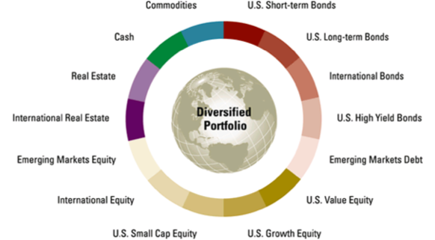
Diversification illustrated

Slide 30
The “110” Rule
Take your age and subtract it from 110 to yield the percent allocation you should have in equity
Example: 110-20 = 90% allocation in stocks
Why do we follow the 110 Rule?
As young investors, we can risk losing all our money without losing our lives
As you get older, a strong foundation for retirement is generally a good idea

Slide 31
Summary slide
Stock and bonds differ largely in how they are bought and how they are profitable
Diversification is important and risk taking should be proportional to your age
The TDA is a widely used method for analyzing the US market and choosing securities to invest in
Mistakes are more important than successes

Slide 32
Goals moving forward
Learn more about the lucrative industry of finance and Wall Street
Learn techniques and calculations to analyze companies
Examine different security screenings and security selections at an extensive level

Slide 33
Questions, comments, concerns
Conclusion of Lecture 1

