Slide 1
L4: Financial Statements
Lecturer: Justin Thomas (MC 2017)
November 5th, 2015 – 9:00 P.M.

Slide 2
Stock picks of the week
Last stock pick (AAVL): went up 17.6% since I suggested to buy it
Last stock pick (NVET): went up 42.2% since I suggested to buy it
Feel free to check lecture slides from October 15th
I’m not saying I’m a prophet, but this is free money
Current stock pick (KERX): looking for 20% over the next 2 weeks
We’ll see how I do next lecture
These picks could either guarantee you win the competition of guarantee you lose

Slide 3
Financial Statements
Gives information about cash flows, accounting identities, useful ratios (EV/EBITDA), and health of company ($$$)
Public companies are required to release statements
Private companies are not required to release statements
Three main statements:
Income statement
Cash Flow statement
Balance sheet

Slide 4
Lecture Goals of L4 + L5
L4: Introduce income statement and balance sheet
L5: Build cash flow statement and conceptual questions regarding all three

Slide 5
Income Statement
Performance over time (quarter or year)
Revenue – expenses = income (profit)
Net income > 0
Strong profit margins

Slide 6
Income Statement and Terms
Revenue (Sales)
Value of products and services sold over time
Price x quantity sold = revenue
COGS (cost of goods sold)
Represents expenses linked to the sale of products
Gross profit
Revenue – COGS = gross profit
Operating Expenses
Costs not directly linked to product sales
SG&A (Selling, goods, administrative)
Employee salaries
Depreciation and Amortization

Slide 7
Simplified Income Statement
Revenue (sales)
COGS
Gross Profit
Operating Expenses
SG&A
Rent, employee salary
D&A
Operating Income
Interest income / (expense)
Other income
Gain or (loss) on sale of PP&E (Property, plant and equipment)
Pre-tax Income
Tax provision (tax rate)
NET INCOME

Slide 8
Bakery example
$2000 Revenue (sales)
(800) COGS
1200 Gross Profit
(130) Operating Expenses
70 Worker salary
40 Rent for the year
20 2010 toaster machine
1070 Operating Income
(100) Interest income / (expense)
0 Other income
(200) Lost money losing a toaster
707 Pre-tax Income
(248) Tax provision (35%)
$459 NET INCOME

Slide 9
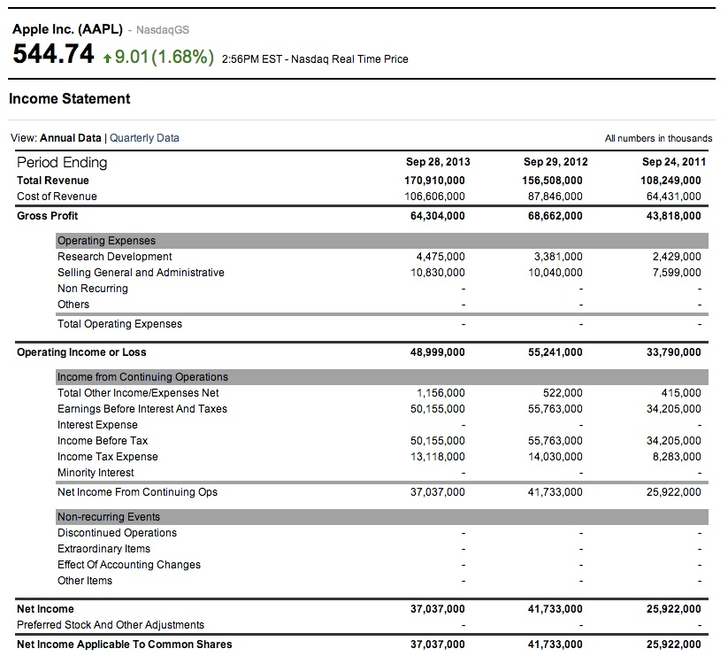

Slide 10
Balance Sheet
Snapshot of company performance
Assets: receive cash in the future
Liabilities: lose cash in the future
Equity: Shareholder’s ownership
Leftover between what is owned and what is owed
Shareholder’s have a right to certain assets (these are the assets)
MUST ALWAYS BE TRUE:
ASSETS = LIABILITIES + EQUITY

Slide 11
Balance sheet ASSETS and terms
Cash
Physical cash only
Short term investments are still less liquid than cash
Accounts receivable
Recorded revenue on income statement but not received cash yet (IOU)
Prepaid expenses
Paid expenses in cash that have not been recorded as expenses on income statement
Inventory
Materials company need to manufacture and sell products

Slide 12
Balance sheet ASSETS and terms
Plants, property, and equipment (PP&E)
Factories, buildings, land, equipment and machinery
Other tangible assets
Patents, trademarks, intellectual property
Usually a result of an acquisition (Goodwill – when a company pays more during an acquisition)

Slide 13
Balance sheet LIABILITIES and terms
Revolver
Similar to a corporate credit card
Can borrow money but must replay quickly
Accounts payable
Expenses recorded on income statement but yet to be paid in cash
One time items with invoices
Accrued Expenses
Similar to accounts payable, but payments owed recur every month
Employee wages, utilities, rent (if not paid for) – all spread over time

Slide 14
Balance sheet LIABILITIES and terms
Deferred Revenue
Company has collected cash in advance but customers have not received product or service
Think of real revenue over time
Deferred Tax Liability
Company has paid lower taxes than what was owed and must pay additional taxes in future
Long Term Debt
Similar to a mortgage or car loan – debt that is due and must be repaid over annual time period

Slide 15
Balance sheet EQUITY and terms
Common stock & Additional Paid in Capital
Market value of shares at the time those shares were issued
When a company goes public, the total dollar value of shares shows up here
This value does not change even if the share price changes afterward
Treasury Stock
Cumulative value of shares the company has repurchased from investors
This does not change even if share price does afterward

Slide 16
Balance sheet EQUITY and terms
Retained Earnings
Company’s saved up, after tax proQits (minus any dividends issued)
Accumulated Other Comprehensive Income (AOCI)
“miscellaneous saved up income”
Unrealized gains and losses on certain types of securities
value goes up or down but company hasn’t sold that security yet
Effect of foreign currency exchange rates

Slide 17
Bakery Example
CURRENT ASSETS
1000 Cash and Bank Account
100 Stocks from small investment
400 Sold 20 loaves but didn’t get paid
150 Paid for dough but didn’t record
400 Inventory of ingredients
$2,050 Total Current Assets

Slide 18
Bakery Example
LONG-TERM ASSETS
3000 My three ovens
200 Patent on bread making
1000 Own the building next to bakery
200 Paid $200 more than its worth
4400 Total Long-term Assets

Slide 19
Bakery Example
CURRENT LIABILITIES
1000 I owe money on my credit card
500 Bought a big sign but haven’t repaid
100 Staff wages but I haven’t paid yet
$1600 Total Current Liabilities
LONG-TERM LIABILITIES
860 Bob gave me money but I haven’t delivered
600 I paid less in taxes and owe more
1200 Bank gave me 30 year loan on facility
$2660 Total Long-term Liabilities

Slide 20
Bakery Example
SHAREHOLDER EQUITY
$1000 Total value of shares offered
500 I repurchased some shares
700 I sold bread in China and benefited from exchange rate
$2200 Total Shareholder Equity

Slide 21
Summation of Components
TOTAL ASSETS = TOTAL LIABILITIES + EQUITY
$6460 = $4260 + $2200

Slide 22
Going Forward
Next lecture will cover a simplified version of the cash flow statement and how to construct it from the previous 2 statements
Common interview question: stuck on island, which two statements do you need to value a company?
Income statement + balance sheet
Next lecture will include some common accounting questions presented in technical interviews for investment banking

