Slide 1
YUDI
Sophomore Meeting 1
Introduction & Finance Review

Slide 2
Welcome YUDI Class of 2018!

Slide 3
About Myself
Junior, Ezra Stiles, Co-Founder & Co-President of YUDI
From New Jersey
Varsity Soccer
Economics Major
Have previously worked at:
Morgan Stanley (Wealth Management) *most recent
Goldman Sachs (Sales & Trading)
J.P. Morgan (Investment Banking)
Strong interests in:
finance, investing, entrepreneurship, life-coaching
Soft interests in:
philosophy & martial arts

Slide 4
Outline for Today: More Informational
Year-Schedule (excluding speaker and networking events)
Goals of YUDI
Discuss the importance of vision and self-reflection for career choice
Discuss meritocracy and how it will play into YUDI
Go over some finance terminology we’ll be using

Slide 5
Sophomore Curriculum:
-Lecture 1 – Introduction & Finance Review: Asset Return & Business Statistics Sept. 17th, 9:00PM
- Lecture 2 - Portfolio Optimization: Modern Portfolio Theory, CAPM, Market Efficiency Oct. 1st, 9:00PM
- Lecture 3 - Active Portfolio Management Part I, Oct. 15^{th,} 9:00PM (HW 1 DUE)
- Lecture 4 – Credit & Fixed Income: their importance in our economy Nov. 5th 9:00PM
- Lecture 5 – Tying it all together & Review (discussion based), Nov. 19th, 9:00PM (HW 2 DUE)
EXAM 1 (Semester 1 Material) Dec 10th, 9:00PM
- Lecture 6 – Lecture on Effective Networking Jan 21st, 9:00PM
- Lecture 7 - Active Portfolio Management: Investment Selection & Valuation Under the Buffet Philosophy (S2) Feb 4th, 9:00PM
- Lecture 8- Advanced Discounted Cash Flow Analysis March 3rd, 9:00PM
- Lecture 9- Performance Evaluation: Modern Portfolio Theory vs. Buffet (S2) March 31st, 9:00PM
- Lecture 10 – Personal Finance, Must Do’s in the Summer, & Review (S2) April 14th, 9:00PM
EXAM 2 (Semester 2 Material), April 28th, 9:00pm
Notes:
Luis patino III
Leonardo Sanchez-noya
Ammar saeed

Slide 6
Starting NOW to your realize your vision work backwards
1) Vision/Goal: to become an Investment Banker at Goldman Sachs
to get an offer, you NEED to get a junior year summer internship (summer analyst program). All about doing well in the summer program and impressing someone enough for them to make you an offer. Work hard, be tenacious, be curious.
Well, how do you get a junior year internship? You NEED to do something good sophomore summer, as well as network and be proactive. Doesn’t necessarily have to be in finance, but preferable. All about experience, interest, knowledge, and who you know. You need to present yourself as different, and they NEED to know you by this point.
Well, how do I get something good sophomore year? You NEED to do something freshmen summer; you need to network and be proactive. Classes you take and organizations you are in matter. GPA matters. Emphasis on Networking
Well, how do I get something freshmen summer? You need to network and be proactive. Simple as that. You need to hunt. No one is going to hand it to you. Classes you take and organizations you are in matter. GPA matters. Emphasis on Networking.
Common Thread = networking & being proactive…

Slide 7
Everyone take out a piece of paper and write down what your vision is… your goal—what you want to be and do
What is your Vision?

Slide 8
The Promise of Meritocracy
You will be evaluated off your scores from the following assessments:
Energy, passion, and dedication to learning, connecting, and YUDI (35%)
Exams (30%)
Assignments (25%)
Performance in the stock competition (10%)
Why are you being scored?
Most importantly, you will get a sense of how much you have taken away and learned through your experience with YUDI
There will also be 2 class leadership positions handed out at winter break!
So work hard for us and we’ll work hard for you! It’s a simple equation!

Slide 9
Good, now that we’re all Settled… Transition to Some Finance Review -Asset Classes & Their Returns - Necessary Statistics

Slide 10
Investment Decisions
To make an investment decision, we need to know, or assume:
The Expected Return of a security
The Riskiness of a security
For now, we’ll look at historical data to determine these things.

Slide 11
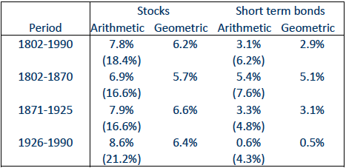
Historical Returns
We will largely be focused on stocks and bonds and how these asset classes have performed historically…

Slide 12
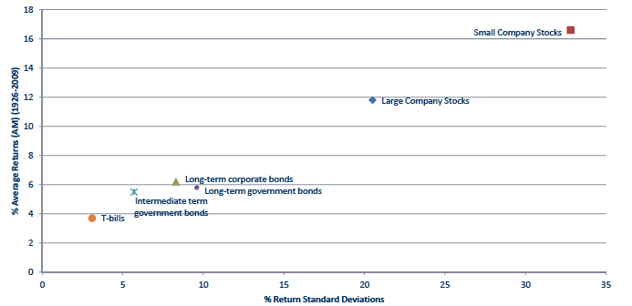
Historical Asset Class Returns

Slide 13
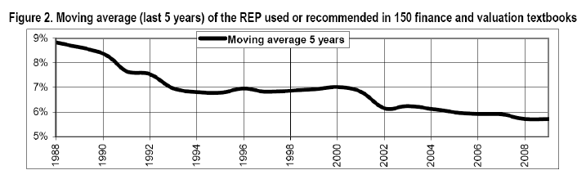
Declining Equity Risk Premium
Meaning, it is getting less risky to invest in stocks…
The Point: Based off Mean & Variance (Return & Risk), high stocks returns seemed linked to high risk…but, the compensation for bearing such risk (ERP) seems to be declining…perhaps due to increasing efficient markets?

Slide 14
Some Statistics we’ll be using going forward

Slide 15
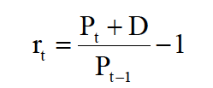
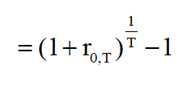


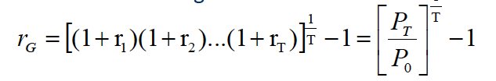
Definitions: Returns
Net Return (r_{t}):
Gross Return: R = (1 + r_{t})
Equivalent Annualized Return:
Holding Period Return:
Arithmetic Return:
Geometric Return:
1

Slide 16

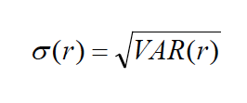


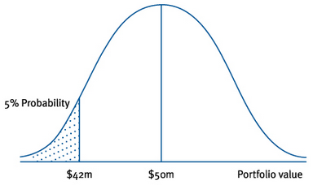

Definitions: Risk
Variance (=VAR):
Standard Deviation (=STDEV):
Co-Variance (=COV):
Correlation (=CORR):
Variance at Risk (VaR): [E( r) – 1.645 x S.D.] Beta:
Co-variance!

Slide 17
Going Forward:
we will continue to familiarize ourselves with the fundamental concepts of finance and start putting these definitions and concepts into context and practice, starting next meeting when we dive into Portfolio Optimization and then Active Portfolio Management.

Slide 18
Questions?

