Slide 1
Portfolio Optimization: Modern Portfolio Theory
YUDI
Sophomore Meeting 2

Slide 2
Outline for Today
Introduce & Deepen our understanding and applications of Modern Portfolio Theory (MPT) to optimize portfolios
2) Put MPT into the context of Market Efficiency & CAPM Discussion…see the implications derived from such insight

Slide 3
Last Year
So…freshman year of YUDI we introduced portfolio construction & management
But…did so in a basic way with the assumption that we understood what expected return and risk actually meant and how these measures were derived.
Today, we are going to dive deeper into this process of how to optimize your portfolio using the insight gained from the Modern Portfolio Theory

Slide 4
Modern Portfolio Theory
What is it?
a theory that maximizes return for a given level of risk, or put oppositely, minimizes risk for a given level of return, by optimally choosing the proportion of assets.
NOTE: Doesn’t tell you how to find alpha…assumes once you found alpha for given securities here’s the way to optimally combine and manage the securities. MPT is not investment selection, but investment management.

Slide 5
The Portfolio Problem:
But First, we should determine why we needed a theory in the first place…
There were two questions that led us to this theory:
What does a “good” risky portfolio even look like?
Given a positive payoff for bearing risk (higher risk, higher return), how much risk should we take (i.e. Risk Tolerance)
Modern Portfolio Theory provides a solution:
Tells us what risky portfolio of assets we should hold, and in what combination
Tells us how to optimally distribute our wealth between a risky portfolio of assets and a risk free asset, based on our risk aversion.

Slide 6
How to use MPT in Practice?
How does you apply this theory in the real world?
Using excel, you create spread sheets to estimate:
expected returns
standard deviations
and covariance matrices of security returns.
then with the excel tool “solver,” you maximize the Sharpe Ratio of your portfolio by optimizing individual security weights. What’s the result??
Result: APPL = 35%, FB = 46%, & EBAY= 19%
We will walk through one example together soon.

Slide 7
Different Case Scenarios
We are going to Examine how we apply MPT under the following scenarios:
1 Risky Asset & a Risk-free Asset
2 Risky Assets & no Risk-free Asset
2 Risky Assets & a Risk-free Asset

Slide 8
1 Risky & 1 Risk-free Asset
r_{p}
r_{b}
r_{f}
When deciding between 1 risky asset and 1 risk free asset, there is where one’s risk preferences come into play…how much risk are you willing to bear? Thus, we first need to know how to measure risk?
Where r_{b}= blended portfolio
Where r_{p} = risky asset
Where r_{f} = risk free asset

Slide 9
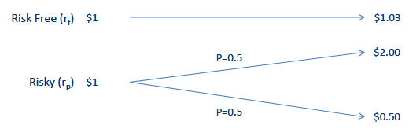

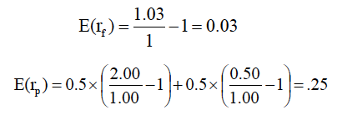
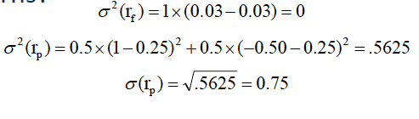
Measuring Expected Returns & Risk: Mathematical Example
EXPECTED RETURN:
RISK (STANDARD DEVIATION)

Slide 10
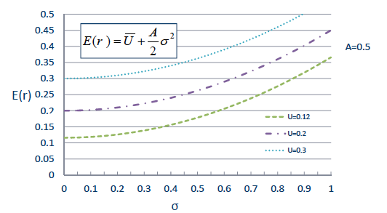
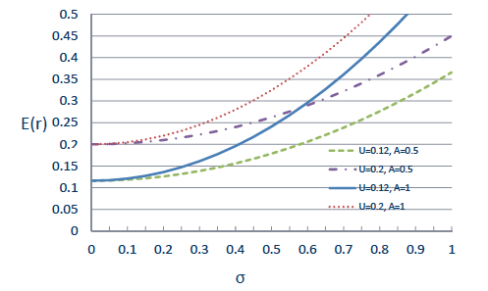

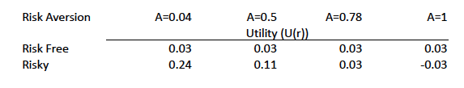
Risk Preferences

Slide 11
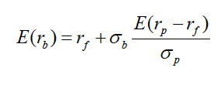
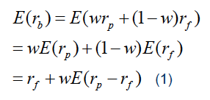

Optimal Allocation Between 1 Risky Asset and 1 Risk free Asset
To determine optimal allocation to the risky asset and risk-free asset, you need to know the E(r) and S.D. of the blended portfolio.
CAPITAL ALLOCATION LINE (CAL)
SHARPE RATIO
Risk-adjusted measure of return

Slide 12
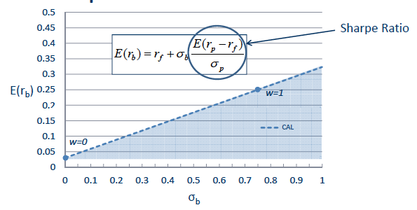
Capital Allocation Line (CAL)
The Slope of the Sharpe Ratio implies the tradeoff between return and risk. Thus, with excess return on the numerator, the optimal portfolio is one in which the Sharpe Ratio is maximized.

Slide 13
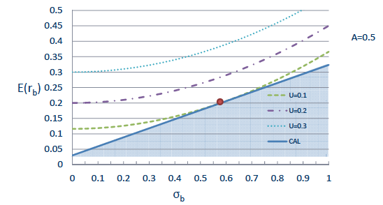
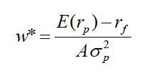
Deciding “w” for 1 risky asset
The Optimal weight “w” allocated to the risky asset is determined by combining your risk preferences with the CAL. Optimal Allocation occurs when your utility curve is just tangent to the CAL. To relate to economics, the CAL is simply your budget constraint with the indifference curve representing your preferences.
As “A” goes up, w* goes down (i.e. put less in the risky asset as risk aversion goes up)

Slide 14
Questions?

Slide 15
2 Risky Assets & no Risk-free rate
Next…

Slide 16

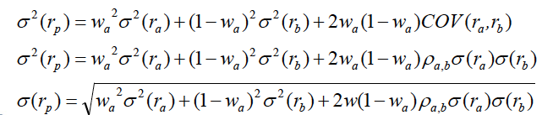
2 Risky Assets & no Risk-free rate
EXPECTED RETURN:
Where w_{a} is the weight put in stock a
Note: r_{b} is “stock” b, not the blended portfolio
VARIANCE & STANDARD DEVIATION
CORRELATION:
As Correlation goes down, benefits from diversification go up!
-1 < P_{a,b} < 1

Slide 17

Optimal Risky Portfolio: 2 risky assets, no r_{f}
However, the addition of a risk – free rate allows us to improve performance

Slide 18
2 Risky Assets & 1 Risk-free Asset
r_{b}
MVE
r_{p}
r_{b}
r_{a}
r_{f}
Understand that the two r_{b’s} are not the same

Slide 19
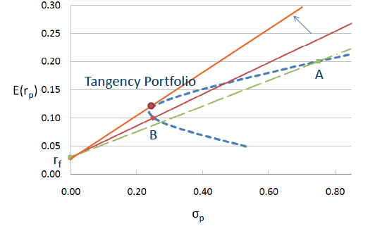
2 Risky Assets & 1 Risk-free Asset
Tangency Portfolio = Mean-Variance Efficient (MVE) Portfolio. The tangency portfolio represents the optimal portfolio where the Sharpe Ratio (Slope of CAL) is maximized. REGARDLESS of risk aversion, the tangency portfolio, combined with r_{f} is the optimal portfolio of choice FOR ALL INVESTORS…it don’t matter if you are rich, poor, or even a child for that matter.

Slide 20
2 Risky Assets & 1 Risk-free Asset
With the optimal risky portfolio established...
investors can now allocate their wealth between the tangency portfolio and the risk-free asset to satisfy their risk tolerance.
i.e. if you are near retirement, you put only 40% into the optimal risky portfolio and the rest in T-bills.

Slide 21
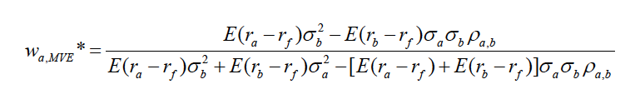
The Optimal Risky Portfolio: MVE
W_{a} tells you how much you should optimally allocate to the risky portfolio
1-W_{a} tells you how much to put into T-bills (risk free asset) unless we consider the general market, then 1-W_{a} tells you how much to invest into the general market.
MAIN POINT: The optimal risky portfolio has nothing to do with risk aversion…all investors choose the same risky portfolio and then allocate to the risk free asset accordingly based off risk preferences.

Slide 22

Minimum Variance Portfolio (MVP)
If you want to minimize risk instead of maximizing returns…here is the two asset case. If there are more than two assets, we resort to solver.

Slide 23
Mean Variance Strategy
If you have two risky assets (i.e. r_{a} = stock fund, r_{b}= bond fund…yes bonds are risky, t-bills are not), estimate the expected return, standard deviation, and covariance between the assets (start with historical data)
With these parameters, solve for the optimal risky MVE tangency portfolio that all investors share
Allocate money between the optimal risky portfolio and the risk-free asset, based on risk aversion.
*Note again that risk aversion only comes in at the end of the portfolio construction process.

Slide 24
Assumptions of MVE
Mean‐variance analysis works off the assumption that all investors care about is the return and risk of returns.
What does this imply?
Portfolio management can be broken down into two steps
Find the unique mean‐variance efficient portfolio
Combine this with the risk free asset to suit your risk aversion
However, finding inputs (i.e. expected returns or alpha) to your model may be difficult (garbage in, garbage out)

Slide 25
CAPM & Market Efficiency
The Capital Asset Pricing Model (CAPM) asks, if everybody is rational, has the same expectations and inputs, and performs MVE analysis to determine their portfolio holdings in efficient markets… what happens?
The answer is that the market portfolio becomes the tangency portfolio, meaning that the best, portfolio for you to hold (on a risk-adjusted basis) is the market portfolio.
This makes sense logically, for if all the experts are doing the hard, dirty work for you, just buy the market portfolio (S&P) to piggy back off their work… this insight is what has led to the surge of indexing over the past 20 years.

Slide 26
CAPM Implications
R*
= R_{m}
The Market Portfolio is the Tangency Portfolio, thus the investor combines the optimal risky portfolio with the risk free asset based off their risk aversion.
R_{b}
R_{f}

Slide 27
CAPM downfalls
However, the CAPM does not come without heavy costs, the most noticeable being that it assumes markets are perfectly semi-strong efficient and that all investors are rational mean variance optimizers
We have seen with more frequency that price does not always equal intrinsic value, due to the “animal spirits” of greed, fear, optimism, pessimism, etc., inflating or deflating the stock price undeservingly.
Arbitrage Pricing Theory (APT) Models have been created to “capture the alpha” including those from Fama French suggesting there are in fact mispricings in the market.

Slide 28

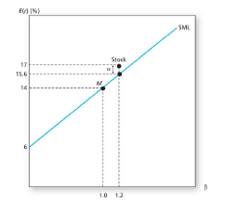
Security Market Line
Under the intuition of the CAPM, all assets lie perfectly on this line, for they are presumed to be perfectly priced in the market.
However, APT practitioners, believe that the markets are not all entirely efficient and they can put their resources to work to find “alpha” or mispricing's in the market for them to exploit to make a profit.
Firms like Vanguard, who are more passive, are advocates of the CAPM while Hedge Funds, who are active managers, reject the CAPM.

Slide 29
Thus, Next Meeting’s Topic:
r₁
Maximize Alpha
r_{A}
r₂
w_{a}
r₃
MVE
r*_{p}
1-w_{a}
r_{m}
Blended
Portfolio
r_{b}
r_{f}
Active Portfolio Management…how the search and discovery of alpha effects the optimal risky portfolio

Slide 30
Homework
HW assignment will be emailed to you via PDF
Start trading in stock game!

