Slide 1
YUDI
Active Portfolio Management
Sophomore Meeting 3
Notes:
https://www.youtube.com/watch?v=Y3QpubKy8_s

Slide 2
Assignment #1
What did you think of the assignment?
Hard?
Wanna Quit? ☺

Slide 3
Sophomore Curriculum:
-Lecture 1 – Introduction & Finance Review: Asset Return & Business Statistics Sept. 17th, 9:00PM
- Lecture 2 - Portfolio Optimization: Modern Portfolio Theory, CAPM, Market Efficiency Oct. 1st, 9:00PM
- Lecture 3 - Active Portfolio Management Part I, Oct. 15^{th,} 9:00PM (HW 1 DUE)
- Lecture 4 – Credit & Fixed Income: its importance in our economy Nov. 5th 9:00PM
- Lecture 5 – Tying it all together & Review (discussion based), Nov. 19th, 9:00PM (HW 2 DUE)
EXAM 1 (Semester 1 Material) Dec 10th, 9:00PM
- Lecture 6 – Lecture on Effective Networking Jan 21st, 9:00PM
- Lecture 7 - Active Portfolio Management: Investment Selection & Valuation Under the Buffet Philosophy (S2) Feb 4th, 9:00PM
- Lecture 8- Advanced Discounted Cash Flow Analysis March 3rd, 9:00PM
- Lecture 9- Performance Evaluation: Modern Portfolio Theory vs. Buffet (S2) March 31st, 9:00PM
- Lecture 10 – Personal Finance, Must Do’s in the Summer, & Review (S2) April 14th, 9:00PM
EXAM 2 (Semester 2 Material), April 28th, 9:00pm
Notes:
Luis patino III
Leonardo Sanchez-noya
Ammar saeed

Slide 4
Portfolio Optimization: first thought
r₁
r_{p}*
r₂
r_{b}
r_{f}

Slide 5
Portfolio Optimization: CAPM Implications
r_{p}*
r_{MKT}
r_{b}
r_{f}

Slide 6
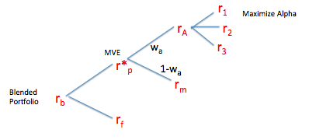
Portfolio Optimization: Overall Picture

Slide 7
Portfolio Optimization
LAST MEETING FOCUS!

Slide 8
Portfolio Optimization
TODAY’S MEETING FOCUS!

Slide 9
Outline for Today
So today we are going to focus on what happens when people break from the idea that the market portfolio is the optimal risky portfolio (indexing) and assert they can beat the market through active management using their superior information, research, etc...

Slide 10
Why do people think they can beat the market?
They see the great active investors, like Warren Buffet, and say “hmmm.. that doesn’t seem so hard!” They try…they lose all their money.
Remember…it’s a zero-sum game
But more importantly, if people like Buffet and more than a handful of others are doing it, it indicates that the market might not be so efficient after all…i.e. there may be opportunities to make money with deeper insight (much deeper insight )
Should we (college students) try to manage our money actively?
Nah, probably not..
Why not?
We don’t have enough money to make it worth it (we are students)
We don’t have enough knowledge (we are inexperienced)
And we don’t have the resources to gain such knowledge (we aren’t a firm)

Slide 11

Evidence for inefficient markets
+ α
Times Series and Cross Sectional tests have been constructed to measure the validity of the CAPM—they indicate that CAPM does not completely explain expected returns.
Times Series Test: Jensen’s Alpha—tested to see if all alpha was jointly equivalent to 0, which in efficient markets it should be. They could not prove this. Failure of the CAPM
Cross Sectional Returns: Regressed the betas of securities against their returns. In efficient markets the results should lie exactly on the Security Market Line (SML) as the CAPM Predicts—it says covariance with the market is the only thing that effects price. While it was more suggestive, they could not prove this. Failure of the CAPM.
Info Graphic on next Page

Slide 12
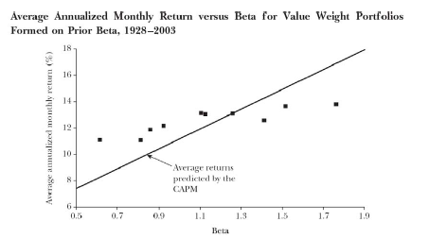
Cross-Sectional Examination: Betas vs Returns
SML is more flat in practice than predicted…possible failure of the CAPM

Slide 13
Investors Want Answers
And so the search for anomalies began!
If the CAPM failed to be proven, something was driving its failure; investors have spent the latter part of the 20th century up to the present day focused on determining systematic reasons to fill the CAPM gaps
Thus, we have seen the emergence and prominence of:
KCG
Roger Ibbotson:
Zebra (google trends)
Fama French:
3 Factor Model
Bob Shiller:
“Animal Spirits”
High Frequency
Trading
Crazy Hedge Funds
APT
Behavioral
Finance
All of these methods created and applied to fill the holes in the CAPM, serving to capture the apparent alpha that the CAPM was missing to explain!
Notes:
Arbitrage Pricing Theory (APT)
Multifactor Models (like Fama French)
Behavioral Finance
Applying Cognitive Psychology to explain returns, emphasizing human emotions and its destabilizing effects on the market

Slide 14
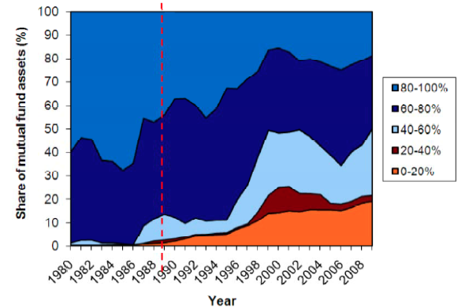
However, Indexing…up up and away
Despite the search for anomalies, indexing has been on the rise…
ACTIVE SHARE

Slide 15
So what’s the optimal portfolio? Active or Passive?
OUR FOCUS
The Short Answer: it depends!
The Longer Answer:
If you have super high conviction opinion on securities, like Buffet, you should be almost entirely ACTIVE
If you have some views, but not quite to the same level or conviction as Buffet, you should be MIXED…Core & Satellite
If you have no views…you should just buy an index fund and get on with your life (This is not a bad thing! Dumb money stops being dumb when you acknowledge it!) PASSIVE

Slide 16
Treynor Black: Core & Satellite Portfolio
7%
CMG
15%
Energy
ETF
Passively Managed Core
SPY
Hedge
Funds
-7%
SHAK
55%
10%
Small
Cap ETF
20%

Slide 17
Core & Satellite
So…How do we actually construct this portfolio?

Slide 18
Treynor Black: Active Portfolio Optimization
The Treynor Black Model breaks portfolio management into three steps:
Using estimated inputs, build an active portfolio (Satellite Portfolio) NEW!
Optimally combine the active portfolio with the market index (Core Portfolio) to construct overall portfolio with maximized Sharpe Ratio KIND OF NEW!
Decide how much to allocate to the optimal risky portfolio based off risk aversion LAST MEETING!
The Treynor Black Model allows us to add value through alpha estimates while still remaining diversified.

Slide 19
Remember!

Slide 20



Single Index Model: Active Portfolio Optimization Mathematics
So, how do we get alpha?
Well… that’s the Million
Dollar question
We make a BIG assumption
That alpha is already determined. Next year’s focus is on trying to find strategies to find alpha, but for now, it is assumed. (we have one upcoming lecture on it)
Expected Returns:
Variance:
Co-variance:

Slide 21
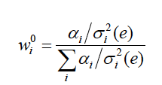

Constructing the Active Portfolio: How much to allocate to each security within the active portfolio (w_{i}⁰)
Where w_{i}⁰ is the optimal weight to give to stock I within the active portfolio (weights within the active portfolio will sum to 1)
Is the expected excess return over the CAPM prediction for stock i
Is the residual (idiosyncratic) variance of stock i

Slide 22
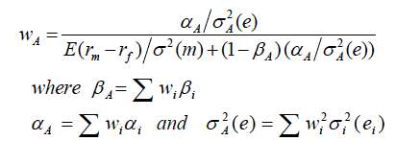
Constructing the Active Portfolio: How much to allocate to the active portfolio (W_{A})
NOTE: Final Portfolio weight for stock i is: W_{i}⁰ x W_{A}
and 1-W_{A} is allocated to the market index

Slide 23
Remember!
w₁⁰
w₂⁰
w₃⁰

Slide 24
Let’s go through an example..
So we have a new client, Hellen, YAY!
She has $1,000,000 to invest and expects us to beat the market.
NOTE: After all, if we are going to be working at firms like Morgan Stanley, Goldman Sachs, J.P. Morgan, etc…we are going to be expected to do this. It’s why they are paying us and why we charge them high fees (~ 100 BPS)!

Slide 25
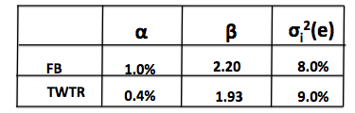
Let’s go through an example…
Let’s assume:
E(r_{m}) = Expected Return = 10%= .10
σ²(m) = Variance = 4% = .04
r_{f} = risk-free asset = 2% = .02
We also have views on Facebook and Twitter; we believe they are currently under valued (Alpha is assumed, equity researchers would generate this number for the portfolio managers):

Slide 26
What to do to make Hellen Happy:
Let’s use the following Info about Facebook and Twitter to:
create the optimal active portfolio
optimally mix it with the index
and then based off the risk aversion of Hellen, decide how much to allocate to the optimal risky portfolio

Slide 27
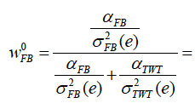

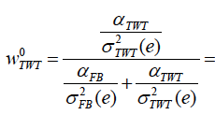

Determining Optimal Weights: within the active portfolio
Notice:
Sums to 1

Slide 28





Summing the Active Portfolio
=
=
(.74 x 2.2) + (.26 x 1.93) = 2.13
=
=
(.74 x .01 ) + (.26 x .004) = .00844
=
=
(.74² x .08) + (.26² x .09) = .0499

Slide 29


Determining Optimal Weights: To the active portfolio
W_{A}= .1270 or 12.7%
Therefore… (1-W_{A}) goes to the passive portfolio = .873 or 87.3%

Slide 30
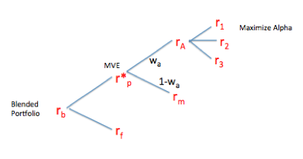
The Optimal Risky Portfolio
Now, the Optimal Risky Portfolio is Constructed…
87.3% goes to the market (i.e. S&P500)
12.7& goes to the active portfolio
This represents r_{p}*

Slide 31
Optimal Risky Portfolio: Determining Expected Return & Standard Deviation
Expected Returns of Optimal Risky Portfolio:
= .00844 + 2.13(.10 - .02)
= .179 or 17.9%
Standard Deviation of Optimal Risky Portfolio:
= ((2.13)²(.04)) + .0499
= .2313
= Thus, Standard deviation = SQRT(.2313) = .481 or 48.1%
Notes:
2.13 .00844 = .0499

Slide 32
Constructing the Blended Portfolio
Some Facts about Hellen:
She is 53 years old
She is married
She has 2 children who both have graduated from college
She has $200,000 outstanding on her mortgage
Her husband (57 years old) and herself both work and make a combined $350,000 per year.
She likes to take risks!
How much should risk is appropriate for her to take? Remember it’s a risky portfolio (48% S.D.!)
This measure is subjective…but these facts could point to 50/50

Slide 33
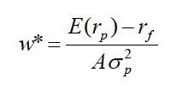




What does this imply about Hellen’s Risk Aversion?
= .5

Slide 34



Constructing the blended portfolio:
Expected Returns of Blended Portfolio:
= (.5)(.179) + (.5)(.02)
= .0995 or 9.95%
Standard Deviation of Blended Portfolio:
= (.5)(.481)
= .241 or 24.1%

Slide 35
That’s All!
Homework due soon
email if you have questions or to set up a time to meet up!

