Slide 1
YUDI
Fixed Income & Credit
Sophomore Meeting #4

Slide 2
Announcements
Please Download Ovote: Free Survey App
On the app store—free!
Takes 1 minute
a good way for me to receive feedback on lectures so I can better YUDI!
Still going over your first assignments
will post the solutions this weekend!
Hand in ASSIGNMENT #2 NEXT time we meet!!!
NOV 19th, 2015 @ 9:00 PM

Slide 3
Today
Going over fixed income concepts:
Video: How The Economy Machine Works
Ray Dalio—Founder & President of Bridgewater Associates
How to value different types of bonds
The Yield Curve
Introduction to Duration and VaR

Slide 4
How The Economy Machine Works https://www.youtube.com/watch?v=PHe0bXAIuk0

Slide 5
Bond Valuation

Slide 6
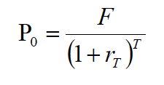
Zero Coupon Bond Valuation
Where P₀ = the price of the bond
F = the Face Value of the bond
r_{T} = is the prevailing interest rate
T = the maturity of the bond

Slide 7
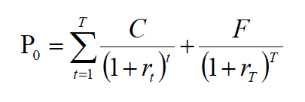
Coupon Bond Valuation
Where C = the coupon
i.e. if the Face Value of a bond is $1000 and the coupon rate is 5%, then C = 50 (assuming annual payments)
…if semi-annual payments, then C = 25,
r_{t} = r_{t}/2, and t= tx2

Slide 8
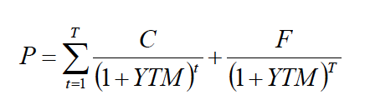
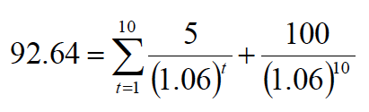
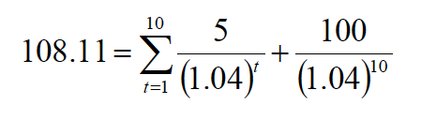
Yield to Maturity
YTM is the “single” interest rate in the market that makes the price of the bond appropriate
DISCOUNT
With a par value of 100, and coupon of 5%, what does the price of this bond imply about the YTM?
PREMIUM
With a par value of 100, and coupon of 5%, what does the price of this bond imply about the YTM?

Slide 9
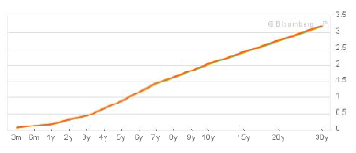
The Yield Curve
The Yield Curve plots the “term structure” of interest rates over different investment horizons.
- Essentially an educated prediction for where interest rates are headed in the short term, medium term, and long term

Slide 10
Cool, but why can the yield curve predict recessions and how do we actually derive the yield curve?

Slide 11
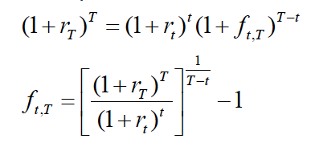
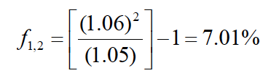
Forward Rates
Where r₁ = 5%, r₂ = 6%

Slide 12



Forward Rates and Term Structure
If the future is certain (risk neutral):
FORWARD RATES = EXPECTED RATES
If the future is uncertain (risk averse):
Long term investor
Why? Because the long term bond is risky, and because they are long term investors, they will accept lower returns by taking a guaranteed return from (1 +r₂)² (i.e. f_{1,2} < E(r_{1,2}))
FORWARD RATES < EXPECTED RATES
Short term investor
Why? Because they are short term investors and need liquidity (want to sell at T = 1), in order to purchase the longer term bond, they must be compensated for doing so (i.e. f_{1,2} > E(r_{1,2}))
FORWARD RATES > EXPECTED RATES

Slide 13

Factors that determine an upward sloping yield curve?
Higher future short term rates
-determined by expectations and forward rates
Liquidity preferences for short term bonds
Defined as the difference between the forward rate and the expected rate
*Long term investors bid long term interest rates down, thus yield curve up (F < E)..less K
*Short term investors bid long term interest rates up, thus yield curve down (F > E)...more K

Slide 14
And as we saw in the video…interest rates shed light on what stage of the business cycle we are at, which implies how close we are to recession or expansion!

Slide 15
Bond Pricing Relationships
Bond Prices and Yields are inversely related
Longer maturity bonds tend to be more price sensitive than shorter term bonds.
lower coupon bonds are more price sensitive than higher coupon bonds

Slide 16
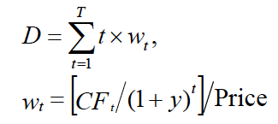
Duration
Tells us the interest rate sensitivity of a bond or bond portfolio
it is essentially a measure of effective maturity.
Measuring the discounted, weighted average time it takes for payments to be received

Slide 17
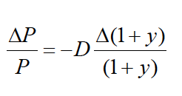
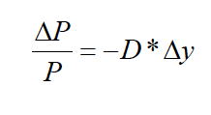
Modified Duration
D
D* =
1 + y

Slide 18
Quick Example…
Question:
Calculate the modified duration (D*) for a new, risk-less 20-year bond with a face value of 100, and an annual coupon rate of 6%, and a price of 99.

Slide 19
Finding Modified Duration
P = 99
F = 100
T = 20
Coupon Rate = .06
Coupon Payment = 6
YTM = ?
Need YTM
How do we get it?
YTM = IRR

Slide 20
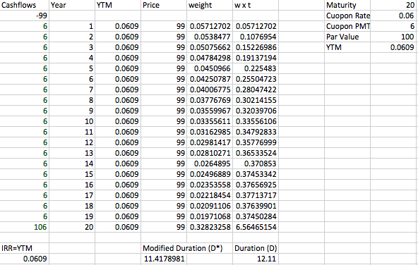
Excel Info Graphic
12.11
= 11.42
1 + .0609

Slide 21
What does 11.42 modified duration mean?
If interest rates rise 1% in the next year, then the value of your bond portfolio is expected to fall 11.42% (based off its modified duration, i.e. sensitivity to interest rate changes).
-.1142
= -11.42 * (.01)

Slide 22
Follow Up Question: VaR
Question:
Next, approximate the 5% value at risk (VaR) over the next year on a portfolio of these bonds if the volatility of yields is 1%?

Slide 23
Determining VaR for Bonds
What we know for EQUITY portfolio:
VaR = E(r) – 1.645 σ(r)
Different for BOND portfolio:
VaR = E(y) + 1.645 σ(y)
= .0609 + (1.645(.01))
= .0773 or 7.73%
Means in the worst 5% cases, yields can exceed 7.73%. Remember, as Yields ^ Price v
-.1879 = - 11.42 *.01645
-18.79%

Slide 24
Summary of Today
We understand how the economy works, the business cycle, and the role/ importance of credit..
We understand the general approach to value a bond
We understand the yield curve and how forward rates and expectations of future rates dictate its shape!
We understand how to determine the duration of a bond, VaR of a bond portfolio, and its implications!

