Slide 1

Not Our (Seg)Fault!
Connor Black
Damien King-Acevedo
Edward Skrod
Alex Windelberg

Slide 2
Presentation overview
Team Members
Introduction
Problem statement
Project justification
Similar Applications
Scope
Schedule
Requirements
Analysis of requirements
Design
Conclusions

Slide 3
Introduction
Lend.me is a debt management application that will allow users to track incoming and outgoing debts.
It will serve three main purposes:
Facilitate the creation and recording of a loan contract
Remind all parties of their obligation and due
Facilitate repayment
Notes:
Facilitate the creation and recording of a loan contract – Allows users to instantiate a loan either as a lender or a borrower.
For example, I might start a loan by selecting a person from whom to borrow. I can set the terms, when I can make repayment, how much interest (if any) I’m willing to pay, etc.
Alternatively, I could start a loan by selecting a person to be the borrower.
Remind all parties of their obligation and due
Automatic notifications which can be selected at the time of the loan creation.
Manually choose to notify a borrower
Facilitate repayment
Lend me will make the payments so that you don’t have to handle cash. You can simply make a loan or pay back a loan within the system by using a 3rd party known as BalancePayments.

Slide 4
Team members
Connor Black – Prototype, Front End, Backend, JSON Documents
Damien King-Acevedo – Use Case Scenarios, Business Logic, UI Layer
Edward Skrod – Database, SRS, Backend, UI Layer
Alex Windelberg – SRS, Backend, Business Logic, UI Layer
Notes:
Front End – Appllciation Object, Modules for changing settings, login, registration, sending emails, Model View and Controllers (Composite Architecture)
Back End – Composite
Tentative List – subject to change

Slide 5
Problem Statement
Lending money to family and friends, even in small amounts, can be a hassle.
It is easy to forget who owes money to who.
Asking for repayment can be tedious.
If repayment never comes, it would be nice to have a paper trail.

Slide 6
Project justification
Similar products exist but fail to provide all the functionality we want from an app
Current applications can cost as much as $15 to purchase

Slide 7
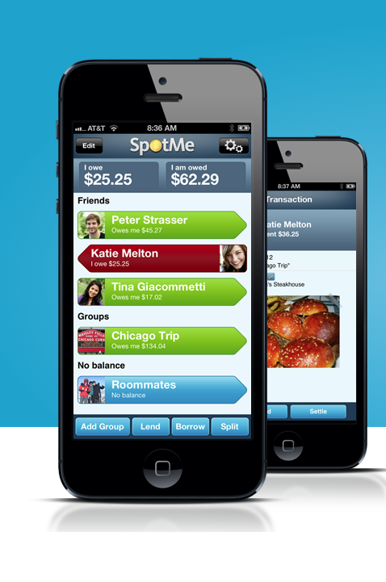
Similar applications
ZimpleMoney
Venmo
CashLender
SpotMe

Slide 8
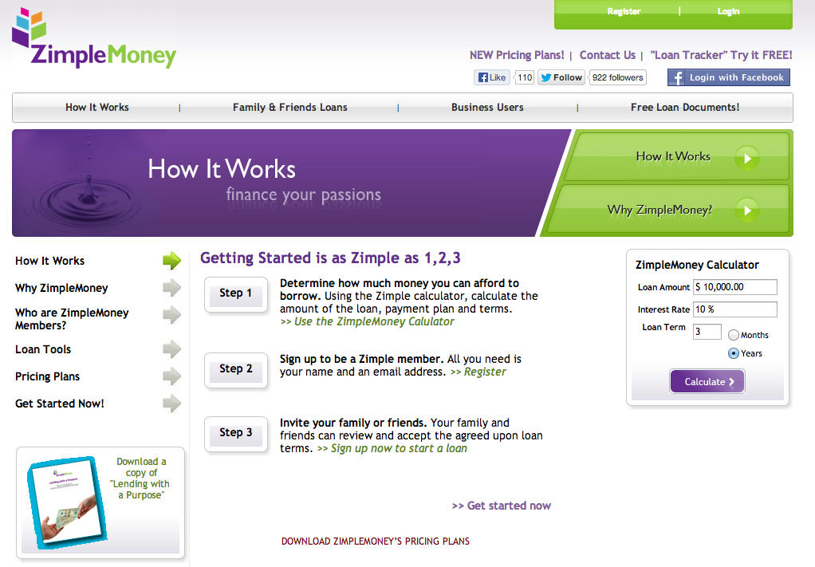
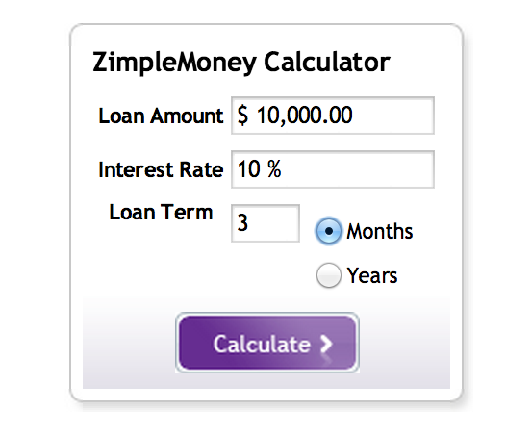
Zimplemoney
Cloud based
Data is password protected
Identity verification
Users can track lenders and borrowers
Multiple options for lending money
Multiple types of loans recognized (amortized, interest only, etc.)

Slide 9
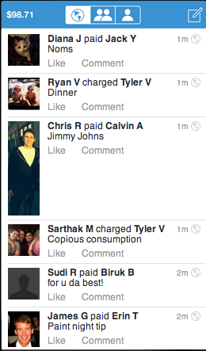
Venmo
Not a lending app, a payment app
Log In with Facebook
Social – Connect with Friends through the Facebook API
Limited features. No concept of loans or debts.
No reminders.
Cost: Free to join. Free to send via Bank. 3% fee if paying with credit cards

Slide 10
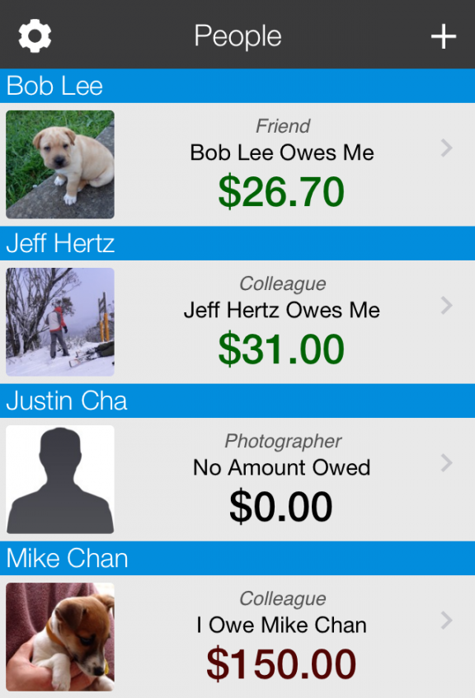
Cash Lender
iCloud compatible
Manage multiple people
Lend and borrowing money
Passcode protection
Email debt reminders
Export history as CSV files
Set debt due dates with reminders using notifications
Total sum of debts per person
Supports partial repayments
Supports local currency
Cost: $1.99 to $14.00
Notes:
iCloud compatible (Sync and store your data)

Slide 11
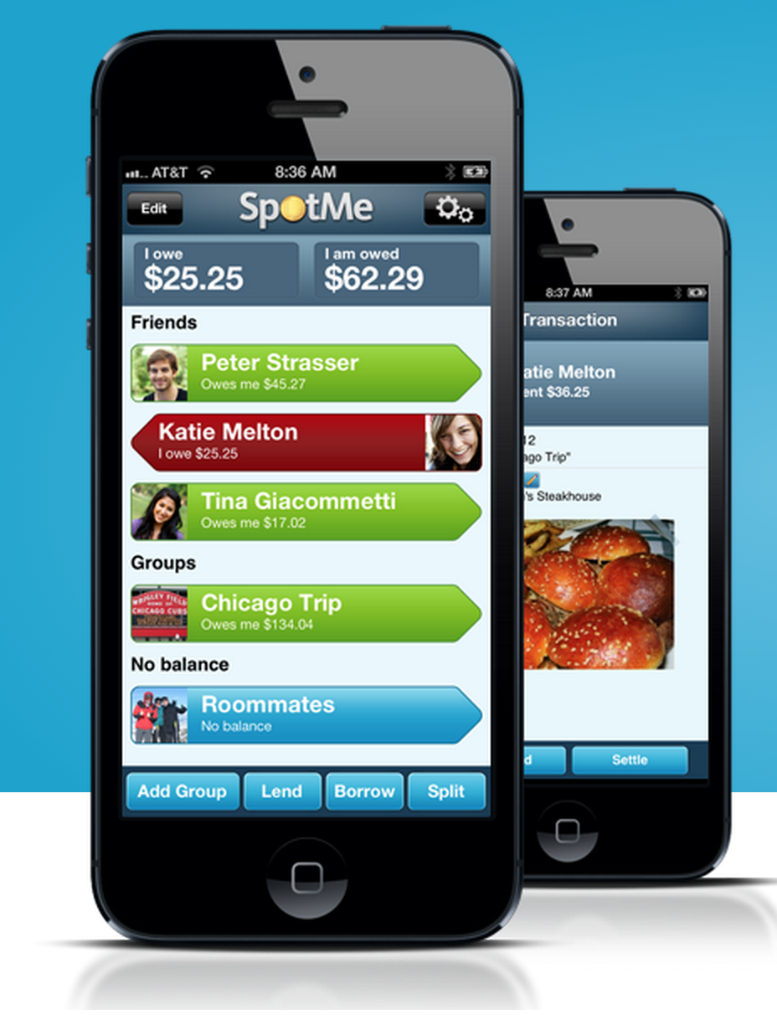
SpotMe
Register with Facebook
Lend to an email address
Can split bill with “Create Group”
Can invite friends
Manually remind borrower by sending an email alert
Rating: 4+ / 5 Stars on ITunes
Cost: Free
Notes:
SpotMe is only loan management. No repayment facilitation

Slide 12
How is Lend.me different?
Free to use. Small charge when payment made within the system
User will have ability to make payments from a credit card or bank account
Simple, web 2.0 interface and design

Slide 13
Analysis of Similar Applications
Optimally we would like to incorporate features from each of the above apps
The loan management from SpotMe
The Interface from Cash Lender or SpotMe
Payment management from Venmo
Zimplemoney served to showcase how not to design a website. It has more features than we would like to implement.

Slide 14
Scope
The scope of this application, in the short term, is to produce a working prototype with maximum functionality for the class.
The project is scalable to the English-speaking world and beyond with minimal further requirements. To take it further, we would need:
A commercially viable name
Multi-lingual support
Support for local currencies
Improved payment system

Slide 15
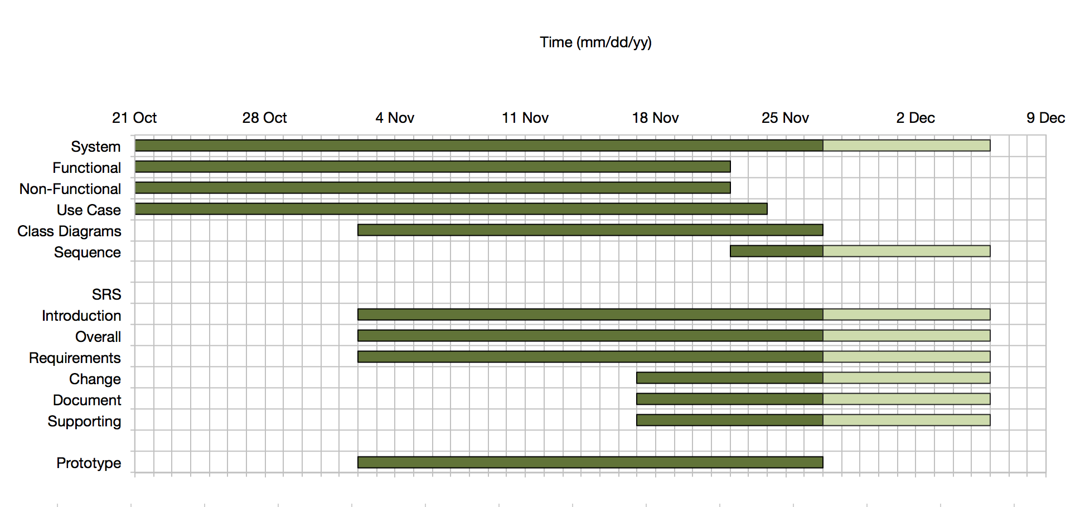
Schedule

Slide 16
Functional Requirements
Visitor
must register for an account to use the system by providing a unique email and password.
User
is able to recover a lost username by entering their email addresses
must login to the system using his/her unique username and password.
is able to change his/her password.
is able to recover a lost password.
is able to query for up-to-date transaction information.
User is notified by email of a reminder of loan due.
can add a friend.

Slide 17
Functional Requirements
Lender
can start and set terms on a new loan
can agree or disagree to new terms of the loan
can access a list of loans outstanding
can click on loan outstanding to access more information about it
can agree or disagree to a loan extension
can forgive the loan (clear it out)
can send loan money via app or with cash
can send a personalized reminder to the borrower
Borrower
can agree or disagree to terms of new loans
can set new terms of the loan
can ask for a loan extension
can ask for loan forgiveness
can pay back loan by using the application or cash

Slide 18
Non-Functional Requirements
Usability
An FAQ should be available to help visitors register for an account
An FAQ should be available to help users lend, borrow or make a payment on a loan
The system should prevent users from changing terms in a contract with the opposite party’s consent
Security
The system should serve an HTTPS server
The system should protect API requests by requiring either an email/password or cookie

Slide 19
Non-Functional Requirements
System Interface
The website should have a modern, uncluttered, Web 2.0 look
The system should have the option to register and authenticate with Facebook
Operation
The system should verify a user’s email before allowing her to continue registration
The records returned to lenders and borrowers during a session should be updated in real time. The system should be capable of updating the displayed record count every few seconds

Slide 20
Design
Use Case Scenarios
Visitor use cases
Login use cases
User use cases
Lender & Borrower specific use cases
Class Diagram
Database modeled with MySQL Workbench
Data Dictionary
Data modeled with JSON documents
Prototype

Slide 21
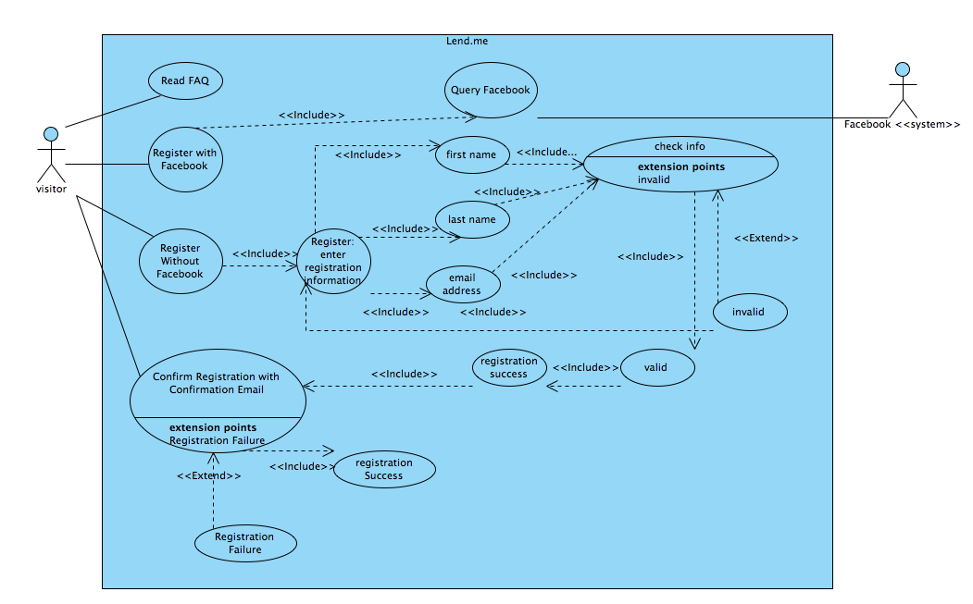
Visitor use cases

Slide 22
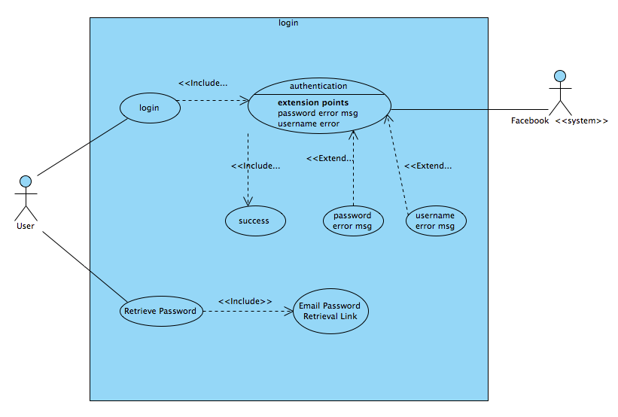
User login use cases

Slide 23
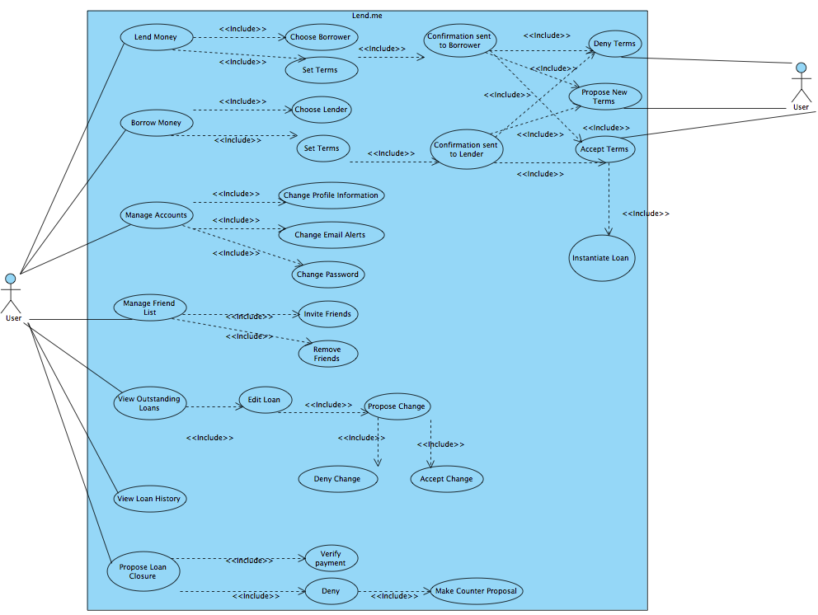
User use cases

Slide 24
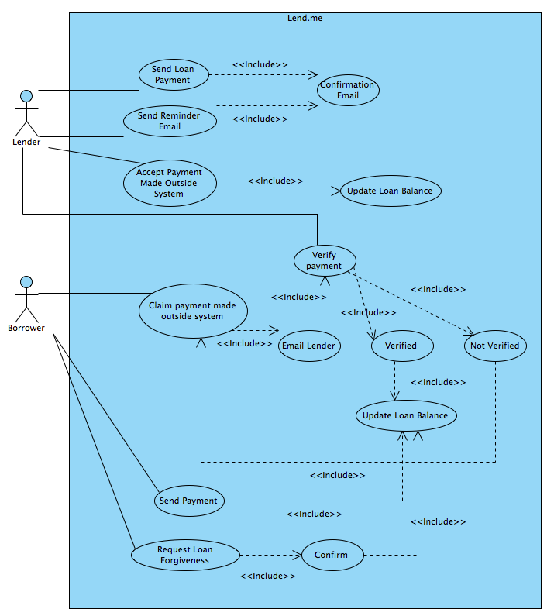
Lender & Borrower Specific Use Cases

Slide 25
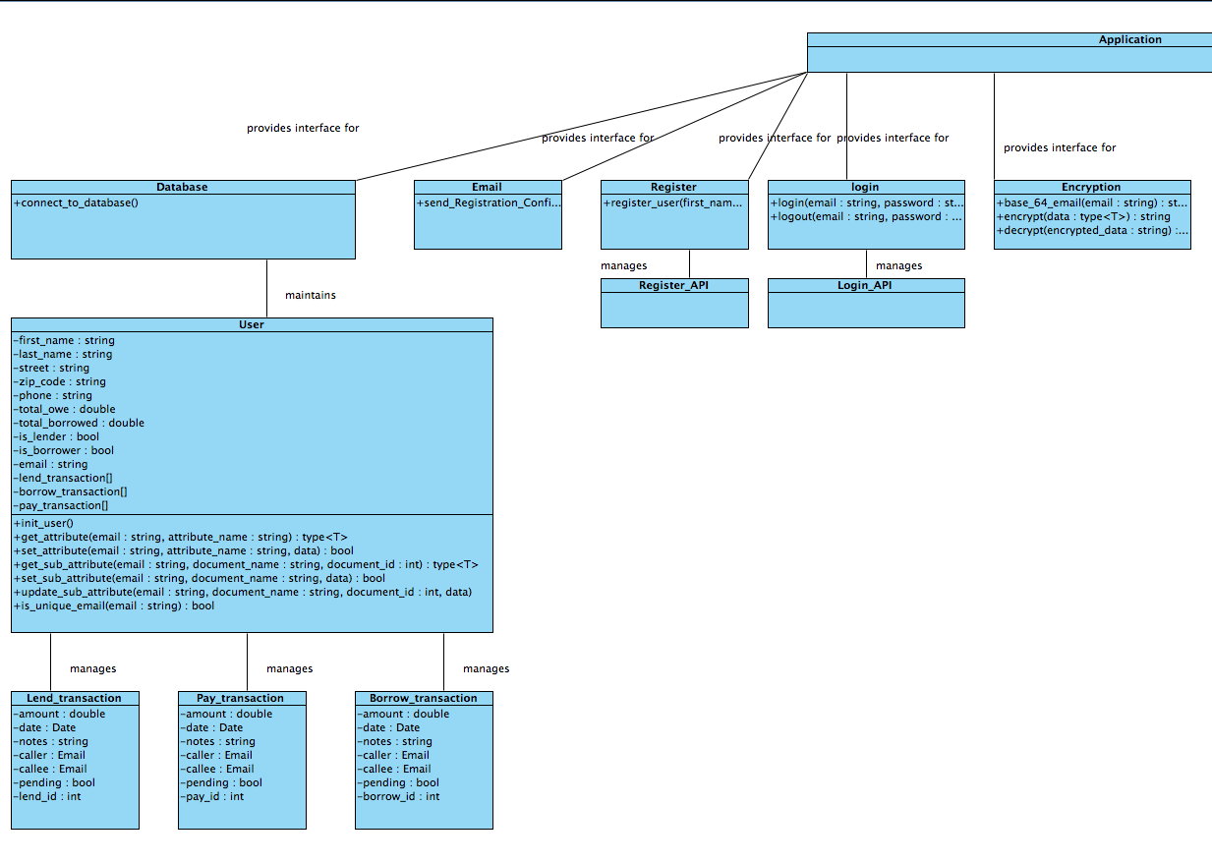
Class Diagram
Notes:
each API interacts with front end
Composite Architecure

Slide 26
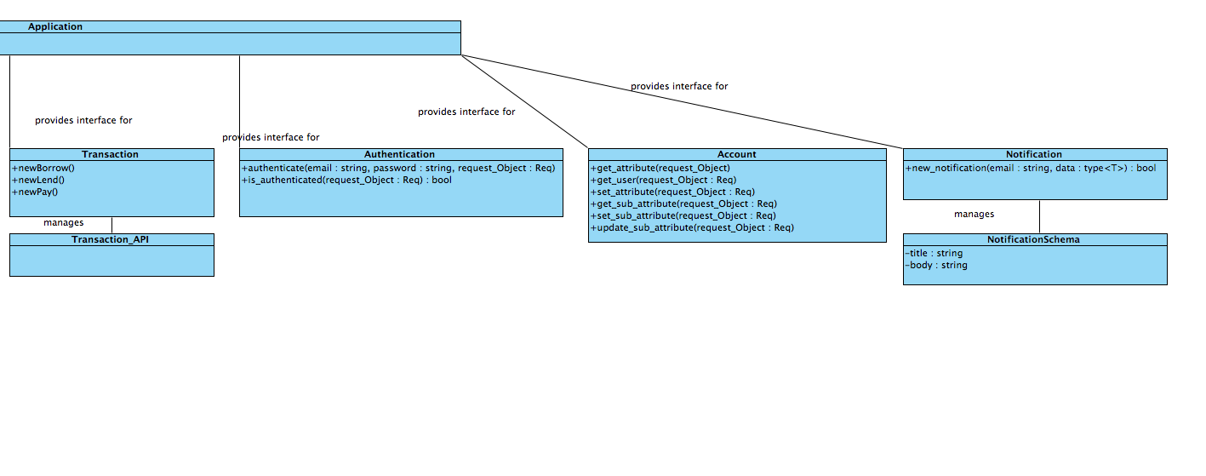
Class Diagram cont.

Slide 27
Preliminary Database Modeled in MySQL
with MySQL workbench

Slide 28
Data dictionary

Slide 29
Database modeled for NoSQL
User Schema
Lend Transaction Schema
{
"_id": {
"$oid": ""
},
"modified": {
"$date": ""
},
"created": {
"$date": ""
},
"__v": “”
"email": "",
"password": "”,
“street”: “”,
“zipcode”: “”,
“phone”: “”,
“total_owed”: “”,
“total_borrowed”: “”,
“is_lender”: “”,
“is_borrower”: “”,
"phone": "",
"last_name": "",
"first_name": "",
“lend_transaction”: [],
“borrow_transaction”: [],
“pay_transaction”: []
}
{
"_id": {
"$oid": ""
},
"modified": {
"$date": ""
},
"created": {
"$date": ""
},
"__v": “”
"amount": "",
"date": "”,
“notes”: “”,
“caller”: “”,
“callee”: “”,
“pending”: “”,
“lend_id”: “”,
}
JSON documents

Slide 30
Borrow Transaction Schema
Pay Transaction Schema
{
"_id": {
"$oid": ""
},
"modified": {
"$date": ""
},
"created": {
"$date": ""
},
"__v": “”
"amount": "",
"date": "”,
“notes”: “”,
“caller”: “”,
“callee”: “”,
“pending”: “”,
“lend_id”: “”,
}
{
"_id": {
"$oid": ""
},
"modified": {
"$date": ""
},
"created": {
"$date": ""
},
"__v": “”
"amount": "",
"date": "”,
“notes”: “”,
“caller”: “”,
“callee”: “”,
“pending”: “”,
“lend_id”: “”,
}

Slide 31
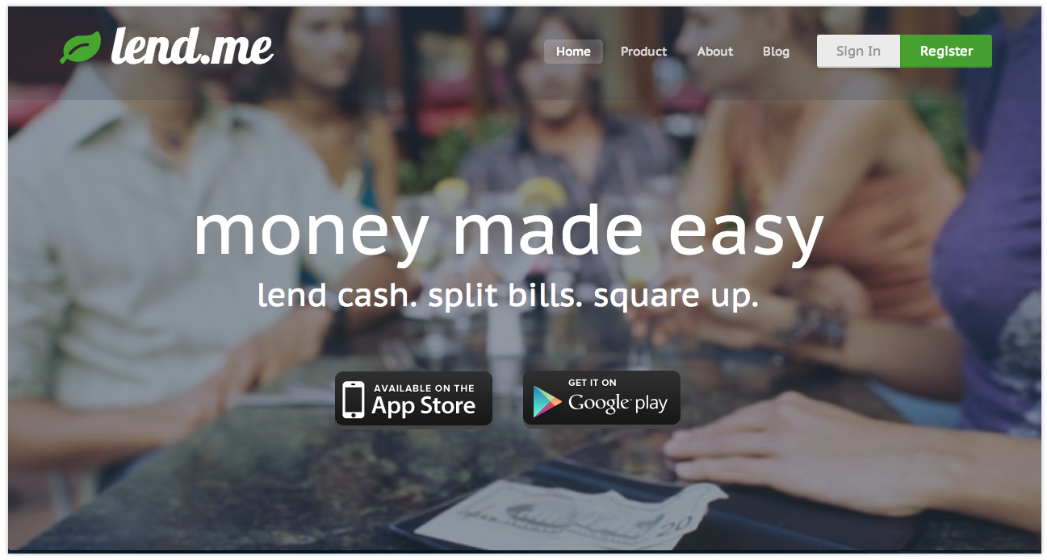
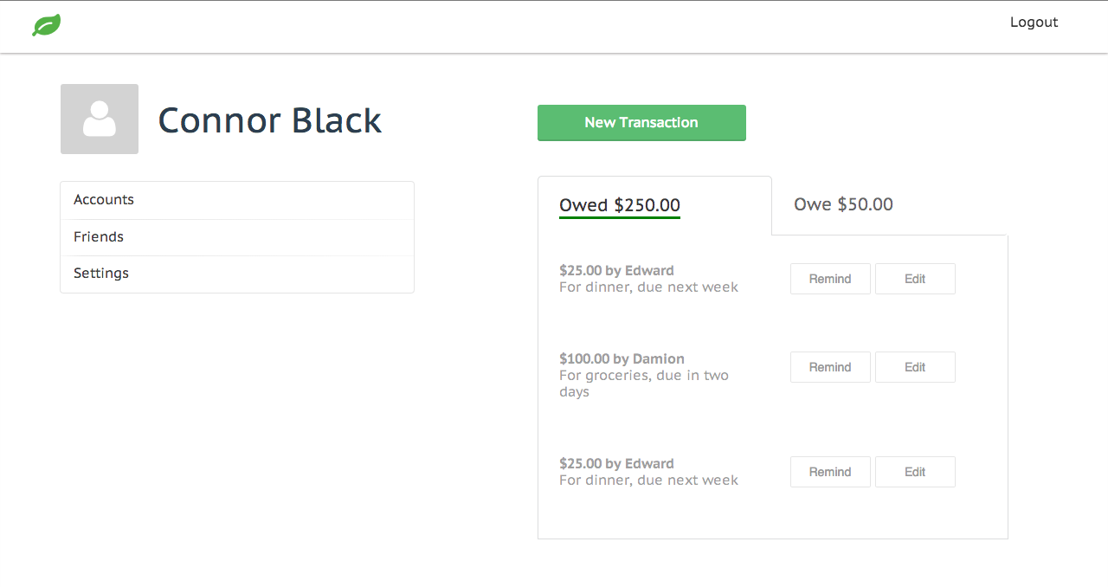
Prototype

Slide 32
Conclusions
There is a market for an application that provides the functionality of Lend.me
The system is feasible to design within the time frame provided for the course.
Challenges:
Mainly educational:
Javascript
Node.js
JSON

Slide 33
Questions?

