Slide 1
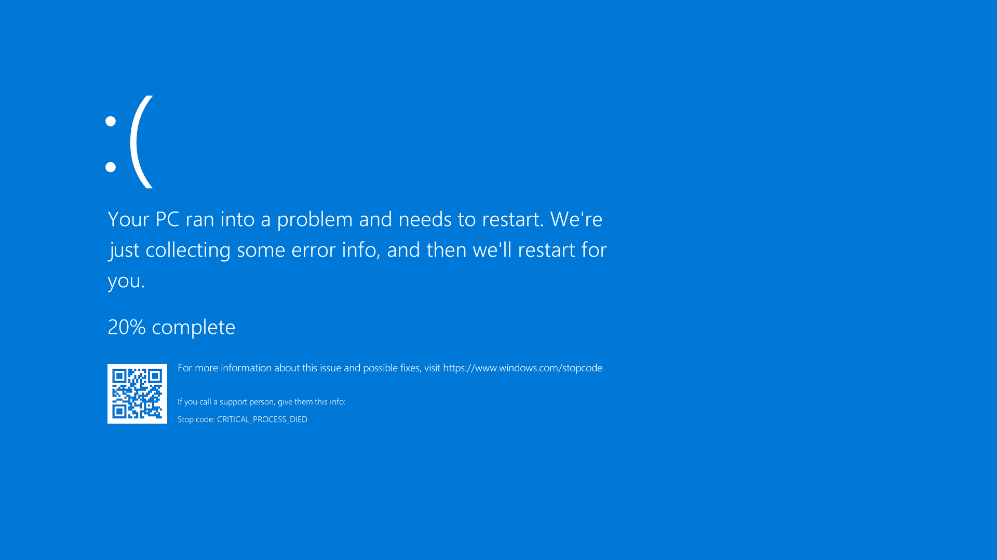

1. Description
Key facts (high-level)
Not a cyberattack: a trusted update triggered the failure.
Affected Windows endpoints used by organizations worldwide.
Microsoft estimated ~8.5M devices impacted (<1% of Windows), yet major disruption.
Raises ethical questions about release gates for privileged, auto-delivered updates.
CrowdStrike Falcon Update Outage (July 2024)
A defective security-content update crashed Windows systems worldwide, disrupting critical services.
Case: CrowdStrike Falcon update outage (July 2024) • Presentation: Mar 9, 2026
1/9
Notes:
[Sources] - Microsoft: “Helping our customers through the CrowdStrike outage” (estimate of ~8.5M devices; <1% of Windows) https://blogs.microsoft.com/blog/2024/07/20/helping-our-customers-through-the-crowdstrike-outage/ - Reuters (CrowdStrike says not a cyberattack; defect in a content update) https://www.reuters.com/technology/crowdstrike-says-actively-working-with-customers-impacted-by-outage-2024-07-19/ - Wikimedia Commons (BSOD screenshot) https://commons.wikimedia.org/wiki/File:Bsodwindows10.png - Wikimedia Commons (CrowdStrike logo) https://commons.wikimedia.org/wiki/File:CrowdStrike_logo.svg [/Sources]

Slide 2
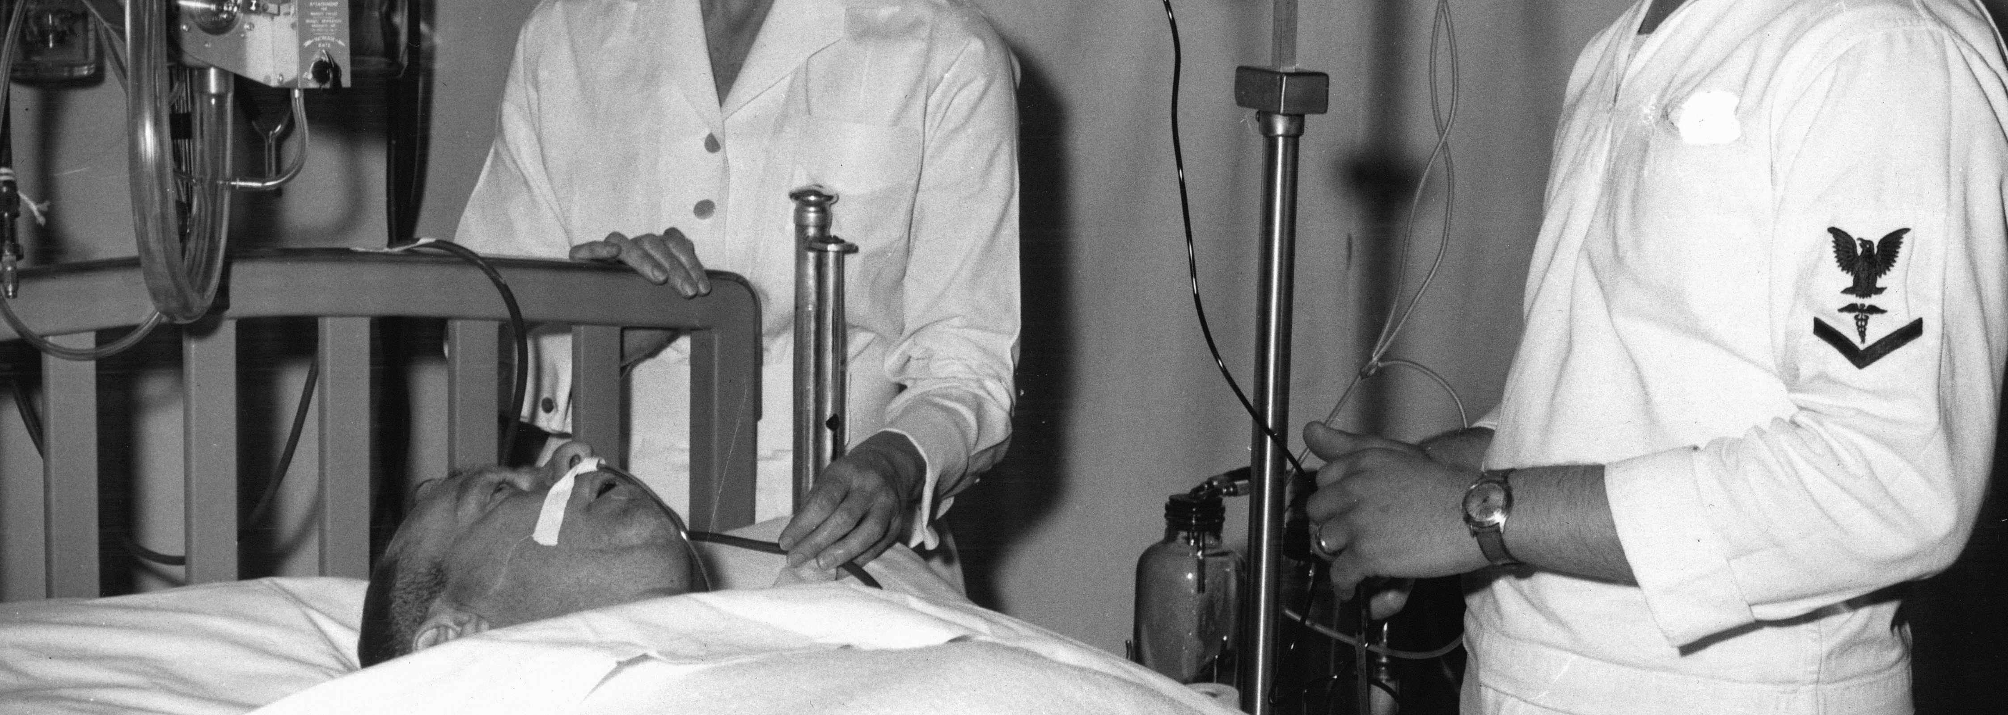
1.1 What
What happened
Technical snapshot
A Falcon “rapid response” content update was released for Windows sensors.
Many endpoints crashed into BSOD/boot loops shortly after applying the update.
Because the sensor operates with deep OS privileges, failures became system-wide.
CrowdStrike’s RCA ties the incident to “Channel File 291” content and a parsing/interpreter failure.
RCA describes an out-of-bounds memory read leading to an invalid page fault/crash.
Recovery often required manual remediation, slowing restoration at scale.
Why privilege matters (simplified stack)
Applications & services
Windows user-mode components
Windows kernel (high privilege) — Falcon sensor operates here
Hardware / firmware
Key idea: when high-privilege software fails, the whole OS can fail—not just one application.
Why it matters: security software becomes “infrastructure” when critical services depend on it.
Case: CrowdStrike Falcon update outage (July 2024) • Presentation: Mar 9, 2026
2/9
Notes:
[Sources] - CrowdStrike: External Technical Root Cause Analysis — Channel File 291 (Aug 6, 2024) https://www.crowdstrike.com/wp-content/uploads/2024/08/Channel-File-291-Incident-Root-Cause-Analysis-08.06.2024.pdf - Reuters (experts on testing / update behavior; BSOD; manual removal) https://www.reuters.com/technology/cybersecurity/crowdstrike-update-that-caused-global-outage-likely-skipped-checks-experts-say-2024-07-20/ - Unsplash (hospital image by Navy Medicine; used under Unsplash License) https://unsplash.com/photos/aXXxbTRdXbY [/Sources]

Slide 3
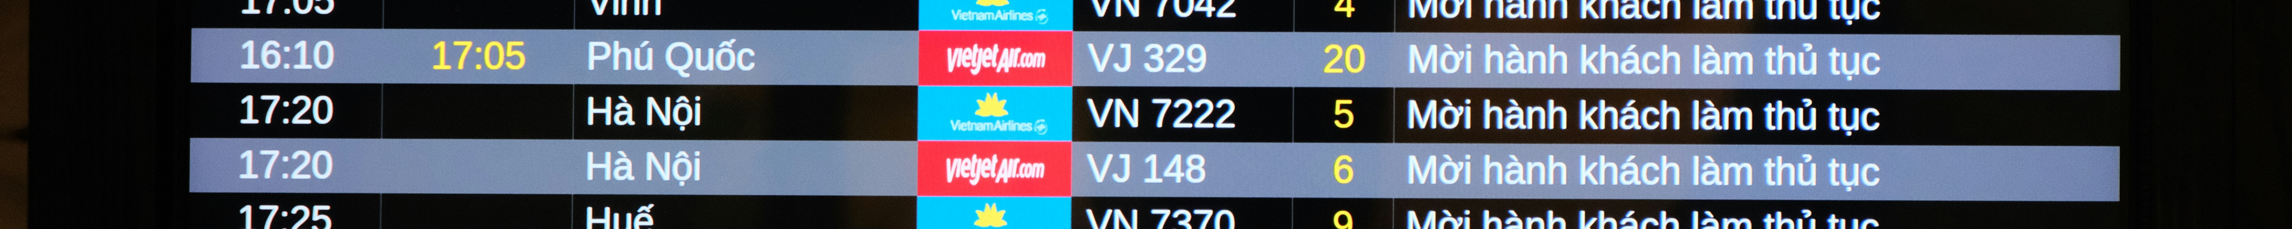
1.2 Why
Why this case is ethically significant (computing at societal scale)
1) Critical services depend on “boring” IT
2) Automation scales harm
3) Trust & professional duty
Air travel, healthcare, banking, and government rely on Windows endpoints.
Even <1% of devices can cause outsized disruption when they sit in critical workflows.
Security tools update frequently to respond to threats.
If validation gates fail, the blast radius can be global within minutes.
Endpoint security runs with high privilege—customers can’t “sandbox” it easily.
Release engineering becomes a public-safety practice, not just DevOps hygiene.
Case: CrowdStrike Falcon update outage (July 2024) • Presentation: Mar 9, 2026
3/9
Notes:
[Sources] - Microsoft (impact estimate; “<1% but outsized impact”) https://blogs.microsoft.com/blog/2024/07/20/helping-our-customers-through-the-crowdstrike-outage/ - Associated Press (cross-sector disruptions from the outage) https://apnews.com/article/what-is-crowdstrike-worldwide-outage-94b4fc5ac6eed46ddcd565a5f1e4b916 - Unsplash (airport departures board photo by Duc Van; used under Unsplash License) https://unsplash.com/photos/airport-departures-board-displaying-flight-information-dY1ZbkN_fOk [/Sources]

Slide 4
1.3 How
Timeline: how the situation unfolded
Jul 19
Outage begins
Windows systems crash globally
Jul 19
CEO statement
“Not a cyberattack”
Jul 20
Microsoft guidance
~8.5M devices affected
Jul 24
QC failure described
validation bug let content slip
Aug 6
Root-cause analysis
Channel File 291 details
CISA / Reuters
Reuters
Microsoft / Reuters
Reuters
CrowdStrike
Ethics hinge on two things:
1) Pre-release safety gates for high-privilege updates
2) Post-incident transparency + fast, scalable remediation
Case: CrowdStrike Falcon update outage (July 2024) • Presentation: Mar 9, 2026
4/9
Notes:
[Sources] - CISA alert (initial notice + mitigation context) https://www.cisa.gov/news-events/alerts/2024/07/19/widespread-it-outage-due-crowdstrike-update - Reuters (CEO statement; not a cyberattack; defect in content update) https://www.reuters.com/technology/crowdstrike-says-actively-working-with-customers-impacted-by-outage-2024-07-19/ - Microsoft blog (estimate of ~8.5M devices; recovery guidance) https://blogs.microsoft.com/blog/2024/07/20/helping-our-customers-through-the-crowdstrike-outage/ - Reuters (QC bug / “template instance” bypassed checks) https://www.reuters.com/technology/crowdstrike-says-bug-quality-control-process-led-botched-update-2024-07-24/ - CrowdStrike RCA (Channel File 291 details) https://www.crowdstrike.com/wp-content/uploads/2024/08/Channel-File-291-Incident-Root-Cause-Analysis-08.06.2024.pdf [/Sources]

Slide 5
2. The CARE Process
CARE = a structured way to apply the ACM Code of Ethics
Using CARE keeps the evaluation consistent with both the letter and spirit of the Code.
C — Consider
A — Analyze
R — Review
E — Evaluate
Actors, stakeholders, effects, missing context
Rights, technical facts, Code principles, values
Responsibilities, authority, policies, alternatives
Argument: question → theory → facts → objections → conclusion
In this case, CARE helps separate:
• What happened (facts)
• Why it mattered (impacts)
• What obligations existed (Code + duties)
• What should have been done differently (ethical argument)
Case: CrowdStrike Falcon update outage (July 2024) • Presentation: Mar 9, 2026
5/9
Notes:
[Sources] - ACM Code of Ethics booklet (CARE framework) https://www.acm.org/binaries/content/assets/about/acm-code-of-ethics-booklet.pdf [/Sources]

Slide 6
2.1 Consider
Stakeholders and observable effects
Who is involved?
Observable effects
CrowdStrike
(release + validation)
Microsoft
(platform + recovery)
Operational downtime across sectors (travel, healthcare, finance, government).
Manual recovery burden for IT teams (time-to-recover scaled poorly).
Trust impact: security update pipelines became a single point of failure.
Customer orgs
(airlines, hospitals, banks, government agencies)
More context that would sharpen analysis
Was rollout staged (canary rings)? How fast could rollback occur?
Could customers defer/pin content updates in high-risk environments?
Did tests mirror production parsers/interpreters and real endpoint diversity?
Public
(travelers, patients, citizens)
Case: CrowdStrike Falcon update outage (July 2024) • Presentation: Mar 9, 2026
6/9
Notes:
[Sources] - Associated Press (scope of cross-sector disruption; not a cyberattack framing) https://apnews.com/article/what-is-crowdstrike-worldwide-outage-94b4fc5ac6eed46ddcd565a5f1e4b916 - Microsoft (impact magnitude; recovery guidance) https://blogs.microsoft.com/blog/2024/07/20/helping-our-customers-through-the-crowdstrike-outage/ - CrowdStrike RCA (validation + remediation discussion) https://www.crowdstrike.com/wp-content/uploads/2024/08/Channel-File-291-Incident-Root-Cause-Analysis-08.06.2024.pdf [/Sources]

Slide 7
2.2 Analyze
Rights, technical facts, Code principles
Stakeholder rights impacted
Most relevant technical facts
ACM principles & values
Continuity of essential services (healthcare, transport, finance).
Safety and welfare (delayed care, disrupted travel).
Economic interests (lost revenue, recovery costs).
Social expectation of due care for privileged software.
Falcon sensor operates with deep OS privileges on Windows.
Faulty content update triggered BSOD/boot loops.
RCA: out-of-bounds memory read → invalid page fault/crash.
Recovery often required manual steps (hard to scale remotely).
Most relevant principles
1.2 Avoid harm
2.5 Thorough evaluation & risk analysis
2.9 Robustly and usably secure systems
3.1 Public good as central concern
3.7 Special care for infrastructure systems
Values to weigh
Prudence (blast-radius awareness)
Transparency
Accountability
Reliability as a security property
Case: CrowdStrike Falcon update outage (July 2024) • Presentation: Mar 9, 2026
7/9
Notes:
[Sources] - ACM Code of Ethics (principles 1.2, 2.5, 2.9, 3.1, 3.7) https://www.acm.org/code-of-ethics - CrowdStrike RCA (technical root cause summary; out-of-bounds memory read) https://www.crowdstrike.com/wp-content/uploads/2024/08/Channel-File-291-Incident-Root-Cause-Analysis-08.06.2024.pdf - Microsoft blog (impact magnitude; why small % produced large effects) https://blogs.microsoft.com/blog/2024/07/20/helping-our-customers-through-the-crowdstrike-outage/ [/Sources]

Slide 8
2.3 Review
What shaped choices—and what could have changed outcomes?
Shaping forces (responsibilities & incentives)
Actions that likely reduce harm
Security vendors are pressured to ship rapid updates against emerging threats.
Customers often auto-apply security content for protection.
Kernel/privileged operation increases consequences of mistakes.
Release authority (validation + distribution) sits largely with the vendor.
CISA treated the outage as a national-level incident requiring guidance.
Default staged rollout (canary → small % → broad) for privileged content.
Independent validation that mirrors production parsers/interpreters.
Emergency kill switch + rapid rollback for content updates.
Customer controls: defer windows, pin versions, pre-prod testing rings.
Remote remediation tooling to avoid hands-on recovery bottlenecks.
System-level takeaway: the ecosystem responded by emphasizing “resilience” and reducing dependence on kernel-level third-party drivers—treating this as a structural risk, not just a one-off bug.
Case: CrowdStrike Falcon update outage (July 2024) • Presentation: Mar 9, 2026
8/9
Notes:
[Sources] - CISA alert (incident guidance; mitigation context) https://www.cisa.gov/news-events/alerts/2024/07/19/widespread-it-outage-due-crowdstrike-update - CrowdStrike RCA (mitigations and validation changes) https://www.crowdstrike.com/wp-content/uploads/2024/08/Channel-File-291-Incident-Root-Cause-Analysis-08.06.2024.pdf - Microsoft blog (recovery guidance; ecosystem coordination) https://blogs.microsoft.com/blog/2024/07/20/helping-our-customers-through-the-crowdstrike-outage/ - Microsoft Windows Resiliency Initiative (longer-term response to systemic risk) https://blogs.windows.com/windowsexperience/2025/06/26/the-windows-resiliency-initiative-building-resilience-for-a-future-ready-enterprise/ [/Sources]

Slide 9
2.4 Evaluate (The Argument)
State the question
Address objections
Did CrowdStrike act ethically by distributing a privileged content update in a way that enabled a global outage?
Strongest objection: “Security requires rapid updates; delaying can expose customers to active threats. Microsoft’s kernel architecture also contributes to the risk.”
Identify moral principles (theories)
Rebuttal
Consequentialism: expected harm vs benefit given known blast radius.
Deontology: duty of care for high-privilege infrastructure software.
Virtue ethics: prudence, humility, accountability in release practice.
Speed ≠ “all-at-once”: canaries + staged rollout preserve speed while containing blast radius.
Control matters: CrowdStrike controlled the content artifact and its validation/distribution.
Infrastructure-grade updates require fail-safes (rollback, kill switch, customer deferral).
Apply facts to theory → conclusion
Code alignment (public good)
Conclusion: Not fully ethical. The release process fell short of a reasonable duty of care for privileged, widely deployed security software—violating “avoid harm” and “thorough evaluation.”
Key claim: when your software can brick critical services at scale, staged rollout + rollback controls are ethical minimums, not optional features.
Public-good alignment means treating release engineering as safety engineering: realistic testing, staged delivery, and rapid recovery—because hospitals and transportation systems are downstream stakeholders (ACM 3.1, 3.7).
Selected sources (MLA, abbreviated): Reuters (Jul 19/20/24 2024); AP (Jul 19 2024); Microsoft Blog (Jul 20 2024); CrowdStrike RCA (Aug 6 2024); CISA (Jul 19 2024); ACM Code (2018).
Case: CrowdStrike Falcon update outage (July 2024) • Presentation: Mar 9, 2026
9/9
Notes:
[Sources] - ACM Code of Ethics (public good; avoid harm; thorough evaluation) https://www.acm.org/code-of-ethics - Reuters (not cyberattack; global outage details) https://www.reuters.com/technology/crowdstrike-says-actively-working-with-customers-impacted-by-outage-2024-07-19/ - Reuters (experts on skipped checks/testing) https://www.reuters.com/technology/cybersecurity/crowdstrike-update-that-caused-global-outage-likely-skipped-checks-experts-say-2024-07-20/ - Reuters (QC bug / validation failure) https://www.reuters.com/technology/crowdstrike-says-bug-quality-control-process-led-botched-update-2024-07-24/ - Associated Press (cross-sector disruption) https://apnews.com/article/what-is-crowdstrike-worldwide-outage-94b4fc5ac6eed46ddcd565a5f1e4b916 - Microsoft blog (impact estimate; recovery) https://blogs.microsoft.com/blog/2024/07/20/helping-our-customers-through-the-crowdstrike-outage/ - CrowdStrike RCA (technical root cause; mitigations) https://www.crowdstrike.com/wp-content/uploads/2024/08/Channel-File-291-Incident-Root-Cause-Analysis-08.06.2024.pdf - CISA alert (public-sector guidance) https://www.cisa.gov/news-events/alerts/2024/07/19/widespread-it-outage-due-crowdstrike-update [/Sources]

