Slide 1

Do you have the need?
The need, for speed?

Slide 2

Research Questions
Dataset: Bureau of Transportation Statistics from the USA : TranStats
Airport: George Bush Intercontinental Airport in Houston, Texas.
Predict if flight is on time, delayed, diverted, or cancelled
Predicting delay type
Carrier Delay
Weather Delay
NAS Delay
Security Delay
Late Aircraft Delay
Predicting the length of the delay

Slide 3
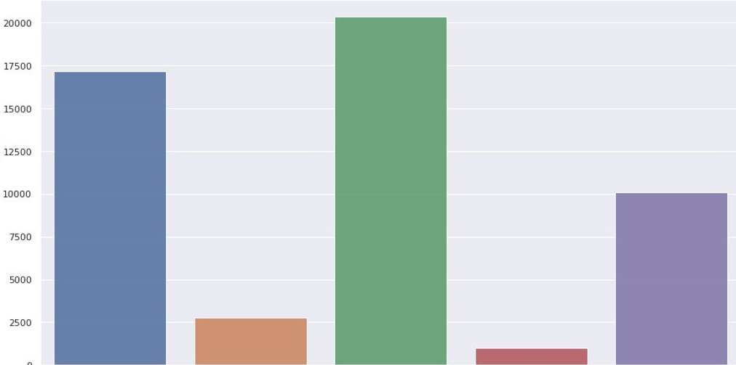
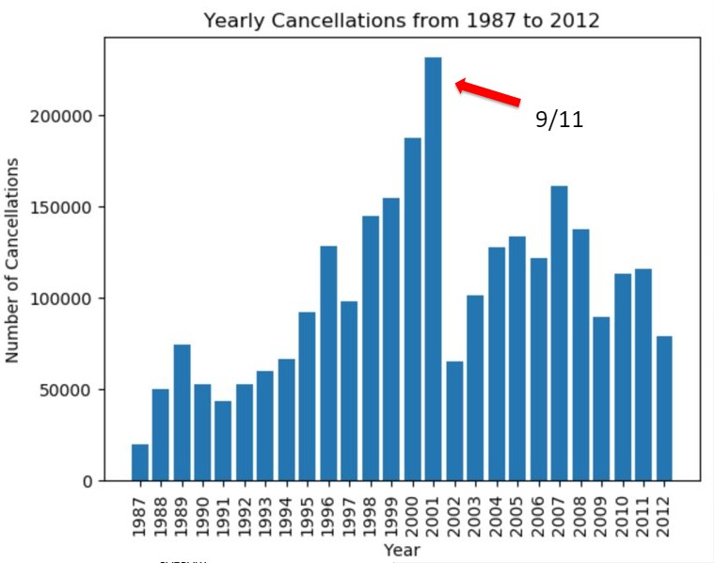
Pre-Processing Steps
Number of Delay Types
Number of Flights
Collect
Download the data from online onto the ARC cluster at the University of Calgary where Spark is installed
Explore
Learn what types of data each feature contains and understand the legends.
Example
CRS_ARR_TIME = Scheduled arrival time
ARR_TIME = Actual arrival time
Visualize
Visualize the distributions of the data to understand what could be interesting to investigate and what could cause problems.
Carrier
Delay
Weather
Delay
NAS
Delay
Security
Delay
Late Aircraft
Delay

Slide 4
Pre-Processing Steps Continued…
Filter
Remove irrelevant data:
Label
Explicitly create a label column
Example:
0 = On Time
1 = Delayed
2 = Diverted
3 = Cancelled
Clean
Check for null values or empty strings
The data was strongly structured, so large amounts of null values were missing for logical reasons
Reduce the scope to flights leaving from Houston
Remove variables such as taxi out time
Some research questions require all flights, others just delayed flights
Null Value Problem | Solution
Missing arrival delay information | Flights were diverted, add another label
Small number of unexplainably missing data | Remove the data points
Missing early year delay type labels (before 2003) | Limit investigation to later years

Slide 5
How Many Nodes To Use?
Preprocessing done on Spark using Spark data frames
Timed the pre-preprocessing for Research Question 1 took using different numbers of nodes
Longest: 1 node - 6.6 minutes
Shortest: >15 nodes - ~1.7 minutes
At a certain point, adding more nodes does not increase performance. A bottleneck that could cause this is reading and writing to csv files.

Slide 6
RQ 1: Predicting if on-time, delayed, diverted or cancelled
K Nearest Neighbour Classification Method

Slide 7
KNN Classification - Process
Split
Encode
Fit
Randomly split into training and test sets
80% Training / 20% Testing
Categorical data -> Airline or Destination
Also split into X and Y variables
For KNN Classification all data must be numerical
One hot encoder converts to dummy variables
Select initial k-value (square root of training set size)
Test set score is collected
Adjust k-value accordingly
Y : on-time, delayed, diverted, or cancelled
Confusion matrix and classification report

Slide 8

KNN Classification – Results and Conclusions
78%
on-time
 | K = 655 | K = 5 | K = 1
Test set score | 78% | 76% | 68%
On-time precision recall | 78% 100% | 80% 93% | 80% 80%
Delayed precision recall | 0% 0% | 30% 16% | 27% 28%
Diverted precision recall | 0% 0% | 0% 0% | 0% 0%
Cancelled precision recall | 0% 0% | 8% 0% | 3% 3%
Too many flights are on-time which skews the results (underfit) with a large k-value
Smaller k-values indicate some potential trends for flight delays but decrease the overall accuracy of the model
Flight delays and cancellations could not be predicted with any serious degree of success

Slide 9
RQ 2: Predicting Delay Type
Logistic Regression and Random Forest Classification Methods

Slide 10
Predicting Delay Type
Split
Encode
Categorical data -> Month, Day of Week, Airline, Destination
Analyze
One vs rest multi label logistic regression
Single label random forest
One for multi label analysis
One for single label analysis
Randomly split into training and test sets
Create two data sets:
Randomly split into training and test sets
70% Training/ 30% Test
Single label logistic regression
Completed feature extraction and re-ran models

Slide 11



Predicting Delay Type
Logistic Regression I
Logistic Regression II
Random Forest
0% precision and recall for security and weather delays
Otherwise averaged:
Accuracy: 60%
Precision: 56%
Recall: 64%
0% precision and recall for security and weather delays
Otherwise averaged:
Accuracy: 42.9%
Precision: 41%
Recall: 43%
Accuracy: 43.1%
Precision: 42%
Recall: 43%
Most “important” features:
Month
Scheduled arrival and departure time
Year

Slide 12
RQ 3: Predicting Delay Length
Multiple Linear Regression Method

Slide 13
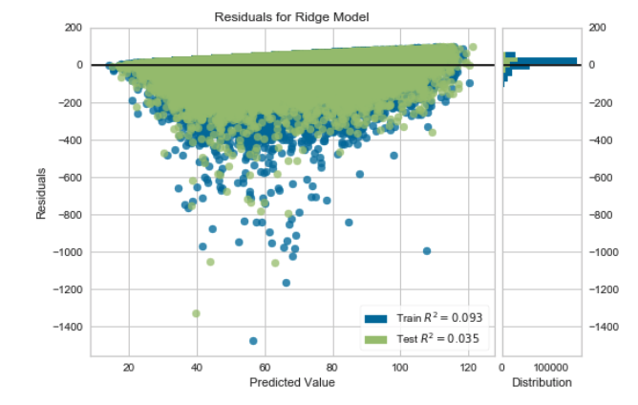
Regression Analysis
Inspect
First case: not knowing the type of delay -> R^2 = 0.03
Was regression a good choice?
Verify by using a residual plot and ensuring residuals are scattered randomly
Optimize
Adding a leading coefficient
Performing polynomial regression
Verify
Second case: knowing the type of delay -> R^2 = 0.09 (200% increase!!)
Incorporating the potential interactions between the variables

Slide 14
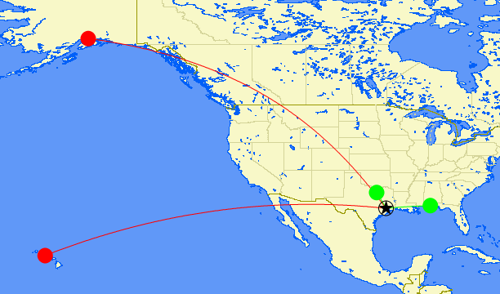
RQ3: Conclusions
Average p-value of 0, so everything is contributing appropriately
Coefficients show the effect certain elements have on the delay length
Most positive effect: security delay type, Pensacola Florida airport, Texas state
Most negative effect: weather delay type, Anchorage, Alaska airport, and Hawaii state
Airline used has equal affect on delay length
Anchorage, AK​
Texas
Pensacola, FL
Hawaii
Houston (IAH)

Slide 15

Questions?

