Slide 1

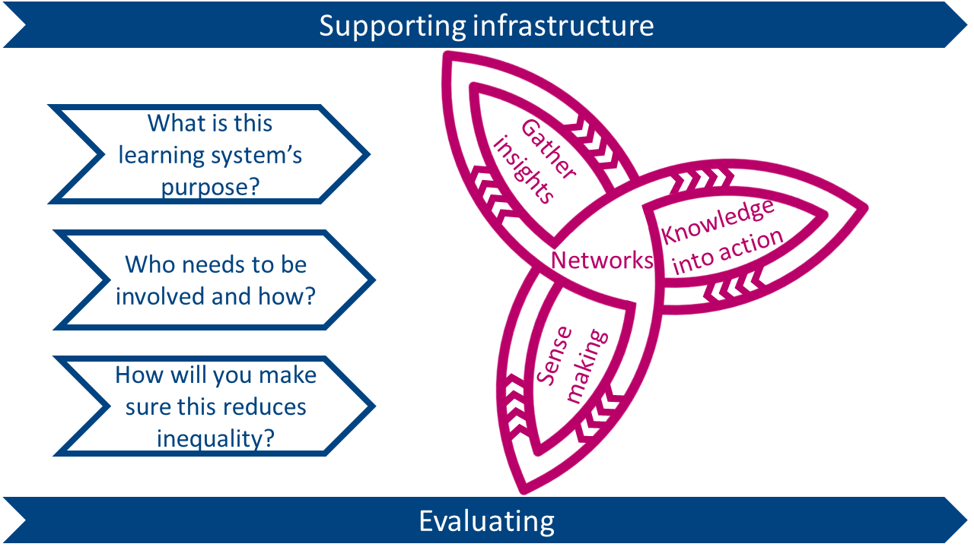
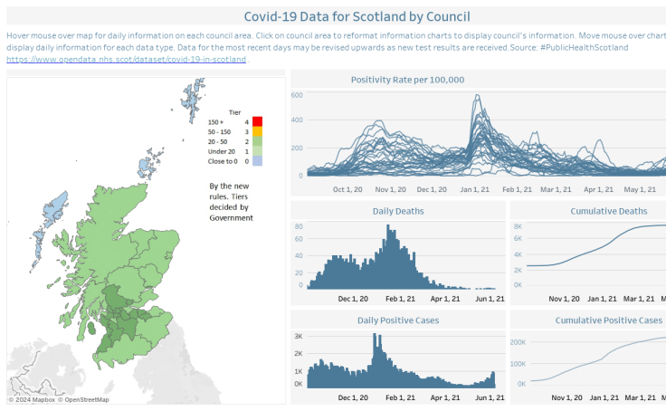
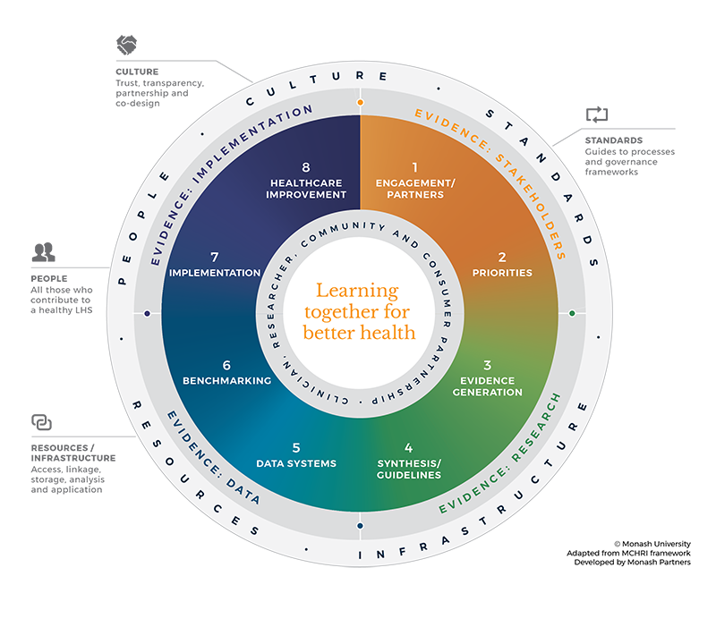
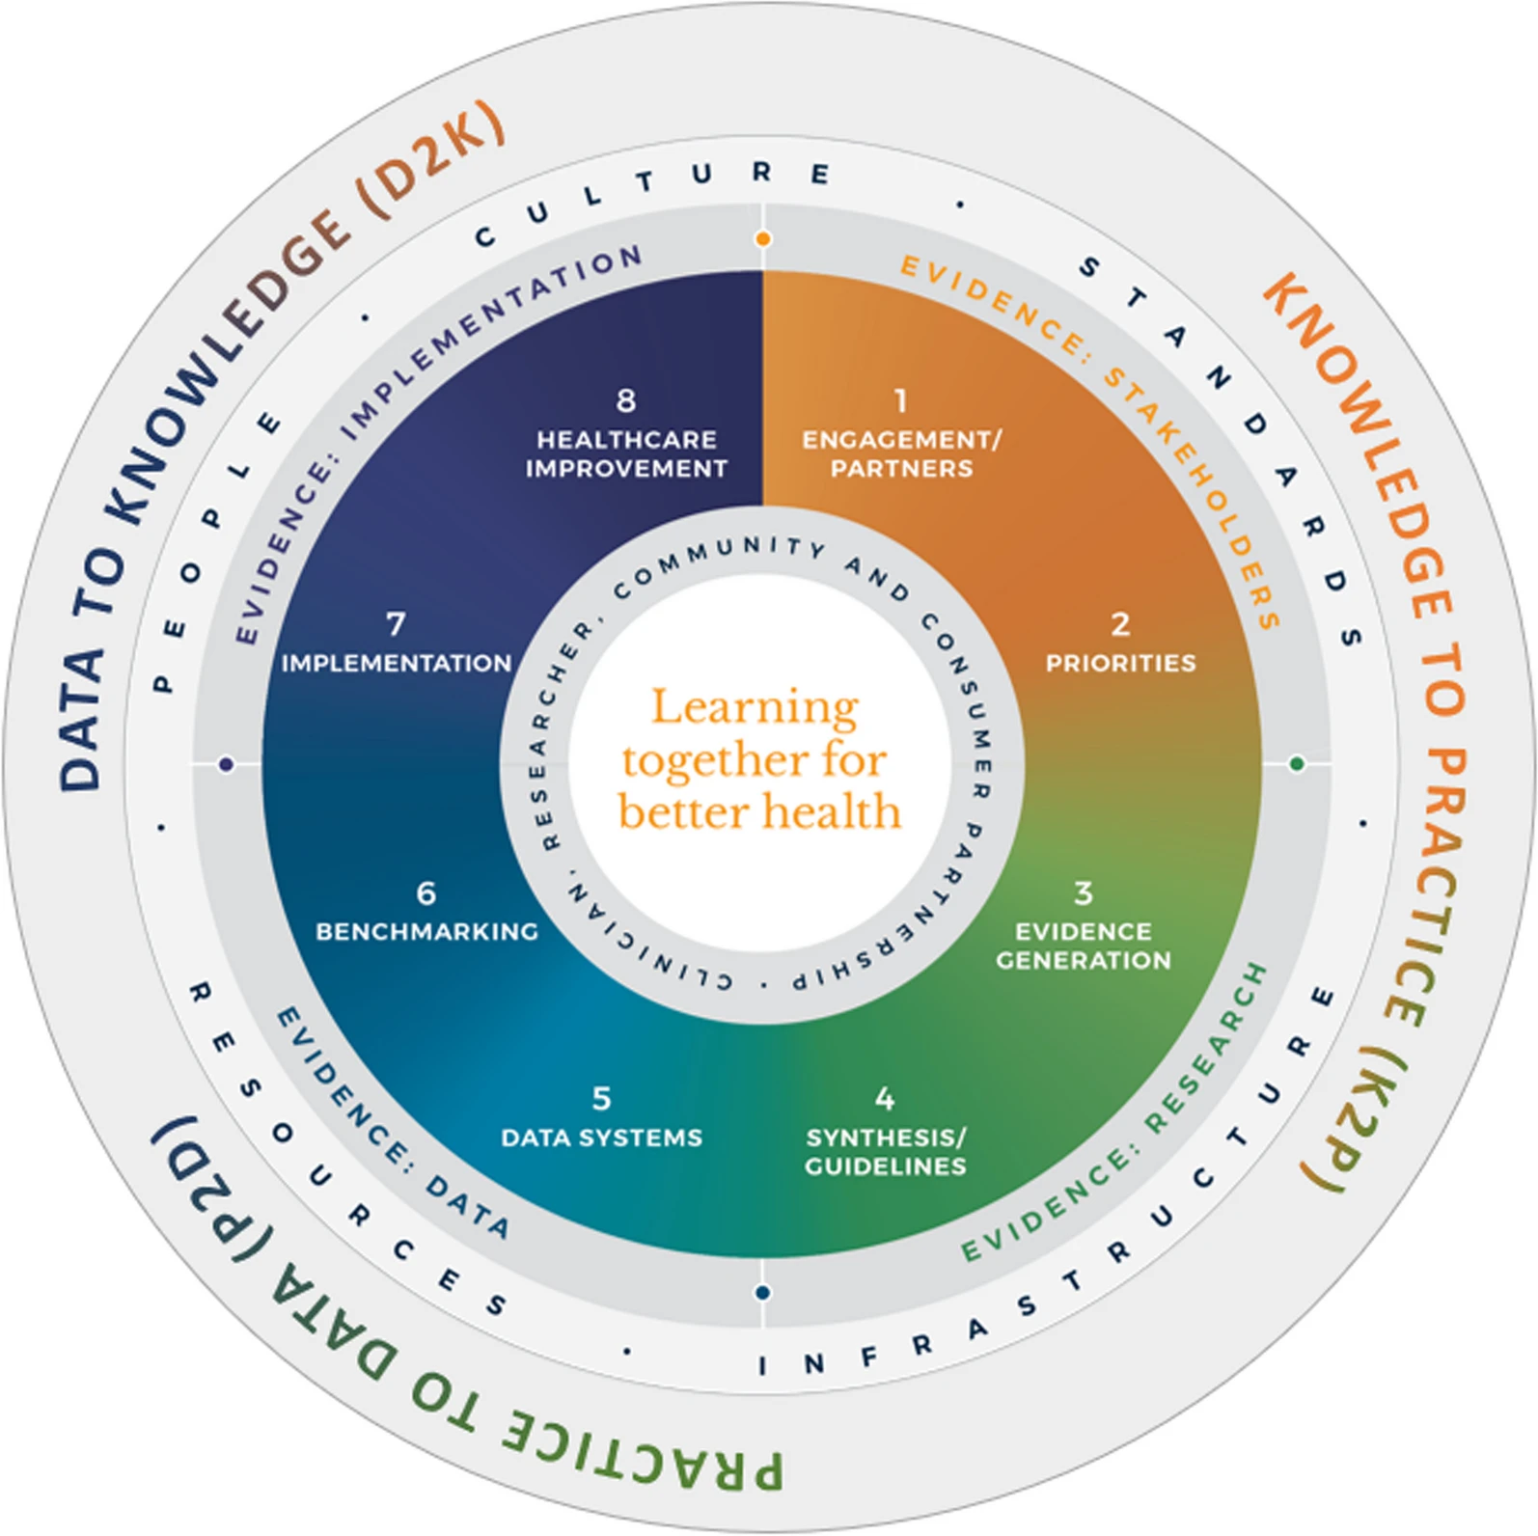
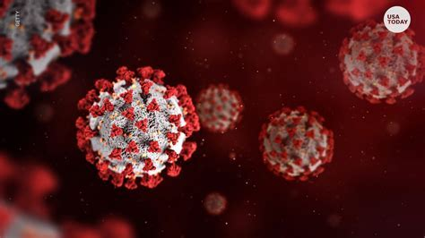
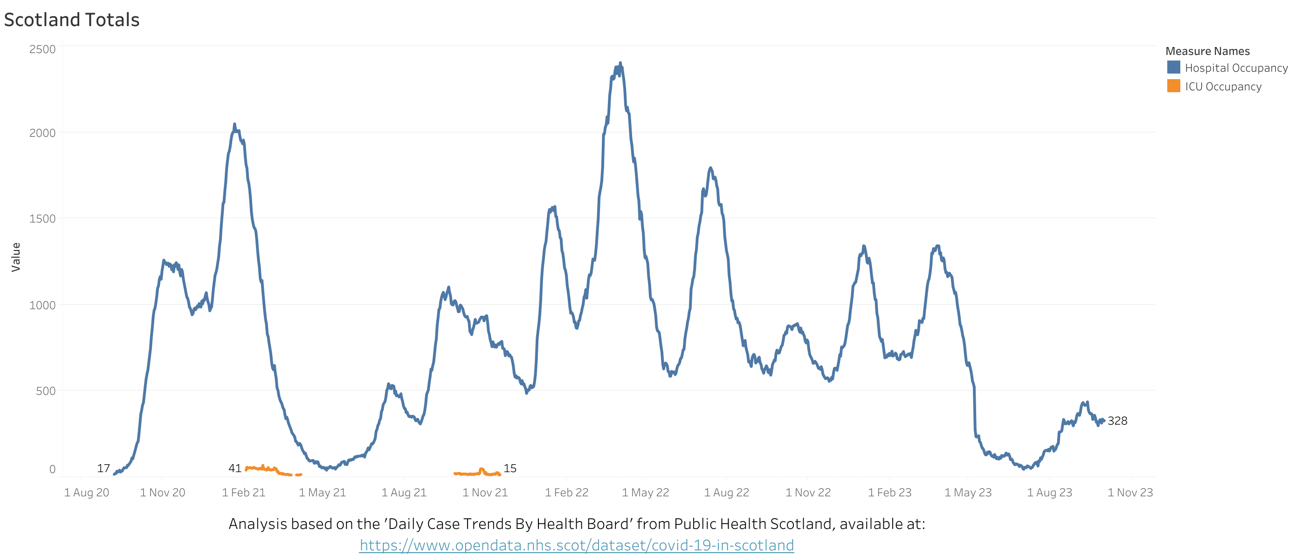



Scotland’s COVID-19 Learning Health System: Integrating Data, Knowledge, and Action
Edward Tamekloe | MSc Health Data Science
Introduction:
A continuous cycle where data is collected from various healthcare settings, analysed, and the findings are rapidly translated into practice to improve Covid-19 pandemic management and response.
Action and Improvement
Policy and guideline development
Quality improvement initiatives: Update Clinical Guidelines and protocols based on new knowledge
Education & Training: Update healthcare worker knowledge and skills through Workforce development and training on new standards
Community outreach and engagement Inform the public through media and campaigns
Scottish Government
Public Health Scotland
Patients and Communities
Healthcare Providers
NHS Scotland
Researchers and academics
Evaluation and Feedback
Monitoring and evaluation framework:
benchmarks and indicators
Stakeholder feedback mechanisms:
Public forum, feedback loops, stakeholder reviews
Continuous learning and improvement:
Iterative development (regular updates to the LHS based on feedback and evaluation results)
Stakeholders
Data Collection
To generate sufficient data to evaluate and advance patient care and health policy for COVID-19, data from many patients across various geographic settings are needed
Sources:
Clinical Data: Symptoms, treatments, outcomes from healthcare providers.
Epidemiological Data: Infection rates, contact tracing information.
Behavioural Data: Public adherence to guidelines, vaccination uptake.
Genomic Data: Viral mutations and vaccine effectiveness.
Socioeconomic Data: Impact on different communities and economic sectors.
Establish data standards and governance
Conclusion
Scotland's LHS: a collaborative response to COVID-19
Key benefits: improved patient outcomes, enhanced public health, and informed policy
By implementing this framework Scotland can enhance its COVID-19 management through a dynamic and responsive system that leverages data to drive continuous improvement in healthcare delivery and public health outcomes.
Dissemination
Decision support systems for healthcare providers
Public health alerts and guidance
Patient engagement and education
Research publications and presentations
Policy Briefs: Summarize key findings for policymakers
Data to Knowledge
Data Integration: Combine data from multiple sources into a central repository.
Data Analytics: Use AI and machine learning to identify trends and patterns.
Modeling & Simulation: Predict pandemic spread and evaluate intervention strategies.
Evidence Synthesis: Aggregate findings from various studies and data sources.
Knowledge Validation: Peer review and expert panels to ensure accuracy.
The University of St Andrews is a charity registered in Scotland, No: SC013532
Notes:
For printing purposes, please keep all text and images within the guideline border and outside the indicated margins around the St Andrews logo. If guides are not visible please go to View and tick the guides button.
This poster can be used with any light coloured background. A background image to fit this page size needs to be a minimum of 2381 x 1684 pixels (aspect ratio 1.41:1). Once placed and positioned correctly on the template select “send to back” to ensure no graphics or text are obscured.
Once completed, convert the file to PDF (using high quality/print quality option if available) and email us (printanddesign@st-andrews.ac.uk), saying whether it is for an A0 or A1 poster, provide your paper requirements and your Cost Centre.
Please allow two working days for posters to be produced. Please check your PDF before sending as occasionally text and images can move when converted from PowerPoint to PDF.

