Slide 1
Earth Mover’s Distance exploration
As potential solution for generating unique number score for given set of categorically performing BMPs

Slide 2
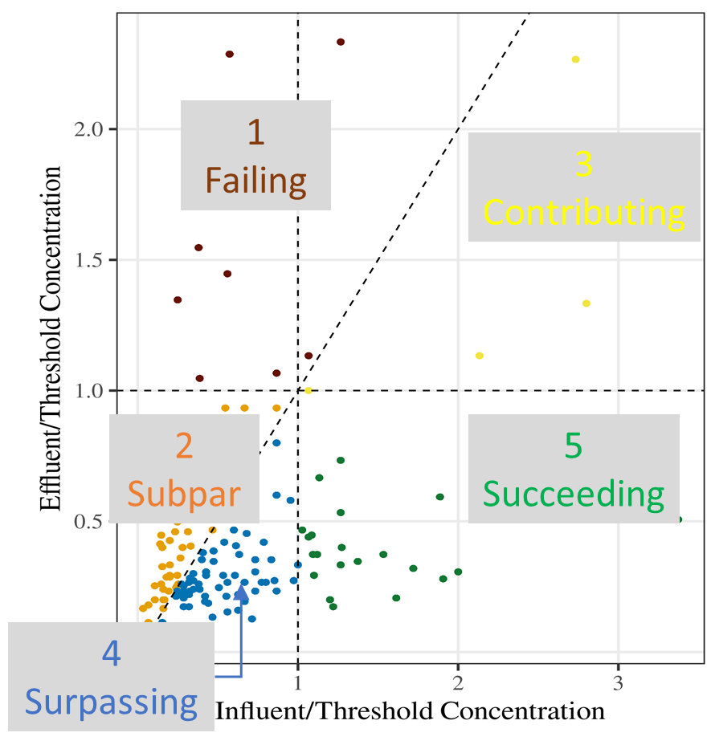
The original problem, Quintile scores give the same value for qualitatively different sets
Does Subpar + Surpassing= Contributing?
Analyte = Total Copper |  |  | BMP Type = Bioretention | BMP Type = Bioretention
Threshold | Performance | Quint Score | Count | % | Quint Score x %
25 | Failing | 1 | 2 | 1.28 | 0.0128
25 | Subpar | 2 | 57 | 36.54 | 0.7308
25 | Contributing | 3 | 1 | 0.64 | 0.0192
25 | Surpassing | 4 | 87 | 55.77 | 2.2308
25 | Succeeding | 5 | 9 | 5.77 | 0.2885
 |  |  | Score per Analyte* |  | 3.2821
* Score per Analyte = Sum of (% x Quint Score) over all performance categories

Slide 3
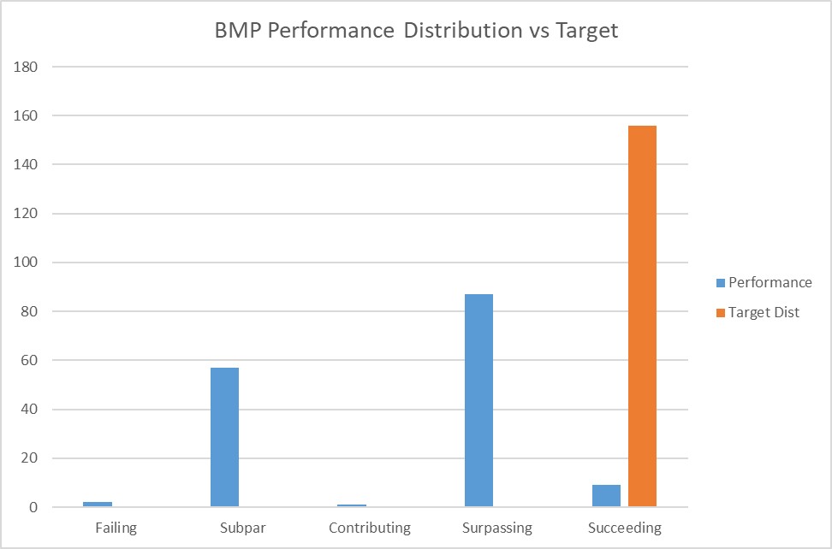

Slide 4
Threshold Weights Rationale
Failing
Effluent = Influent Weight: 1.0
Contributing
Effluent = Threshold Weight: 2.0
Effluent / Threshold Concentration
1.0
Subpar
Succeeding
Influent = Threshold Weight: 0.5
Surpassing
0
1.0
0
Influent / Threshold Concentration

Slide 5
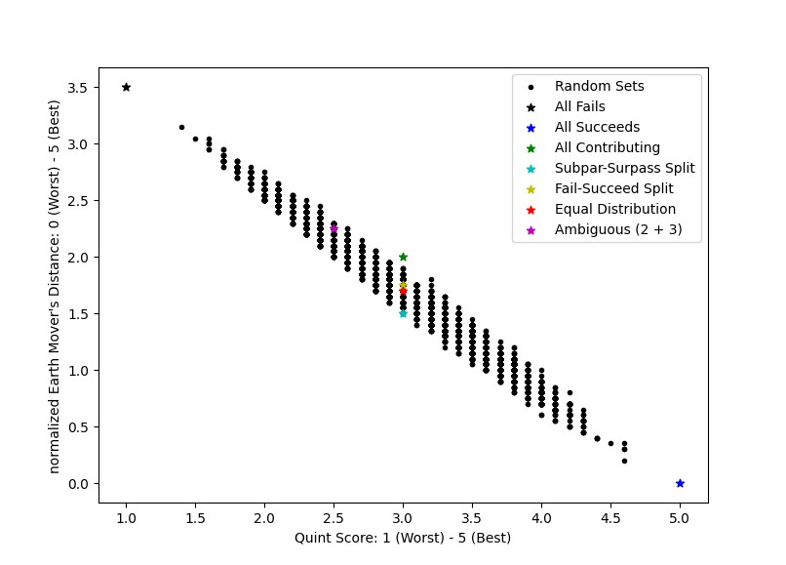
EMD compared to weighted thresholds

Slide 6
Insight – Quint Score = Weighted Thresholds
Failing = 1
Effluent = Influent Weight: 2.0
Contributing = 3
Effluent = Threshold Weight: 2.0
Effluent / Threshold Concentration
1.0
Subpar = 2
Succeeding = 5
Influent = Threshold Weight: 1.0
Surpassing = 4
0
1.0
0
Influent / Threshold Concentration

Slide 7
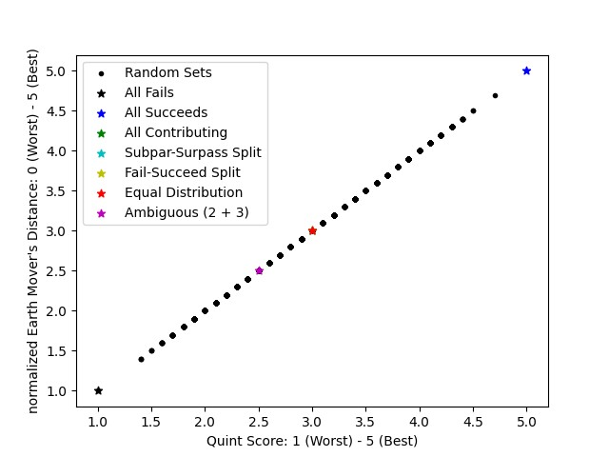
EMD = Quint Score

Slide 8
Insight – Ken Score = Quint Score - 1
Failing = 1
Effluent = Influent Weight: 1.0
Contributing = 2
Effluent = Threshold Weight: 2.0
Effluent / Threshold Concentration
1.0
Subpar = 2
Succeeding = 4
Influent = Threshold Weight: 1.0
Surpassing = 3
0
1.0
0
Influent / Threshold Concentration

Slide 9
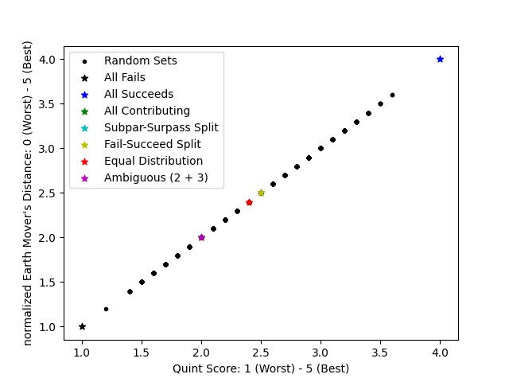
EMD = Ken Score

Slide 10
Categorical Ranking Carries Implicit Threshold Weight: What should ours be?
Failure
Effluent = Influent Weight: 2.0
Effluent = Threshold Weight: 1.0
Effluent / Threshold Concentration
Insufficient
1.0
Marginal
Success
Influent = Threshold Weight: 0.5
Excess
0
1.0
0
Influent / Threshold Concentration

Slide 11
3-2-1 Warning
Failing
Effluent = Influent Weight: 2.0
Contributing
Effluent = Threshold Weight: 3.0
Effluent / Threshold Concentration
1.0
Subpar
Succeeding
Influent = Threshold Weight: 1.0
Surpassing
0
1.0
0
Influent / Threshold Concentration

Slide 12
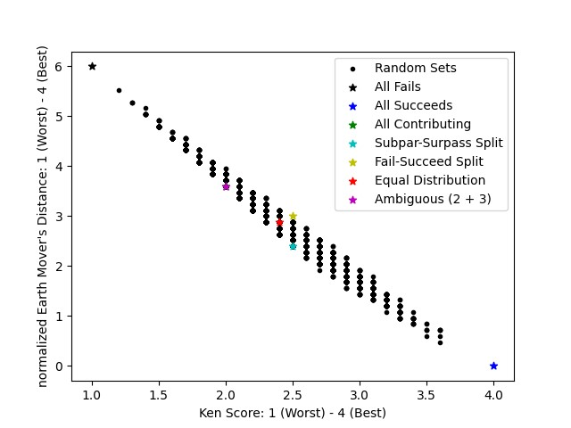
3-2-1 Warning
Contributing = Ambiguous

Slide 13
Failing
Effluent = Influent Weight: 1.0
Contributing
Effluent = Threshold Weight: 2.0
Effluent / Threshold Concentration
1.0
Subpar
Succeeding
Influent = Threshold Weight: 0.5
Surpassing
0
1.0
0
Influent / Threshold Concentration

Slide 14
However, Ken’s solution may be better
Subpar = Contributing = 2
Management impact is the same, probably just wait for more data.

Slide 15
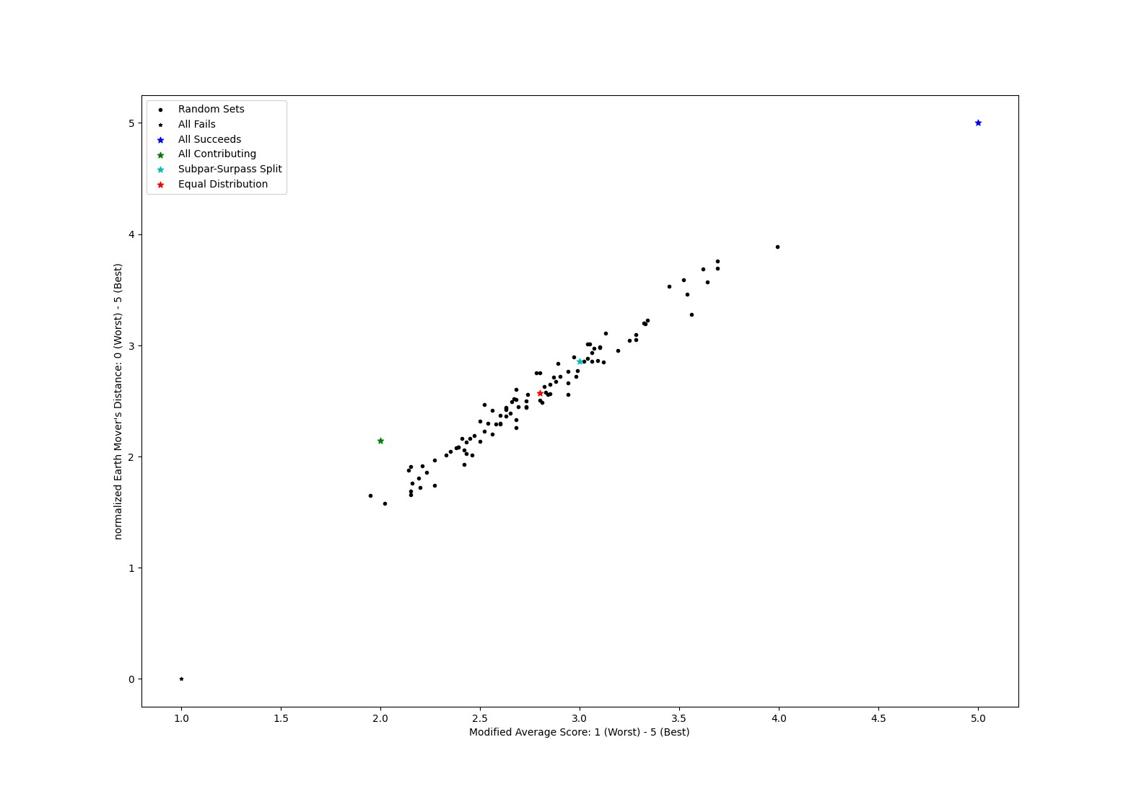
However, Ken’s solution may be better

Slide 16
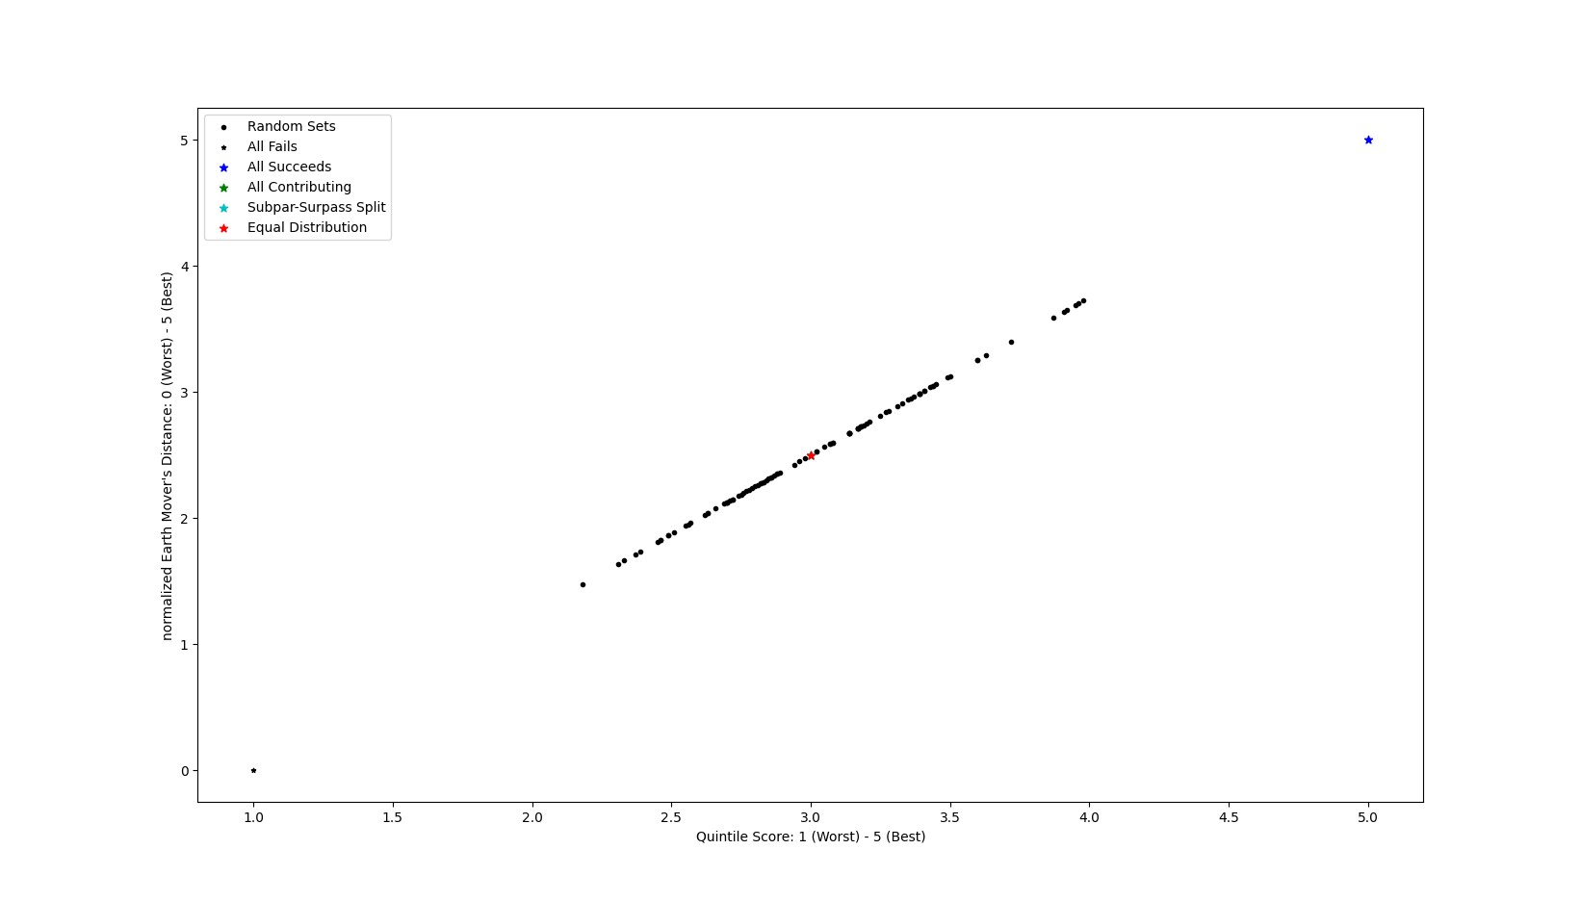
EMD based on integer category ranking

Slide 17
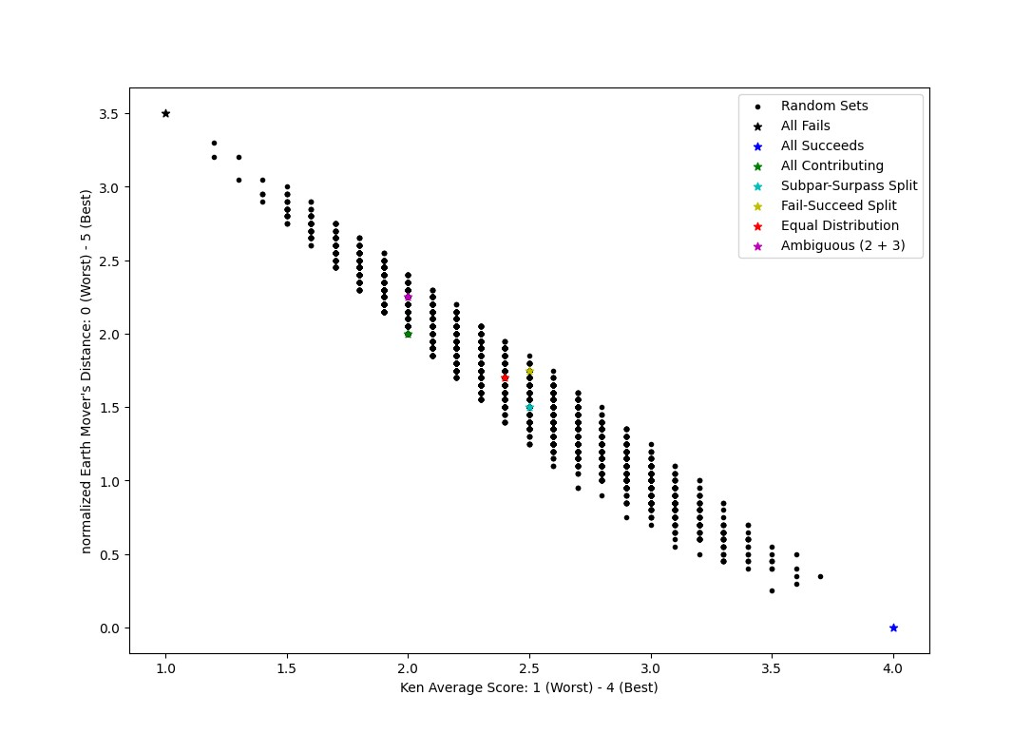

Slide 18
EMD Score (3.5 – 0): 3.5
Ken Score (1 – 4): 1.0
Quint Score (1 – 5): 1.0
EMD Score (3.5 – 0): 0.0
Ken Score (1 – 4): 4.0
Quint Score (1 – 5): 5.0
Failing
10
Contributing
Effluent / Threshold Concentration
1.0
Subpar
Succeeding
10
Surpassing
0
1.0
0
Influent / Threshold Concentration

Slide 19
EMD Score (3.5 – 0): 2.0
Ken Score (1 – 4): 2.0
Quint Score (1 – 5): 3.0
EMD Score (3.5 – 0): 1.5
Ken Score (1 – 4): 2.5
Quint Score (1 – 5): 3.0
Failing
Contributing
Effluent / Threshold Concentration
10
1.0
5
Subpar
Succeeding
5
Surpassing
0
1.0
0
Influent / Threshold Concentration

Slide 20
EMD Score (3.5 – 0): 1.7
Ken Score (1 – 4): 2.4
Quint Score (1 – 5): 3.0
EMD Score (3.5 – 0): 2.25
Ken Score (1 – 4): 2.0
Quint Score (1 – 5): 3.5
EMD Score (3.5 – 0): 1.75
Ken Score (1 – 4): 2.5
Quint Score (1 – 5): 3.0
Failing
2
Contributing
Effluent / Threshold Concentration
5
2
5
1.0
5
Subpar
Succeeding
2
2
2
5
Surpassing
0
1.0
0
Influent / Threshold Concentration

Slide 21
EMD Score (3.5 – 0): 0.55
Ken Score (1 – 4): 3.3
Quint Score (1 – 5): 4.2
EMD Score (3.5 – 0): 0.55
Ken Score (1 – 4): 2.5
Quint Score (1 – 5): 3.0
Failing
Contributing
1
0
Effluent / Threshold Concentration
0
1
1.0
Subpar
0
Succeeding
0
7
5
2
4
Surpassing
0
1.0
0
Influent / Threshold Concentration

Slide 22
EMD Score (3.5 – 0): 1.05
Ken Score (1 – 4): 2.8
Quint Score (1 – 5): 3.6
EMD Score (3.5 – 0): 0.95
Ken Score (1 – 4): 3.2
Quint Score (1 – 5): 3.9
Failing
Contributing
1
0
Effluent / Threshold Concentration
1
1
1.0
Subpar
3
Succeeding
1
0
2
6
5
Surpassing
0
1.0
0
Influent / Threshold Concentration

Slide 23
EMD Score (3.5 – 0): 1.5
Ken Score (1 – 4): 2.5
Quint Score (1 – 5): 3.1
EMD Score (3.5 – 0): 1.5
Ken Score (1 – 4): 2.6
Quint Score (1 – 5): 3.3
Failing
Contributing
1
Effluent / Threshold Concentration
1
1
3
1.0
Subpar
2
Succeeding
3
1
1
3
4
Surpassing
0
1.0
0
Influent / Threshold Concentration

Slide 24
EMD Score (3.5 – 0): 2.0
Ken Score (1 – 4): 2.2
Quint Score (1 – 5): 2.6
EMD Score (3.5 – 0): 2.0
Ken Score (1 – 4): 2.0
Quint Score (1 – 5): 2.6
Failing
Contributing
2
Effluent / Threshold Concentration
4
1
2
1.0
Subpar
0
Succeeding
4
4
1
0
2
Surpassing
0
1.0
0
Influent / Threshold Concentration

Slide 25
EMD Score (3.5 – 0): 2.5
Ken Score (1 – 4): 1.7
Quint Score (1 – 5): 2.1
EMD Score (3.5 – 0): 2.5
Ken Score (1 – 4): 1.9
Quint Score (1 – 5): 2.1
Failing
Contributing
5
Effluent / Threshold Concentration
3
2
1
1.0
Subpar
5
Succeeding
1
0
0
1
2
Surpassing
0
1.0
0
Influent / Threshold Concentration

Slide 26
EMD Score (3.5 – 0): 3.0
Ken Score (1 – 4): 1.5
Quint Score (1 – 5): 1.5
EMD Score (3.5 – 0): 3.0
Ken Score (1 – 4): 1.9
Quint Score (1 – 5): 2.1
Failing
Contributing
5
Effluent / Threshold Concentration
8
0
1
1.0
Subpar
0
Succeeding
5
0
0
1
0
Surpassing
0
1.0
0
Influent / Threshold Concentration

